Slide 1
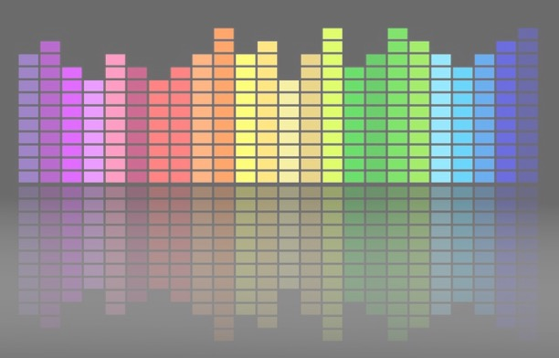

Computational Music Analysis: Audio
A.K.A. “Audio Content Analysis”
3.2 Timbral Features
Claire Arthur
Noel Albën

Slide 2
Timbral Features
We can use features from the frequency domain to gain information about pitch-based information
We (mostly) use features from the time domain to gain information about timing-based features
However, what separates the same melody played by two different instruments? Or the same sentence spoken by two different individuals? …

Slide 3
Timbre
Timbre is a notoriously challenging perceptual attribute, partly due to its (well critiqued) poor definition:
“that attribute of auditory sensation in terms of which a listener can judge that two sounds similarly presented and having the same loudness and pitch are dissimilar”
- American Standards Association (1960)

Slide 4
Timbre
This means that:
Timbre is defined by what it is not (rather than what it is)
Unlike pitch, loudness, or duration, timbre is a multidimensional property
“It is the irregularities and variations that make a musical tone sound interesting and that give it a particular and natural quality.”
Notes:
WHY TIMBRE? WHY DO WE CARE? WHAT DOES IT

Slide 5
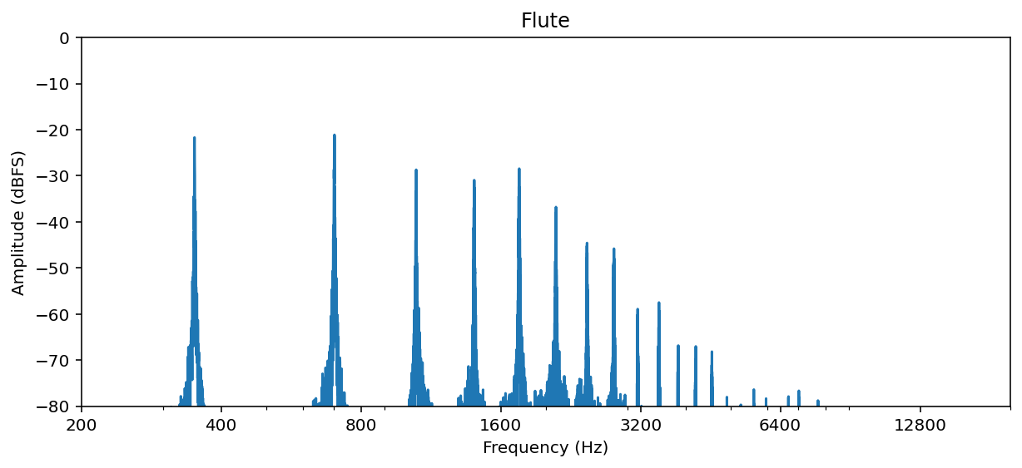
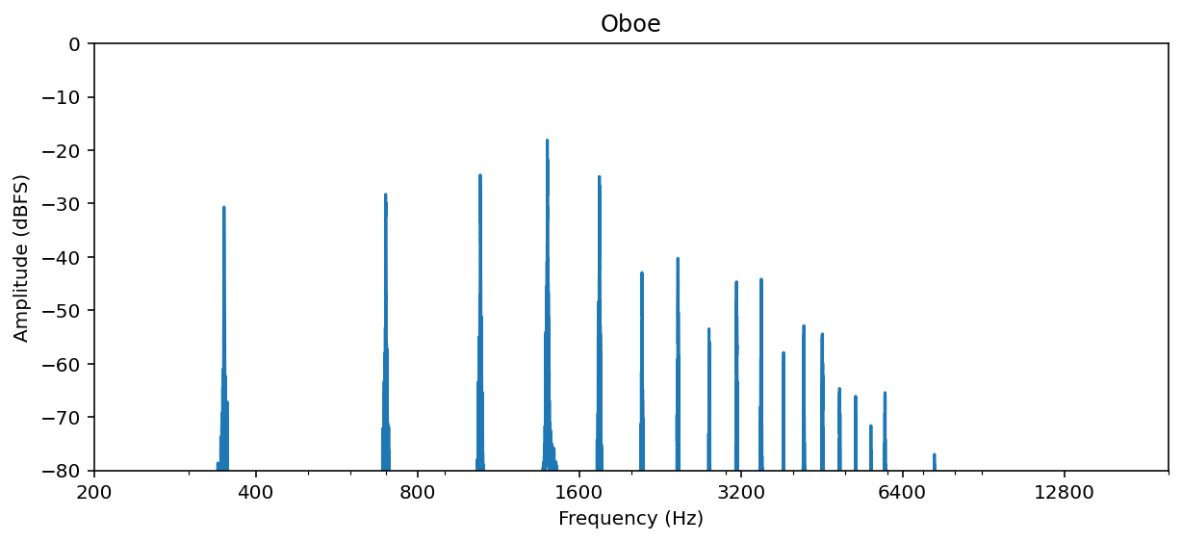

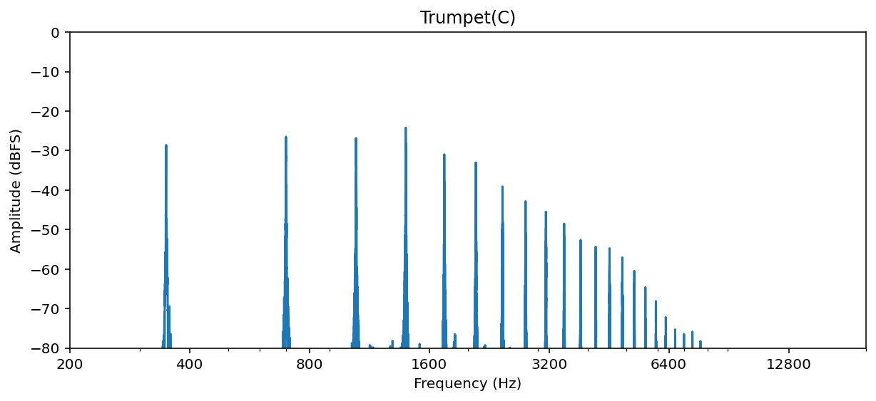
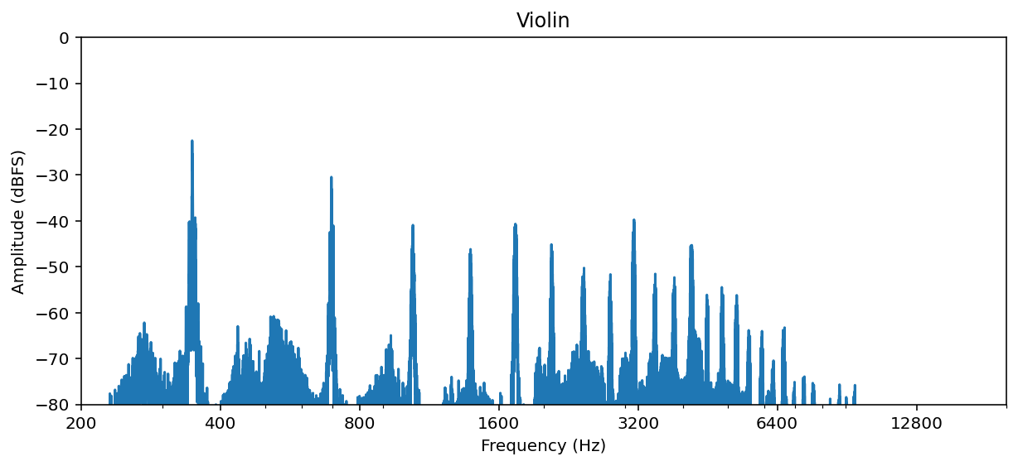
Timbre: Spectra
Flute
Oboe
Trumpet
Violin

Slide 6
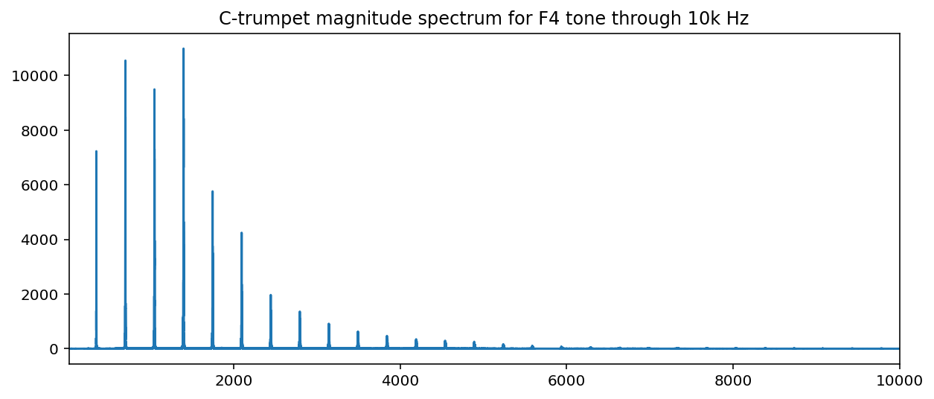
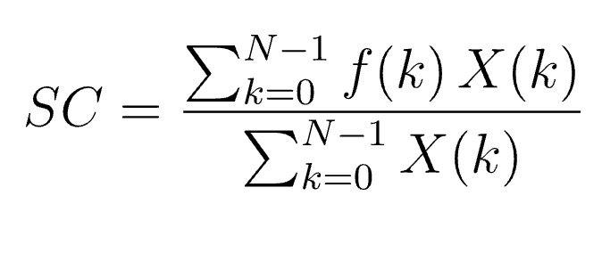
Timbre: Spectra
Since the spectrum is so important to the overall timbre, we may be unsurprised at how many statistical features attempt to capture some ‘snapshot’ of the spectrum.
Applied to linear magnitude (not dB)
Spectral Centroid
“center of gravity” of magnitude spectrum (i.e., weighted mean)
Notes:
X(k) is the actual magnitude value at k; f(k) is the frequency value at k. [k being the index]
Centroid = 1900.14

Slide 7
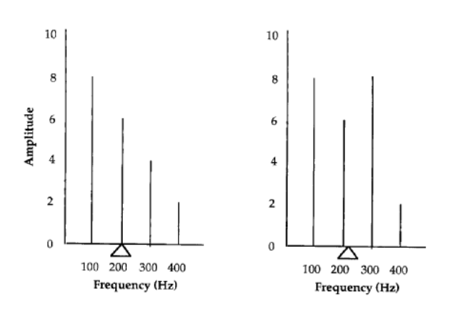
Exercise: Spectral Centroid
Calculate the exact centroid for each.

Slide 8
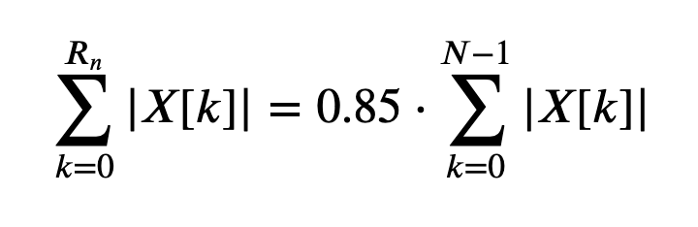
Timbre: Spectra
Since the spectrum is so important to the overall timbre, we may be unsurprised at how many statistical features attempt to capture some ‘snapshot’ of the spectrum.
Applied to linear magnitude (not dB)
Spectral Rolloff
Estimates the frequency below which a specified percentage (typically 85–95%) of the total spectral energy lies. To compute: find the smallest bin index such that the cumulative energy up to that bin hits the threshold.
Notes:
Rn = ​Index of the rolloff bin for frame n;
N = Total number of frequency bins (typically FFT size / 2 + 1)
Rolloff =

Slide 9
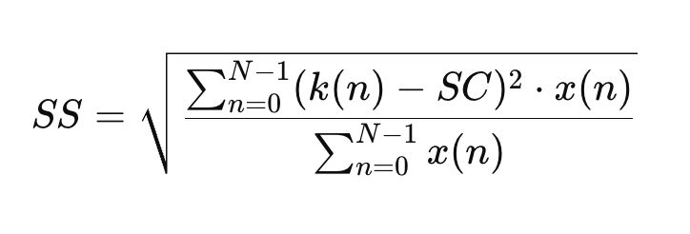
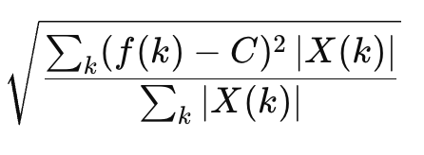
Timbre: Spectra
Since the spectrum is so important to the overall timbre, we may be unsurprised at how many statistical features attempt to capture some ‘snapshot’ of the spectrum.
Applied to linear magnitude (not dB)
Spectral Spread
Describes the concentration of the magnitude spectrum around the spectral centroid. Akin to the standard deviation of the ‘spectral distribution’.
1914.5
Notes:
SS = Spectral Spread
F(k)= the frequency (in Hz) of bin k
X(k)= the magnitude (or power) at bin k
SC = Spectral Centroid (the "center of mass" of the spectrum)
N = total number of frequency bins

Slide 10
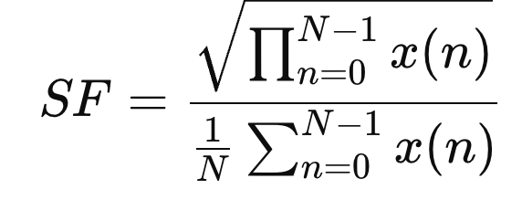
Timbre: Spectra
Since the spectrum is so important to the overall timbre, we may be unsurprised at how many statistical features attempt to capture some ‘snapshot’ of the spectrum.
Applied to linear magnitude (not dB)
Spectral Flatness
Measures how noise-like a sound is (closer to 1), compared to being tonal or pitched (closer to 0). To compute: (the geometric mean of the power spectrum) / (arithmetic mean of the power spectrum)
0.0019
Notes:
k(n) is the center frequency of the nth bin in hz
x(n) is the magnitude of the nth bin
SC is spectral centroid

Slide 11
Exercise: Changing Over Time
For now, you may use librosa…
Calculate and plot (against time) for the file “sax-phrase.wav” (and, if time “vowels_sung.wav“) in Canvas:
Spectral Centroid
Spectral Spread (note librosa calls this “spectral_bandwidth”)
Spectral Flatness
Spectral Rolloff
Don’t forget to:
Normalize audio
Normalize each feature to the same range (e.g., 0-1) for plotting

Slide 12
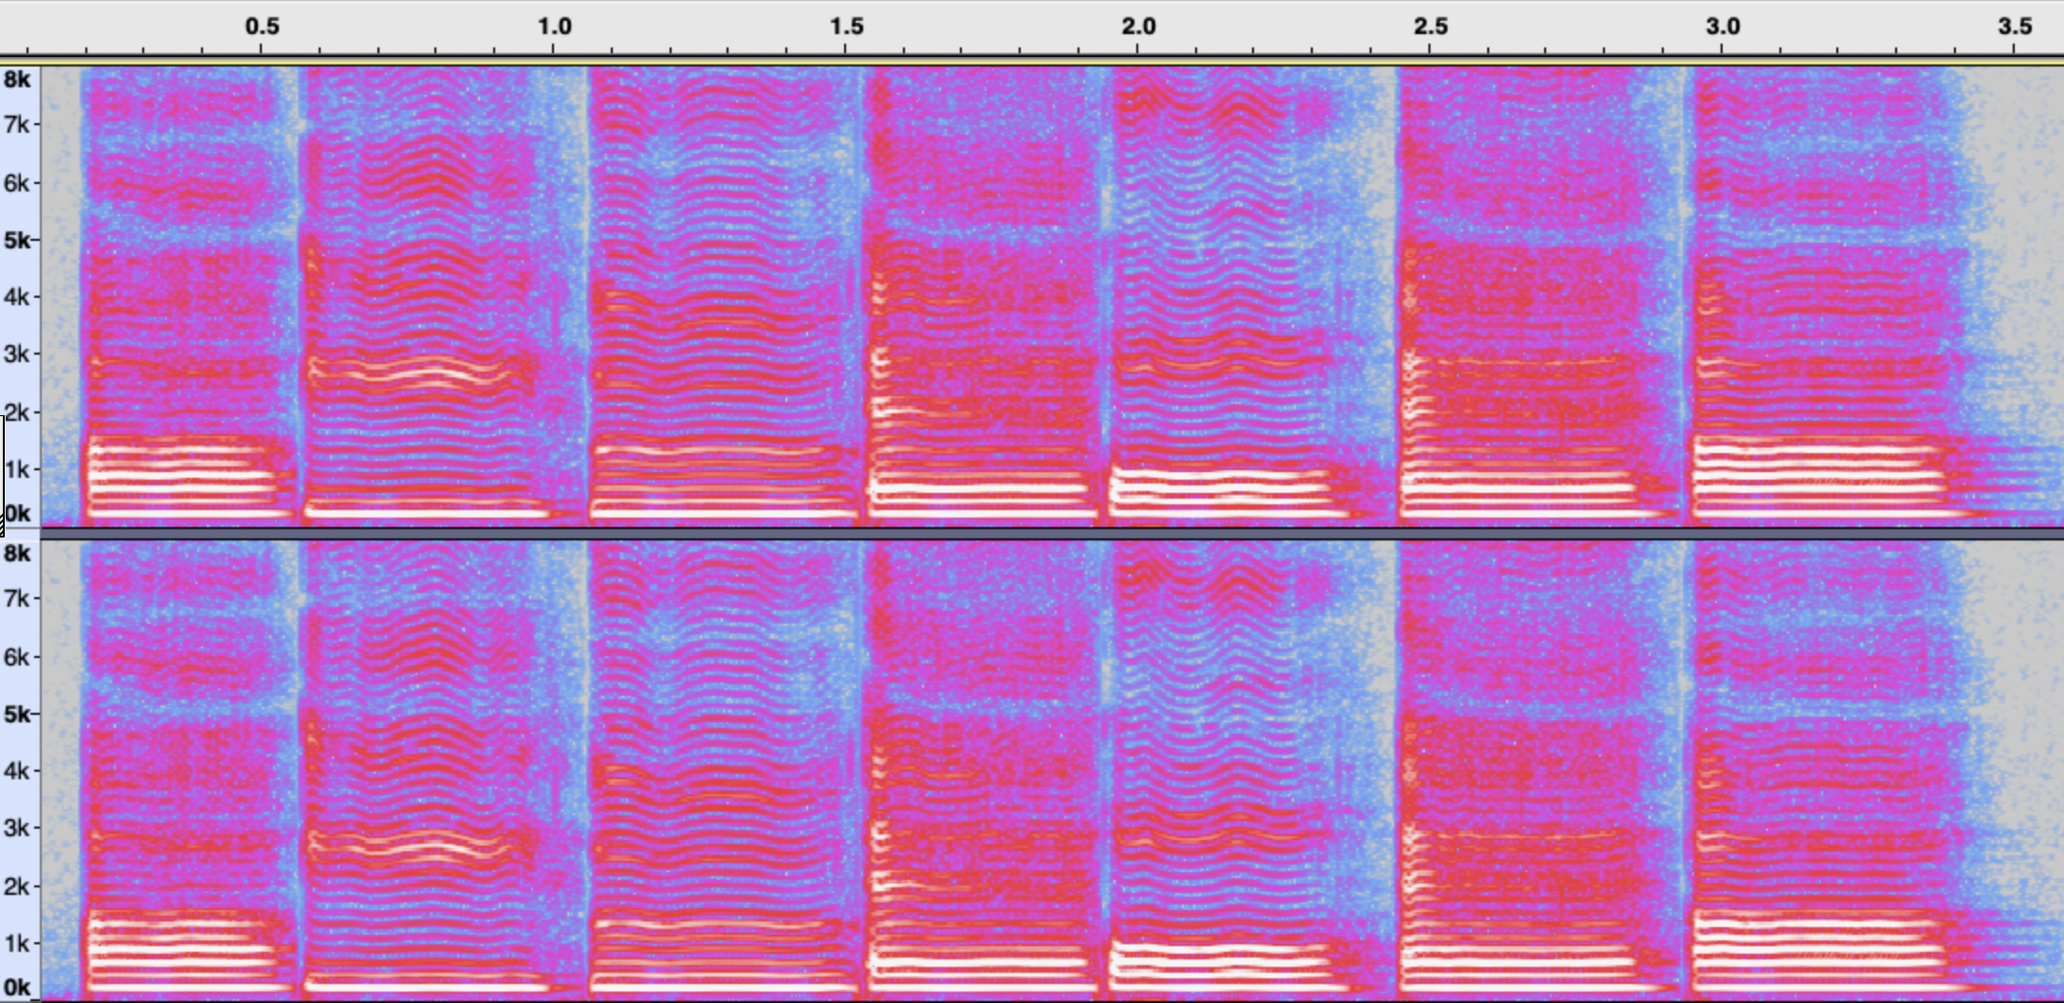
Measuring Spectral Changes
“ah”[a] “ee” [i] “oo” [u] “eh” [ɛ] “oh” [oʊ] “eh” [ɛ ] “ah” [a]
The vocal tract (throat + mouth + tongue position + lip shape) acts like a resonant filter.
Certain frequency regions get amplified by this filter — those resonant peaks are called formants.
Formants selectively boost or dampen certain harmonics, depending on which ones fall near the resonant frequencies.
Notes:
Instruments also have filter-like resonances that shape timbre; but acousticians more commonly call them “resonances” and formants is terminology typically reserved for the human voice.

Slide 13
Measuring Spectral Changes
“ah”[a] “ee” [i] “oo” [u] “eh” [ɛ] “oh” [oʊ] “eh” [ɛ ] “ah” [a]
Notes:
Instruments also have filter-like resonances that shape timbre; but acousticians more commonly call them “resonances” and formants is terminology typically reserved for the human voice.

