Slide 1
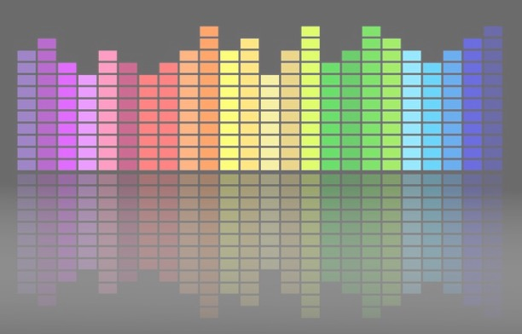

Computational Music Analysis: Audio
A.K.A. “Audio Content Analysis”
1. Course Introduction
Claire Arthur
Noël Alben

Slide 2
Agenda
What is A Sine Wave
What is a function?
How do we define a Sine Wave
Activity Of Computing Similarity
The story of Fourier Transform
Fourier Series
Fourier Transform
Discrete Fourier Transform
Why do we Care?
(Activity) How Fourier Transform Works Today
Properties Of Discrete FFT
STFT

Slide 3

Agenda
What is A Sine Wave
What is a function?
How do we define a Sine Wave
Activity Of Computing Similarity
The story of Fourier Transform
Fourier Series
Fourier Transform
Discrete Fourier Transform
Why do we Care?
How Fourier Transform Works Today
Properties Of Discrete FFT
STFT
Windowing
Spectrogram
Time vs Frequency Duality
Why???
https://musiclab.chromeexperiments.com/spectrogram

Slide 4
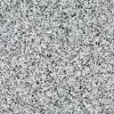

Functions
What is a Function?
a function yields relation between a set of input elements and a set of output elements
$$f[.]$$
1
2
3
4
5
6
1
4
9
16
25
26

Slide 5


Functions
What is a Function?
a function yields relation between a set of input elements and a set of output elements
$$n$$
$$f[.]$$
$$f[n]$$
1
2
3
4
5
6
1
4
9
16
25
26

Slide 6
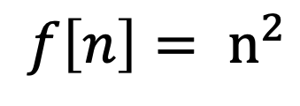
Functions
What is a Function?
a function yields relation between a set of input elements and a set of output elements
$$n$$
$$f[.]$$
$$f[n]$$
1
2
3
4
5
6
1
4
9
16
25
26
$$f\left[n\right]= n^{2}$$

Slide 7
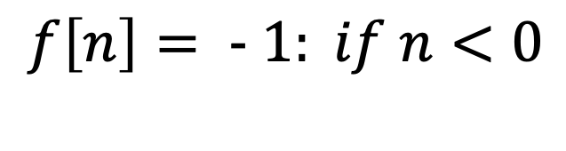

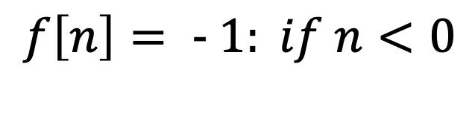
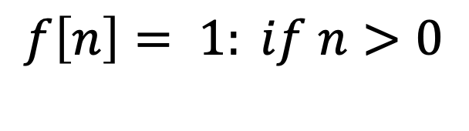


Functions
What is a Function?
a function yields relation between a set of input elements and a set of output elements
$$n$$
$$f[.]$$
$$f[n]$$
$$f\left[n\right]= 1: if n>0$$
$$f\left[n\right]= - 1: if n<0$$
-3
-2
-1
0
1
2
-1
0
1
$$f\left[n\right]= - 1: if n<0$$

Slide 8
Functions
What is a Function?
a function yields relation between a set of input elements and a set of output elements
$$n$$
$$f[.]$$
$$f[n]$$
https://www.desmos.com/calculator/9useprq8i8
-3
-2
-1
0
1
2
-1
0
1

Slide 9
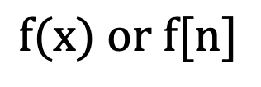
Sine Wave
Properties Of Function
Continuous Vs Discrete
Symmetry Properties
Even Functions
Odd Functions
Periodic
A-periodic
Linear
4. Orthogonality
$$f(x) or f[n]$$

Slide 10
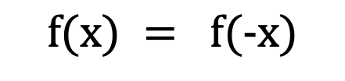
Sine Wave
Properties Of Function
Continuous Vs Discrete
Symmetry Properties
Even Functions
Odd Functions
Periodic
A-periodic
Linear
4. Orthogonality
$$f(x) = f(-x)$$

Slide 11
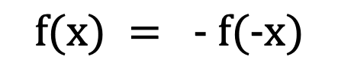
Sine Wave
Properties Of Function
Continuous Vs Discrete
Symmetry Properties
Even Functions
Odd Functions
Periodic
A-periodic
Linear
4. Orthogonality
$$f(x) = - f(-x)$$

Slide 12
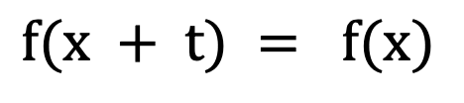
Sine Wave
Properties Of Function
Continuous Vs Discrete
Symmetry Properties
Even Functions
Odd Functions
Periodic
A-periodic
Linear
4. Orthogonality
$$f(x + t) = f(x)$$

Slide 13
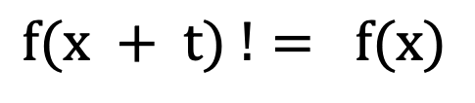
Sine Wave
Properties Of Function
Continuous Vs Discrete
Symmetry Properties
Even Functions
Odd Functions
Periodic
A-periodic
Linear
4. Orthogonality
$$f(x + t) != f(x)$$

Slide 14
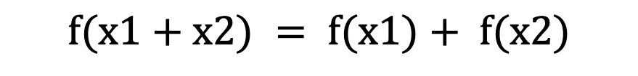
Functions
Properties Of Function
Continuous Vs Discrete
Symmetry Properties
Even Functions
Odd Functions
Periodic
A-periodic
Linear
4. Orthogonality
$$f(x1+x2) = f(x1)+ f(x2)$$

Slide 15
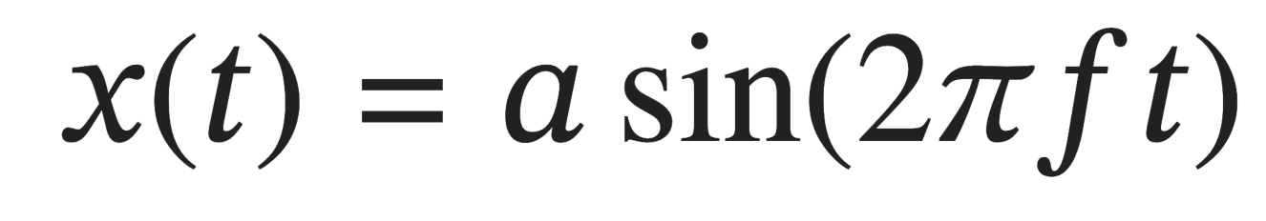
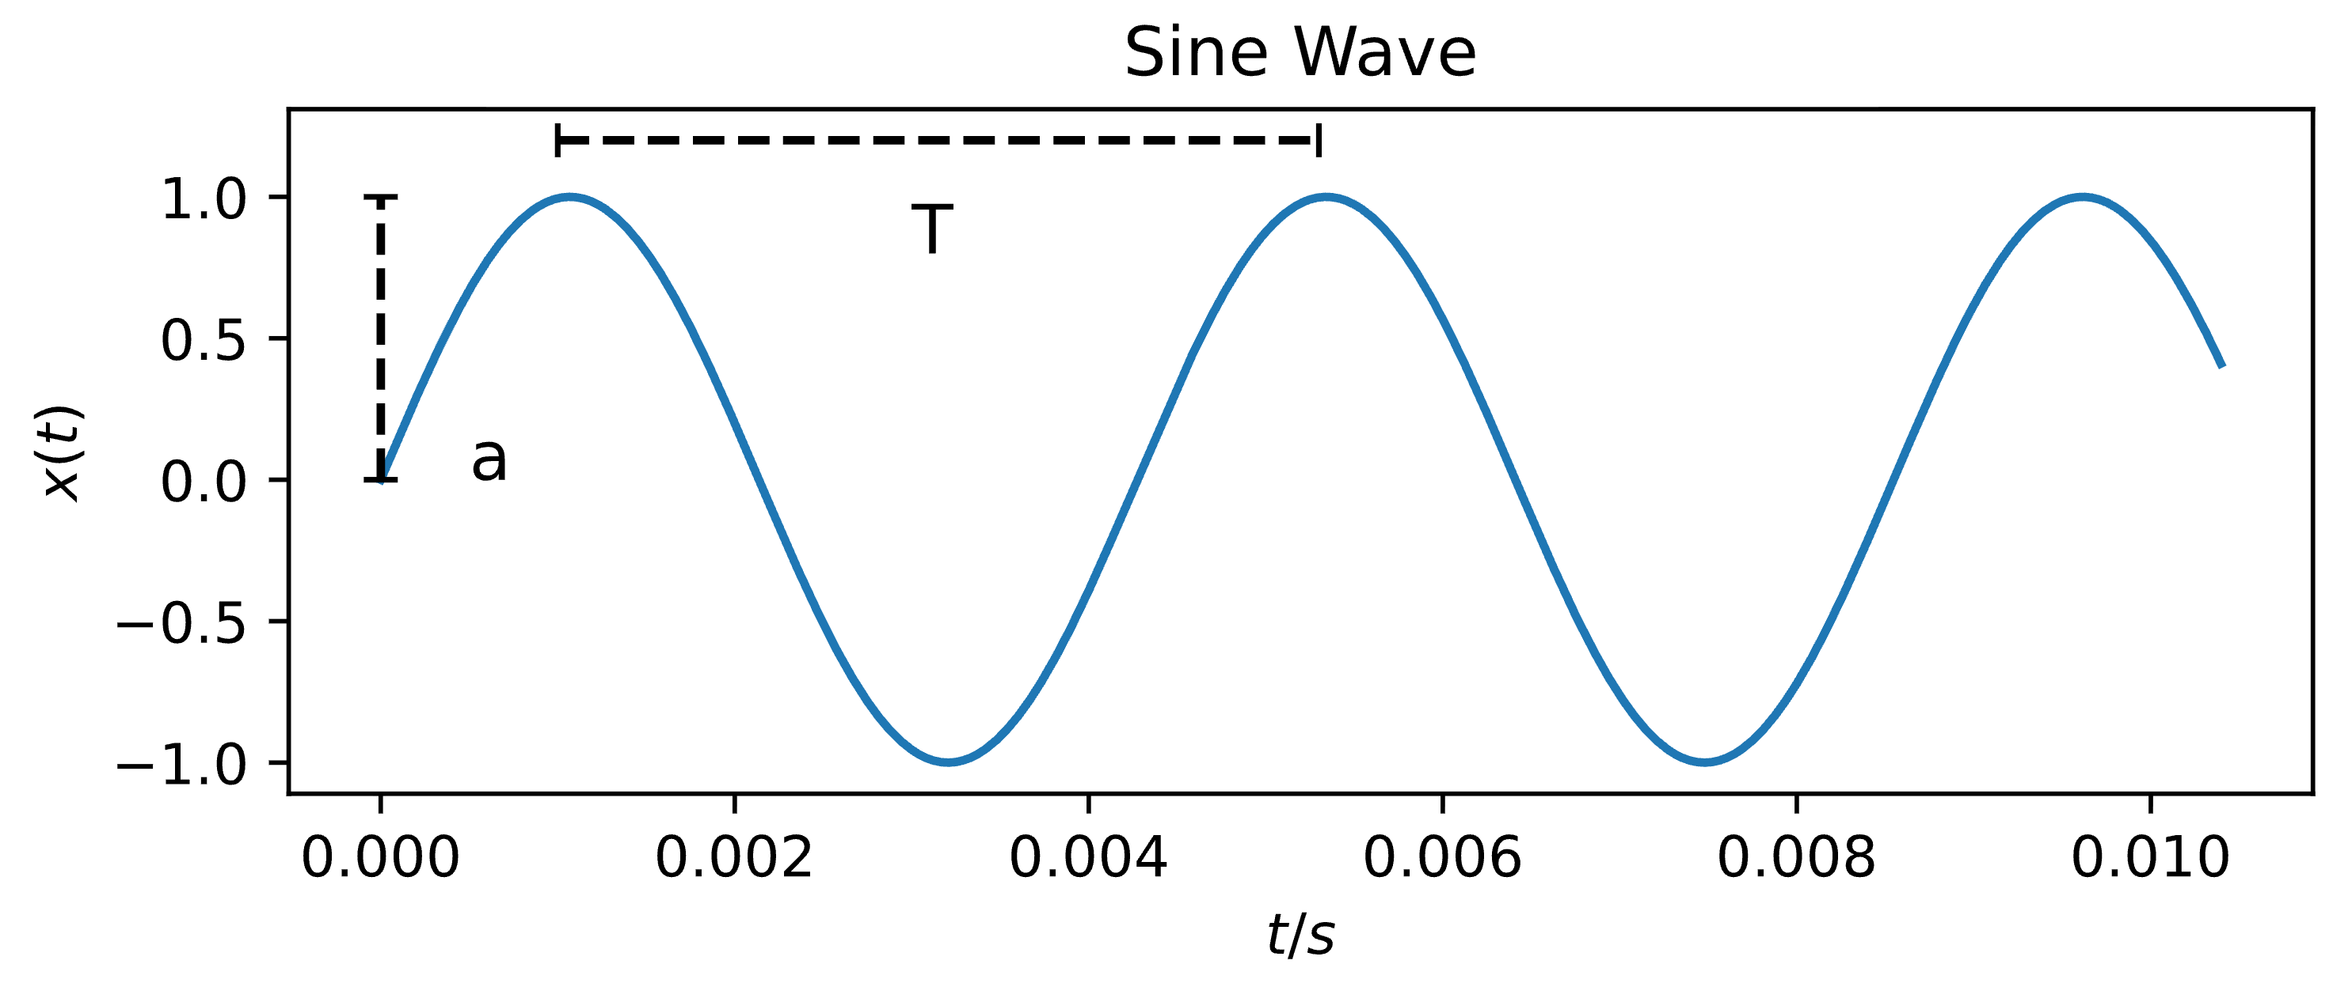
Sine Wave
A Sine Wave

Slide 16
Sine Wave
A Sine Wave
Sine values at points in time t

Slide 17
Sine Wave
A Sine Wave
Amplitude, here a = 1

Slide 18
Sine Wave
A Sine Wave
Angular Frequency

Slide 19
Sine Wave
A Sine Wave
Points in Time

Slide 20
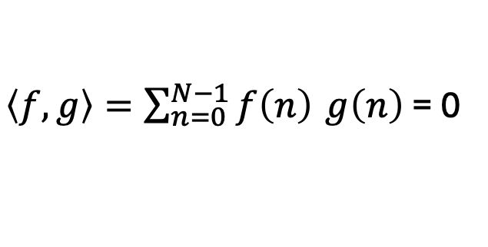
Sine Wave
Properties Of Function
Continuous Vs Discrete
Symmetry Properties
Even Functions
Odd Functions
Periodic
A-periodic
Linear
4. Orthogonality
$\left\langle f,g\right\rangle =\sum_{n=0}^{N−1}{f\left(n\right)} g\left(n\right)$ = 0
[Inner Product = 0 !!]

Slide 21
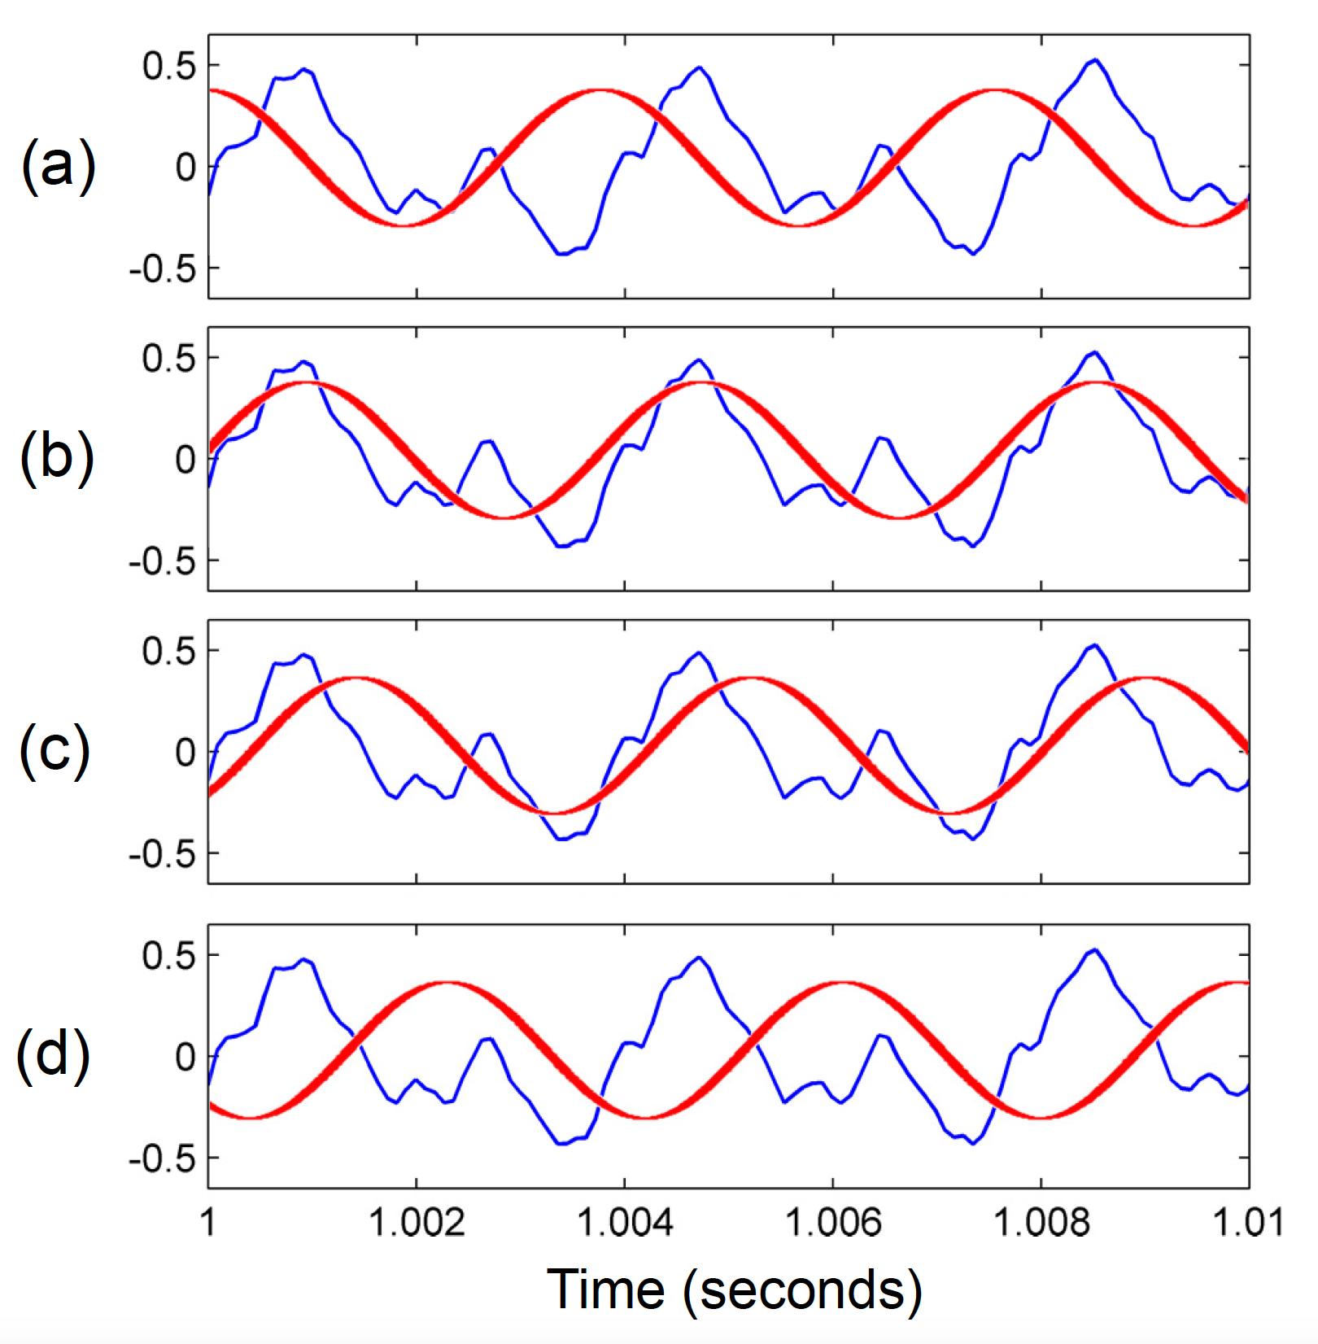
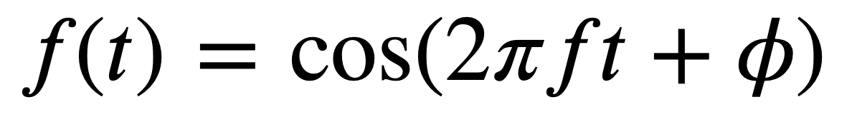
Sine Wave
Phase
https://www.desmos.com/calculator/9useprq8i8

Slide 22
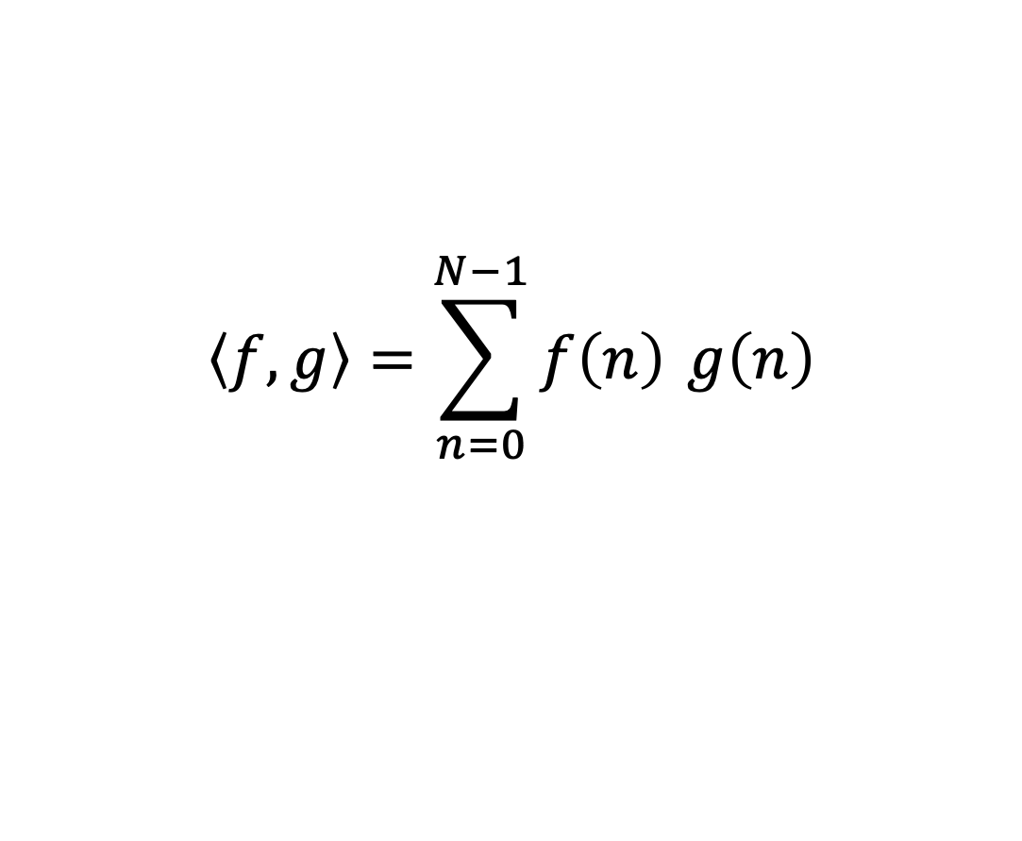
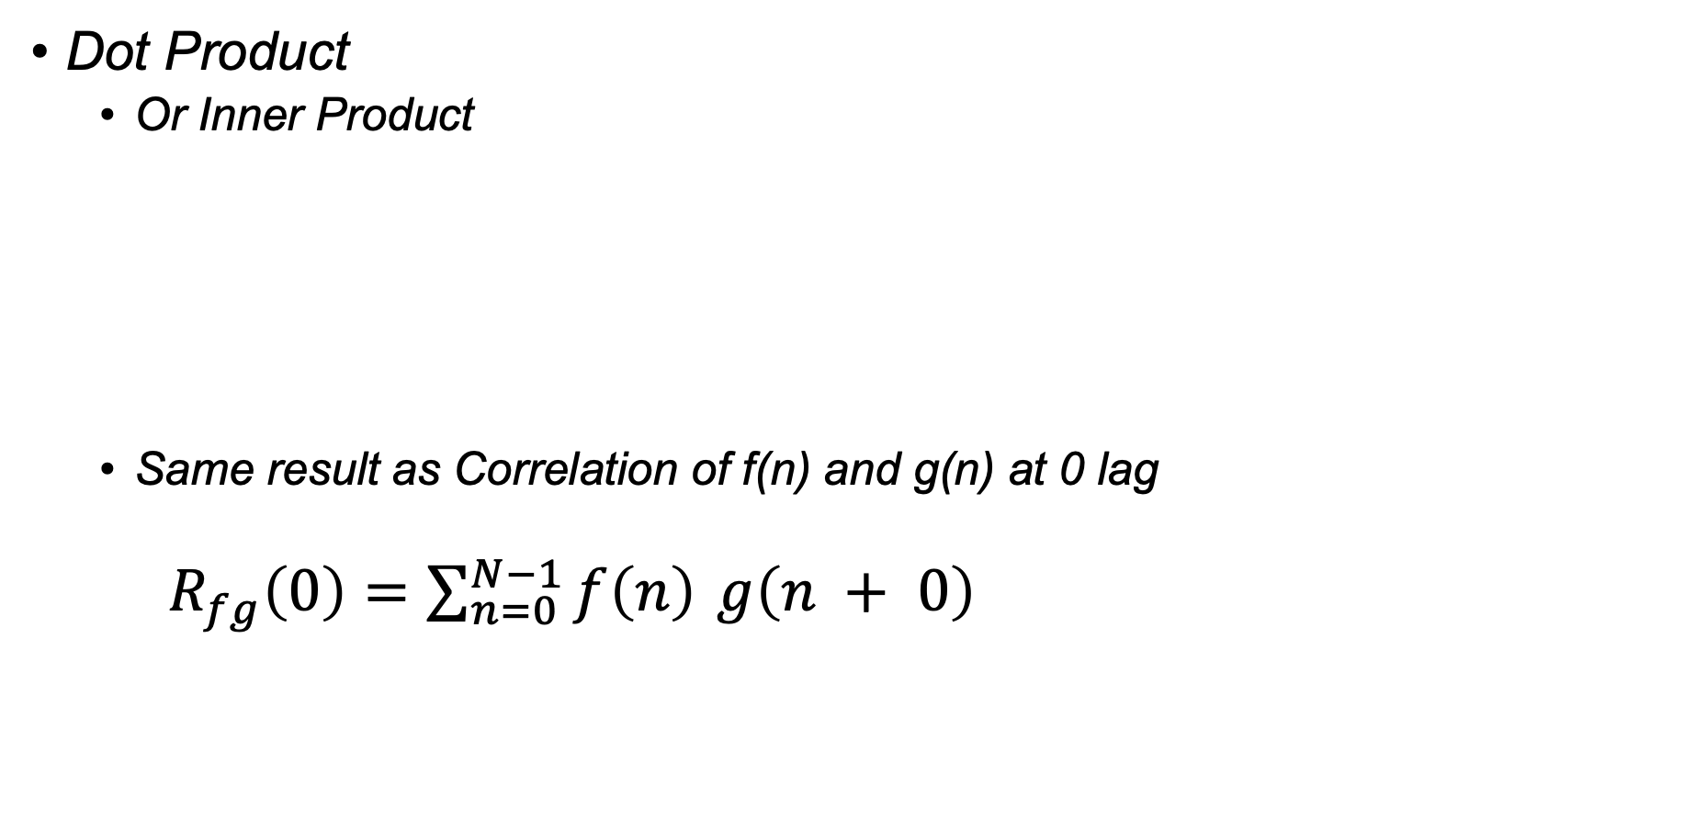
Computing Similarity
Dot Product
Or Inner Product
Same result as Correlation of f(n) and g(n) at 0 lag
$R_{fg}\left(0\right)=\sum_{n=0}^{N−1}{f\left(n\right)} g\left(n + 0\right)$
$$\left\langle f,g\right\rangle =\sum_{n=0}^{N−1}{f\left(n\right)} g\left(n\right)$$

Slide 23
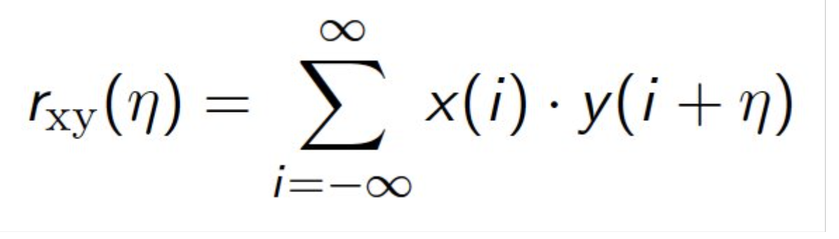
Computing Similarity
Dot Product
Or Inner Product
Same result as Correlation of f(n) and g(n) at 0 lag
$R_{fg}\left(0\right)=\sum_{n=0}^{N−1}{f\left(n\right)} g\left(n + 0\right)$
Remember This!!
$$\left\langle f,g\right\rangle =\sum_{n=0}^{N−1}{f\left(n\right)} g\left(n\right)$$

Slide 24
Activity Computing Similarity
Dot Product
Or Inner Product
Of Target Signal and Sinusoids
https://dev.nonety.pe/~/audio_synth_example?room=sinecorrelation
$$\left\langle f,g\right\rangle =\sum_{n=0}^{N−1}{f\left(n\right)} g\left(n\right)$$

Slide 25
Activity Computing Similarity
Steps
Download Wavfiles from Files in Canvas (Audio/CorrelationActivity)
Use the hints in the file name to complete the missing code logic
Plot and share what frequencies are present in these audio wavefiles with the simple dot product code provided

Slide 26
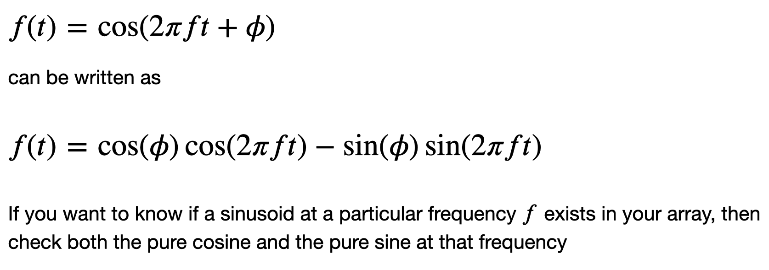
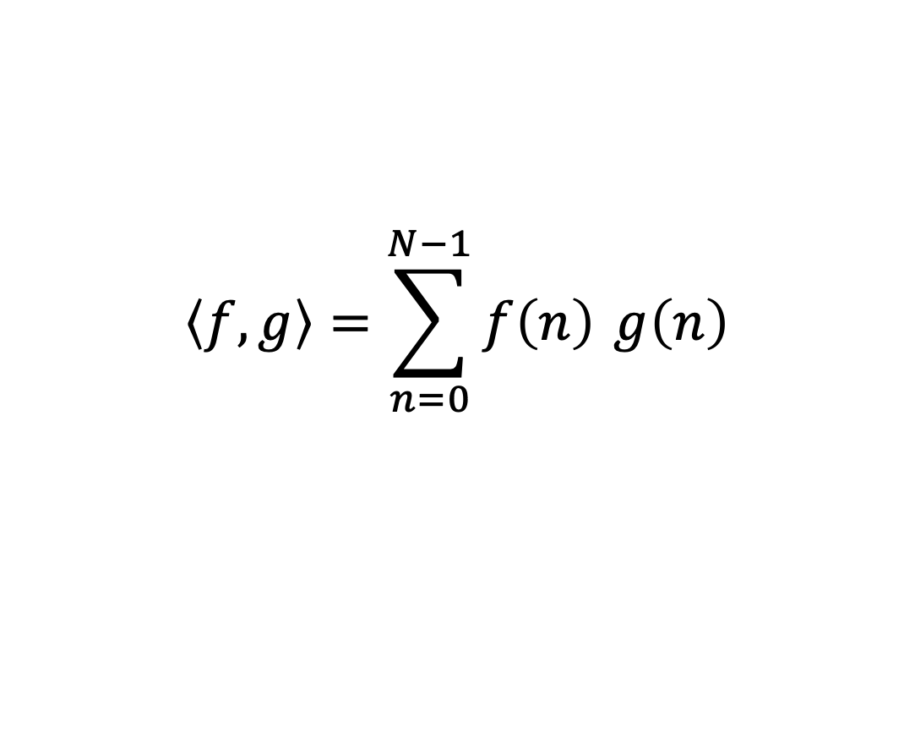
Activity Computing Similarity
$$\left\langle f,g\right\rangle =\sum_{n=0}^{N−1}{f\left(n\right)} g\left(n\right)$$

Slide 27
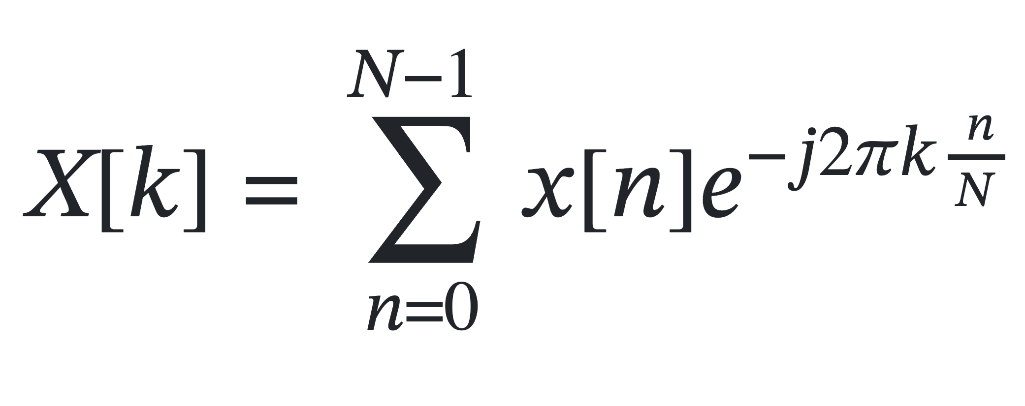
Discrete Fourier Transform

Slide 28
Discrete Fourier Transform

Slide 29
Discrete Fourier Transform

Slide 30
Discrete Fourier Transform
For a Signal Of N discrete points, You get N discrete Frequency Bins

Slide 31
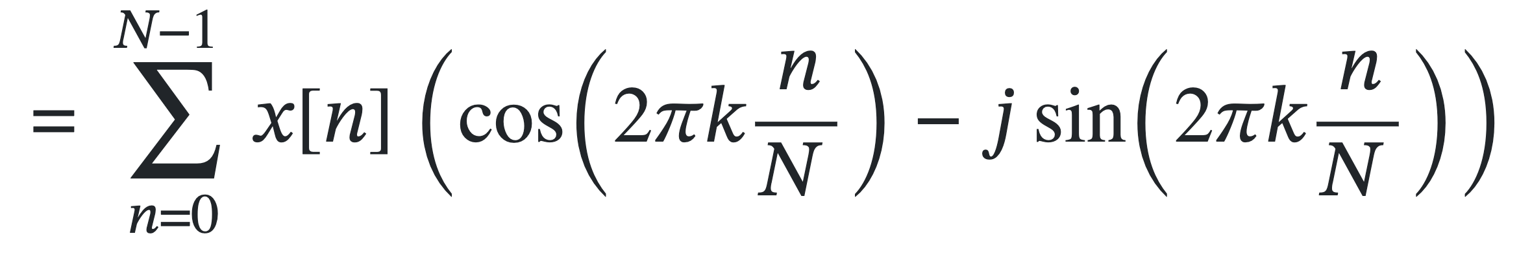
Discrete Fourier Transform

Slide 32

Discrete Fourier Transform
j is the imaginary number $√-1$ ,
Don’t worry too much about it right now, it mathematically helps keep track of the double correlation as a single value.
Things tend to get “complex” here
https://ringbuffer.org/dsp/Fourier_Transform/imaginary-numbers-python/

Slide 33
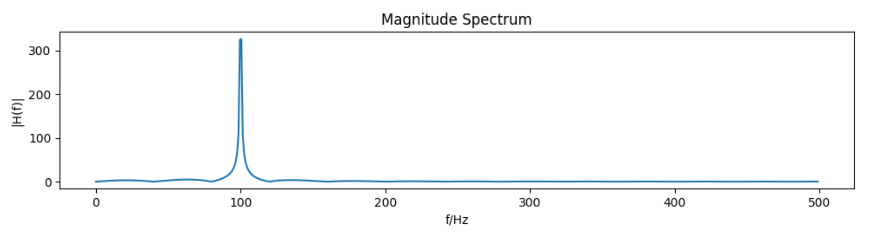
Discrete Fourier Transform
What do we care about?
Magnitude Spectrum
Phase Spectrum

Slide 34
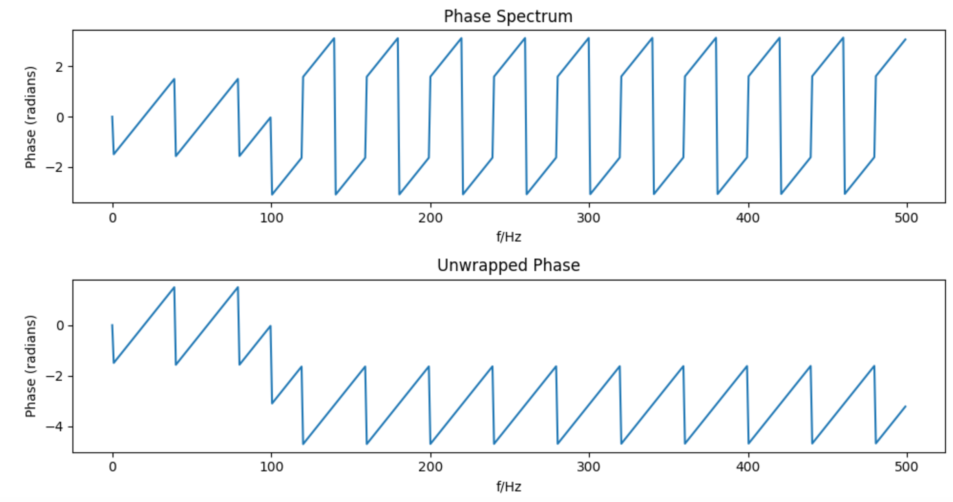
Discrete Fourier Transform
What do we care about?
Phase Spectrum
Phase Spectrum

Slide 35
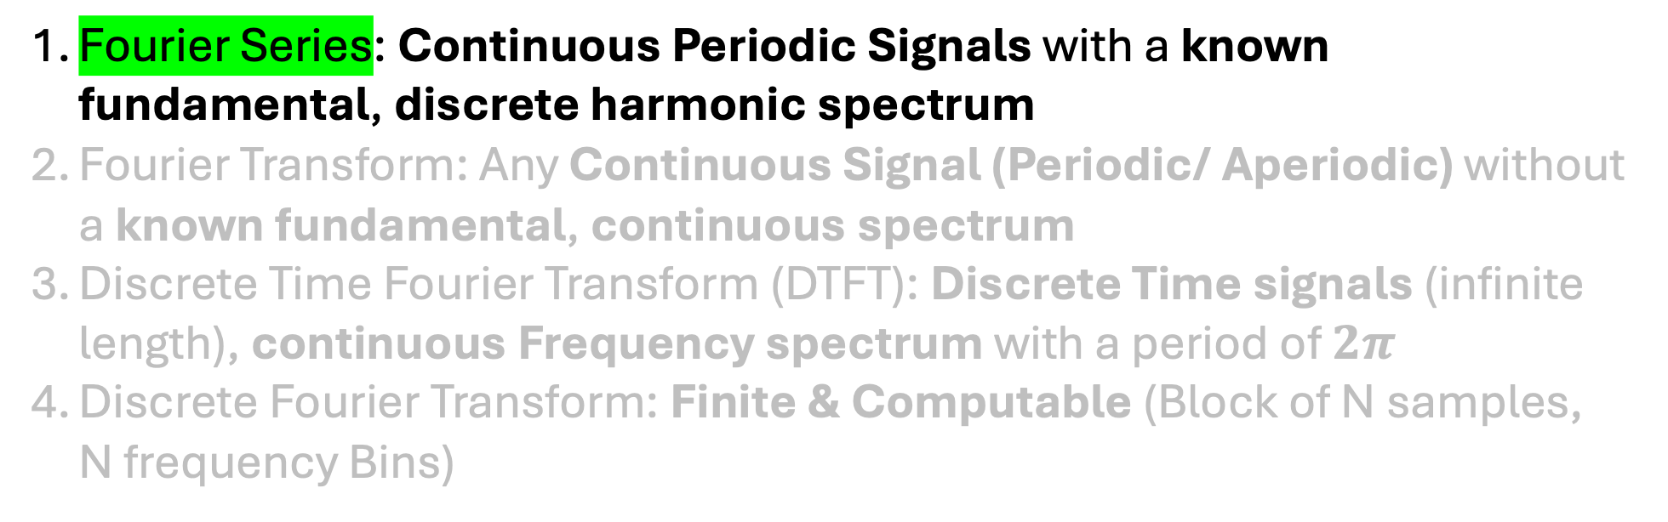
Story Of Fourier Transform
Fourier Series: Continuous Periodic Signals with a known fundamental, discrete harmonic spectrum
Fourier Transform: Any Continuous Signal (Periodic/ Aperiodic) without a known fundamental, continuous spectrum
Discrete Time Fourier Transform (DTFT): Discrete Time signals (infinite length), continuous Frequency spectrum with a period of $2π$
Discrete Fourier Transform: Finite & Computable (Block of N samples, N frequency Bins)

Slide 36
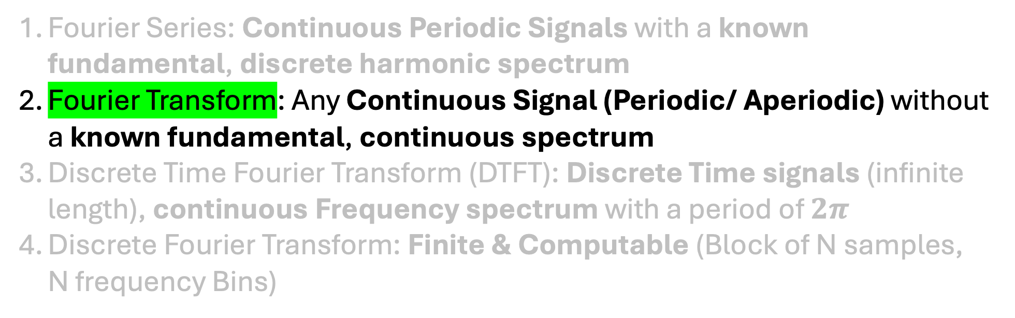
Story Of Fourier Transform
Fourier Series: Continuous Periodic Signals with a known fundamental, discrete harmonic spectrum
Fourier Transform: Any Continuous Signal (Periodic/ Aperiodic) without a known fundamental, continuous spectrum
Discrete Time Fourier Transform (DTFT): Discrete Time signals (infinite length), continuous Frequency spectrum with a period of $2π$
Discrete Fourier Transform: Finite & Computable (Block of N samples, N frequency Bins)

Slide 37
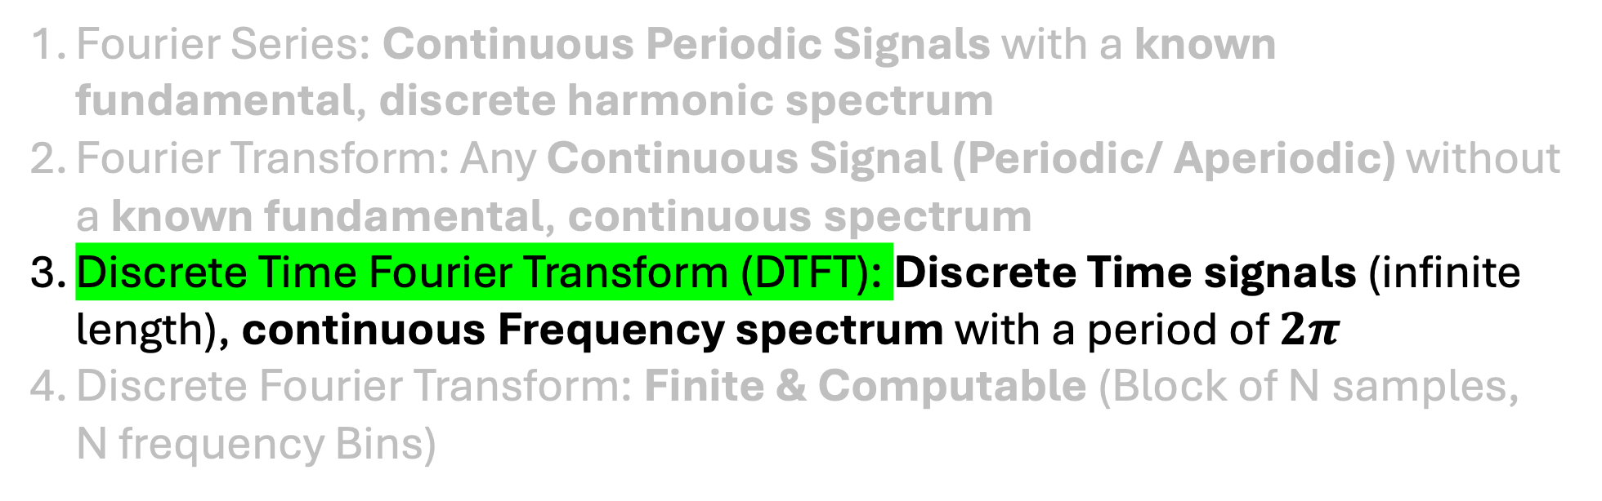
Story Of Fourier Transform
Fourier Series: Continuous Periodic Signals with a known fundamental, discrete harmonic spectrum
Fourier Transform: Any Continuous Signal (Periodic/ Aperiodic) without a known fundamental, continuous spectrum
Discrete Time Fourier Transform (DTFT): Discrete Time signals (infinite length), continuous Frequency spectrum with a period of $2π$
Discrete Fourier Transform: Finite & Computable (Block of N samples, N frequency Bins)

Slide 38
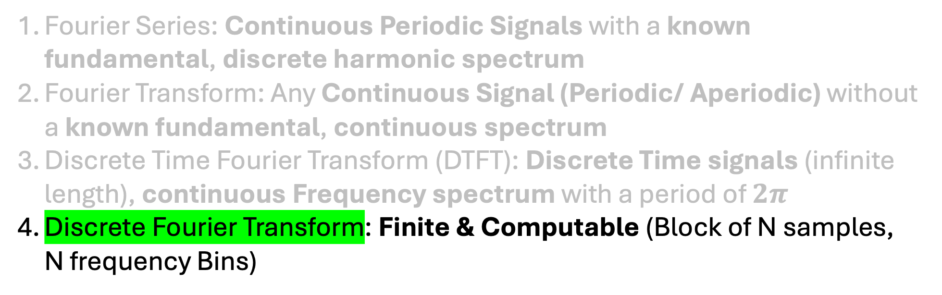
Story Of Fourier Transform
Fourier Series: Continuous Periodic Signals with a known fundamental, discrete harmonic spectrum
Fourier Transform: Any Continuous Signal (Periodic/ Aperiodic) without a known fundamental, continuous spectrum
Discrete Time Fourier Transform (DTFT): Discrete Time signals (infinite length), continuous Frequency spectrum with a period of $2π$
Discrete Fourier Transform: Finite & Computable (Block of N samples, N frequency Bins)

Slide 39
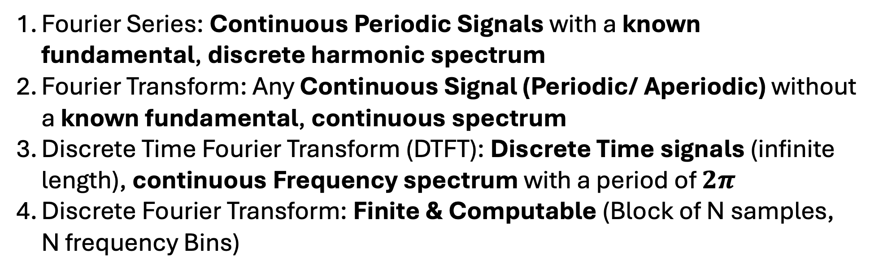
Story Of Fourier Transform
Fourier Series: Continuous Periodic Signals with a known fundamental, discrete harmonic spectrum
Fourier Transform: Any Continuous Signal (Periodic/ Aperiodic) without a known fundamental, continuous spectrum
Discrete Time Fourier Transform (DTFT): Discrete Time signals (infinite length), continuous Frequency spectrum with a period of $2π$
Discrete Fourier Transform: Finite & Computable (Block of N samples, N frequency Bins)

Slide 40
Fourier Transform Activity
Numpy FFT (Fast Fourier Transform)
The FFT delivers the exact same results a DFT does, but it uses more advanced algorithms in the implementation.
https://ringbuffer.org/dsp/Fourier_Transform/fft-python/

Slide 41
Fourier Transform Properties
To Be Continued….

Slide 42
Agenda
What is A Sine Wave
What is a function?
How do we define a Sine Wave
Activity Of Computing Similarity
The story of Fourier Transform
Fourier Series
Fourier Transform
Discrete Fourier Transform
Why do we Care?
(Activity) How Fourier Transform Works Today
Properties Of Discrete FFT
STFT

