Slide 1
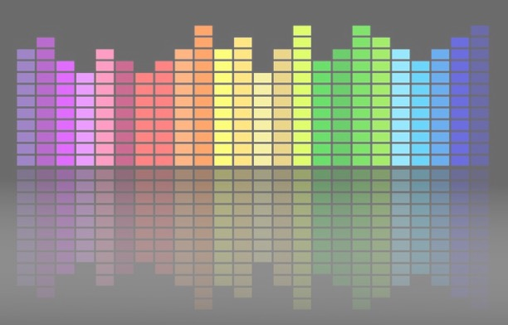

Computational Music Analysis: Audio
A.K.A. “Audio Content Analysis”
1.1 Intro to Music Information Retrieval
Claire Arthur
Noel Alben

Slide 2
What is Music Information Retrieval?
The processing of raw musical data (e.g., audio signal, symbolic score, video) to extract useful information (i.e., “features”).
The goal is to analyze this “content” (information) in ways that are useful or musically meaningful.

Slide 3
What is Music Information Retrieval?
The processing of raw musical data (e.g., audio signal, symbolic score, video) to extract useful information (i.e., “features”).
Applications, Tools, Processes
Informatics, Data-driven knowledge

Slide 4
What is Music Information Retrieval?
The processing of raw musical data (e.g., audio signal, symbolic score, video) to extract useful information (i.e., “features”).
Applications, Tools, Processes
Informatics, Data-driven knowledge
Computational Musicology
Music Information Retrieval

Slide 5
What is Music Information Retrieval?
The processing of raw musical data (e.g., audio signal, symbolic score, video) to extract useful information (i.e., “features”).
MIR therefore encompasses a broad field that may rely on a number of possible inputs (digital score, image, video, audio) and possible outcomes (dataset building, musicological knowledge, digital tools, models, applications, etc.)

Slide 6
What is Music Information Retrieval?
Related:
Machine Listening & Computer Audition
MIR’s goal is often to describe or model the music mathematically or statistically (without necessarily "understanding" it in the human sense).
Machine listening (& more broadly, computer audition) refers to interpreting meaning from the music and context, which is more complex than recognition.

Slide 7
Musical vs Non-musical Sound
music . . .
is a wide band signal
unlike many other audio signals
comprises both tonal and noise components
like most audio signals
combines multiple sound sources
unlike speech, like urban sound
is a poly-timbral mixture
unlike industrial sound
sources are harmonically related and synchronous
unlike other multi-source signals
has a highly structured language that is abstract
unlike speech

Slide 8
Where is the music?
Scores, Jazz improvisation, Classical recording, Live funk band, non-Western music, avant-garde performance…
History, genre, style, tradition, culture… all contribute to ideas about how music is represented and what the music “is”
Requires consideration of the roles of nuance, interpretation, modifications or alterations (e.g., quantization, alphabet reduction, etc.)
Each example above brings different challenges and opportunities

Slide 9
The Focus of This Course
This course is nicknamed “audio content analysis” because we will be focusing on the analysis of the audio signal (as opposed to a digital score or other input)
The emphasis will be on audio signals of music (as opposed to speech, nature sounds, etc.).
Our focus will not be heavily theoretical but more applied.
You will learn a variety of approaches to content analysis with emphasis on critical thinking of approaches and evaluation.

Slide 10
MIR field: ISMIR community
International Society for Music Information Retrieval (ISMIR) is the society dedicated to all work in MIR
International conferences held annually
Published conference papers indexed in scopus: #1 for google metrics in “music”
TISMIR (Journal for ISMIR)
ISMIR-community mailing list (great resource!)
MIREX: MIR Evaluation EXchange

Slide 11
Uses & Applications of MIR
Database creation
Typically made with ideal ‘use case’ (classification, similarity, etc.)
Interfaces
E.g., Search & retrieval, tagging, fingerprinting
Visualization
E.g., Audio/score alignment, similarity, musical structure
Adaptive/interactive HCI systems
E.g., Recommendation, AI generation
Musicological domain knowledge (e.g., musical understanding)
E.g., Common vs rare structures; composer attributes,

Slide 12















Companies and Products Driven By MIR

Slide 13


Companies and Products Driven By MIR
Music Education (Source Separation, Score Following, Pitch Detection, Transcription...)
Content Library (Recommendation, Search & Retrieval, Fingerprinting ..)​
Content Creation (Generative Systems, Mood Classification, Multimodal music systems, Audio Editing ..)​
Creative Applications (Interactive Audio Systems, Human-AI Co-Creativity, Music Production, Musician's Notebook ..)​

