Slide 1
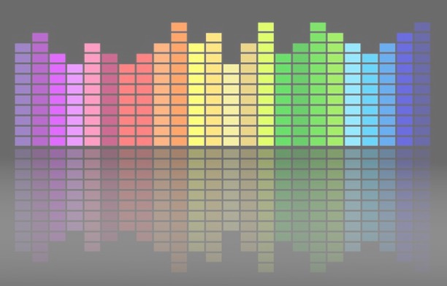

Computational Music Analysis: Audio
A.K.A. “Audio Content Analysis”
2. Intro to Instantaneous Features
Claire Arthur
Noel Alben

Slide 2
Feature Extraction
Recall that a “feature” is essentially a data point (or set of points) that we ‘extract’ (i.e., calculate) from some range of a musical signal (typically one frame of audio).
Features are always “useful” but may not inherently “interpretable” or musically “meaningful” in isolation.
Features are often referred to as existing on “levels” or tiers…
FYI: ‘features’ as an input to an audio analysis system is now a bit “old fashioned” but we still need to learn & understand ☺

Slide 3
Feature Extraction
Feature “levels” exist on tiers:
TIER | DESCRIPTION | EXAMPLES
Low (signal level) | Directly derived from signal/input; Mathematically simple; Typically frame-based; Not typically “musical” or “perceptual”; Form raw material for further analysis | RMS, energy, spectral centroid, zero-crossing rate, MFCCs
Mid (perceptual/ musical attributes) | Aggregated or transformed from low-level into representations closer to basic musical attributes or perceptual characteristics. Often longer timescale. | Tempo, key, chroma features, onsets, timbral descriptors
High (semantic/ conceptual) | Typically descriptions that align with human categories of meaning, style, or emotion. Often require models trained on annotated data. | Genre, mood, instrumentation, similarity measures

Slide 4
Feature Extraction
Features from the musical signal (even low-level) frequently relate back to different musical properties, e.g.,
Pitch/frequency
Rhythm, beats, timing, tempo
Loudness/amplitude
Timbre
Etc.

Slide 5
Feature Extraction
The feature may be calculated from the time-domain representation, or the frequency-domain representation (or other transformations of the representation)
Pitch/frequency
Rhythm, beats, timing, tempo
Loudness/amplitude
Timbre

Slide 6
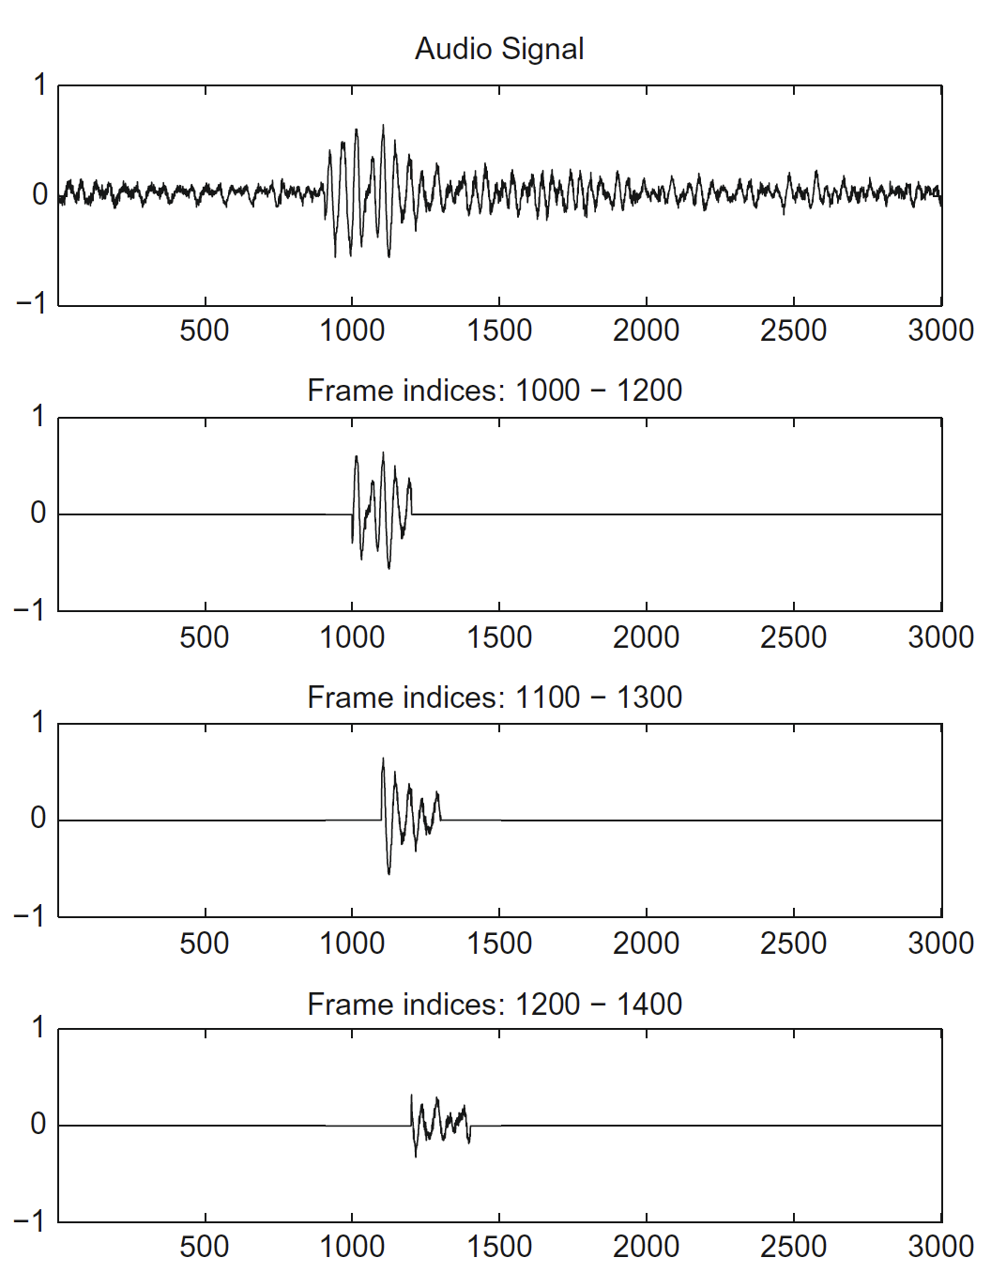
As you recall from your reading…
An Instantaneous Feature is a single value summarizing a particular feature value over one single frame (i.e., milliseconds) worth of audio.
As time moves forward, the signal changes, and therefore the value of certain features do as well.

Slide 7
As you recall from your reading…
An Instantaneous Feature is a single value summarizing a particular feature value over one single frame (i.e., milliseconds) worth of audio.
Time
Feature
value:
0.4

Slide 8
As you recall from your reading…
An Instantaneous Feature is a single value summarizing a particular feature value over one single frame (i.e., milliseconds) worth of audio.
Time
Feature
value:
0.2

Slide 9
As you recall from your reading…
An Instantaneous Feature is a single value summarizing a particular feature value over one single frame (i.e., milliseconds) worth of audio.
Time
Feature
value:
0.1

Slide 10
Three Time Domain Features
Feature
Indicates/Describes:
Energy
Root Mean Square (Energy), ”RMS”
Zero Crossing Rate, “ZCR”
~ Volume/Loudness
~ High frequency content…

Slide 11
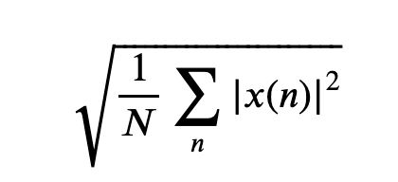
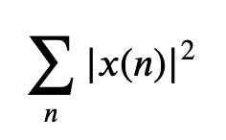
Energy & RMS
The energy of a discrete time signal corresponds to the total magnitude of the signal. This roughly corresponds to how loud a signal is. The energy in a signal is defined as:
The RMS energy of a discrete time signal is similar (how loud), but we take our squared values, then take the mean (divide by N), and then take the root:

Slide 12
Energy & RMS
The energy of a discrete time signal corresponds to the total magnitude of the signal. This roughly corresponds to how loud a signal is. The energy in a signal is defined as:
The RMS energy of a discrete time signal is similar, but we take our squared values, then take the mean (divide by N), and then take the root:
The energy
The RMS
Cumulative power, more sensitive to large changes (e.g., attacks/onsets)
Average power, less sensitive to brief peaks than Energy; more like ‘loudness envelope’

Slide 13
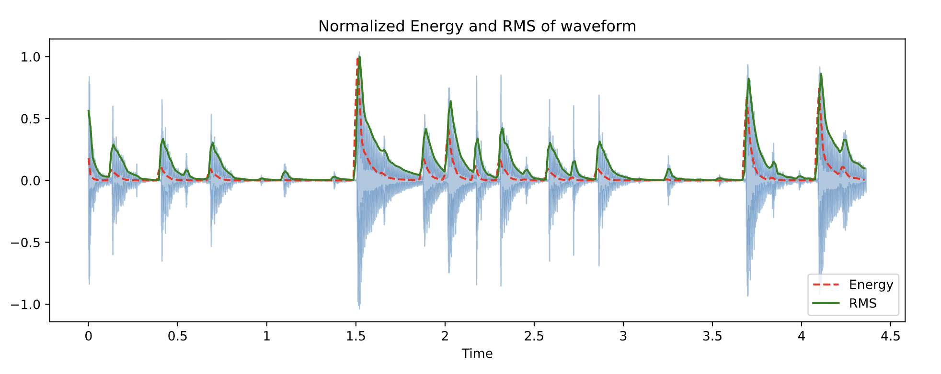
Energy & RMS

Slide 14
Energy & RMS

Slide 15
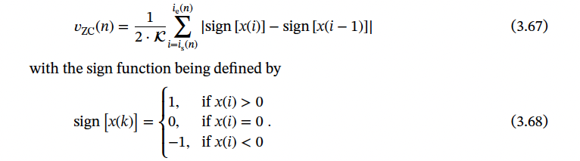
Zero Crossing Rate (ZCR)
Literally measures the number of times that the signal “crosses zero” (i.e., moves from negative to positive amplitude)
Raw ZCR literally gives a count (e.g., 50) for a given frame
Typically ZCR is normalized by dividing by the frame length.
This lets you compare ZCR values regardless of frame size.

Slide 16
Zero Crossing Rate (ZCR)
Higher ZCR = higher frequency content in that frame
‘Noisy’ signals are higher frequency
E.g., Fricatives and plosives in speech/singing
Transients marking the beginning of note onsets for many instruments
Percussion (e.g., cymbals)
The more variable the ZCR the less periodic the signal

Slide 17
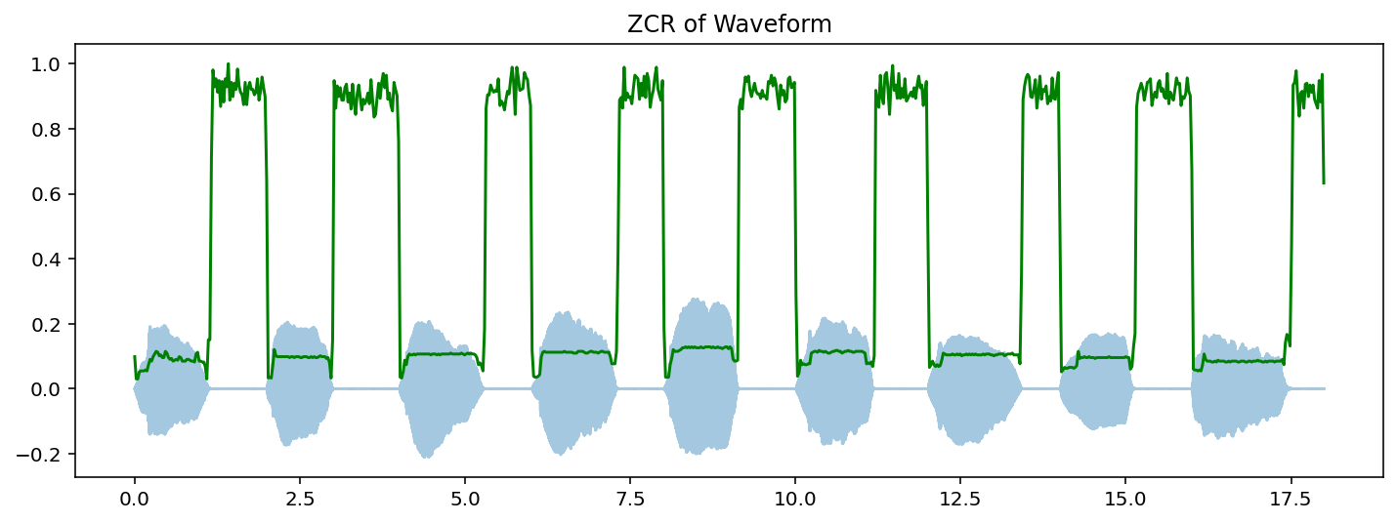
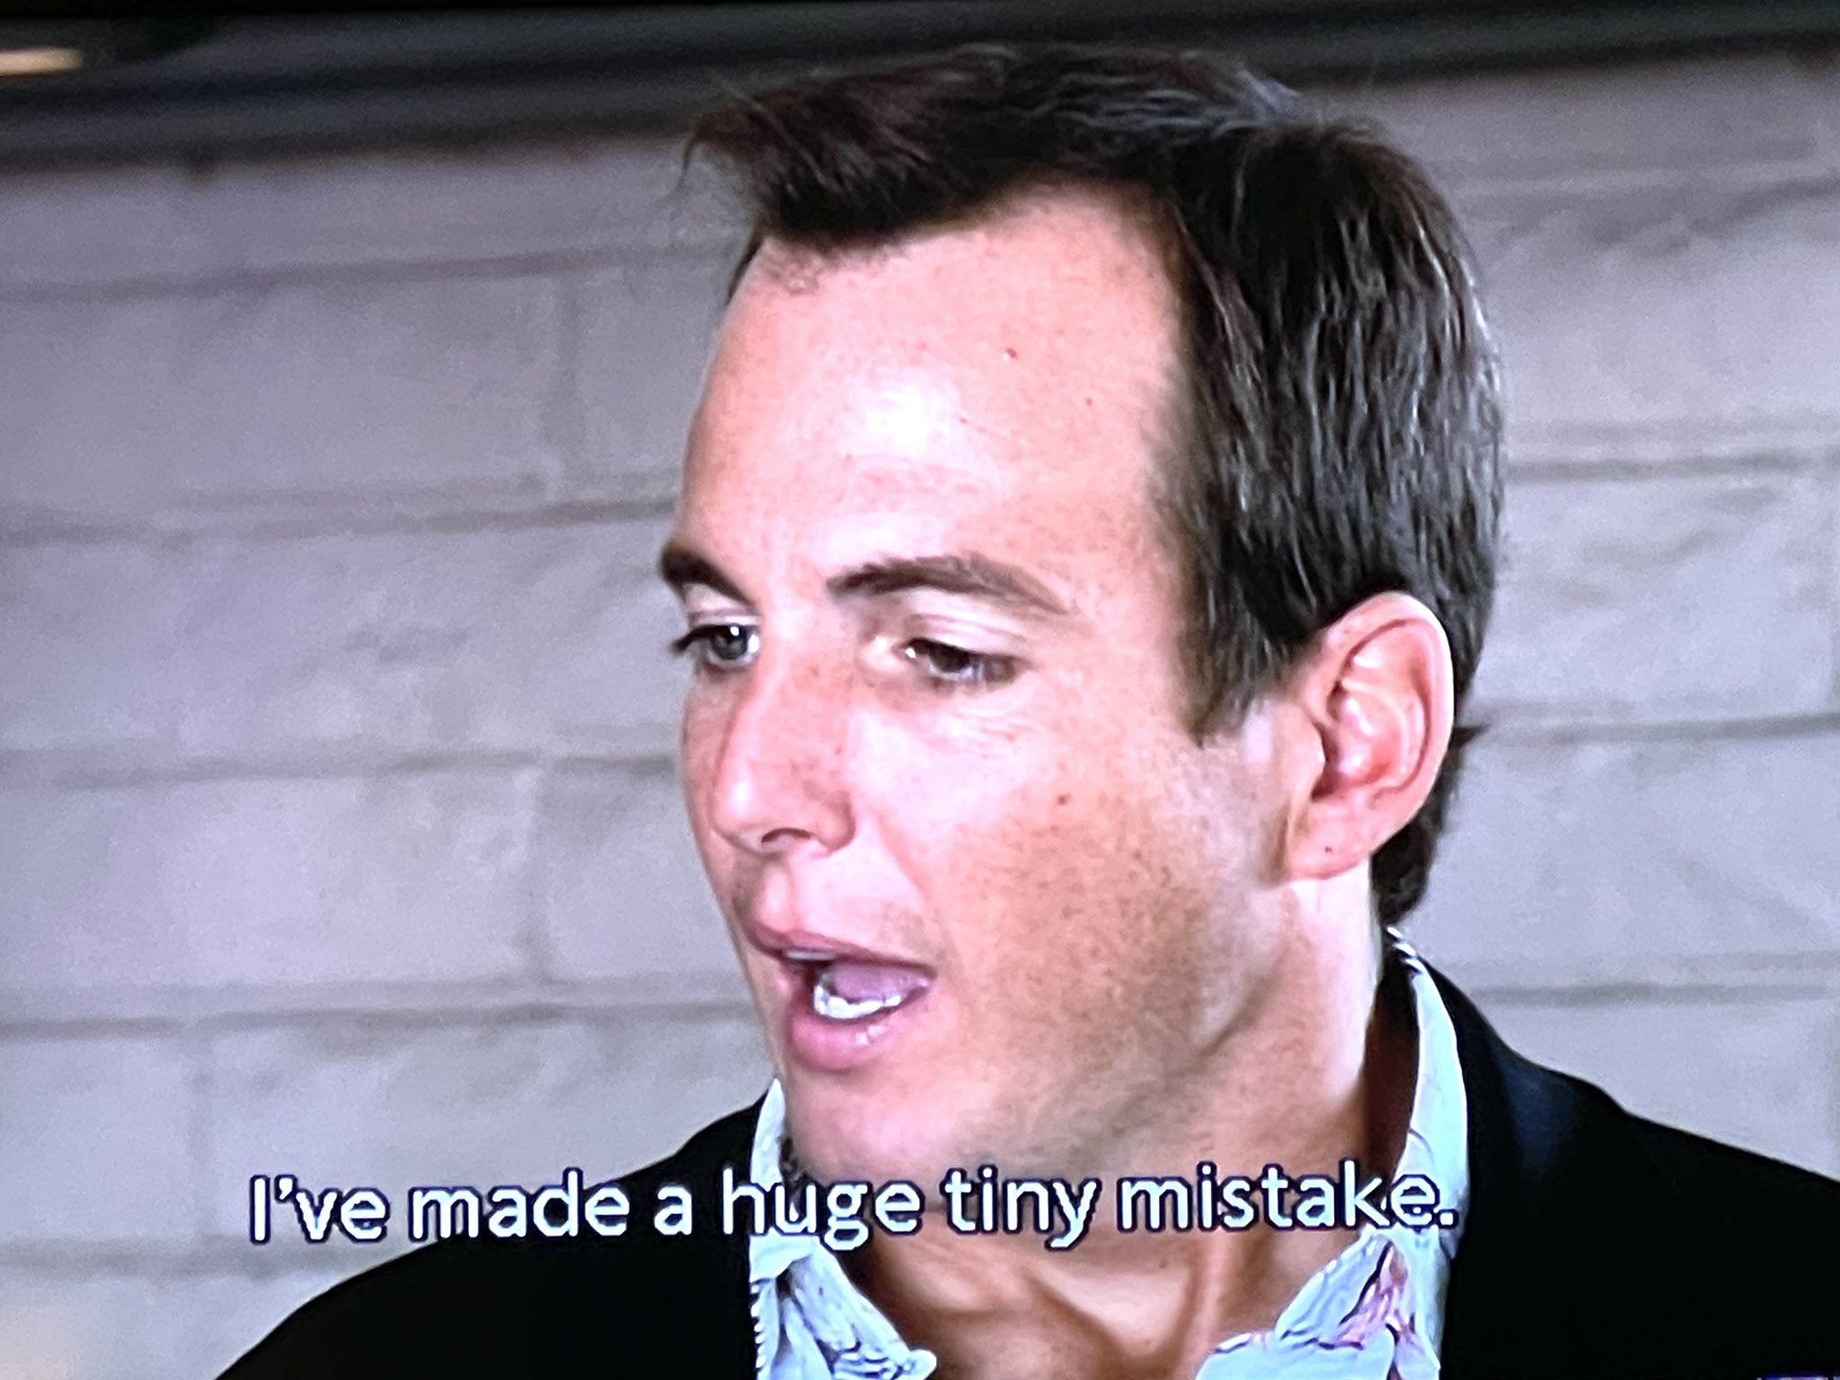
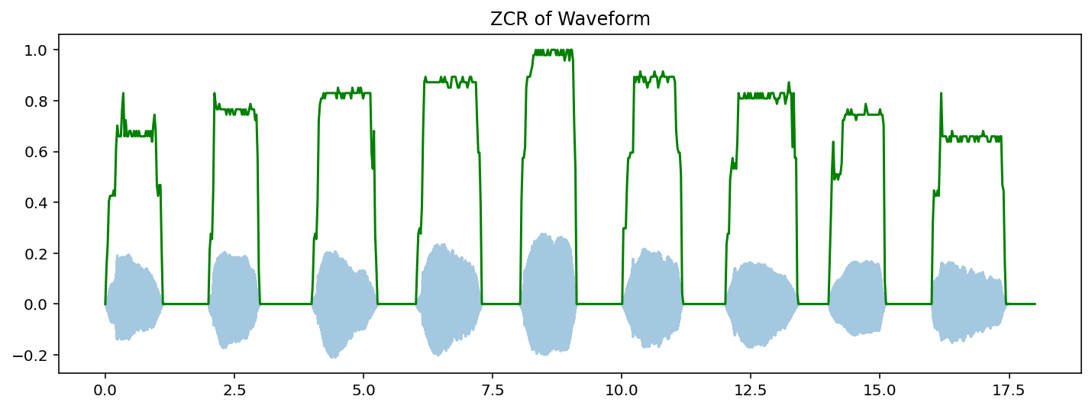
Zero Crossing Rate (ZCR)
“Threshold” parameter set to 0.01

