Slide 1
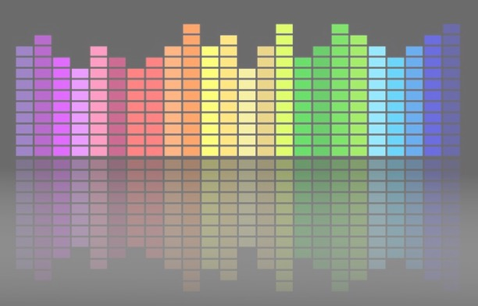

Computational Music Analysis: Audio
A.K.A. “Audio Content Analysis”
1. Temporal Analysis Introduction
Claire Arthur
Noël Alben

Slide 2
Agenda
What is an Onset?
Framework for Onset Detection
Evaluation Of Onset Detection
What is Rhythm?
Applications (Downstream Tasks)

Slide 3
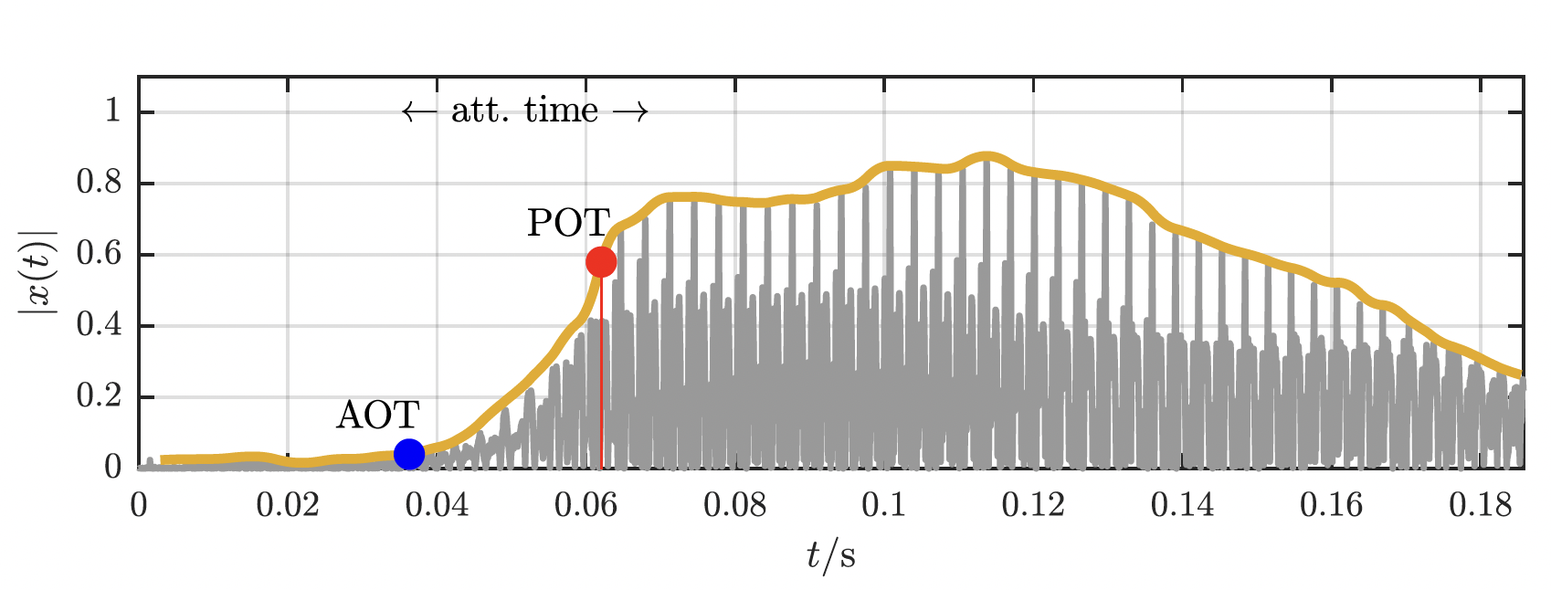
What is an Onset
Note Onset Time (NOT)
moment in time the instrument is triggered
Acoustic Onset Time
Moment in time of first measurable
instrument output
Perceptual Onset Time
Moment in time the event is perceived by
a listener
Lerch, Alexander. An introduction to audio content analysis: Music Information Retrieval tasks and applications. John Wiley & Sons, 2022.

Slide 4
What is an Onset
Aim
Determine the starting points of all musical events in an audio signal
Types Of Onsets
Pitched (hummed voice, bowed strings
wind instruments)
Percussive (drums, handclaps)
Pitched-percussive (piano, guitar)
Challenges
Characteristics for each vary a lot musically and
perceptually
Multiple onsets will occur at the same time
Effects can obfuscate onsets (vibrato, tremolo, reverb)
Lerch, Alexander. An introduction to audio content analysis: Music Information Retrieval tasks and applications. John Wiley & Sons, 2022.

Slide 5
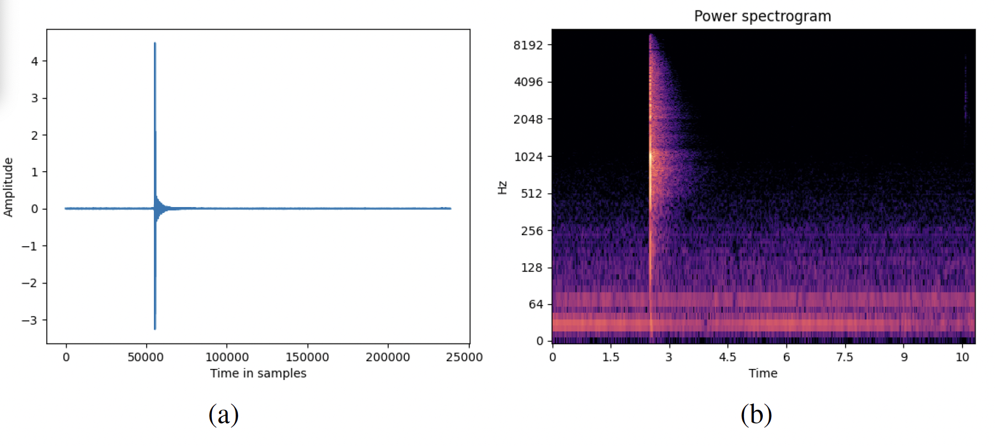
What is an Onset
Activity
Plot and visualize time domain splices of various instrument onsets
Visualize the spectrogram for each splice
All audio files are in files>audio>activities>onset
Template code here
https://app.tilde.audio/~/qkfNAvE5ec3ft0wR7MkDq
Lerch, Alexander. An introduction to audio content analysis: Music Information Retrieval tasks and applications. John Wiley & Sons, 2022.

Slide 6
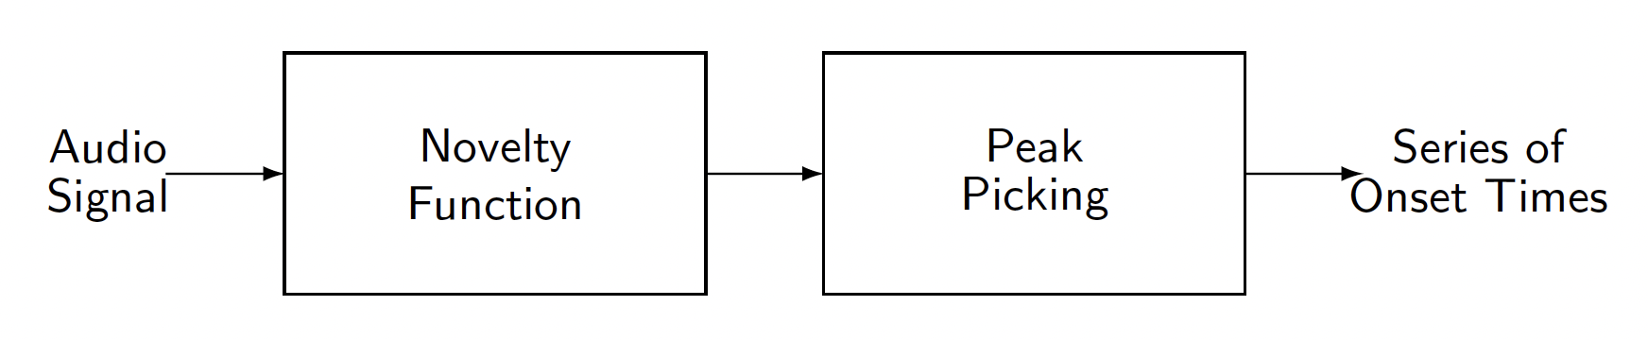
Onset Detection Framework
First, the signal is converted into a suitable feature representation that better reflects the properties of interest.
Then, a type of derivative operator is applied to the feature sequence and a novelty function is derived.
Finally, a peak-picking algorithm is employed to locate the onset candidates.
https://www.audiolabs-erlangen.de/resources/MIR/FMP/C6/C6S1_OnsetDetection.html

Slide 7
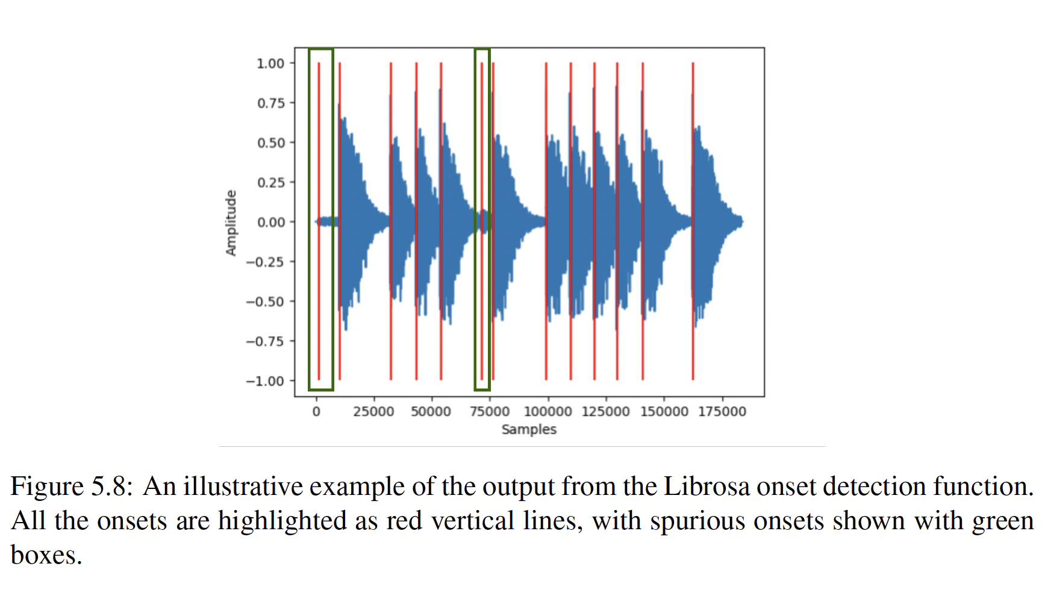
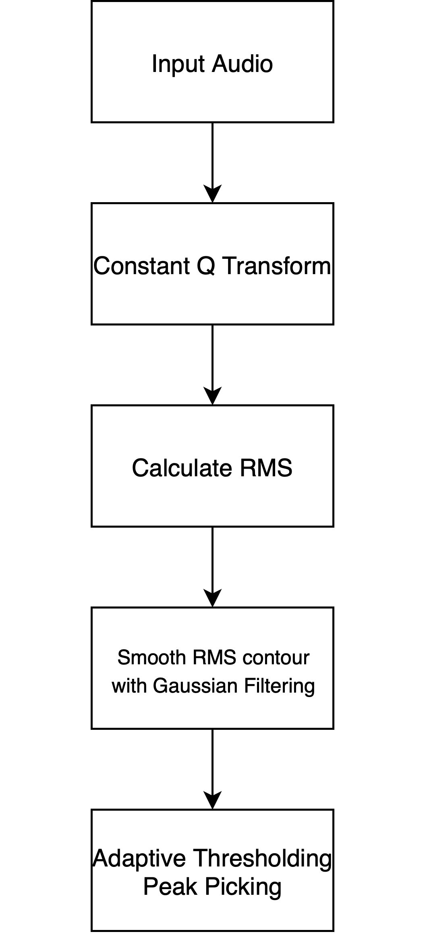
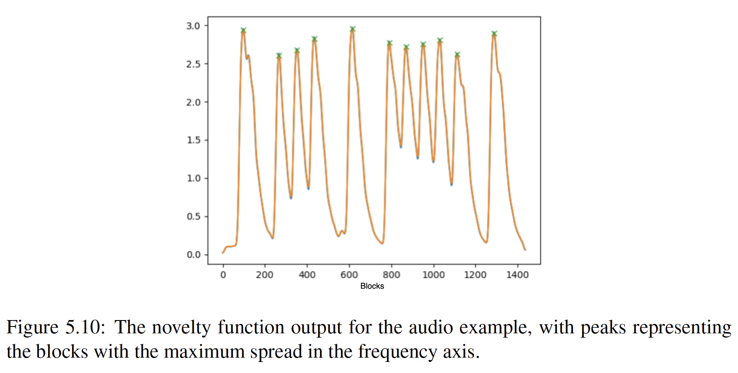
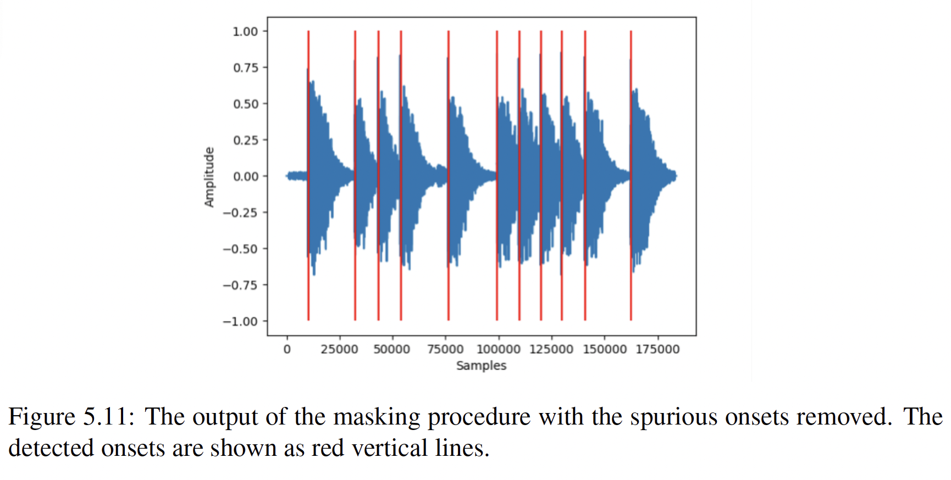
Onset Detection Framework
Alben, N. (2023). RHYTHM RECREATION STUDY TO INFORM INTELLIGENT RHYTHM PEDAGOGY SYSTEMS (Master’s Thesis, Georgia Institute of Technology)

Slide 8
Onset Detection Framework
Discussion Points
“I want to know more about the relationship between detection functions and thresholding. Are there mathematically optimized threshold functions? Or is this another area for trade-offs and trial and error? It seems like this would play a larger role in the effectiveness of the algorithms discussed in the paper, but it was only briefly mentioned.” - Henry Windish

Slide 9
Onset Detection Framework
Discussion Points
“The results clearly show that the best algorithm depends on the instrument being analyzed. If you were tasked with building a single, robust onset detector for any kind of music, how should we design a "hybrid" system that intelligently combines the outputs of different methods?”- Govinda Madhava Bs

Slide 10
Onset Detection Framework
Discussion Points
“One question I’m still thinking about is how to make evaluations line up more with what we actually hear.” - Qiaoyu Yang

Slide 11
Evaluation Of Onset Detection
Goal of evaluation
Compare a series of ground truth time stamps with a series of predicted time stamps
Metrics used
Usually measure a True Positive within a tolerance range in milliseconds (perceptual relevance)
Precision, Recall and F-Measure also calculated (just like a classification problem)
Other metrics can be calculated
mean (absolute) deviation (from expected time stamp)
standard deviation
max deviation

Slide 12
Evaluation Of Onset Detection
Goal of evaluation
Compare a series of ground truth time stamps with a series of predicted time stamps
Metrics used
Usually measure a True Positive within a tolerance range in milliseconds (perceptual relevance)
Precision, Recall and F-Measure also calculated (just like a classification problem)
https://www.geeksforgeeks.org/machine-learning/f1-score-in-machine-learning/
Other metrics can be calculated
mean (absolute) deviation (from expected time stamp)
standard deviation
max deviation

Slide 13
Evaluation Of Onset Detection
Ground Truth Dataset
“the most commonly used method for onset annotation is marking the earliest time point at which a sound is audible by humans. This instant cannot be defined in pure terms (e.g., minimum increase of volume or sound pressure), but is a rather complex mixture of various factors.”
“The annotation process is very time-consuming because it is performed in multiple passes. First, onsets are annotated manually during slowed down playback. In the second pass, visualization support is used to refine the onset positions. Spectrograms obtained with different STFT lengths are used in combination to capture the precise timing of an onset without missing any onset due to insufficient frequency resolution.”
Böck, S., Krebs, F., & Schedl, M. (2012, October). Evaluating the Online Capabilities of Onset Detection Methods. In ISMIR(pp. 49-54).

Slide 14
Evaluation Of Onset Detection
Evaluation
“An onset is considered to be correctly detected if there is a ground truth annotation within (+- 25 ms ) around the predicted position.”
“An important factor in the evaluation is how false positives and negatives are counted. Let us assume that two onsets are detected inside the detection window around a single annotation. If tolerant counting is used, no false positives are counted. Every single detection is considered a true positive, since there is an annotated onset within the detection window.”
Böck, S., Krebs, F., & Schedl, M. (2012, October). Evaluating the Online Capabilities of Onset Detection Methods. In ISMIR(pp. 49-54).

Slide 15
Onset Detection Framework
Activity
Form groups of 2 and discuss, how you would build a transient detection system
Imagine you are building a system that changes visuals on instrument transients
Steps:
Pick a very specific class of instruments you want to work with
Write up Pseudocode
Feel free to use: https://app.tilde.audio/

Slide 16
Evaluation Of Onset Detection
Evaluating timing is very tricky in music
Humans do not play at a constant rate
Instantaneous tempo doesn’t really exist
difference between notation and perception
“groove”, “on top of the beat”, “behind the beat”, etc.
systematic deviations (e.g. swing)
expressive timing

Slide 17
What is Rhythm
Rhythm refers to medium and large-scale temporal phenomena
With the following components
Timing: when events occur
Tempo: how often events occur
Meter: what structure best describes the event occurrences
Grouping: phrase structure
The metrical structure of a musical piece is generally organized in a hierarchical way, with beats defining the most salient level, and downbeats the first beat inside a bar.
Every bar consists of a certain number of beats, defined by the meter or time signature
Very Western Music Transcription Biased
Cooper and Meyer (1960); Lerdahl and
Jackendoff (1983); Honing (2001)

Slide 18
What is Rhythm
Rhythm refers to medium and large-scale temporal phenomena
With the following components
Timing: when events occur
Tempo: how often events occur
Meter: what structure best describes the event occurrences
Grouping: phrase structure
The metrical structure of a musical piece is generally organized in a hierarchical way, with beats defining the most salient level, and downbeats the first beat inside a bar.
Every bar consists of a certain number of beats, defined by the meter or time signature
Very Western Music Transcription Biased
Cooper and Meyer (1960); Lerdahl and
Jackendoff (1983); Honing (2001)

Slide 19
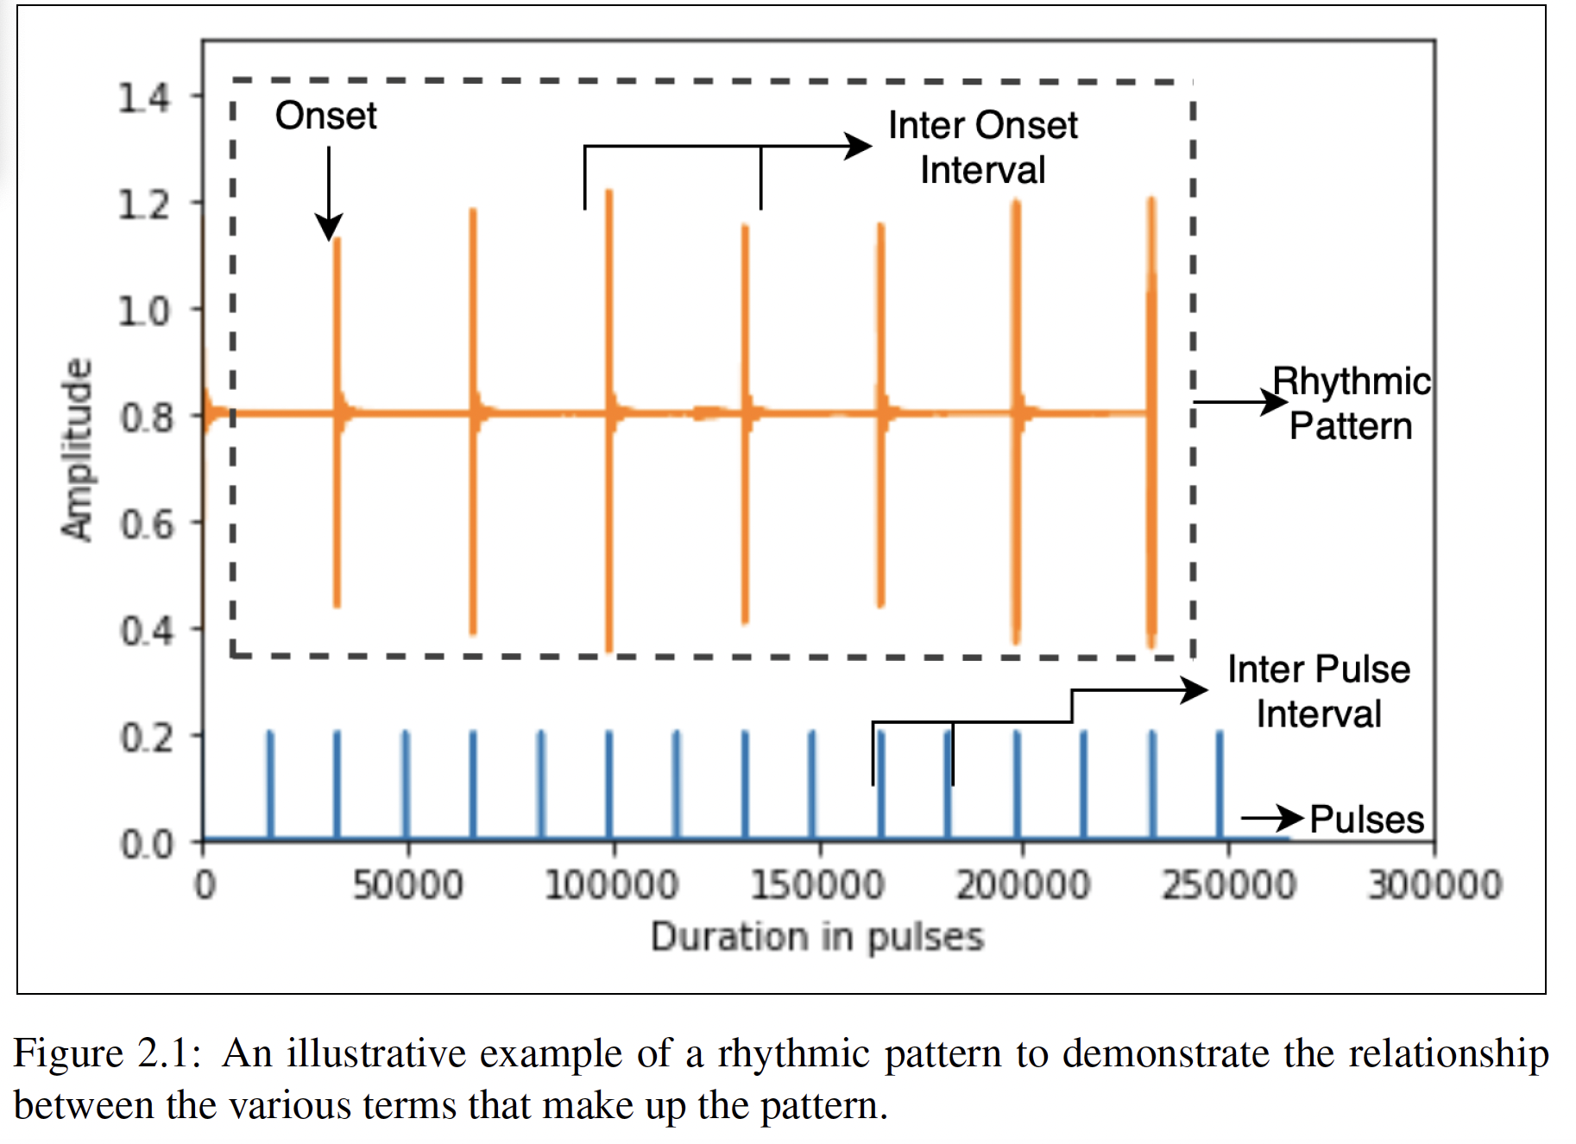
What is Rhythm
I tried to define it as patterns of onsets
Even though, Pulse can be considered regularly spaced
events
It is often only explicit through score
Perceptually, multiple onsets can exist simultaneously
Alben, N. (2023). RHYTHM RECREATION STUDY TO INFORM INTELLIGENT RHYTHM PEDAGOGY SYSTEMS (Master’s Thesis, Georgia Institute of Technology)

Slide 20
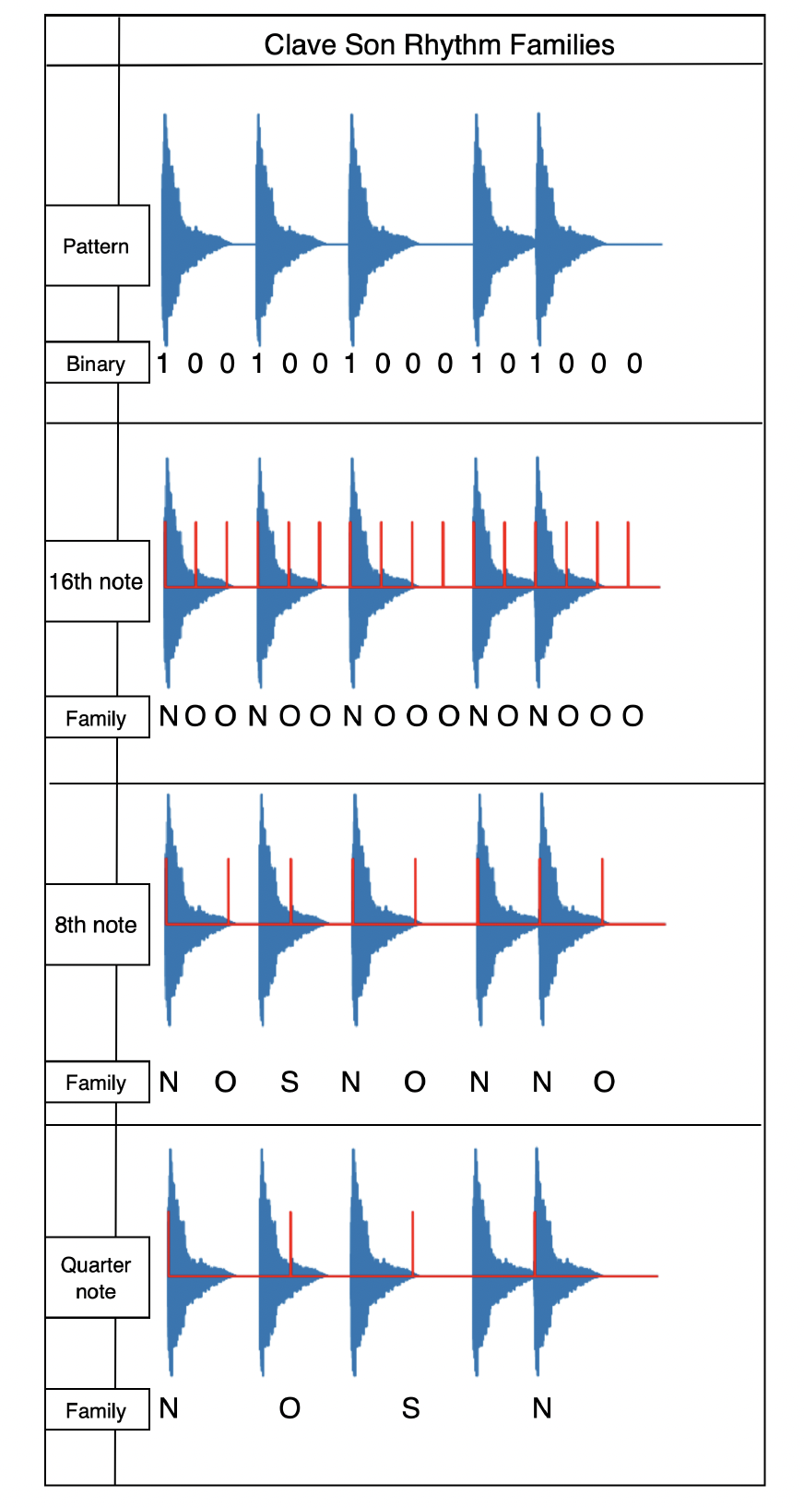
What is Rhythm
I tried to define it as patterns of onsets
How you perceive the pulse determines how you feel the rhythm
MAKES TRANSCRIPTION, EVALUATION, EVERYTHING SO HARD!!!
Alben, N. (2023). RHYTHM RECREATION STUDY TO INFORM INTELLIGENT RHYTHM PEDAGOGY SYSTEMS (Master’s Thesis, Georgia Institute of Technology)

Slide 21
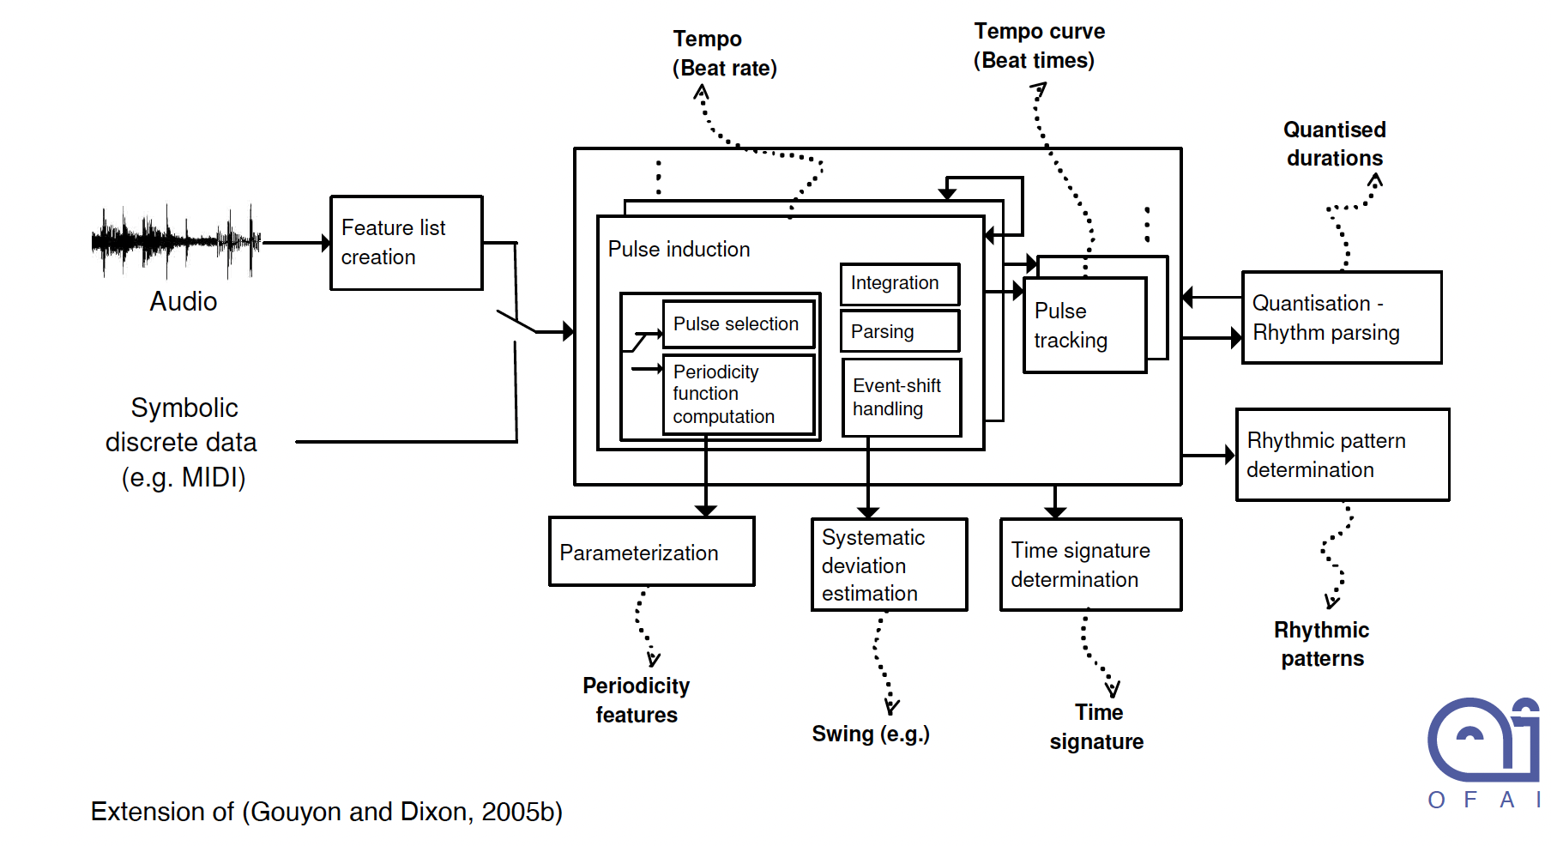
What is Rhythm

Slide 22
Applications Of Onset Detection/ Rhythm Representations
Automatic Music Transcription
Interactive Beat Tracking
Audio Alignment
Classification with Rhythm Patterns
Query-by-Rhythm
Performance Assessment

Slide 23
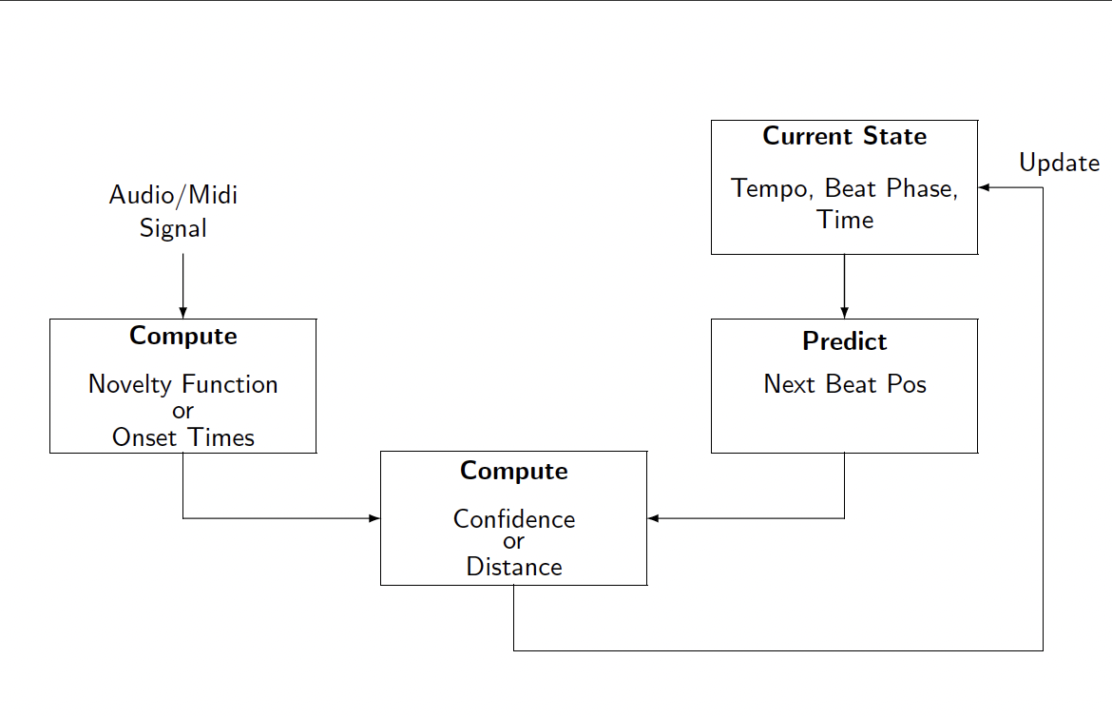
Tempo Detection
Lerch, Alexander. An introduction to audio content analysis: Music Information Retrieval tasks and applications. John Wiley & Sons, 2022.

Slide 24
Tempo Detection
Lerch, Alexander. An introduction to audio content analysis: Music Information Retrieval tasks and applications. John Wiley & Sons, 2022.

Slide 25
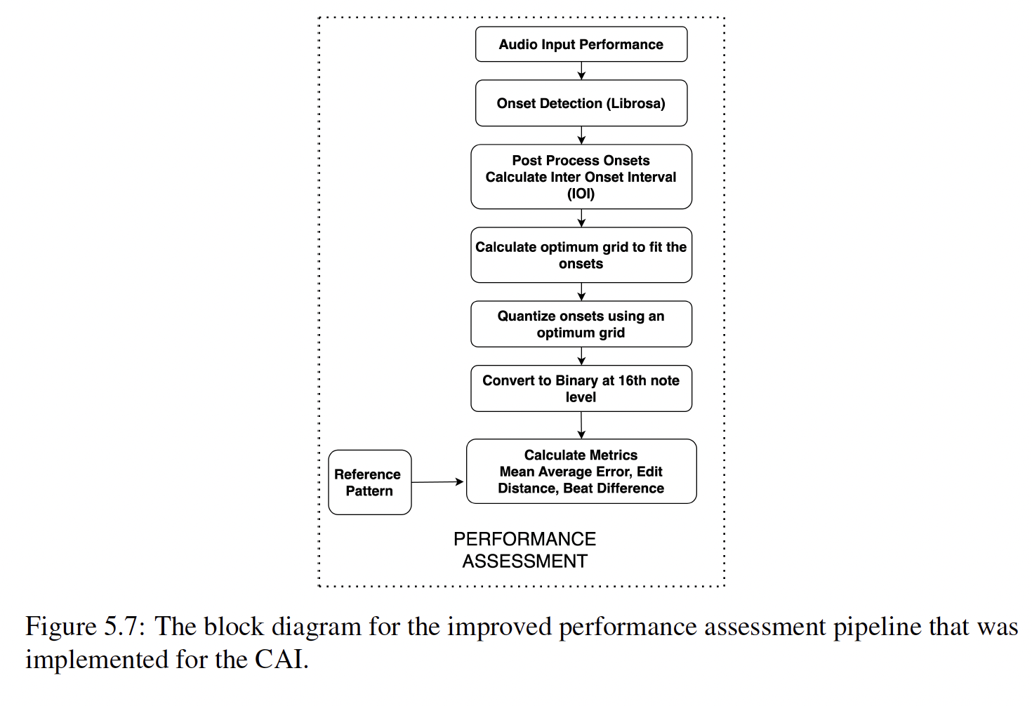
Tempo Detection
Alben, N. (2023). RHYTHM RECREATION STUDY TO INFORM INTELLIGENT RHYTHM PEDAGOGY SYSTEMS (Master’s Thesis, Georgia Institute of Technology)

