Slide 1
EXPOSYS DATA LABS
Web Development (Internship)
(Video Chatting App)
Ishaan Misra
Indian Institute of Technology(IIT-BHU),
Varanasi

Slide 2
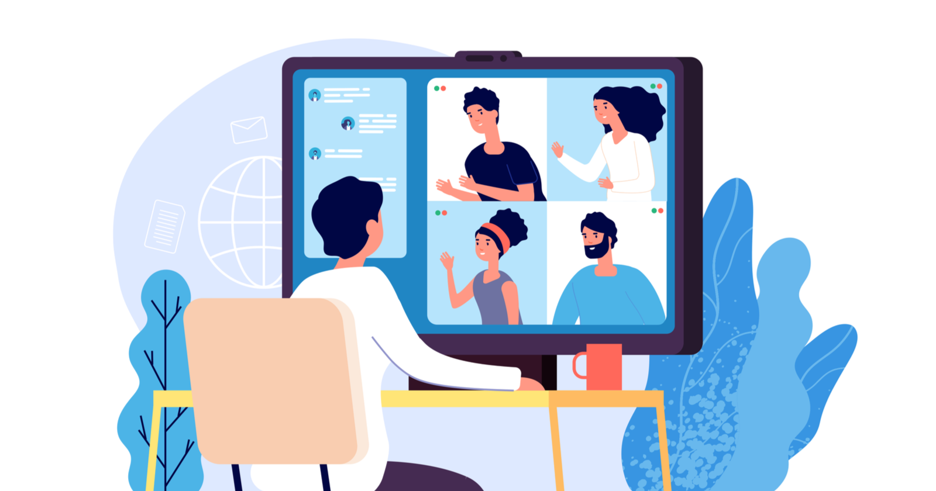
ABSTRACT
This presentation is about video chatting webapp where you can connect with your friends and have one to one video chat with them. It also tells us about technical aspects of the app.
So let’s dive right in!!
Ishaan Misra
Indian Institute of Technology(IIT-BHU) Varanasi

Slide 3
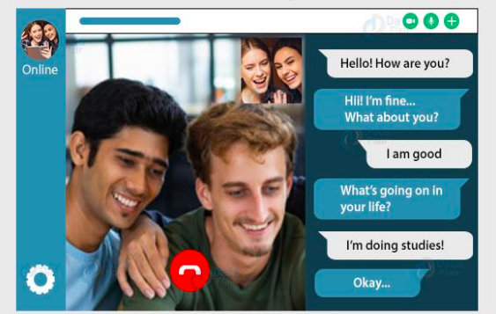
Table Of Contents
Introduction
Existing Method
Architecture of used method
Methodology
Implementation
Conclusion
Ishaan Misra
Indian Institute of Technology(IIT-BHU) Varanasi

Slide 4

Introduction
Video calls have become an integral part of today's communication. Only in the first four months of the COVID-19 pandemic was a 500% increase in search impressions for web and video conferencing software. And video chat apps continue growing in popularity with incredible speed both for businesses and personal use.
The worldwide web conferencing market is expected to grow by around $19 billion by 2025. These stats are telling. Video conferencing app development is on the rise.
Ishaan Misra
Indian Institute of Technology(IIT-BHU) Varanasi

Slide 5
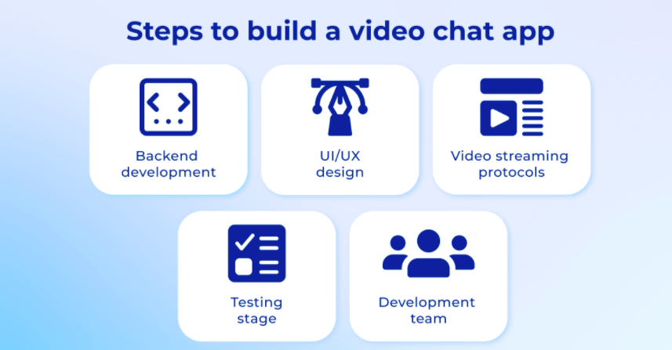
Existing Method
Most of the video chatting apps that are in use in the present use use webRTC technology to help users connect with each other via video and audio methods. The existing method uses a few components like
UI/UX design
Backend Development
Video streaming protocol integration
Ishaan Misra
Indian Institute of Technology(IIT-BHU) Varanasi

Slide 6
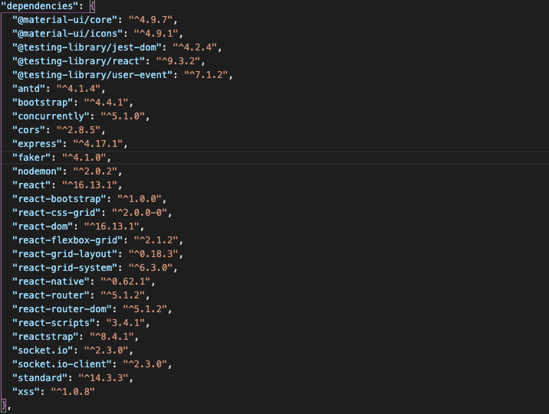
Architecture of method used
I have Developed the app with ReactJS, Node.js and SocketIO.
Some other libraries that I have used are:
Ant Design
Material UI
Bootstrap
Other libraries can be seen here in the picture attached ===>
Ishaan Misra
Indian Institute of Technology(IIT-BHU) Varanasi

Slide 7
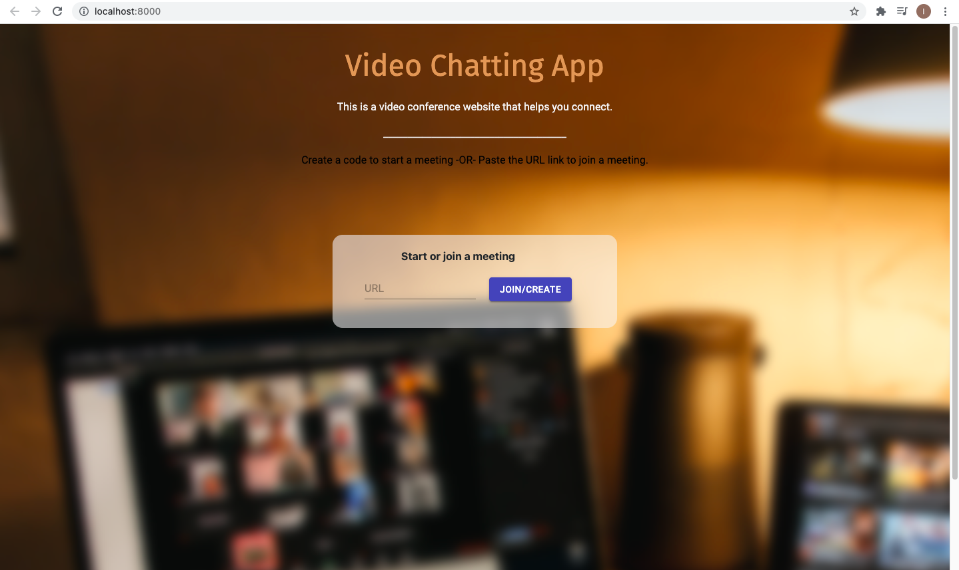
Methodology
Step 1:
CREATE A MEET CODE
OR
PASTE THE URL TO JOIN THE MEETING.
CLICK THE “JOIN/CREATE” BUTTON TO START/JOIN THE MEET.
It automatically generates a meeting URL if you do not enter the starting meeting code.
Ishaan Misra
Indian Institute of Technology(IIT-BHU) Varanasi

Slide 8
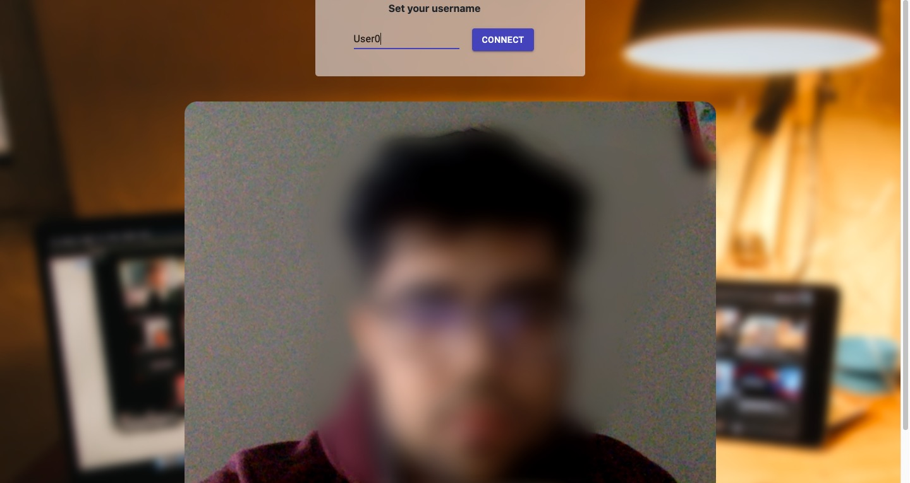
Methodology
Step 2:
SET YOUR USERNAME AND THEN CLICK THE “CONNECT” BUTTON TO JOIN THE MEET.
It automatically generates an alias username if you do not want to use your username.
Ishaan Misra
Indian Institute of Technology(IIT-BHU) Varanasi

Slide 9
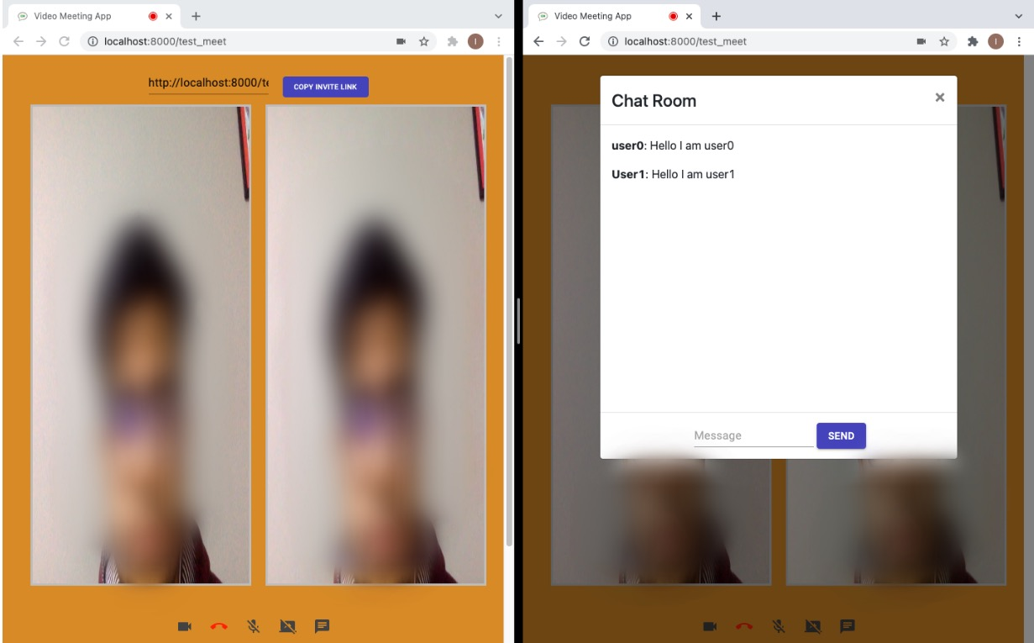
Methodology
WINDOW 1
WINDOW 2
THIS LINK CAN BE SHARED AND PASTED IN ANOTHER WINDOW TO JOIN THE SAME MEET
CHAT BOX
SCREEN SHARING BUTTON
TURN ON/OFF AUDIO AND VIDEO
Ishaan Misra
(IIT-BHU) Varanasi
END CALL

Slide 10
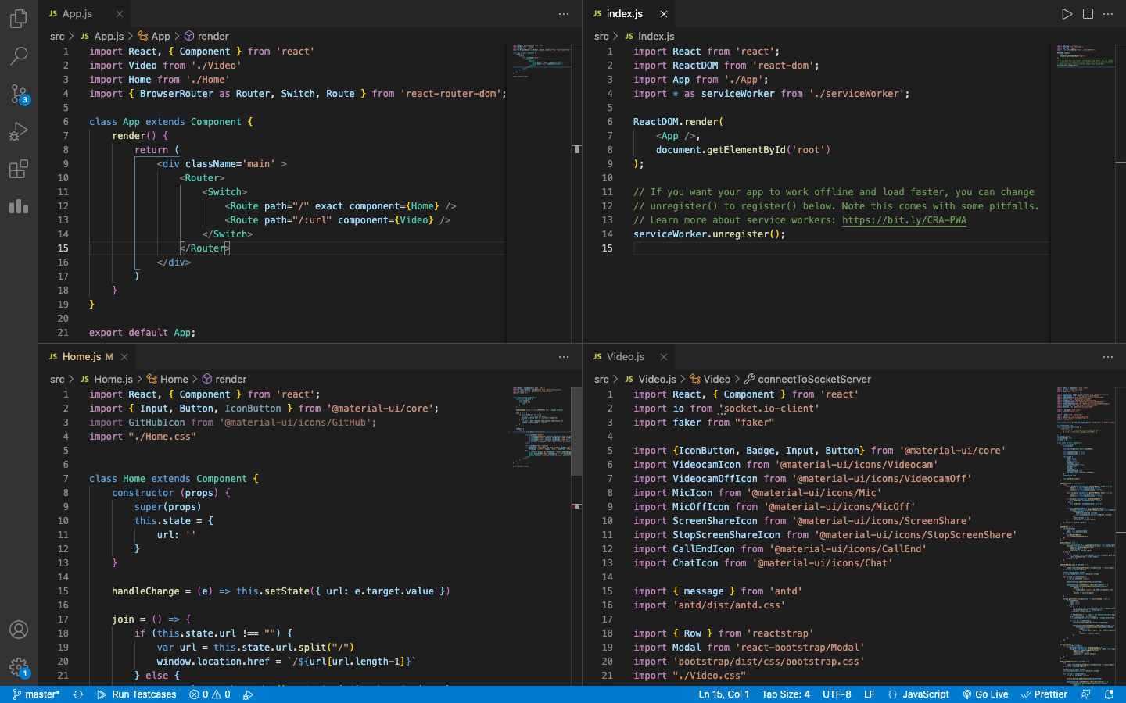
IMPLEMENTATION
Index.js
App.js
Home.js
Video.js
Ishaan Misra
(IIT-BHU) Varanasi

Slide 11
CONCLUSION
In the end, this is a Google Meet / Zoom clone in a few lines of code.
### Features
- No account needed
- Unlimited users
- Messaging chat and video streaming in real-time
- Screen sharing to present documents, slides, and more
- Everything is peer-to-peer thanks to webrtc
To run this on your local server just use the following code on your terminal/cmd inside this directory
-“npm run dev” or
-“yarn install” and then “yarn dev”
THANK YOU!!
Ishaan Misra
Indian Institute of Technology(IIT-BHU) Varanasi

