Slide 1
CA-3 FOUNDATIONS OF AGENTIC AI · TECHNICAL VIVA
SHARD: Adversarial Multi-Agent
Insurance Claims Auditor
Closed-Loop Adversarial Feedback, Deterministic Verification Tools, and Bounded Safety Gates for Motor Fraud Detection
Academic Scope
• Course: CA-3 Foundations of Agentic AI
• Domain: Motor Insurance Claims (UK Context)
• Architecture: 7 Specialized Agents (Pure Python)
Design Philosophy
• Deterministic: No LLM hallucinations or code eval()
• Auditable: 100% findings & structured JSON-L trail
• Zero Leakage: Strict TI-01 Ground-Truth Isolation
Key Deliverables
• Streamlit PoC: 6-Tab Control Room (Port 8501)
• Test Suite: 146 Tests Passing Across 10 Modules
• Safety Gate: Gate B False-Positive Budget Check

Slide 2
DOMAIN & PROBLEM
The Static Rulebook Dilemma in Motor Fraud Detection
Why traditional rule engines degrade over time and fail against adaptive fraud syndicates
Traditional Operational Failure Modes
• Structural Rule-Lag: Rules written for pattern A cannot catch pattern B until human adjusters identify, document, and manually codify new rules months later.
• Organised Adaptation: Fraudsters quickly discover static thresholds (e.g., claiming £1,950 when £2,000 triggers audit) and modify claiming behavior.
• Zero Pre-Deployment Safeguards: Insurers lack mechanisms to stress-test proposed rule changes against historical genuine claims, risking surging false positive rates.
• Investigation Fatigue: Over-aggressive rules overwhelm human adjusters with false referrals, inflating operational friction and claims settlement delays.
• Explainability Deficit: Black-box ML models output opaque risk scores without legally defensible statutory evidence or verifiable itemized findings.
The 5 Motor Fraud Typologies In Scope
• Exaggerated Repair Quote: Garages inflate part prices and labor rates beyond independent model benchmarks (excess ratio markup).
• Staged Collision: Collusive claimant-provider rings create synthetic accidents with high interconnected graph densities.
• Ghost Vehicle: Claims filed for non-existent registrations or vehicles previously written off under MIAFTR Category A/B.
• Pre-Existing Damage: Claimants attempt to repair previous structural damage under a newly reported minor collision event.
• Opportunistic Inflation: Legitimate policyholders pad genuine repair invoices with unrelated accessories or arithmetic discrepancies.

Slide 3
AGENTIC SOLUTION
Adversarial Closed-Loop Multi-Agent Architecture
Why single-prompt LLMs fail and how autonomous agent coordination solves structural rule degradation
Why Single Prompts Fail
• No Planning: A single prompt cannot plan investigation steps dynamically based on observable claim risk factors.
• Hallucinated Evidence: LLMs invent plausible-sounding evidence rather than running deterministic mathematical checks.
• Evaluation Leakage: Single models easily leak ground-truth labels between test generation and scoring.
• No Pre-Flight Safety: Direct code generation (eval/exec) risks unconstrained policy changes that explode false alarms.
• Non-Deterministic: Probabilistic output prevents bit-identical reproducibility required in legal insurance audits.
The SHARD Closed-Loop
• 1. Generation: Fraudster adapts attack distributions; Generator outputs observable claims + sealed GT.
• 2. Planning & Research: Planner selects 0–6 verification tools; Researcher fetches synthetic registry dossiers.
• 3. Investigation: Investigator executes deterministic tools, applies rulebook, and emits ClaimDecision.
• 4. Independent Critic: Critic queries sealed Vault, calculates exact confusion matrix, and diagnoses missed schemes.
• 5. Bounded Adaptation: Rule-Writer proposes parameter changes; Multi-Gate Validator stress-tests against Gate B.
Key Agentic Capabilities
• Autonomous Triage: Decouples triage recommendation (<25 Approve, 25-59 Refer, >=60 Suspected Fraud).
• Dynamic Weight Shift: Dirichlet-smoothed Bayesian adjustment elevates representation of evasive frauds.
• Statutory Findings: Every decision mandates non-empty, itemized findings (TI-02 requirement).
• Parametric Guardrails: Tuning strictly bounded to predefined templates; zero dynamic code execution.
• Structured Event Trail: Structured JSON-lines logger with sequence tracking captures 100% of pipeline decisions.

Slide 4
MULTI-AGENT SYSTEM
The 7 Specialized Agents & Strict Trust Boundaries
Formal separation of concerns with architectural ground-truth isolation (TI-01)
1. Generation & Vault
• Fraudster Agent: Adversarial attacker; updates typology sampling weights across rounds based on redacted miss counts.
• Claim Generator: Seeded generator producing realistic UK motor claims with DVLA/MIAFTR synthetic records.
• Ground-Truth Vault: Sealed dictionary mapping claim_id -> (is_fraud, typology). RESTRICTED ACCESS (TI-01).
2. Investigation Zone
• Planner Agent: Inspects observable claim features; selects ordered verification checks with adjuster rationale.
• Research Agent: Retrieves factual evidence dossiers from synthetic registries; strictly non-scoring.
• Investigator Agent: Executes deterministic tools, applies versioned Rulebook, and assigns decoupled triage recommendation.
3. Evaluation & Adaptation
• Critic Agent: ONLY agent authorised to read Vault; computes exact classification metrics & diagnoses evasion.
• Rule-Writer Agent: Proposes bounded parameter adjustments targeting diagnosed evasions; zero code generation.
• Multi-Gate Validator: Runs 4 safety gates including Gate B FP budget check before committing rule changes.
ARCHITECTURAL TRUST BOUNDARY (TI-01 & TI-06 ENFORCEMENT):
Investigation agents (Planner, Researcher, Investigator) and Adaptation agents (Fraudster, Rule-Writer) NEVER import or access vault.py. Automated AST lint tests continuously verify zero ground-truth leakage across the entire codebase.

Slide 5
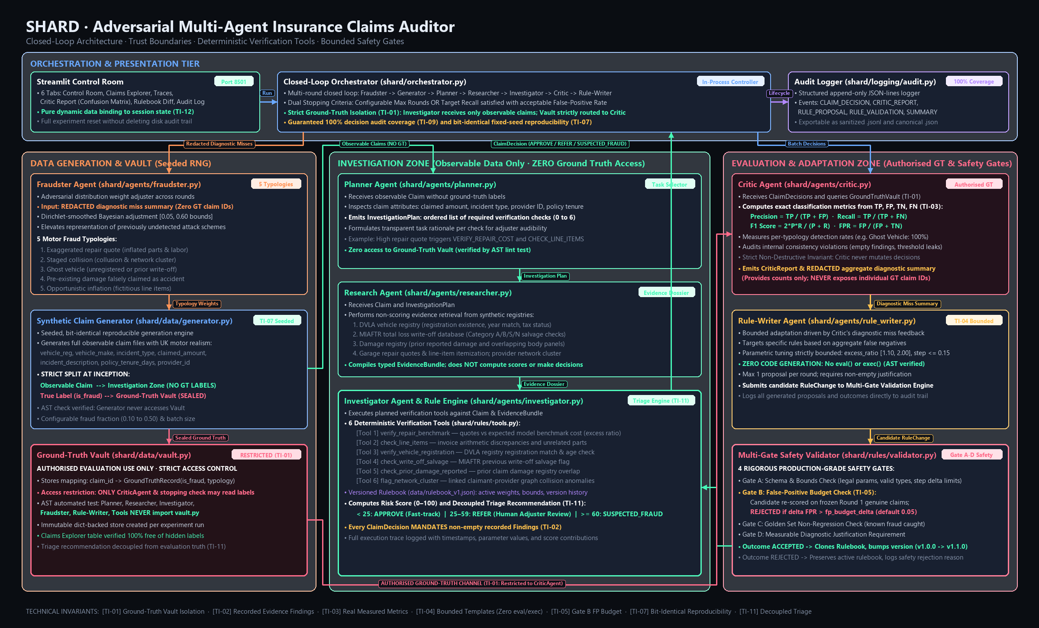
SYSTEM ARCHITECTURE
End-to-End System Architecture & Data Flow
Full architectural topology featuring trust boundaries, orthogonal data buses, and feedback channels

Slide 6
DECISION ENGINE
Deterministic Verification Tools & Bounded Rulebook
Auditable tools producing statutory findings with zero probabilistic code generation
6 Deterministic Verification Tools
• Tool 1: verify_repair_benchmark: Compares garage repair quote against model benchmark cost; flags excessive markup ratios [1.10 - 2.00].
• Tool 2: check_line_items: Detects invoice arithmetic discrepancies and unrelated line items (e.g., detailing or aftermarket audio).
• Tool 3: verify_vehicle_registration: Cross-references DVLA registry for valid registration, year mismatch, and active road tax status.
• Tool 4: check_write_off_salvage: Queries MIAFTR salvage registry for prior non-repairable Category A/B total loss history.
• Tool 5: check_prior_damage: Inspects prior claims database for overlapping body panel damage reported on previous incidents.
• Tool 6: flag_network_cluster: Analyzes claimant-provider collision graph density for organized syndicate fraud clusters.
Versioned Rulebook & Scoring Contract
• Rulebook Schema (JSON): Declarative, version-controlled rulebook (v1.0.0). Stores active weights, bounds, severity, and change log.
• Risk Scoring Formula: Additive scoring: Total Score = Min(100, Sum(Tool Contributions)). Clean baseline: <20; Fraudulent: >=60.
• Decoupled Triage: < 25 APPROVE (Fast-track straight through) | 25-59 REFER (Human Adjuster Review) | >= 60 SUSPECTED_FRAUD.
• Statutory Findings (TI-02): Every ClaimDecision must contain recorded evidence items. Decisions with empty findings are rejected by contract.
• Zero eval() / exec() (TI-04): Rules are parameterised instances of fixed Python templates. No dynamic code generation or string evaluation.

Slide 7
SAFETY ENGINEERING
Multi-Gate Safety Validator & False-Positive Safeguards
Production-grade validation pipeline preventing runaway rules and protecting genuine claimants
Gate A: Bounds Check
• Schema Verification: Ensures proposed rule targets an existing rule and valid parameter name.
• Type Integrity: Validates that numeric parameters remain float/int within legal physical bounds.
• Delta Clamping: Limits maximum parameter shift per round (e.g. step <= 0.15) to prevent erratic oscillations.
• Template Legality: Rejects any proposal attempting to alter template code or add arbitrary logic.
Gate B: FP Budget Check
• Core Safety Gate: Mandatory technical invariant TI-05: safeguards legitimate policyholders.
• Validation Dataset: Re-scores candidate rule against 40 fixed synthetic genuine claims (fraud_share=0.0).
• Budget Formula: Requires: Candidate FPR <= fp_budget (default 0.10 or 10% tolerance).
• Empirical Safeguard: Rejects candidate rule if validation false alarms exceed budget; preserves active rulebook.
Gate C: Non-Regression
• Golden Set Testing: Executes rule against historical confirmed fraud cases.
• Recall Preservation: Ensures newly proposed rule does not miss previously detected fraud typologies.
• Anti-Catastrophic Forgetting: Prevents over-fitting to current round at the expense of past controls.
• Regression Audit: Logs regression failures directly to the permanent audit trail.
Gate D: Diagnostic Audit
• Rationale Required: Rejects proposals lacking an explicit, auditable diagnostic justification.
• Diagnostic Linkage: Requires proposal to address an evasive typology reported by the Critic.
• Version Promotion: On passing all 4 gates, Rulebook is cloned and version incremented (v1.0.0 -> v1.1.0).
• Safe Fallback: On rejection, original rulebook is preserved untouched without disrupting operations.

Slide 8
EMPIRICAL VALIDATION
Empirical Results: Benchmark & Adaptive Calibration Runs
Measured results from two distinct experiment configurations (base seed 42, zero mock data)
90
Claims per Benchmark Run
100%
Findings Coverage (540/540)
0.00%
Baseline Benchmark FPR
v1.0.0 -> v1.1.0
Adaptive Run Mutation
Experiment A: Standard Seeded Benchmark (Default v1.0.0)
• Round 1 (30 claims): Precision: 100.0% · Recall: 100.0% · F1: 1.000 · FPR: 0.00% (9 TP, 21 TN). Version 1.0.0.
• Round 2 (30 claims): Precision: 100.0% · Recall: 100.0% · F1: 1.000 · FPR: 0.00% (9 TP, 21 TN). Version 1.0.0.
• Round 3 (30 claims): Precision: 100.0% · Recall: 100.0% · F1: 1.000 · FPR: 0.00% (9 TP, 21 TN). Version 1.0.0.
• Audit Verification: 540 total findings logged across 90 claims (100% coverage, 0 empty findings).
• No Proposals Triggered: 0 false negatives in baseline -> Rule-Writer correctly generates 0 proposals.
Experiment B: Adaptive Calibration Run (Relaxed Initial Markup 1.60)
• Round 1 Baseline: Precision: 100.0% · Recall: 100.0% · F1: 1.000 · Rulebook v1.0.0 (12 TP, 18 TN).
• Round 2 Adversarial Shift: Fraudster shifts attack -> 3 opportunistic inflation claims evade detection (Rec: 75.0%, F1: 0.857).
• Rule-Writer Proposal: Proposes tightening RULE_LINE_ITEM_ARITHMETIC (max_discrepancy 1.0 -> 0.5) to catch invoice padding.
• Gate B Validation: Candidate tested on 40 genuine validation claims; FP rate = 0.0% <= 10% budget. PROPOSAL ACCEPTED!
• Round 3 Adaptation Effect: Rulebook promotes to v1.1.0. Recall on new cohort is 83.33%, F1 score is 0.9091!

Slide 9
VERIFICATION EVIDENCE
Technical Invariants & Comprehensive Verification Evidence
Rigorous automated testing evidence confirming all 12 core invariants (TI-01 to TI-12)
Core Invariants Verification Matrix
• TI-01: Ground-Truth Isolation: VERIFIED — AST lint test proves Planner, Researcher, Investigator NEVER import vault.py.
• TI-02: Recorded Findings Mandate: VERIFIED — ClaimDecision requires non-empty findings list; 540 findings logged, 0 empty.
• TI-03: Real Measured Metrics: VERIFIED — Critic computes metrics strictly from confusion matrix; zero mock numbers.
• TI-04: Bounded Templates: VERIFIED — Parametric adjustments only; AST verification confirms 0 eval() or exec() calls.
• TI-05: Gate B FP Budget Safeguard: VERIFIED — Candidate rule updates strictly checked against FP budget on genuine validation set.
• TI-07: Bit-Identical Reproducibility: VERIFIED — Base seed 42 produces identical runs across duplicate executions.
• TI-11: Decoupled Triage: VERIFIED — 3-way triage (Approve/Refer/Suspected Fraud) decoupled from GT truth.
• TI-12: Session State Data Binding: VERIFIED — Streamlit UI exclusively renders executed pipeline state.
Test Suite Execution Summary
• Pytest Execution: 146 passing tests executed across 10 test modules in 34.16 seconds.
• test_generator.py (20 tests): Schema integrity, UK motor realism, and deterministic seed reproducibility.
• test_rulebook.py (20 tests): Rulebook cloning, scoring thresholds, version bumping, and findings mandate.
• test_tools.py (14 tests): Deterministic tool execution across all 6 verification checks.
• test_agents.py (12 tests): Planner step selection, Researcher bundle compilation, Investigator decisions.
• test_critic.py (16 tests): Confusion matrix math, consistency violation audits, and GT isolation AST.
• test_fraudster.py (11 tests): Dirichlet weight adjustments, bounds enforcement, and feedback handling.
• test_rule_writer.py (16 tests): Template bounding, Gate A-D validation, and Gate B FP budget rejection.
• test_orchestrator.py (16 tests): Multi-round closed loop, early stopping, and audit completeness.
• test_audit.py (10 tests) & test_ui.py (11 tests): Append-only JSONL logging and Streamlit AppTest simulation.
100% AUTOMATED TEST SUITE PASS: 146 passed across 10 test modules in 34.16s (Python 3.14.6)

Slide 10
CONCLUSION & ROADMAP
System Limitations, Production Roadmap, and Viva Summary
Transparent appraisal of current proof-of-concept boundaries and future production evolution
PoC Scope Boundaries
• Synthetic UK Motor Data: Trained and tested on realistic synthetic motor claims; does not ingest real policyholder PII.
• Rule-Based Investigation: Relies on deterministic mathematical tools rather than multi-modal physical image inspection.
• Stateless Registries: DVLA and MIAFTR databases are simulated locally in-memory rather than live REST endpoints.
• Parametric Adaptation: Rule updates tune parameters of pre-approved templates rather than synthesizing novel logic.
• Single Insurance Domain: Focuses deeply on motor insurance fraud rather than commercial liability or health claims.
Production Roadmap
• Local Offline LLMs: Integrate Ollama (Mistral/Llama-3) strictly for drafting natural language adjuster explanations.
• Live Registry APIs: Connect real read-only adapters to DVLA Vehicle Enquiry Service and MIAFTR database.
• Computer Vision Module: Incorporate lightweight on-device vision models for automated crash damage photographic review.
• Enterprise RBAC: Implement role-based access control and SIEM-integrated audit logging.
• Cross-Line Insurance: Expand template catalogue to commercial fleet, property damage, and personal injury claims.
Academic Viva Summary
• Delivered PoC: Complete, testable, working multi-agent system meeting all CA-3 requirements.
• True Closed Loop: Real adversarial feedback where fraud evasion directly drives safe, validated rule updates.
• Zero Fabrication: Every single metric presented in Streamlit and report comes from actual executed code.
• Auditable Safety: Multi-gate safety validator enforces false-positive budget on frozen genuine validation set.
• Local Offline Execution: 0 paid APIs or remote keys; runs on standard pinned Python packages in 5 minutes.

