Slide 1
FINANCIAL PULSE
MONITORING LIQUIDITY AND CASH FLOW THROUGH ECONOMIC INDICATORS

Slide 2





CHALLENGES IN THE INVESTMENT BANKING PROCESS
FORECASTING LIQUIDITY NEEDS AND MANAGING CASH FLOW DURING MARKET FLUCTUATIONS
DELAYS IN RESPONDING TO MARKET EVENTS THAT COULD IMPACT FINANCIAL POSITIONS
INVESTMENT DECISIONS DUE TO THE LACK OF INTEGRATED REAL-TIME DATA AND INSIGHTS
CHALLENGES IN MONITORING RELEVANT NEWS AND EVENTS THAT
MAY AFFECT LIQUIDITY
FRAGMENTED DATA SOURCES

Slide 3

PROPOSED SOLUTION
Develop an AI-driven, real-time treasury management solution that integrates liquidity forecasting, legal entity analysis based on news events, and decision-support tools for optimizing cash flow and investment strategies

Slide 4
Our Submission
Software
Frontend
Backend
Intuitive
Professional Design
Accessible
Scrapes throughout the internet
Database
AI Integrated

Slide 5
AI INTEGRATED BACKEND
Database
Scrapes through URLs of news that impacts cash flows based on keywords to integrate fragmented data sources
Uses BART model by Hugging Face API pre-trained on CNN news to interpret the data for the user and help in financial decisions
Stores scraped data in MongoDB is a readable format for further use
Web Scraper
AI Integration

Slide 6
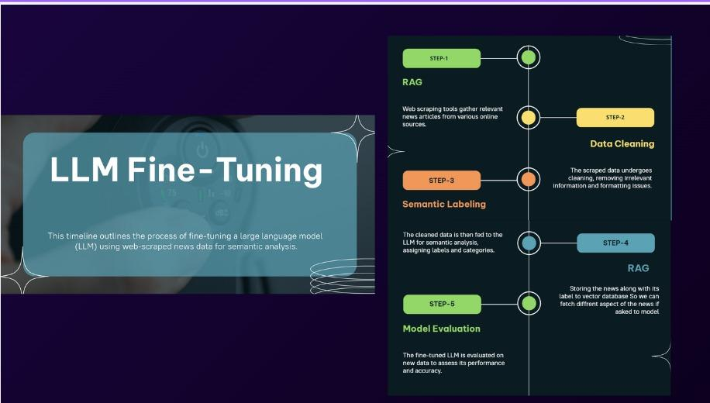

Slide 7
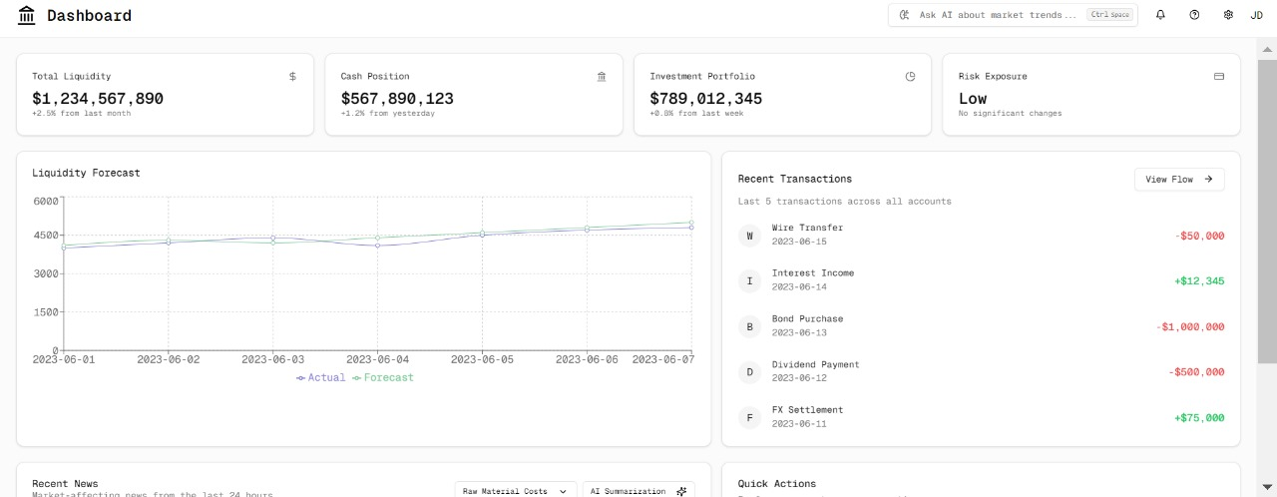
USER FRIENDLY FRONTEND
Accessibility : Sound feature to help visually challenged users

Slide 8
FUTURE WORK
Enhanced AI Algorithms: Improve the accuracy of forecasting models with advanced machine learning techniques and natural language processing for better news analysis.
Scalability and Performance Optimization: Expand the solution to handle larger datasets, multiple legal entities, and higher transaction volumes without compromising performance.
Expansion of Data Sources: Integrate additional data sources, such as social media, regulatory filings, and financial reports, for a more comprehensive view of market events.
Automated Compliance Monitoring: Develop automated tools for tracking regulatory changes and assessing their impact on liquidity and treasury operations.
Scenario Simulation and Stress Testing: Implement more sophisticated scenario analysis tools to simulate various market conditions and perform stress testing for risk management.
User-Centric Interface Enhancements: Improve the user interface based on feedback to make decision-support tools more intuitive and customizable.

Slide 9
THANK YOU
Github URL https://github.com/lorstenoplo/Deutsche-Bank-dashboard/tree/main
Demo Video
https://drive.google.com/file/d/10OWAJnRGKeUWSPYBDBuJBsWaH7j7ryC6/view?usp=sharing

