Slide 1
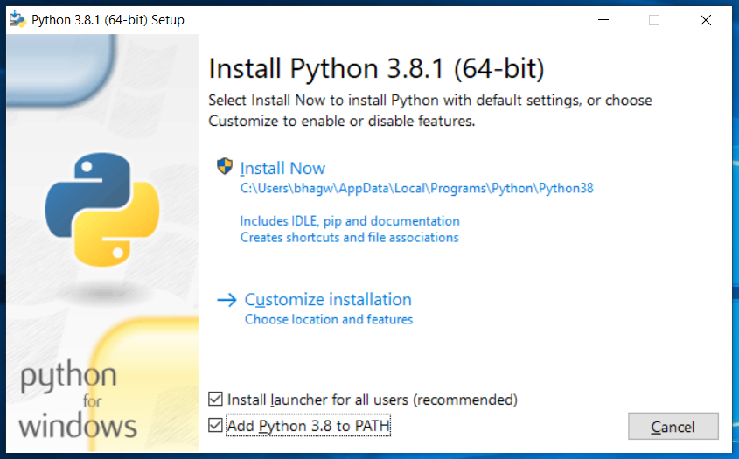
Check on add python to path
And then click on install now to install

Slide 2
Install the requirements using: pip install in command promt
Django==3.1.5
psycopg2==2.8.6

Slide 3
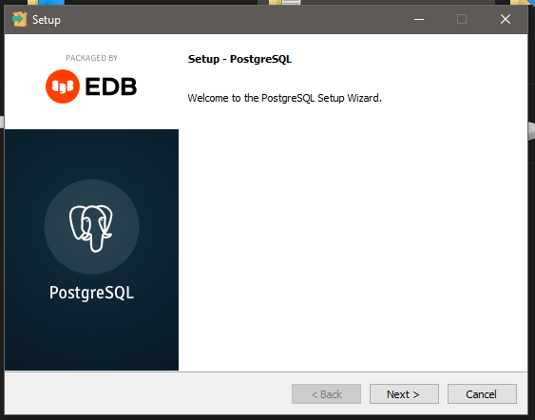
Download postgresql 12.6 for windows
Leave everything default in installer

Slide 4
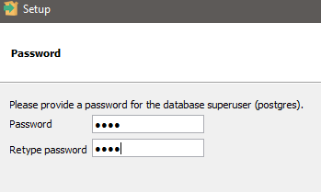
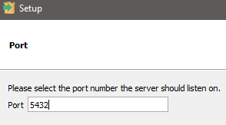
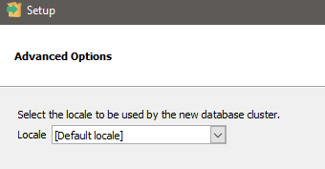
Password:1234
Leave port number default

Slide 5
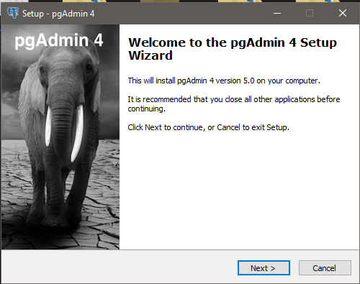
Install pgadmin4 5.0 leave everything default

Slide 6
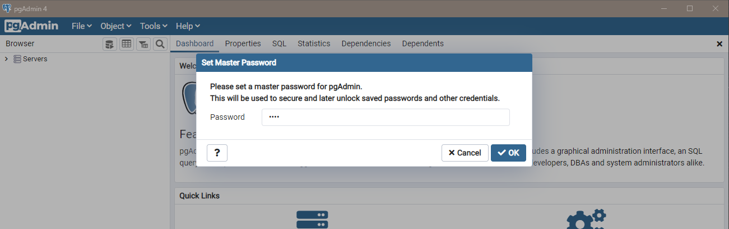
Enter:1234 in password
It may ask 2 times to enter

Slide 7
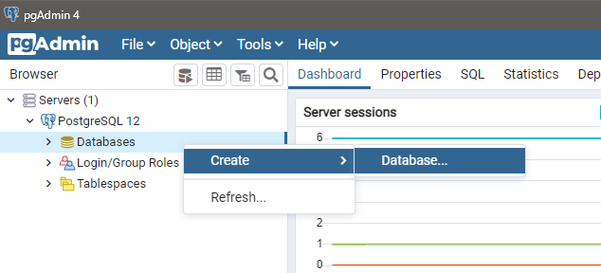

Slide 8
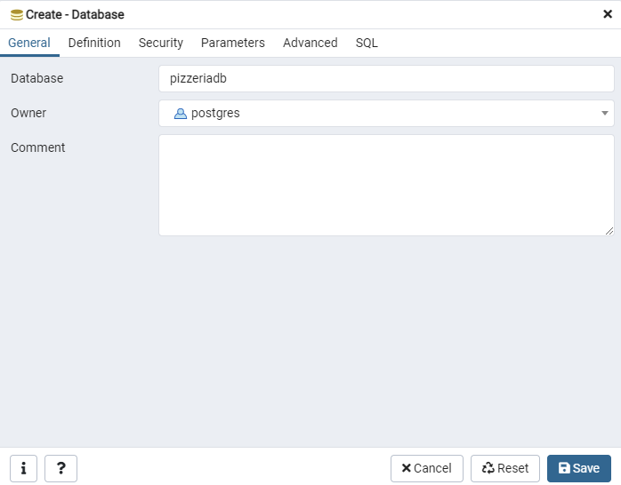

Slide 9
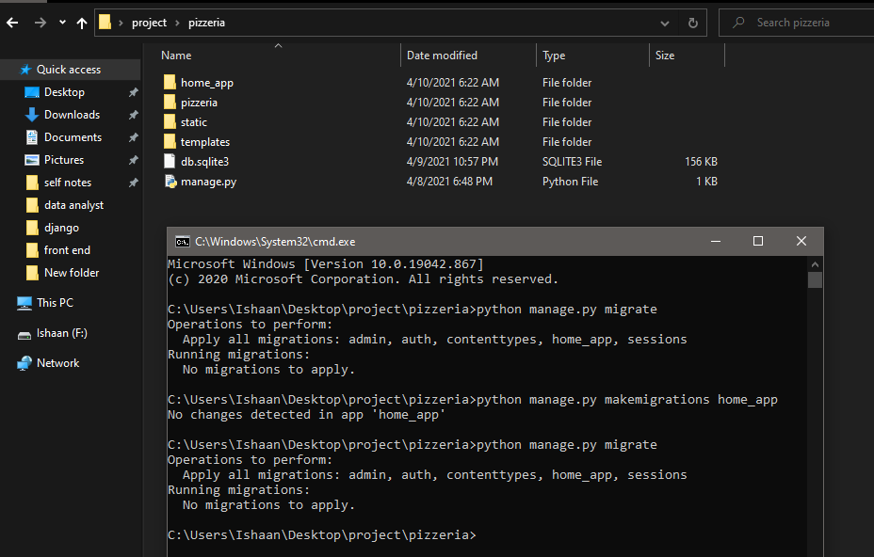
Run these command in pizzeria directory that contain manage.py file
Run these 3 commands in same sequence

Slide 10
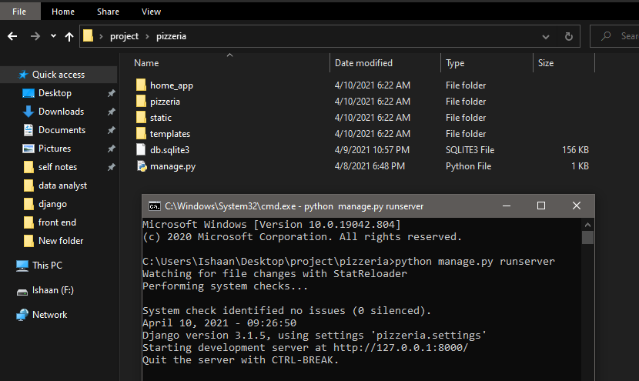
Run this command in pizzeria directory that contain manage.py file
Open this url in browser

Slide 11
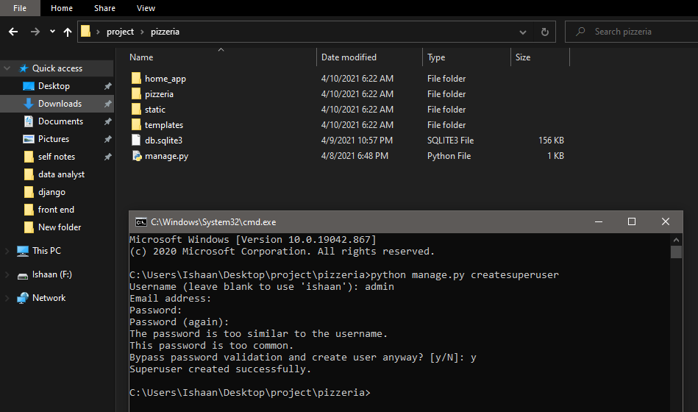
Run this command
Username:admin
Password:admin1234
Leave email blank

Slide 12
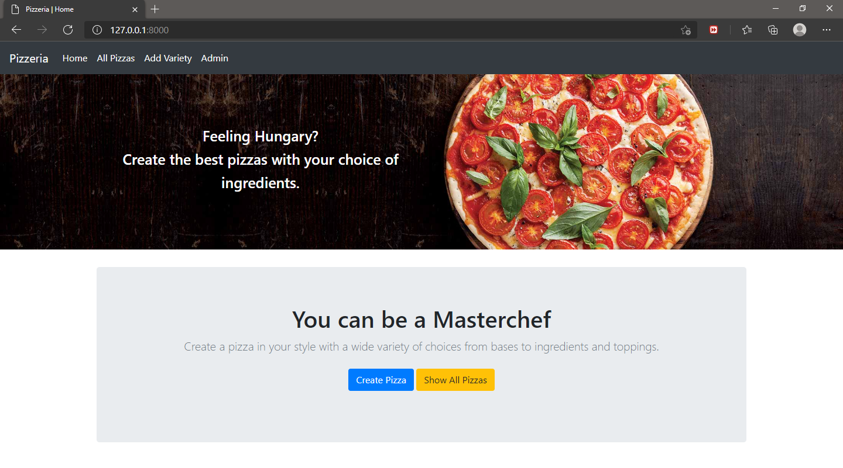
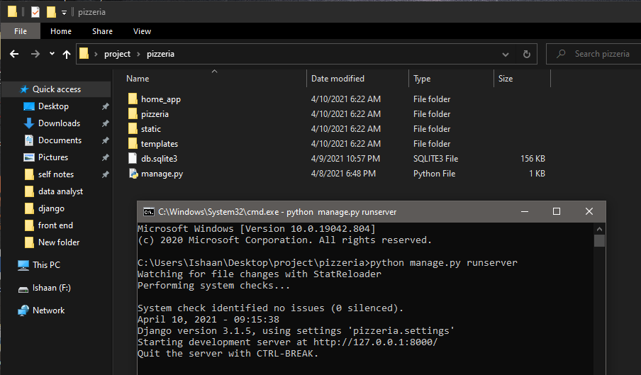
First add variety of sizes and toppings
Run the command: python manage.py runserver , in pizzeria directory
Run this url in browser

Slide 13
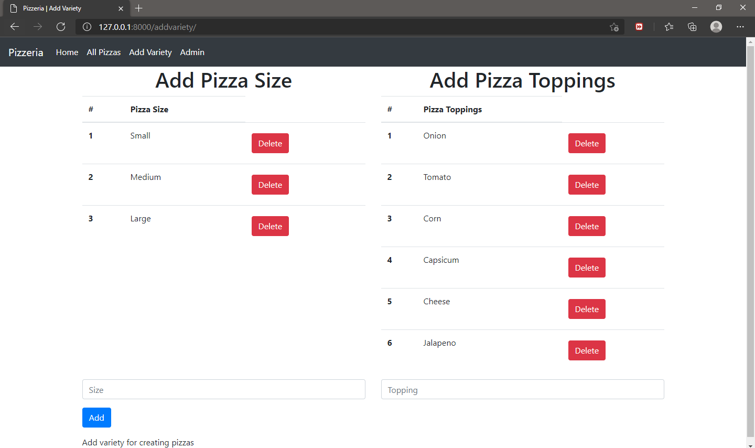

Slide 14
See list and also edit
Create pizza

Slide 15
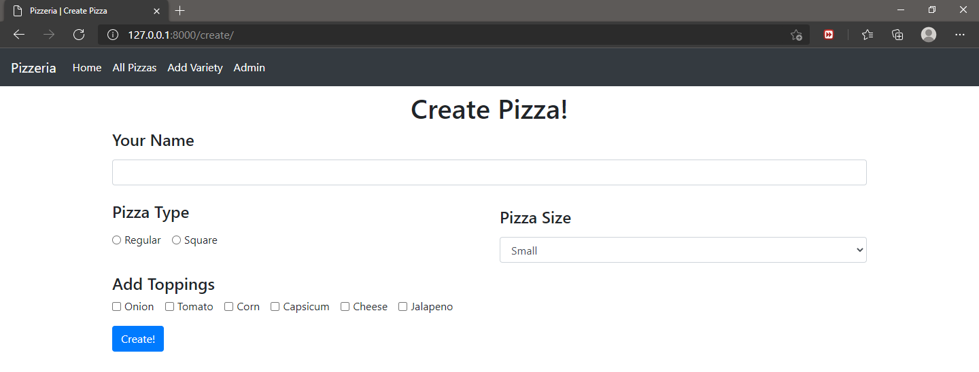

Slide 16
