Slide 1
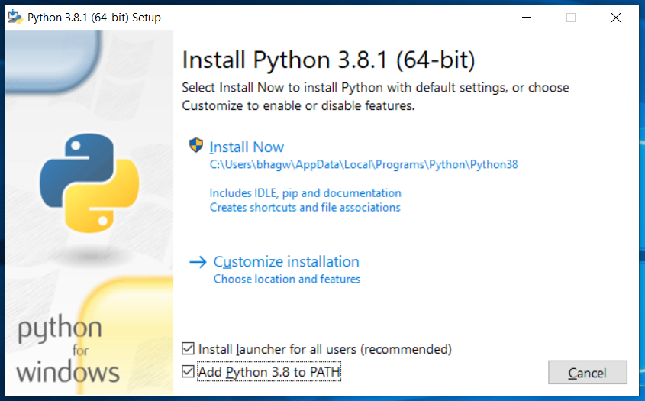
Check on add python to path
And then click on install now to install

Slide 2
Install the requirements using: pip install in command promt
Django==3.1.5
psycopg2==2.8.6

Slide 3
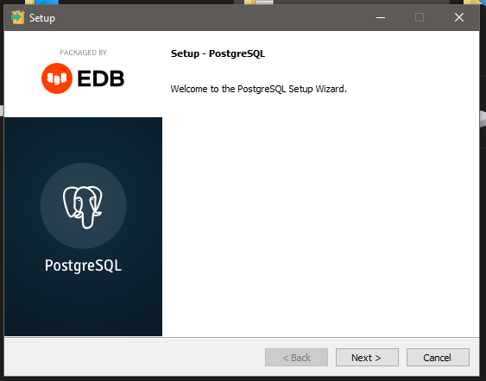
Download postgresql 12.6 for windows
Leave everything default in installer

Slide 4
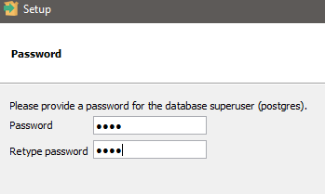
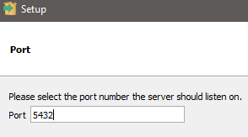
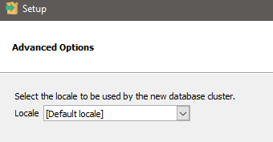
Password:1234
Leave port number default

Slide 5
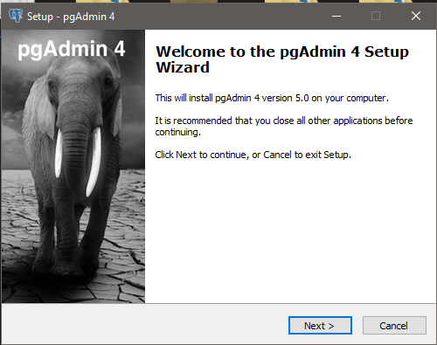
Install pgadmin4 5.0 leave everything default

Slide 6
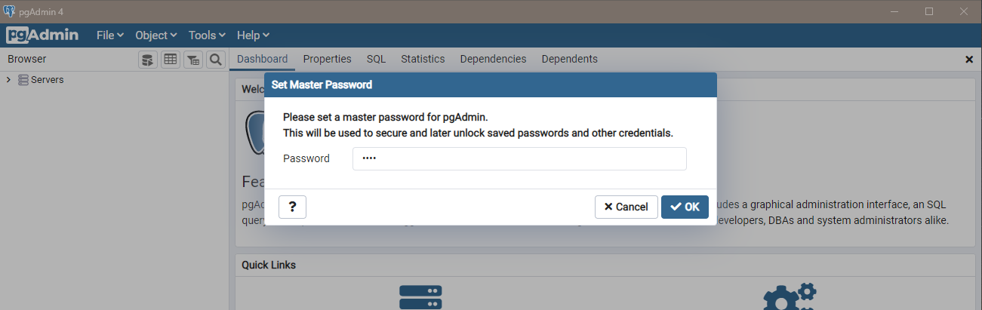
Enter:1234 in password
It may ask 2 times to enter

Slide 7
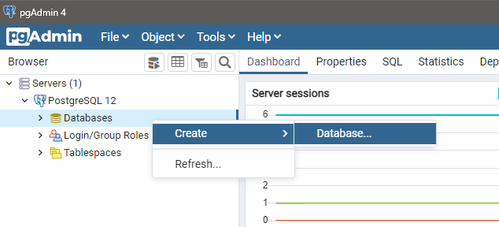

Slide 8
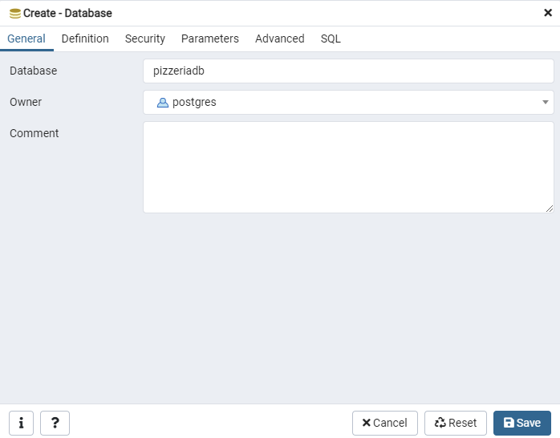

Slide 9
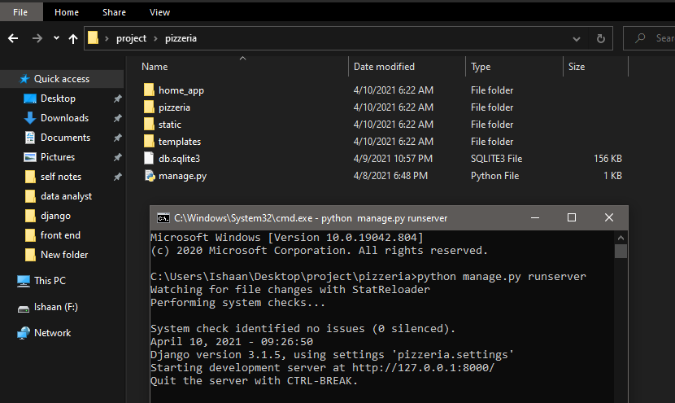
Run this command in pizzeria directory that contain manage.py file
Open this url in browser

Slide 10
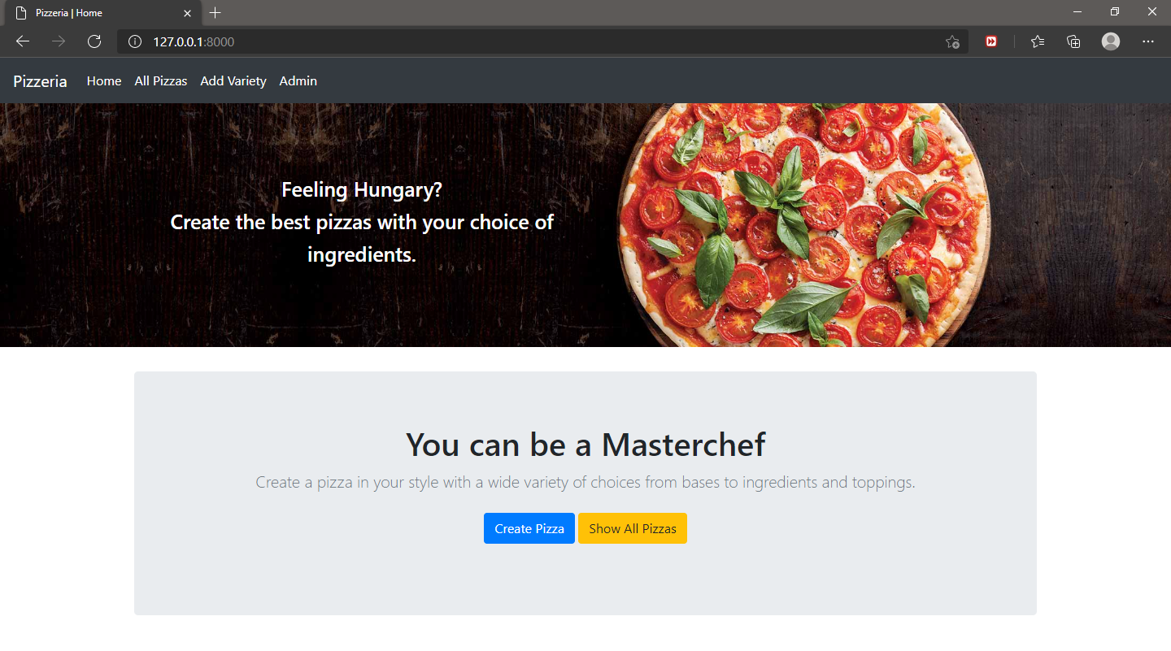
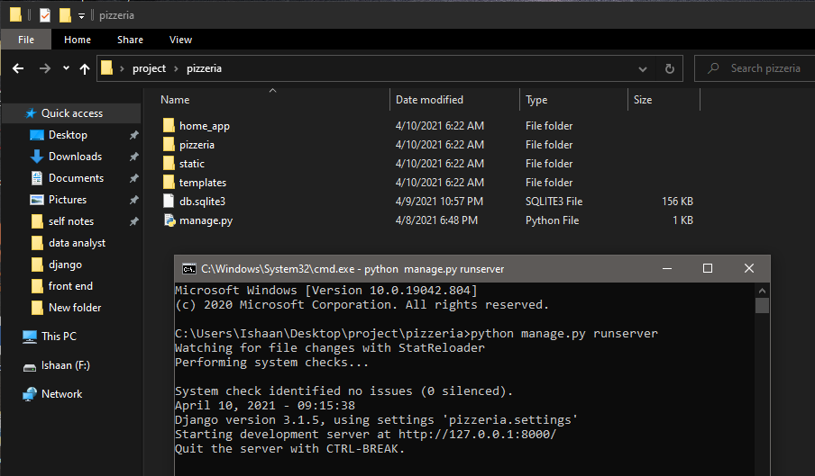
First add variety of sizes and toppings
Run the command: python manage.py runserver , in pizzeria directory
Run this url in browser

Slide 11
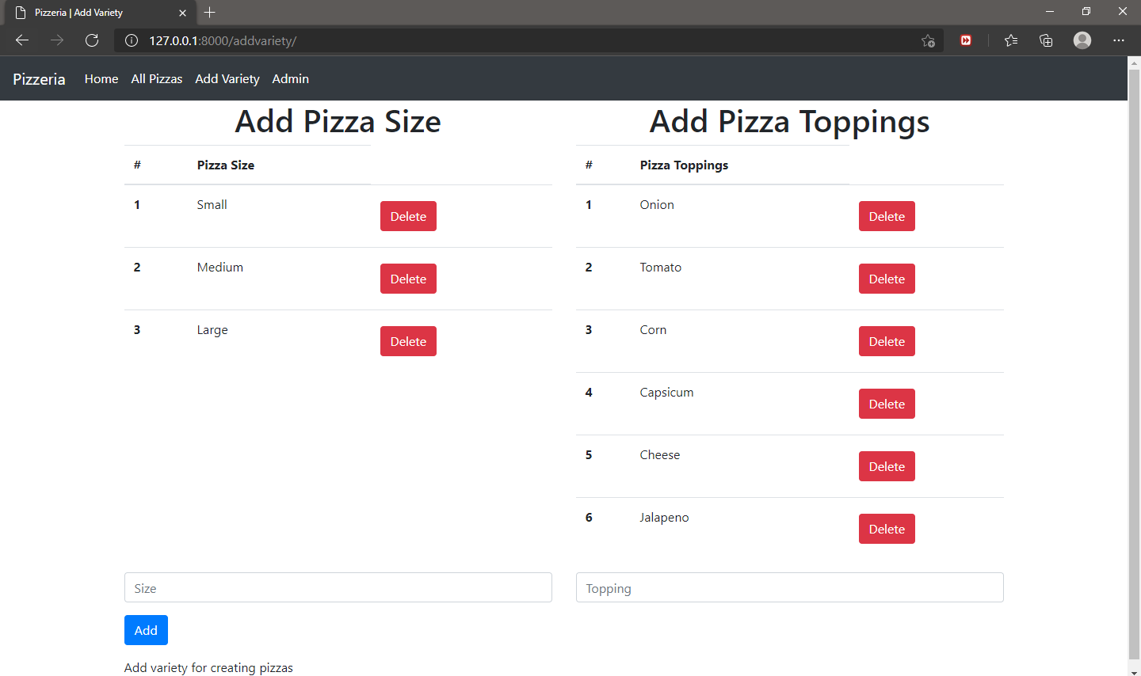

Slide 12
See list of created pizzas and also edit them
Create pizza

