Slide 1
Combine model: size and position
Term | Coef | p
Intercept | -7.86 | 0.354
height_in | 0.277 | 0.028
wingspan_in | -0.121 | 0.179
vertical_max_in | 0.100 | 0.115
Center vs Guard | -1.506 | 0.130
Forward vs Guard | -0.955 | 0.112
QUANTITATIVE: HEIGHT
For every 1 inch increase in height, ppg_3yr goes up about 0.28 PPG, holding all other predictors constant.
QUALITATIVE: CENTER
A Center is predicted to have lower ppg_3yr than a Guard, by about 1.5 PPG, holding the other predictors constant. p = 0.130, so not significant.
ppg_3yr = -7.86 + 0.28 height - 0.12 wingspan + 0.10 vertical - 1.51 Center - 0.95 Forward. Guard is the baseline.
Test MSE 17.98
Test R² 0.044

Slide 2
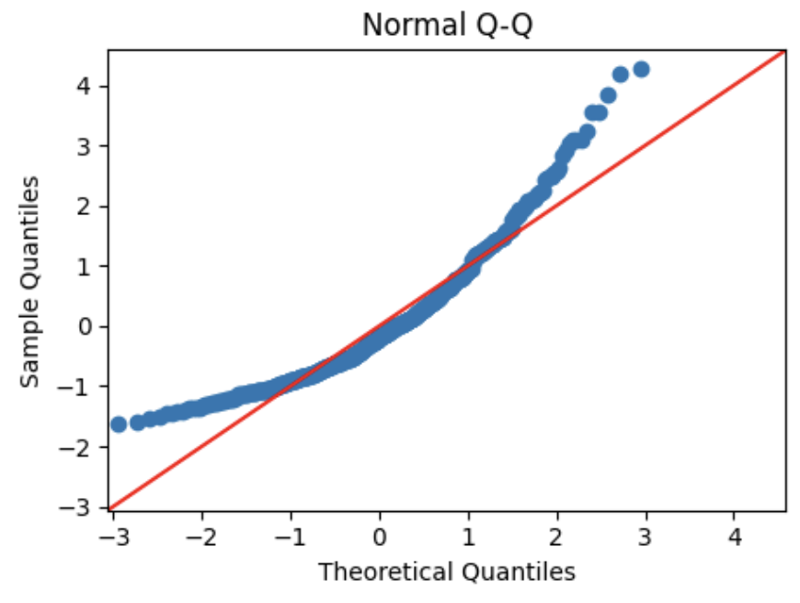
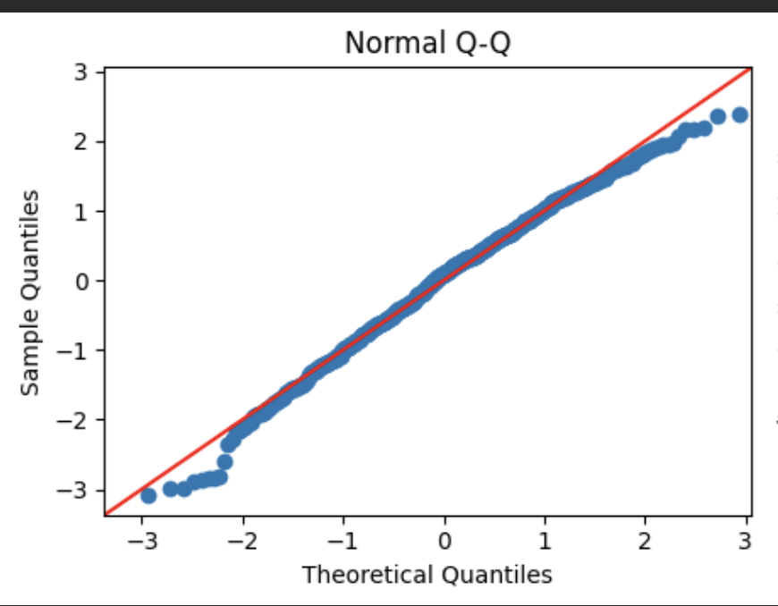
Residuals not normal
TEST SET RESULT
 | Test MSE | Test R²
Original | 17.978 | 0.044
Log fix | 19.386 | -0.031
PROBLEM
Normality is violated. The Q-Q plot curves above the line at the right end: a few players score far more than the model predicts.
OTHER CHECKS
Linearity, constant variance and multicollinearity (max VIF 4.6) were satisfied.
FIX
Predict log(1 + PPG) instead of PPG. log1p because 8 players have 0 PPG. After the fix, the Q-Q plot sits closer to the line, but test MSE rose from 17.978 to 19.386.
Before
After

