Slide 1
College scoring is the one clear predictor of NBA PPG
Model (baseline position: Guard)
PPG = β0 + β1·NCAA_PPG + β2·NCAA_FG% + β3·Wingspan + β4·Vertical + β5·Forward + β6·Center + ε
Fitted equation
PPG^ = −8.04 + 0.267·NCAA_PPG + 0.066·NCAA_FG% + 0.046·Wingspan + 0.106·Vertical − 0.448·Forward − 0.576·Center
Term | Estimate | p-value
NCAA PPG | 0.267 | <0.001
NCAA FG% | 0.066 | 0.055
Wingspan (in) | 0.046 | 0.53
Vertical (in) | 0.106 | 0.085
Forward vs Guard | −0.448 | 0.41
Center vs Guard | −0.576 | 0.54
Training set only (n = 616). Outcome: NBA points per game, first 3 post-combine seasons.
Notes:
Model: NBA PPG on NCAA PPG, NCAA FG%, wingspan, max vertical, and position (Guard baseline). Only NCAA PPG is clearly significant. Fitted on the shared 80/20 split (seed 42), train only.

Slide 2
Each college point adds 0.27 NBA PPG, but R² is only 0.084
+0.27 PPG
−0.58 PPG
Quantitative: each extra point per game scored in college goes with 0.27 more NBA points per game, holding the other predictors fixed.
Qualitative: Centers average 0.58 fewer NBA PPG than Guards (baseline), holding the others fixed. Not significant (p = 0.54).
Test MSE 17.22 PPG² | Test R² 0.084
Assumptions: linearity, independence and VIF (all < 2.4) held; non-constant variance and non-normal errors were violated, so we fixed them (next slide).
Notes:
Interpretations in PPG units. Test metrics computed once on the 154-player test set. Assumptions: 3 of 5 held, 2 violated (mild funnel and right-skewed residuals).

Slide 3
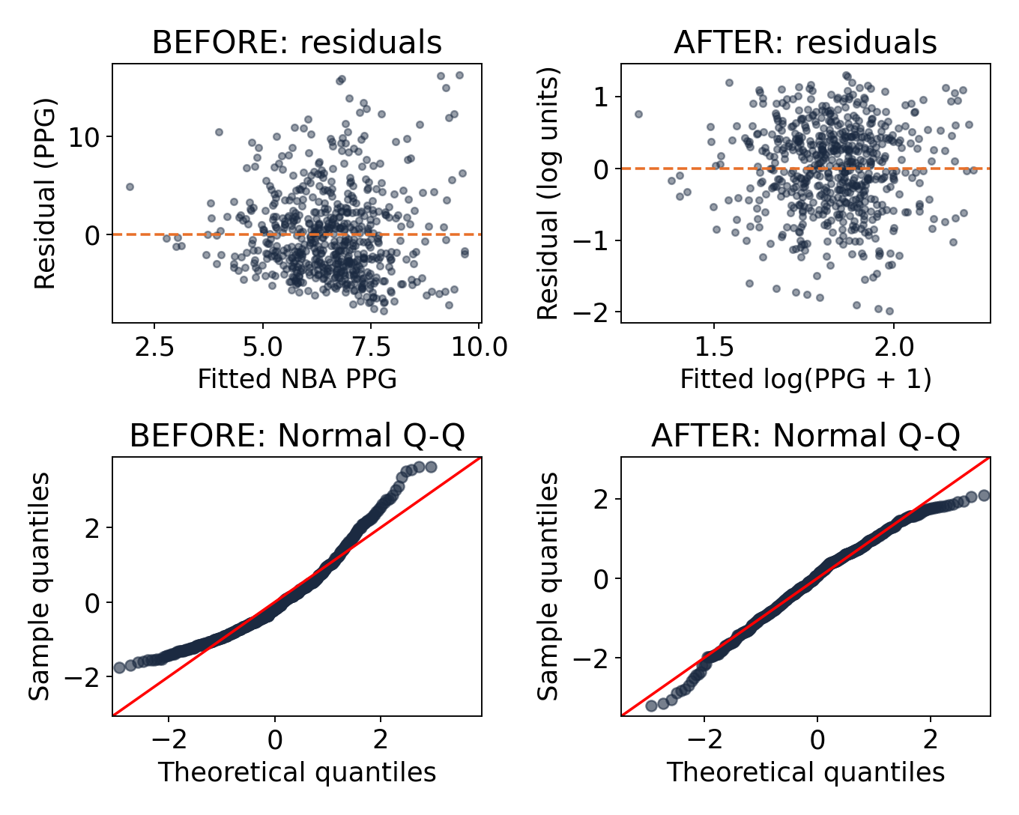
Log transform fixed skewed residuals but raised test error
Problem: residuals fan out and the Q-Q curve bends up, so errors are right-skewed.
Fix: model log(PPG + 1); predictions converted back to PPG.
After: funnel gone, Q-Q follows the line.
But: test MSE 17.22 → 18.65 and R² 0.084 → 0.008, so we keep the original model.
Notes:
Plots: top row residuals vs fitted (x = fitted value, y = residual); bottom row Normal Q-Q. Left column before, right column after the log(PPG+1) transform. Log model predictions were back-transformed with exp(yhat)-1 so MSE is in PPG^2 like the other members.

Slide 4
Combine + NCAA stats gave the lowest test error
Member | Predictors | Test MSE | Test R²
1: Combine | height, wingspan, vertical, position | 17.98 | 0.044
2: NCAA | NCAA PPG, APG, FG%, position | 17.41 | 0.074
3: Combined | NCAA PPG, FG%, wingspan, vertical, position | 17.22 | 0.084
The combined model predicts best because it pairs college scoring with combine measures. Gains are small: all models explain under 10% of the variation in NBA PPG.
Notes:
Same 154-player test set, outcome in PPG units for all three. Member names can be added in the first column.

