Slide 1
College scoring and shooting percentage are associated with NBA PPG
Model (baseline position: Guard)
NBA PPG = β₀ + β₁(NCAA PPG) + β₂(NCAA APG) + β₃(NCAA FG%) + β₄(Forward) + β₅(Center) + ε
Fitted equation
NBA PPG^ = −1.005 + 0.244(NCAA PPG) + 0.154(NCAA APG) + 0.0718(NCAA FG%) - 0.141(Forward) − 0.348(Center)
Term | Estimate | p-value
Intercept | -1.005 | 0.567
NCAA PPG | 0.244 | <0.001
NCAA APG | 0.154 | 0.276
NCAA FG% | 0.0718 | 0.035
Forward vs Guard | −0.141 | 0.779
Center vs Guard | −0.348 | 0.675
Training set: n = 616. Outcome: average NBA PPG over the first three post-combine seasons. Bold rows are statistically significant at α = 0.05.
Notes:
Model: NBA PPG on NCAA PPG, NCAA APG, NCAA FG%, and position (Guard baseline). NCAA PPG and NCAA FG% are statistically significant (p < 0.05). Fitted on the shared 80/20 split (seed 42), training set only (n = 616).

Slide 2
Each additional NCAA PPG is associated with +0.244 predicted NBA PPG, but R² is only 0.074
+0.244 PPG
−0.348 PPG
Quantitative interpretation
Each additional NCAA point per game is associated with 0.244 more predicted NBA points per game, holding NCAA APG, NCAA FG%, and position constant.
Qualitative interpretation
Centers are predicted to score 0.348 fewer NBA points per game than Guards, holding other predictors constant. Not statistically significant (p = 0.675).
Test MSE: 17.405 PPG² | Test R²: 0.074
Assumptions: possible linearity and constant-variance violations; nonnormal residuals; independence plausible; all VIFs below 2.
Test set: 154 players. The model explains approximately 7.4% of the variation in NBA PPG on the test set.
Notes:
Interpretations in NBA PPG units. Test metrics computed on the shared 154-player test set. Test MSE = 17.405 and R² = 0.074. Assumptions: possible linearity and constant-variance violations, nonnormal residuals, plausible independence, and low multicollinearity (all VIFs < 2).

Slide 3
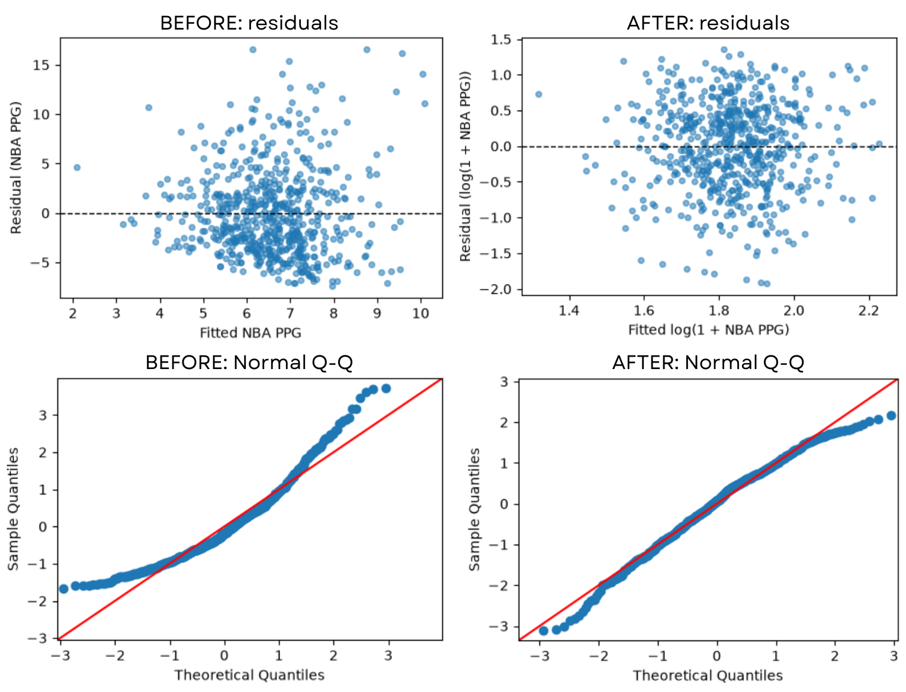
Log transformation improved residual normality but increased test error
Problem
Original residuals showed nonnormality, particularly in the tails, and possible unequal variance.
Fix
Applied log(1 + NBA PPG) and refitted the model using the same predictors.
After
The Q-Q plot followed the reference line more closely, although tail deviations remained.
Decision
Test MSE increased from 17.405 to 18.864, while R² decreased from 0.074 to −0.003. We retained the original model.
Notes:
Plots: top row shows residuals vs. fitted values; bottom row shows Normal Q-Q plots. Left column is the original NCAA model; right column is the log(1 + NBA PPG) model. Log-model predictions were back-transformed using exp(ŷ) − 1 so test MSE could be compared in PPG². The log transformation improved residual normality but increased test error, so the original model was retained.

Slide 4
College scoring is the one clear predictor of NBA PPG
Model (baseline position: Guard)
PPG = β0 + β1·NCAA_PPG + β2·NCAA_FG% + β3·Wingspan + β4·Vertical + β5·Forward + β6·Center + ε
Fitted equation
PPG^ = −8.04 + 0.267·NCAA_PPG + 0.066·NCAA_FG% + 0.046·Wingspan + 0.106·Vertical − 0.448·Forward − 0.576·Center
Term | Estimate | p-value
NCAA PPG | 0.267 | <0.001
NCAA FG% | 0.066 | 0.055
Wingspan (in) | 0.046 | 0.53
Vertical (in) | 0.106 | 0.085
Forward vs Guard | −0.448 | 0.41
Center vs Guard | −0.576 | 0.54
Training set only (n = 616). Outcome: NBA points per game, first 3 post-combine seasons.
Notes:
Model: NBA PPG on NCAA PPG, NCAA FG%, wingspan, max vertical, and position (Guard baseline). Only NCAA PPG is clearly significant. Fitted on the shared 80/20 split (seed 42), train only.

Slide 5
Each college point adds 0.27 NBA PPG, but R² is only 0.084
+0.27 PPG
−0.58 PPG
Quantitative: each extra point per game scored in college goes with 0.27 more NBA points per game, holding the other predictors fixed.
Qualitative: Centers average 0.58 fewer NBA PPG than Guards (baseline), holding the others fixed. Not significant (p = 0.54).
Test MSE 17.22 PPG² | Test R² 0.084
Assumptions: linearity, independence and VIF (all < 2.4) held; non-constant variance and non-normal errors were violated, so we fixed them (next slide).
Notes:
Interpretations in PPG units. Test metrics computed once on the 154-player test set. Assumptions: 3 of 5 held, 2 violated (mild funnel and right-skewed residuals).

Slide 6
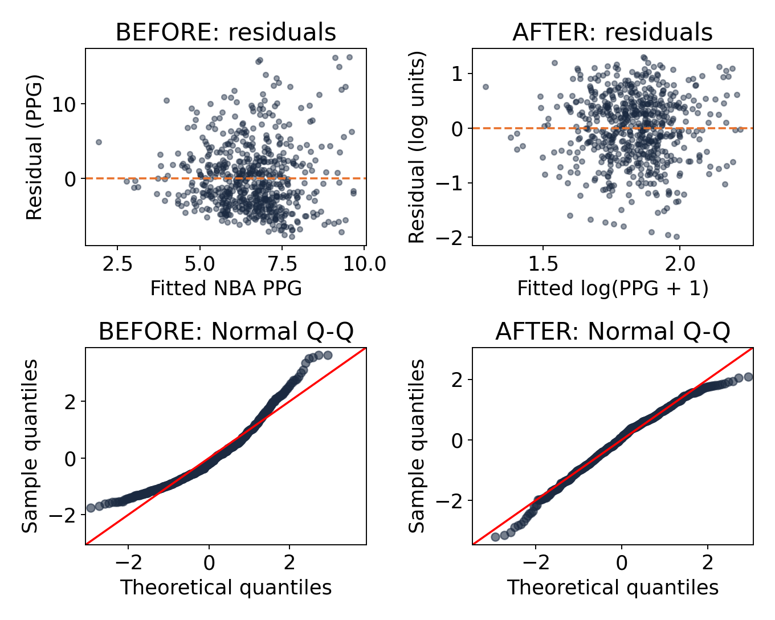
Log transform fixed skewed residuals but raised test error
Problem: residuals fan out and the Q-Q curve bends up, so errors are right-skewed.
Fix: model log(PPG + 1); predictions converted back to PPG.
After: funnel gone, Q-Q follows the line.
But: test MSE 17.22 → 18.65 and R² 0.084 → 0.008, so we keep the original model.
Notes:
Plots: top row residuals vs fitted (x = fitted value, y = residual); bottom row Normal Q-Q. Left column before, right column after the log(PPG+1) transform. Log model predictions were back-transformed with exp(yhat)-1 so MSE is in PPG^2 like the other members.

Slide 7
Combine + NCAA stats gave the lowest test error
Member | Predictors | Test MSE | Test R²
1: Combine | height, wingspan, vertical, position | 17.98 | 0.044
2: NCAA | NCAA PPG, APG, FG%, position | 17.41 | 0.074
3: Combined | NCAA PPG, FG%, wingspan, vertical, position | 17.22 | 0.084
The combined model predicts best because it pairs college scoring with combine measures. Gains are small: all models explain under 10% of the variation in NBA PPG.
Notes:
Same 154-player test set, outcome in PPG units for all three. Member names can be added in the first column.

