Slide 1
COGS 109 · Checkpoint 1 · Group [#]
Can pre-draft data predict a player's NBA scoring in their first three seasons?
Thomas Ton · Riley Ramos · Ishaan Tibdewal
Data: NBA Draft Combine + NBA Stats (nba_api) and ESPN NCAA box scores (SportsDataverse), 2005–2022
Notes:
Introduce the group, the project, and the two data sources.

Slide 2
Teams draft on measurements and college stats, but which predicts NBA scoring?
The Combine
College stats
Why it matters
Every year, prospects are measured on height, wingspan, vertical leap, and speed. Teams lean on these numbers when picking.
Most prospects also have a full college season of points, assists and shooting from the year they enter the draft.
A draft pick is a multi-year bet. Knowing which pre-draft data actually predicts NBA production helps teams spend picks better.
Notes:
Motivation: the draft is a high-stakes prediction problem. We want to know whether athletic testing or college production carries more information about early NBA scoring.

Slide 3
Our question: can pre-draft data predict early NBA scoring?
Can pre-draft data predict a player's NBA scoring (points per game) in their first three seasons?
Specifically: do NCAA stats improve prediction beyond Draft Combine measurements?
Thomas Ton
Riley Ramos
Ishaan Tibdewal
Combine only: height, wingspan, vertical, position
NCAA only: college PPG, APG, FG%, position
Combined: college PPG, FG%, wingspan, vertical, position
Notes:
One question, three models. Comparing their test error on the same split answers whether NCAA stats add predictive value.

Slide 4
770 players with both Combine measurements and a matched college season
NBA Draft Combine | Units
Height, weight | in, lb
Wingspan, standing reach | in
Max & standing vertical | in
Sprint, lane agility | sec
Bench reps, body fat | reps, %
Position (qualitative) | G / F / C
NCAA (combine-year season) | Units
Points, assists, rebounds | per game
Steals, blocks, turnovers | per game
Minutes, games | per game, count
FG%, 3P%, FT% | %
Outcome: NBA PPG over the first 3 post-combine seasons (points/game)
n = 770, p = 22: 21 quantitative + 1 qualitative (position)
Notes:
Sources: NBA Stats combine and league stats via nba_api; NCAA from SportsDataverse ESPN men's college basketball player box scores. Players matched by normalized name and combine year; ambiguous names excluded. College stats come from the season ending in the combine year.

Slide 5
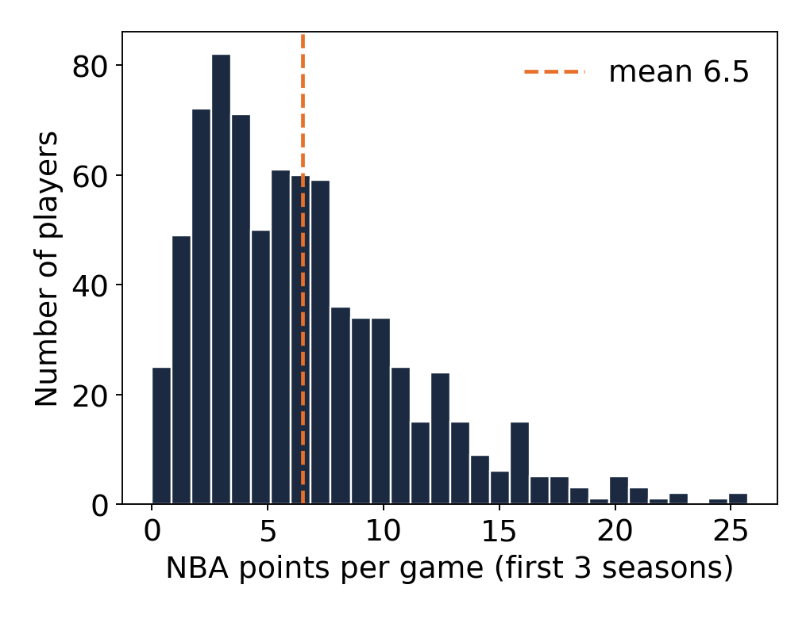
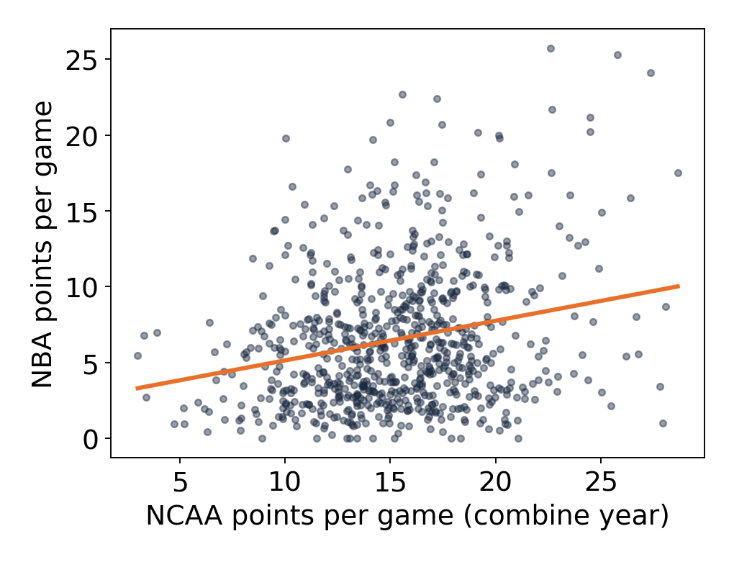
NBA PPG is right-skewed, and college scoring tracks it (r = 0.23)
Shared split: 80% train (616) / 20% test (154), random seed 42, stratified by position. Height (r = −0.05) and wingspan (r = −0.08) barely relate to NBA PPG.
Notes:
Left: histogram, x = NBA PPG, y = number of players; mean 6.5, long right tail. Right: x = NCAA PPG, y = NBA PPG, orange line = least-squares fit; positive but noisy. This motivated using college scoring as a predictor.

Slide 6
Member 1: Thomas Ton · model slide
Notes:
Member 1 to add content.

Slide 7
Member 1: Thomas Ton · interpretation & test results
Notes:
Member 1 to add content.

Slide 8
Member 1: Thomas Ton · problem & fix (only if needed)
Notes:
Member 1 to add content.

Slide 9
Member 2: Riley Ramos
College scoring and shooting percentage are associated with NBA PPG
Model (baseline position: Guard)
NBA PPG = β0 + β1(NCAA PPG) + β2(NCAA APG) + β3(NCAA FG%) + β4(Forward) + β5(Center) + ε
Fitted equation
NBA PPG^ = −1.005 + 0.244(NCAA PPG) + 0.154(NCAA APG) + 0.0718(NCAA FG%) − 0.141(Forward) − 0.348(Center)
Term | Estimate | p-value
Intercept | −1.005 | 0.567
NCAA PPG | 0.244 | <0.001
NCAA APG | 0.154 | 0.276
NCAA FG% | 0.0718 | 0.035
Forward vs Guard | −0.141 | 0.779
Center vs Guard | −0.348 | 0.675
Training set n = 616. Bold rows are significant at α = 0.05.
Notes:
Model: NBA PPG on NCAA PPG, NCAA APG, NCAA FG%, and position (Guard baseline). NCAA PPG and NCAA FG% are statistically significant (p < 0.05). Fitted on the shared 80/20 split (seed 42), training set only (n = 616).

Slide 10
Member 2: Riley Ramos
Each NCAA point adds 0.244 NBA PPG, but R² is only 0.074
+0.244 PPG
−0.348 PPG
Quantitative: each additional NCAA point per game goes with 0.244 more NBA PPG, holding APG, FG% and position constant.
Qualitative: Centers are predicted to score 0.348 fewer NBA PPG than Guards (baseline), holding others constant. Not significant (p = 0.675).
Test MSE 17.405 PPG² | Test R² 0.074
Assumptions: possible linearity and constant-variance violations; non-normal residuals; independence plausible; all VIFs below 2.
Notes:
Interpretations in NBA PPG units. Test metrics computed on the shared 154-player test set; the model explains about 7.4% of the variation in NBA PPG.

Slide 11
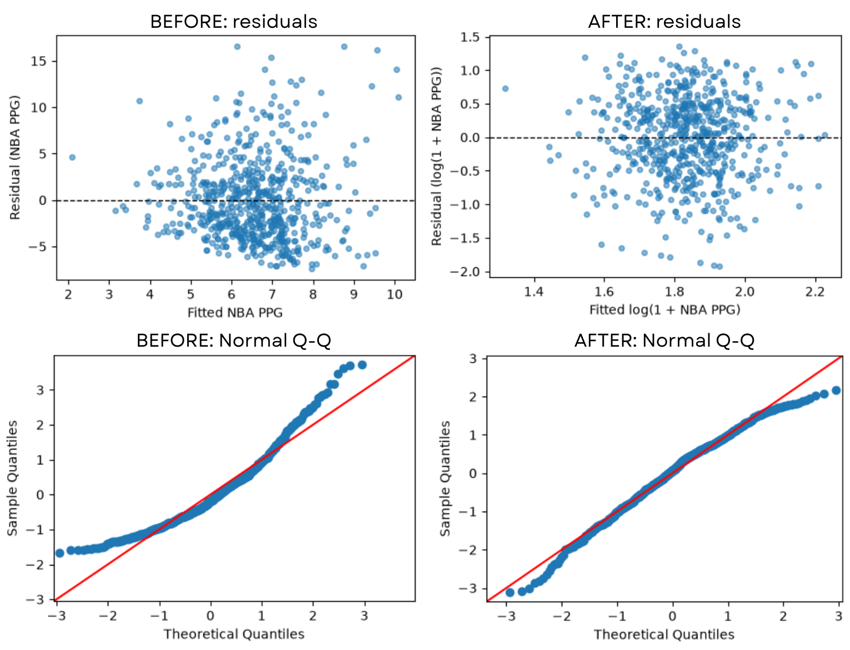
Member 2: Riley Ramos
Log transformation improved residual normality but increased test error
Problem: residuals non-normal in the tails, possible unequal variance.
Fix: refit with log(1 + NBA PPG), same predictors.
After: Q-Q follows the line more closely.
Decision: test MSE 17.405 → 18.864, R² 0.074 → −0.003, so we kept the original model.
Notes:
Top row: residuals vs fitted; bottom row: Normal Q-Q. Left column original model, right column log(1 + NBA PPG) model. Log predictions back-transformed with exp(yhat) − 1 so MSE is in PPG².

Slide 12
Member 3: Ishaan Tibdewal
College scoring is the one clear predictor of NBA PPG
Model (baseline position: Guard)
NBA PPG = β0 + β1(NCAA PPG) + β2(NCAA FG%) + β3(Wingspan) + β4(Vertical) + β5(Forward) + β6(Center) + ε
Fitted equation
NBA PPG^ = −8.044 + 0.267(NCAA PPG) + 0.066(NCAA FG%) + 0.046(Wingspan) + 0.106(Vertical) − 0.448(Forward) − 0.576(Center)
Term | Estimate | p-value
Intercept | −8.044 | 0.226
NCAA PPG | 0.267 | <0.001
NCAA FG% | 0.066 | 0.055
Wingspan (in) | 0.046 | 0.528
Vertical (in) | 0.106 | 0.085
Forward vs Guard | −0.448 | 0.408
Center vs Guard | −0.576 | 0.540
Training set n = 616. Bold rows are significant at α = 0.05.
Notes:
Model: NBA PPG on NCAA PPG, NCAA FG%, wingspan, max vertical, and position (Guard baseline). Only NCAA PPG is significant at 0.05. Fitted on the shared 80/20 split (seed 42), training set only.

Slide 13
Member 3: Ishaan Tibdewal
Each college point adds 0.267 NBA PPG, but R² is only 0.084
+0.267 PPG
−0.576 PPG
Quantitative: each extra NCAA point per game goes with 0.267 more NBA PPG, holding FG%, wingspan, vertical and position fixed.
Qualitative: Centers average 0.576 fewer NBA PPG than Guards (baseline), holding the others fixed. Not significant (p = 0.54).
Test MSE 17.220 PPG² | Test R² 0.084
Assumptions: linearity, independence and multicollinearity (all VIFs < 2.4) held; non-constant variance and non-normal errors violated (fix on next slide).
Notes:
Interpretations in PPG units. Test metrics computed once on the shared 154-player test set. 3 of 5 assumptions held, 2 violated (mild funnel and right-skewed residuals).

Slide 14
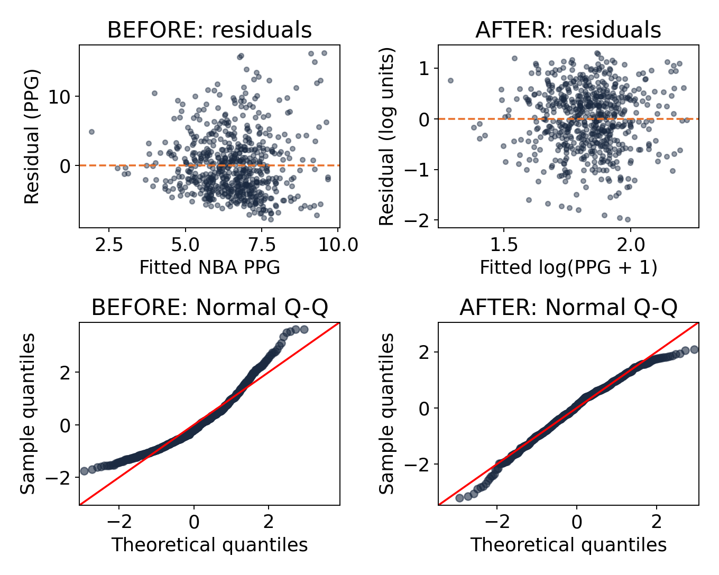
Member 3: Ishaan Tibdewal
Log transform fixed skewed residuals but raised test error
Problem: residuals fan out and the Q-Q curve bends up (right skew).
Fix: refit with log(PPG + 1); predictions converted back to PPG.
After: funnel gone, Q-Q follows the line.
Decision: test MSE 17.220 → 18.654, R² 0.084 → 0.008, so we kept the original model.
Notes:
Top row: residuals vs fitted (x = fitted value, y = residual). Bottom row: Normal Q-Q. Left before, right after the log(PPG+1) transform. Log predictions back-transformed with exp(yhat) − 1 so MSE is in PPG² like the other members.

Slide 15
Combine + NCAA stats gave the lowest test error
Member | Predictors | Test MSE (PPG²) | Test R²
Thomas: Combine | height, wingspan, vertical, position | 17.978 | 0.044
Riley: NCAA | NCAA PPG, APG, FG%, position | 17.405 | 0.074
Ishaan: Combined | NCAA PPG, FG%, wingspan, vertical, position | 17.220 | 0.084
The combined model predicts best because it pairs college scoring with Combine measurements. NCAA stats help more than the Combine alone, but all models explain under 10% of the variation in NBA PPG.
Notes:
Same 154-player test set, outcome in PPG for all three models. Member 1 numbers come from reports/group_comparison.csv; update if Member 1 changes their final model.

Slide 16
Next steps: move from one split to classification, cross-validation and trees
1
2
3
4
Classify
Validate
Regularize
Go non-linear
Logistic regression: predict whether a player becomes a 10+ PPG scorer (Checkpoint 2).
k-fold cross-validation instead of a single 80/20 split, so results are less split-dependent.
Lasso / ridge on all 21 quantitative predictors to pick out the useful ones.
Trees and random forests (Checkpoint 3) to capture interactions like position × size.
Notes:
Our linear models explain little of NBA scoring, so next we try classification, cross-validation, regularization, and tree-based models.

