Slide 1
Wind Energy Generation Models

Slide 2
Wind Turbines
Wind turbines are mechanical devices designed to capture wind's kinetic energy and convert it into mechanical or electrical energy.
Wind, which is essentially moving air, possesses kinetic energy due to its motion. When wind interacts with the blades of a wind turbine, it exerts a force on them, causing them to rotate. This rotational motion is then transferred to a generator through a shaft, which converts the mechanical energy into electrical energy.
The main components of a wind turbine are:
Rotor: The part that captures wind energy, usually with three blades attached to a shaft. The blades work similarly to airplane wings or helicopter rotor blades.
Generator: Converts the rotational motion of the rotor into electricity. The generator is made of magnets and conducting wire wrapped around a core.

Slide 3
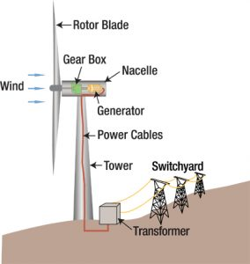
Nacelle: A large, box-shaped structure that houses the generator, gearbox, and other key components. It also contains sensors and control systems that monitor and adjust the turbine's performance.
Tower: The structure that supports the rotor and generator at the top.

Slide 4
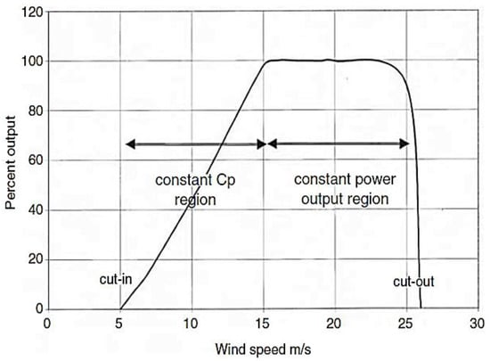
Power Curve
A typical power curve has three regions:
Cut-in wind speed: The minimum wind speed at which the turbine starts generating power.
Rated wind speed: The wind speed at which the turbine generates its maximum (rated) power.
Cut-out wind speed: The maximum wind speed at which the turbine is allowed to operate. Above this, the turbine is shut down to avoid damage

Slide 5
Types of Wind Turbines
Horizontal-axis turbines
Most common type.
Rotor is parallel to the wind direction.
High efficiency.
Advantages:
Higher efficiency as blades capture maximum wind energy.
Well-suited for locations with consistent wind.
Disadvantages:
Requires yaw mechanism to align with wind direction.
Larger footprint and higher installation costs.

Slide 6
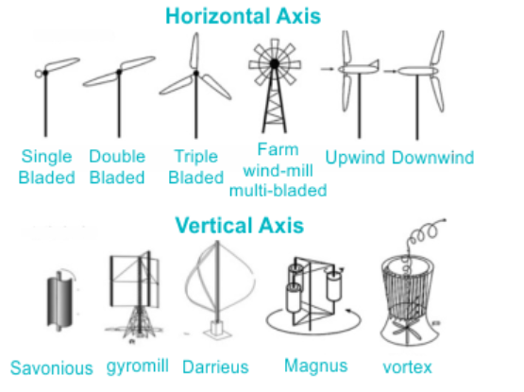
Vertical Axis Wind Turbines (VAWT)
Rotor is perpendicular to the wind.
Easier to maintain but less efficient.
Advantages:
Operates in all wind directions
Easier maintenance as components are closer to
the ground.
Disadvantages:
Lower efficiency compared to HAWT.
Less stable and suitable for large-scale
applications.

Slide 7
Classification of Models
Content:
Physical Models: Based on aerodynamic equations.
Statistical Models: Use time-series data .
Hybrid Models: Combine statistical models with AI/ML techniques.

Slide 8
Physical Models
Actuator Disk Model (ADM)
Treats the wind turbine rotor as a thin, porous disk that uniformly extracts energy from the wind.
Based on momentum theory and energy conservation.
Assumptions:
Uniform wind speed across the disk.
No rotational wake effects.
Steady and incompressible flow.

Slide 9

$$P=\frac{1}{2}×ρAv^{3}Cp$$
Where,
P: Power
ρ: Air density
A: Swept area
v: Free-stream wind speed
Cp​: Power coefficient

Slide 10
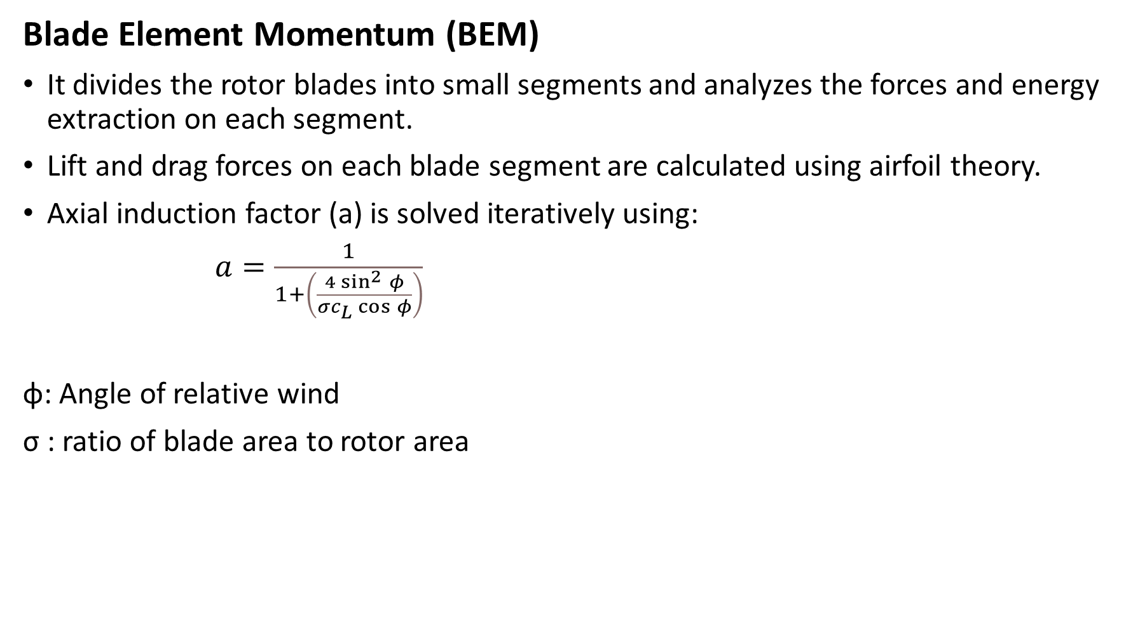
Blade Element Momentum (BEM)
It divides the rotor blades into small segments and analyzes the forces and energy extraction on each segment.
Lift and drag forces on each blade segment are calculated using airfoil theory.
Axial induction factor (a) is solved iteratively using:
$a=\frac{1}{1+\left(\frac{4\sin^{2}{φ}}{σc_{L}\cos{φ}}\right)}$
ϕ: Angle of relative wind
σ : ratio of blade area to rotor area

Slide 11
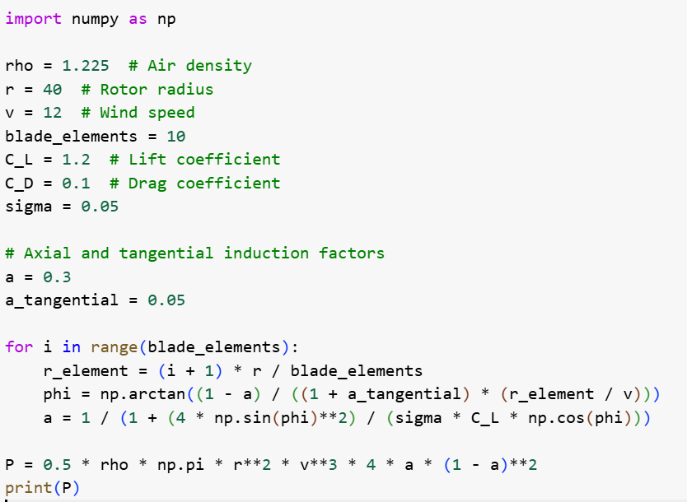

Slide 12
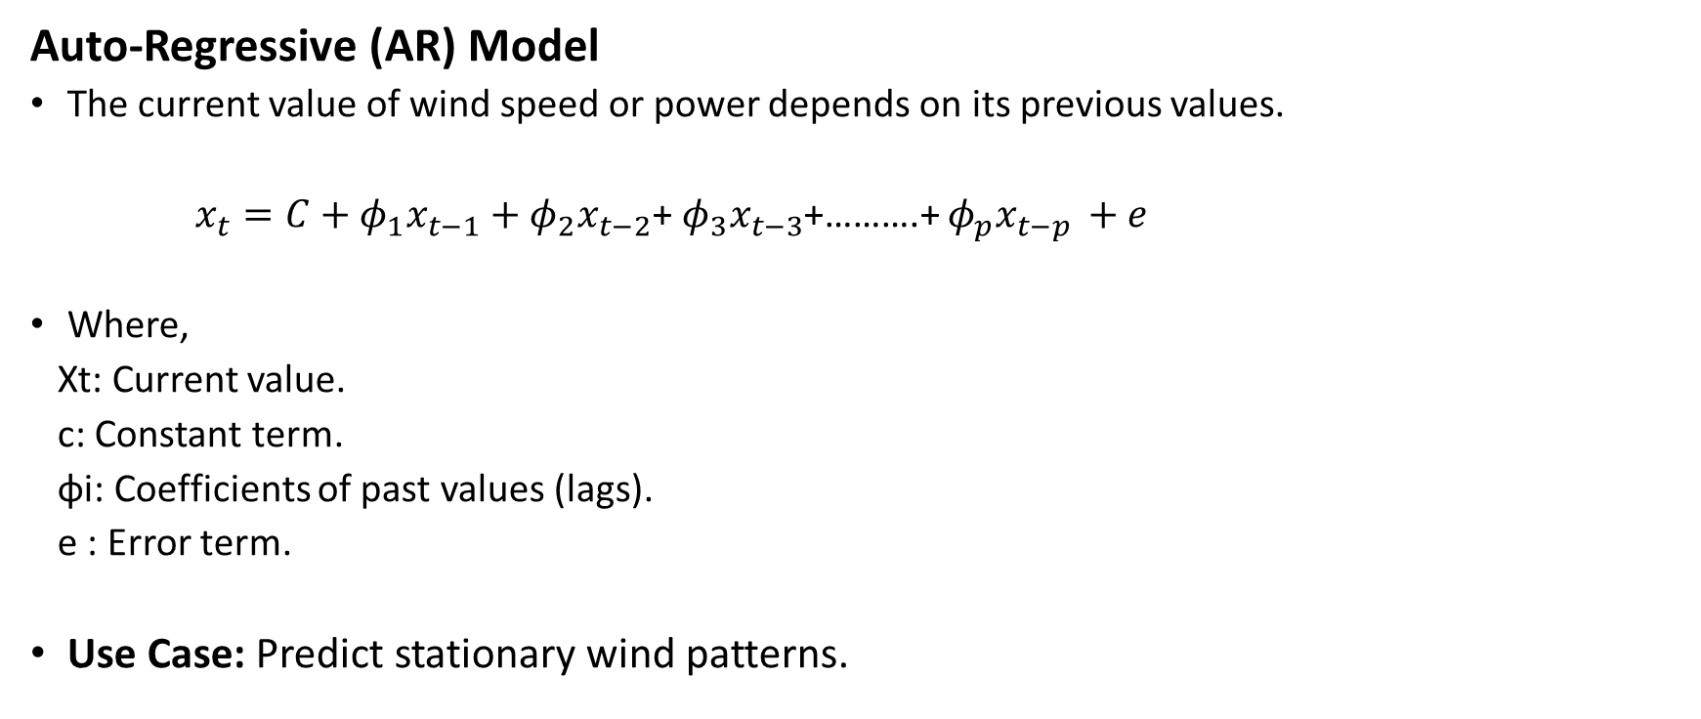
Statistical Models
Auto-Regressive (AR) Model
The current value of wind speed or power depends on its previous values.
$x_{t}=C+φ_{1}x_{t−1}+φ_{2}x_{t−2}$+ $φ_{3}x_{t−3}$+……….+ $φ_{p}x_{t−p }+e$
Where,
Xt​: Current value.
c: Constant term.
ϕi​: Coefficients of past values (lags).
e ​: Error term.
Use Case: Predict stationary wind patterns.

Slide 13
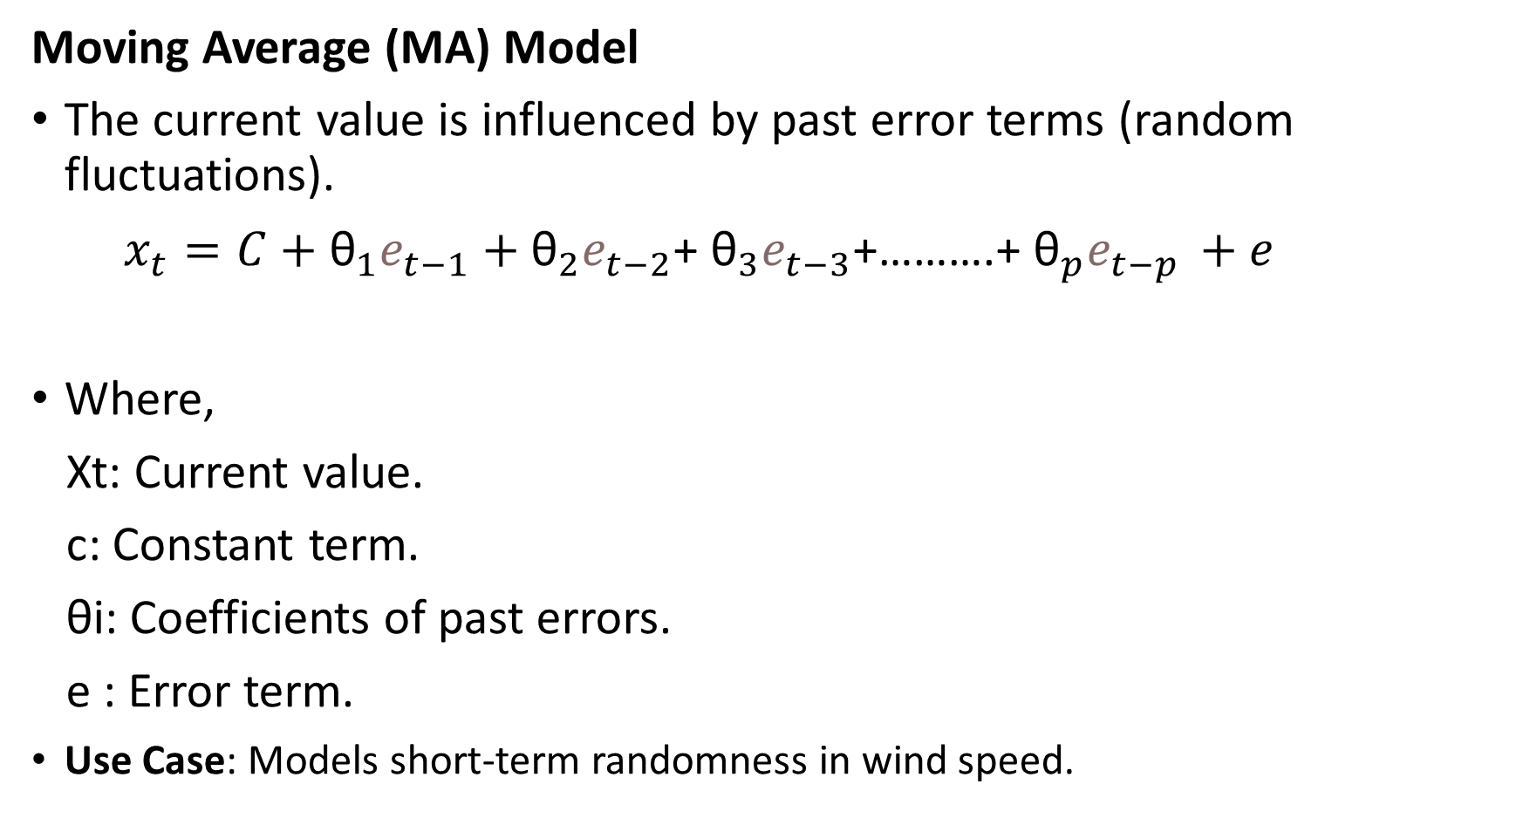
Moving Average (MA) Model
The current value is influenced by past error terms (random fluctuations).
$x_{t}=C+{\text{θ}}_{1}e_{t−1}+{\text{θ}}_{2}e_{t−2}$+ ${\text{θ}}_{3}e_{t−3}$+……….+ ${\text{θ}}_{p}e_{t−p }+e$
Where,
Xt​: Current value.
c: Constant term.
θi​: Coefficients of past errors.
e ​: Error term.
Use Case: Models short-term randomness in wind speed.

Slide 14
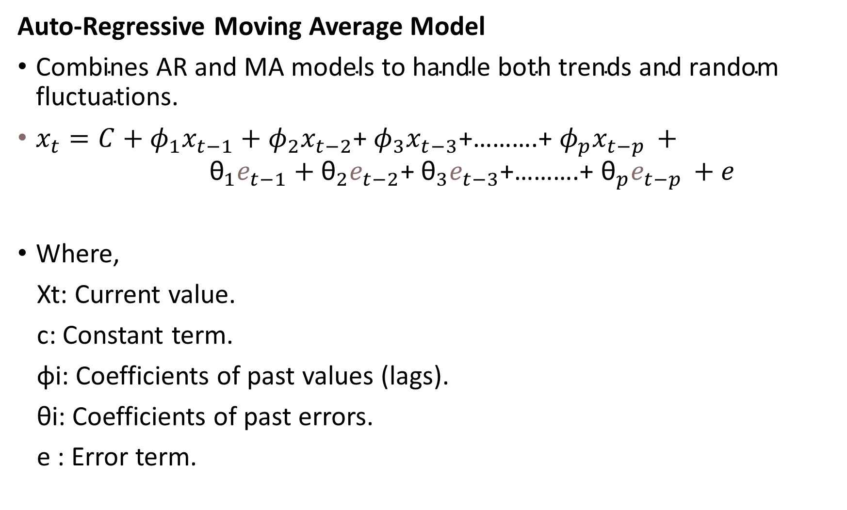
Auto-Regressive Moving Average Model
$\text{Combines} \text{AR} \text{and} \text{MA} \text{models} \text{to} \text{handle} \text{both} \text{trends} \text{and} \text{random} \text{fluctuations}\text{.}$
$x_{t}=C+φ_{1}x_{t−1}+φ_{2}x_{t−2}\text{+} φ_{3}x_{t−3}\text{+……….+} φ_{p}x_{t−p }+ {\text{θ}}_{1}e_{t−1}+{\text{θ}}_{2}e_{t−2}$+ ${\text{θ}}_{3}e_{t−3}$+……….+ ${\text{θ}}_{p}e_{t−p }+e$
Where,
Xt​: Current value.
c: Constant term.
ϕi​: Coefficients of past values (lags).
θi​: Coefficients of past errors.
e ​: Error term.

Slide 15
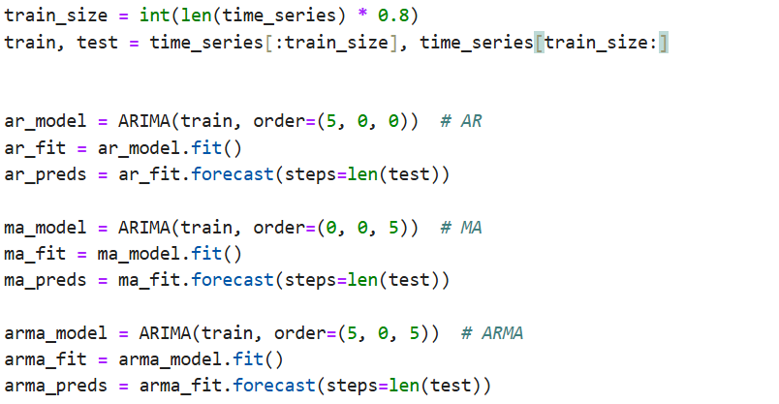

Slide 16

Linear Regression
Predicts the wind energy output based on the wind speed and other meteorological variables.
The relationship between wind speed and energy output can often be approximated linearly, though non-linearity may require more complex models.
y is the dependent variable (e.g., power output).
x is the independent variable (e.g., wind speed).
β0 is the intercept (constant term).
β1​ is the coefficient for x
ϵis the error.

Slide 17

Multiple Linear Regression
Multiple linear regression extends the concept of simple linear regression by considering more than one independent variable.
This is useful when multiple factors (e.g., wind speed, temperature, air density) affect the dependent variable.
y is the dependent variable (e.g., power output).
x1,x2 is the independent variable (e.g., wind speed).
β0 is the intercept (constant term).
β​ is the coefficient for x
ϵis the error.

Slide 18

Polynomial Regression
Polynomial regression is an extension of linear regression, where the relationship between the independent variable and the dependent variable is modeled as an nth-degree polynomial.
This is useful when the relationship between the variables is nonlinear

Slide 19
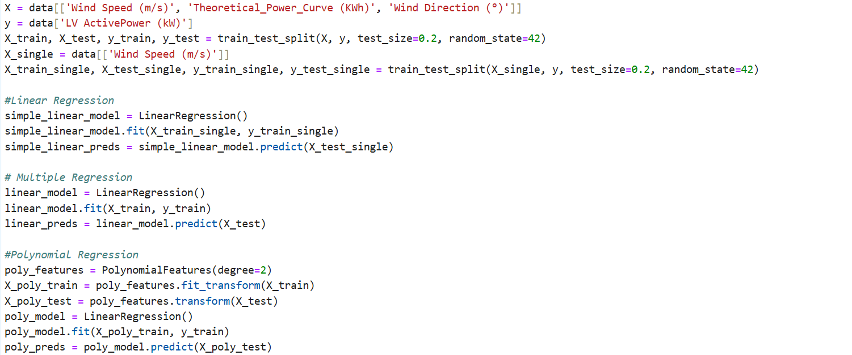

Slide 20

K-Nearest Neighbours (KNN) Regression
K-Nearest Neighbors (KNN) is a non-parametric regression method that predicts the value of a target variable (e.g., wind speed or power output) based on the values of the k-nearest neighbors.
Simple model for short-term wind speed forecasting.

Slide 21
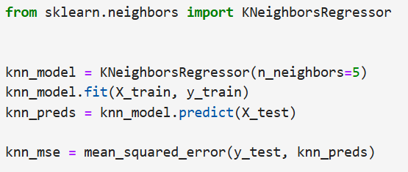
For a given input, the distances to all other points in the dataset are calculated.
Then, k-nearest points (neighbors) are selected based on the calculated distances.
The predicted value is the average (or weighted average) of the target values of the k-nearest neighbors

Slide 22
Artificial Neural Network
An Artificial Neural Network (ANN) is a computational model inspired by the structure and functioning of biological neural networks. It is composed of layers of interconnected nodes (neurons) that process data and learn patterns through training.
Key Components of an ANN:
Input Layer: The first layer receives the input features (e.g., Wind Speed, Wind Direction).Each input is represented as a node, and the number of nodes equals the number of features.
Hidden Layers: Layers between the input and output layers. Perform transformations on the input data using weights, biases, and activation functions. Hidden layers allow the network to learn complex relationships in the data.

Slide 23
Output Layer: Produces the final prediction or classification result.
Activation Functions: Introduce non-linearity to allow the network to learn complex patterns.
Common functions : ReLU, Sigmoid,​ Linear.

Slide 24
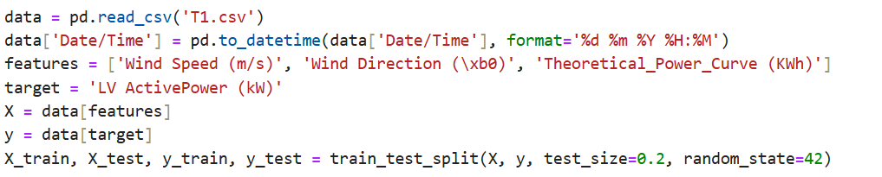
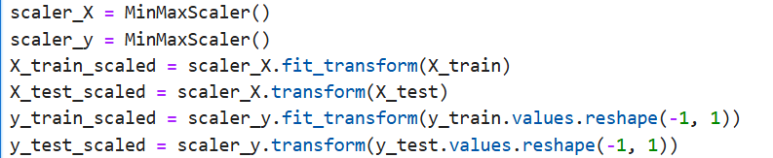
1)Data preprocessing
2)Data scaling

Slide 25
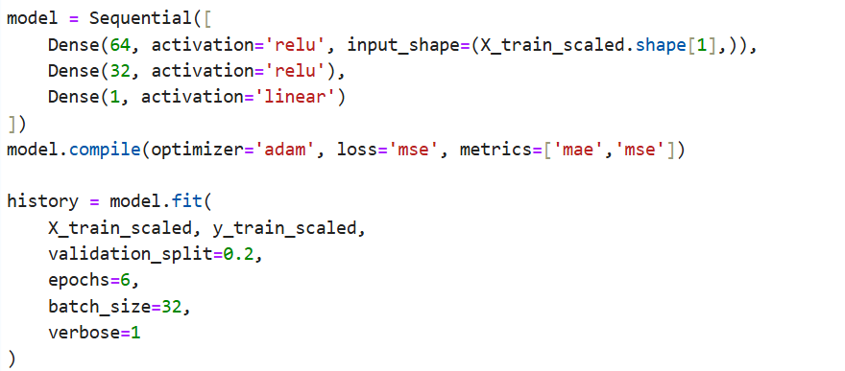
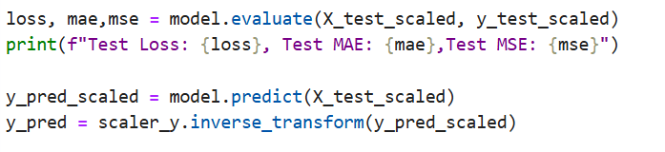
3) Building the ANN model
4) Predictions and evaluation's

Slide 26
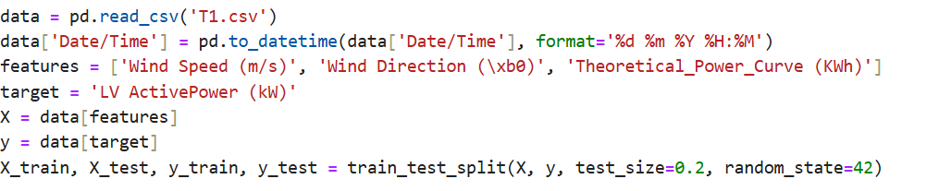
Recurrent Neural Network (RNN)
A Recurrent Neural Network (RNN) is a type of artificial neural network designed for sequential data. Unlike traditional ANNs, RNNs can handle temporal dependencies by maintaining a hidden state that carries information across time steps.
1)Data preprocessing

Slide 27
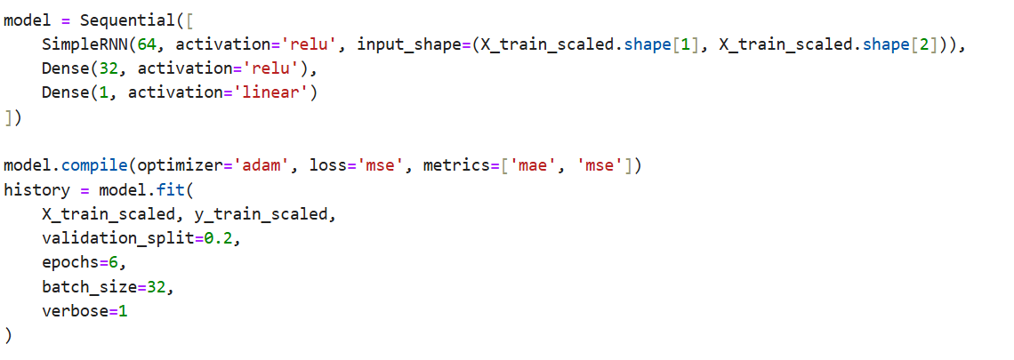
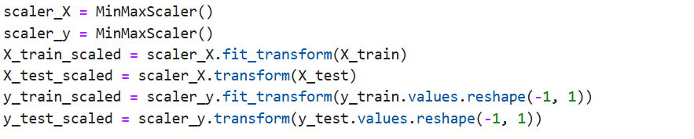
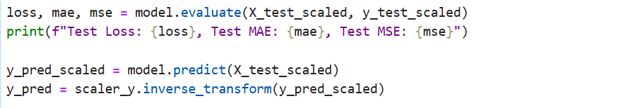
2)Data scaling
3) Building the RNN model
4) Predictions and evaluation's

Slide 28
Wind Dataset
Time: Timestamps of the observations.
temperature_2m, relativehumidity_2m, dewpoint_2m: Meteorological parameters.
windspeed_10m, windspeed_100m, winddirection_10m, winddirection_100m: Wind characteristics.
windgusts_10m: Wind gust data.
Power: Target variable representing wind power generation.

Slide 29
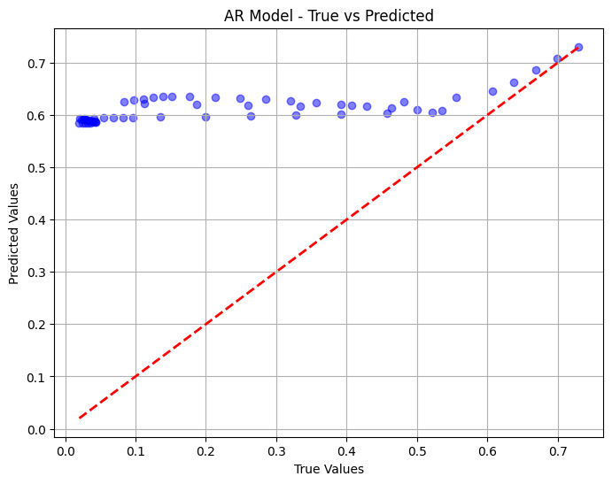
AR model
MAE:0.3872976416569316
MSE: 0.18614891212323528

Slide 30
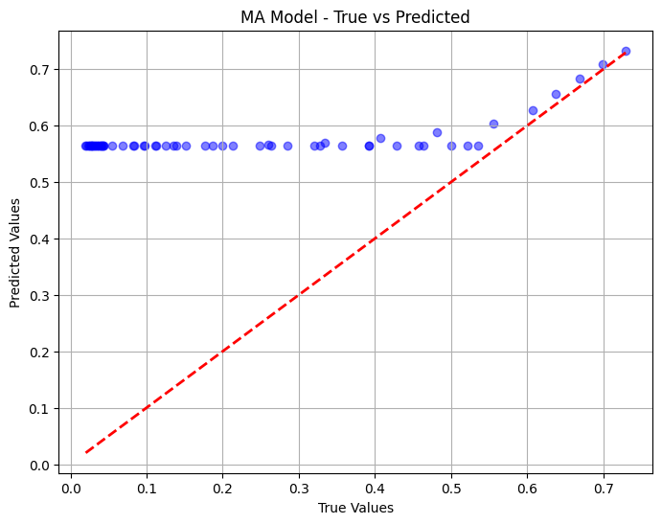
MA model
MAE:0.3502214174949668
MSE:0.15849120315731516

Slide 31
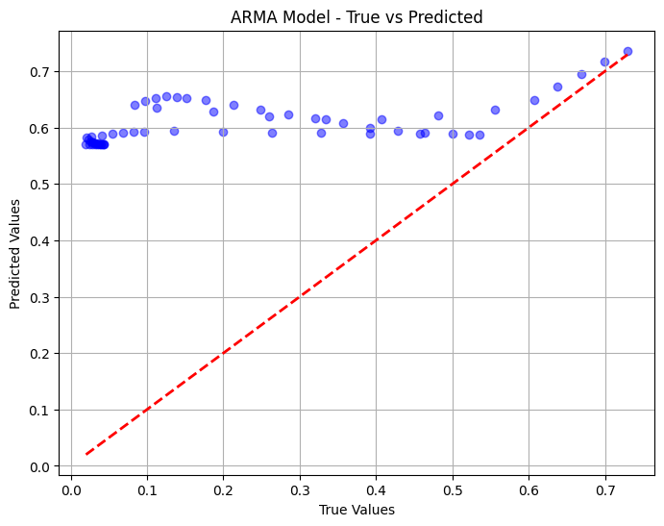
ARMA model
MAE:0.38152531170897397
MSE:0.18169296699993592

Slide 32
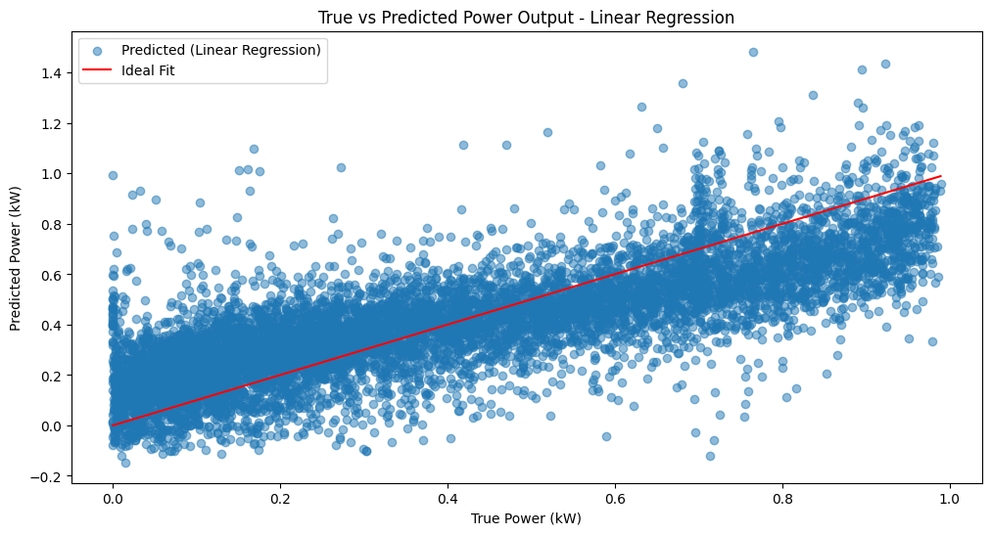
Linear Regression
MAE: 0.14062722008259482
MSE: 0.03179257274279978

Slide 33
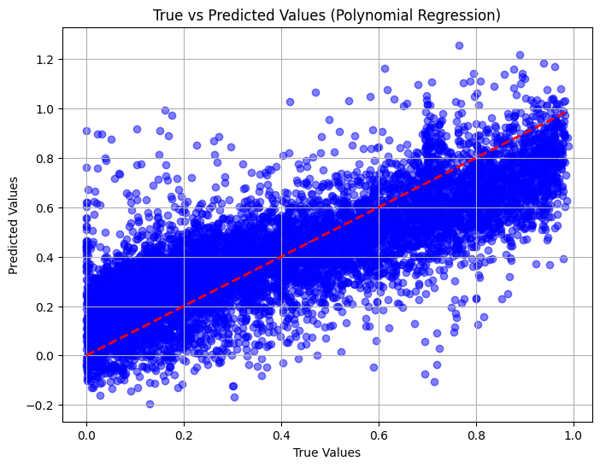
Polynomial regression
MAE: 0.1364707130404405
MSE: 0.03016331267520909

Slide 34
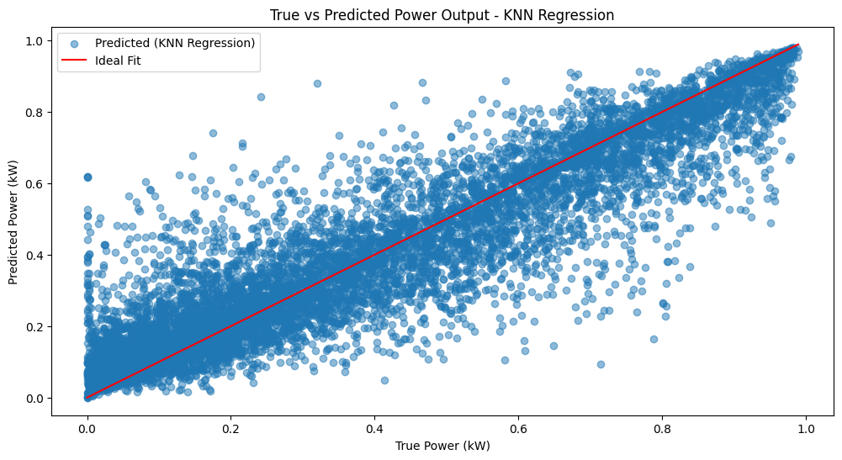
KNN
MAE: 0.08232827194767997, MSE: 0.013860315955656203

Slide 35
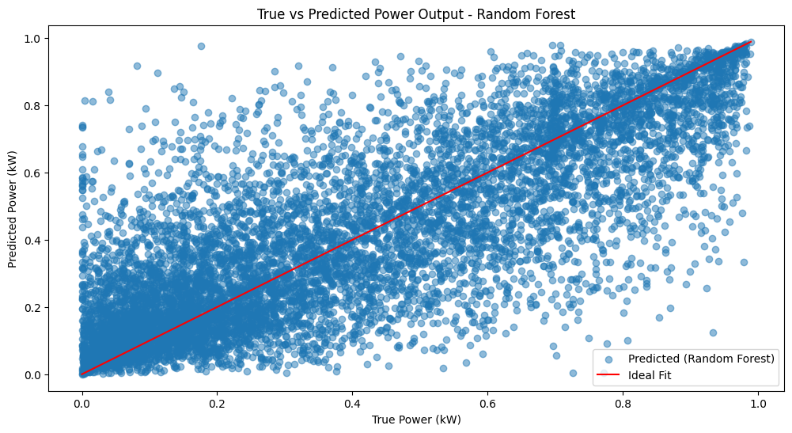
Random Forest
MAE: 0.13101288285711257
MSE: 0.03265215317967408

Slide 36
Summary of Statistical models
Autoregressive (AR)
MAE: 0.3873, MSE: 0.1861
The AR model relies only on the past values of the target variable (Power). Its performance indicates it has the highest errors (both MAE and MSE) compared to the other models.
Moving Average (MA)
MAE: 0.3502, MSE: 0.1585
The MA model, which uses past error terms for prediction, performs the best among the three models. Its lower errors suggest that the noise or residuals in the data are relatively less.
ARMA Model
MAE: 0.3815, MSE: 0.1817
The ARMA model combines both the AR and MA components. Its performance lies between the AR and MA models, indicating that adding autoregressive components didn’t significantly improve predictions over the MA model.

Slide 37
Linear Regression:
Mean Absolute Error (MAE): 0.1406
Mean Squared Error (MSE): 0.0318
Simple and interpretable but has higher errors compared to some other models.
Polynomial Regression:
MAE: 0.1365
MSE: 0.0302
Improves upon Linear Regression by capturing non-linear relationships, leading to slightly better performance.
K-Nearest Neighbors (KNN):
MAE: 0.0823
MSE: 0.0139
Achieves the lowest errors among the models tested, indicating high accuracy for this specific prediction task. However, it might be computationally intensive for large datasets.

Slide 38
Random Forest:
MAE: 0.1310
MSE: 0.0327
Performs better than Linear Regression but slightly worse than Polynomial Regression and KNN. It offers robustness and handles non-linearity well, but its performance lags behind KNN for this task.
Conclusion
KNN stands out as the best-performing model for predicting wind turbine power, achieving the lowest MAE and MSE.
Polynomial Regression also demonstrates decent performance, especially in capturing non-linear relationships.
Random Forest provides a balanced error rates, but its performance is not as competitive.
Linear Regression, while straightforward and easy to interpret, has the highest errors and is the least suited for this task among the tested models.

Slide 39
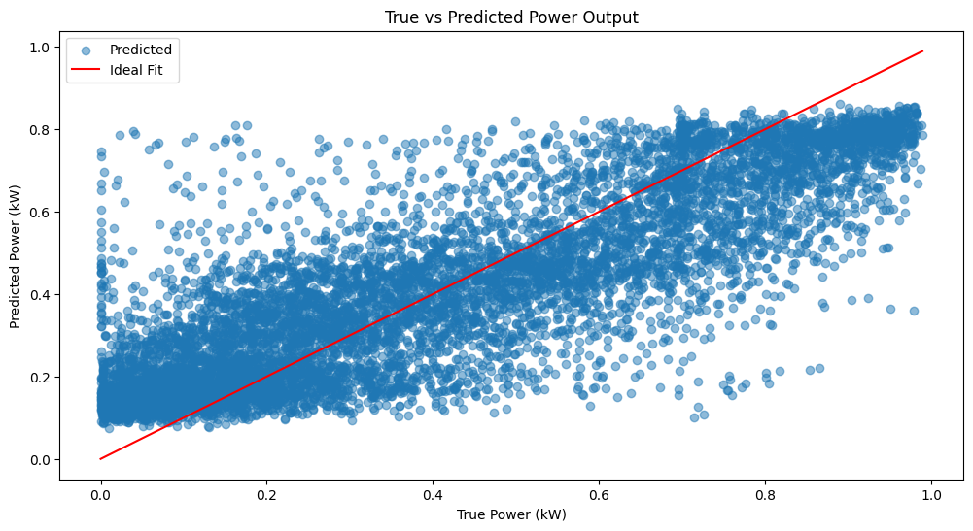
ANN (adam,reLu)
Test Loss: 0.024868831038475037,
Test MAE: 0.024868831038475037,
Test MSE: 0.0022831049282103777,

Slide 40
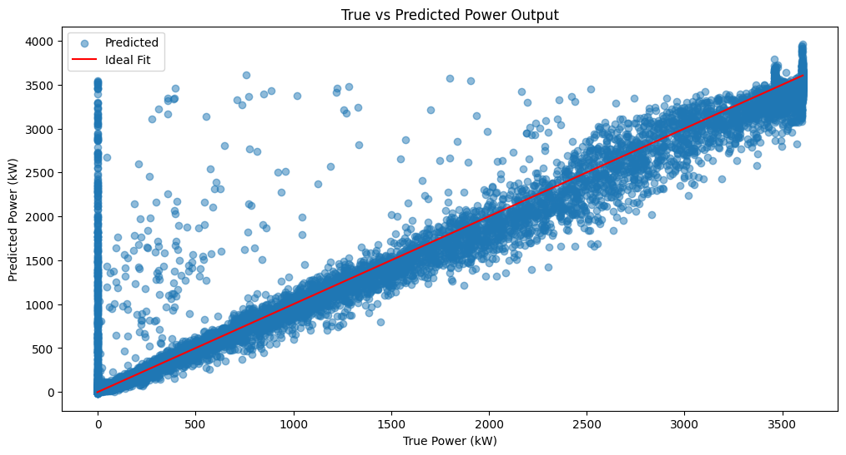
RNN (adam,reLu)
Test Loss: 0.011907434090971947
Test MAE: 0.04457017779350281
Test MSE: 0.011907434090971947

Slide 41
Summary of Hybrid Models
Artificial Neural Network (ANN):
Test Loss: 0.0249
Test MAE: 0.0249
Test MSE: 0.0023
The ANN model shows excellent performance with low error metrics, particularly excelling in Mean Absolute Error (MAE) and Mean Squared Error (MSE). It demonstrates the ability to capture complex patterns effectively.
They excel at learning non-linear relationships in complex datasets, which likely dominate the wind turbine power prediction problem.

Slide 42
Recurrent Neural Network (RNN):
Test Loss: 0.0119
Test MAE: 0.0446
Test MSE: 0.0119
The RNN model, although having higher MAE than ANN, shows strong performance with a low test loss. Its sequential modeling ability likely contributes to improved handling of time-series dependencies in data.
Conclusion:
The ANN model has a lower Test MAE and Test MSE, indicating a slightly better fit for predicting wind turbine power under these conditions.
The RNN model, however, also performs very well and may have advantages in scenarios where time-series or sequential dependencies are more prominent.
Overall, both models perform significantly better compared to traditional ML methods like KNN or Random Forest, with ANN showing marginally better error metrics.

Slide 43
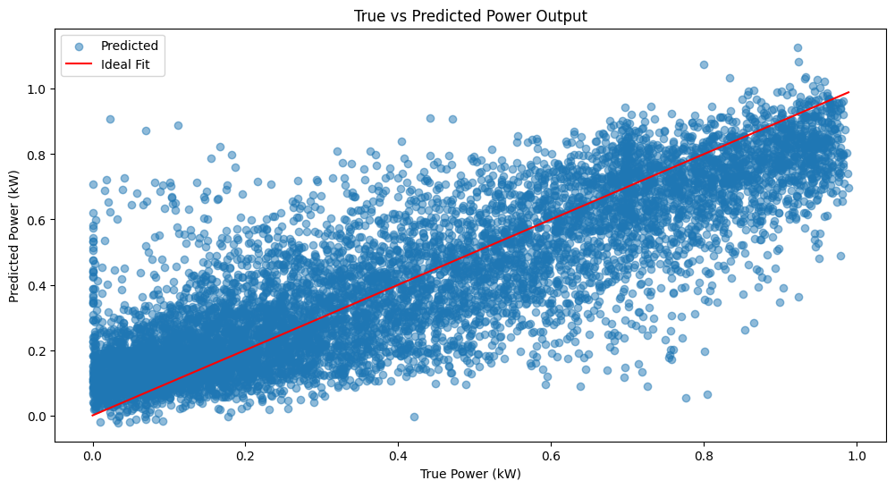
ANFIS
MAE: 0.11327385786875645
MSE: 0.022725813722030665

Slide 44
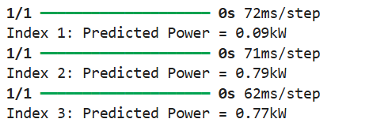
Digital Twin

Slide 45
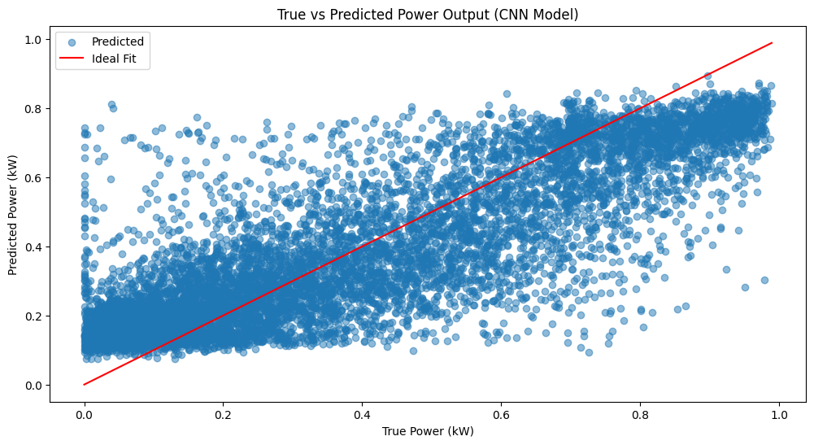
Convolution Neural Network
Test MAE: 0.1239
Test MSE: 0.0257

Slide 46
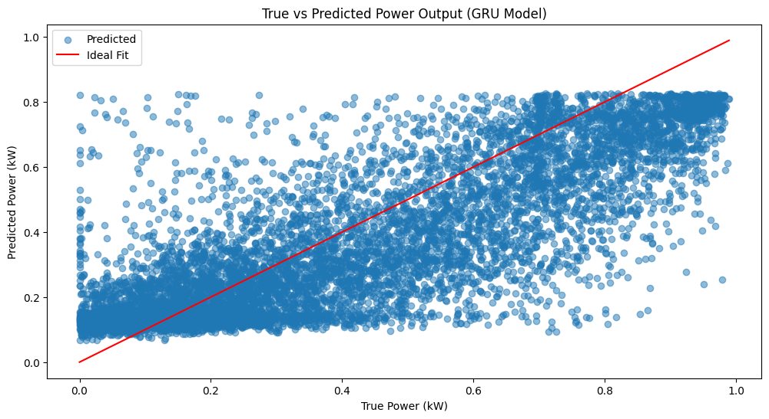
Gated Recurrent Unit
Test MAE: 0.1313
Test MSE: 0.0301

Slide 47
Comparison of Errors for Different Models
Model | MSE | MAE | R-square
AR | 0.186 | 0.387 | -3.204
MA | 0.158 | 0.350 | -2.579
ARMA | 0.182 | 0.382 | -3.101
Linear Regression | 0.032 | 0.141 | 0.622
Polynomial Regression | 0.03 | 0.136 | 0.642
K-nearest neighbour | 0.014 | 0.082 | 0.835
Feed forward neural network | 0.002 | 0.025 | 0.693
Recurrent neural network | 0.012 | 0.045 | 0.696
ANFIS | 0.113 | 0.023 | 0.718
CNN | 0.123 | 0.025 | 0.698
GRU | 0.126 | 0.027 | 0.676

Slide 48
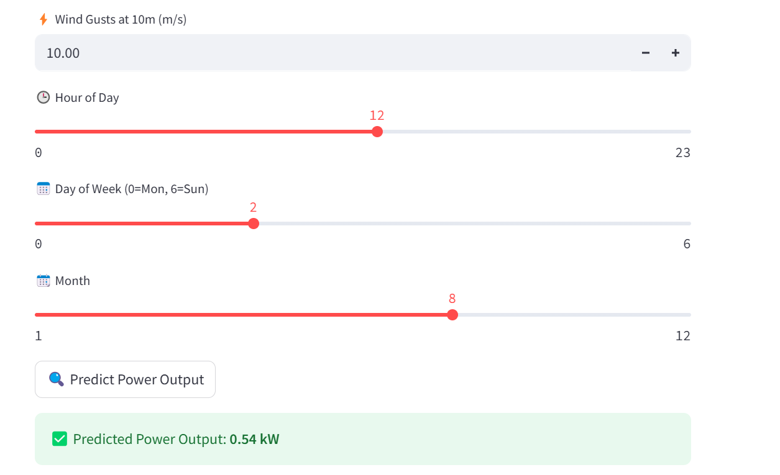
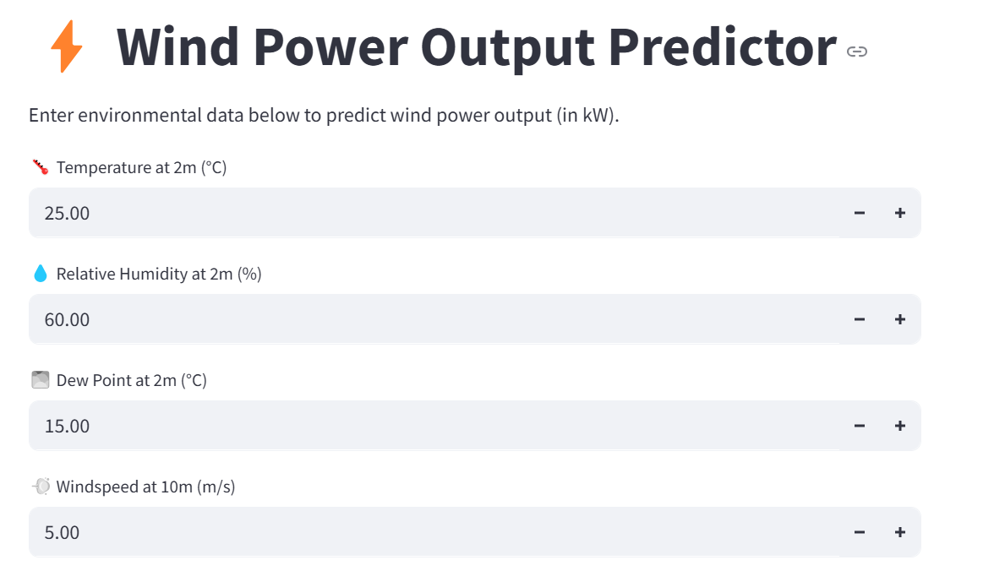

Slide 49
References
A Simplified Wind Power Generation Modelfor Reliability EvaluationRajesh Karki, Senior Member, IEEE, Po Hu, Student Member, IEEE, and Roy Billinton, Life Fellow, IEEE.
Different Models for Forecasting Wind Power Generation: Case Study David Barbosa de Alencar 1,*, Carolina de Mattos Affonso 1 , Roberto Célio Limão de Oliveira 1 ID , Jorge Laureano Moya Rodríguez 2 , Jandecy Cabral Leite 3 and José Carlos Reston Filho 4 .
A Critical Review on Wind Turbine Power Curve Modelling Techniques and Their Applications in Wind Based Energy Systems ,Vaishali Sohoni, S. C. Gupta, R. K. Nema

