Slide 1
CHAPTER 1
INTRODUCTION TO
OPERATING SYSTEMS

Slide 2
1.1 General Definition
An OS is a program which acts as an interface between computer system users and the computer hardware.
It provides a user-friendly environment in which a user may easily develop and execute programs.
Otherwise, hardware knowledge would be mandatory for computer programming.
So, it can be said that an OS hides the complexity of hardware from uninterested users.

Slide 3
1.1 General Definition
In general, a computer system has some resources which may be utilized to solve a problem. They are
  Memory
  Processor(s)
  I/O
  File System
  etc.

Slide 4
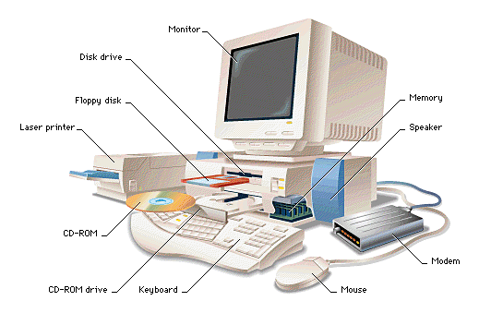
1.1 General Definition
Mainboard

Slide 5
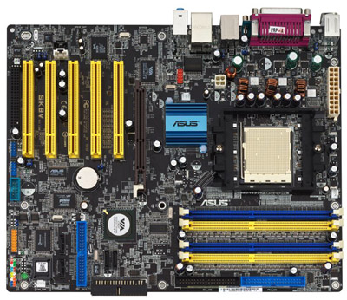
1.1 General Definition

Slide 6
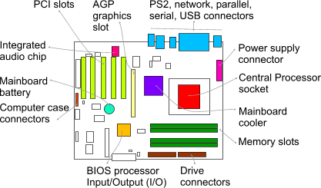
1.1 General Definition
mainboard

Slide 7
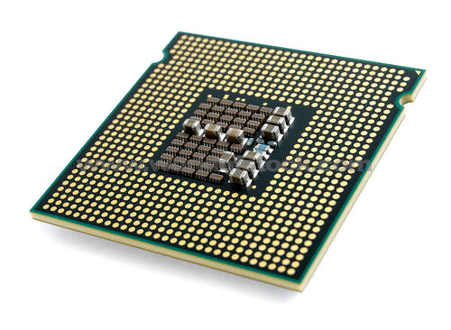


1.1 General Definition
processor

Slide 8
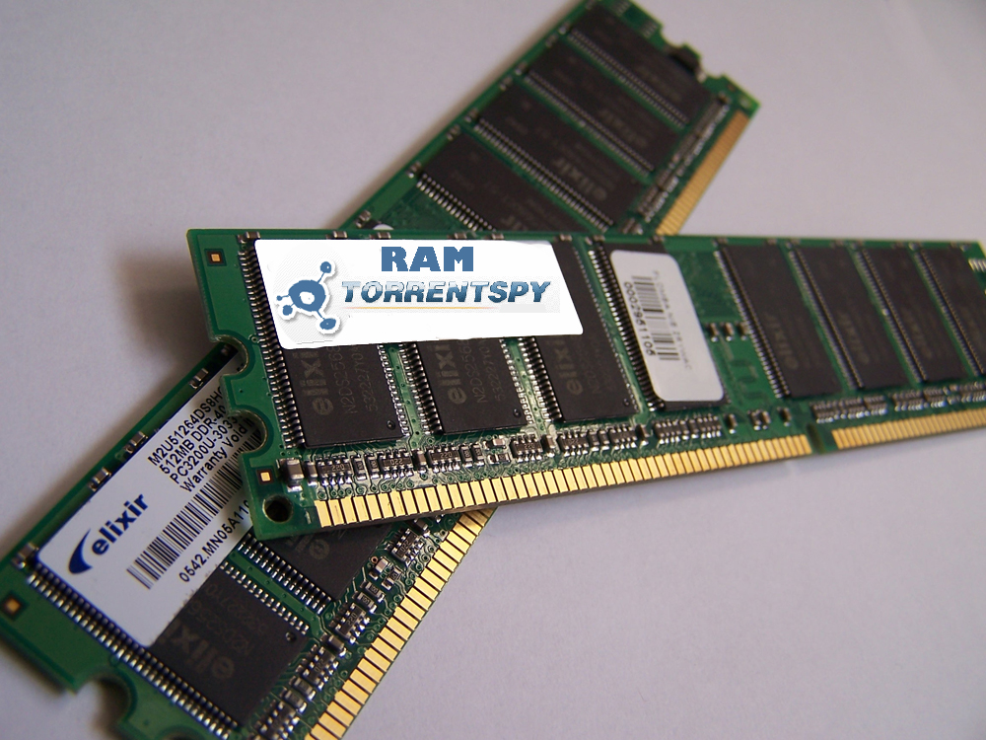
1.1 General Definition
RAM

Slide 9
1.1 General Definition
The OS manages these resources and allocates them to specific programs and users.
With the management of the OS, a programmer is rid of difficult hardware considerations.
An OS provides services for
  Processor Management
  Memory Management
  File Management
  Device Management
  Concurrency Control

Slide 10
1.1 General Definition
Another aspect for the usage of OS is that; it is used as a predefined library for hardware-software interaction.
This is why, system programs apply to the installed OS since they cannot reach hardware directly.
Application Programs
System Programs
Operating System
Machine Language
HARDWARE

Slide 11
1.1 General Definition
Since we have an already written library, namely the OS, to add two numbers we simply write the following line to our program:
c = a + b ;

Slide 12
1.1 General Definition
in a system where there is no OS installed, we should consider some hardware work as:
(Assuming an MC 6800 computer hardware)
  LDAA $80 → Loading the number at memory location 80
  LDAB $81 → Loading the number at memory location 81
  ADDB → Adding these two numbers
  STAA $55 → Storing the sum to memory location 55
As seen, we considered memory locations and used our hardware knowledge of the system.

Slide 13
1.1 General Definition
In an OS installed machine, since we have an intermediate layer, our programs obtain some advantage of mobility by not dealing with hardware.
For example, the above program segment would not work for an 8086 machine, where as the
“c = a + b ;”
syntax will be suitable for both.

Slide 14
1.1 General Definition
A simple program segment with no hardware consideration
A more sophisticated program segment with hardware consideration
Hardware response
  OS
Machine Language

Slide 15
1.1 General Definition
With the advantage of easier programming provided by the OS, the hardware, its machine language and the OS constitutes a new combination called as a virtual (extended) machine.
Operating System
Machine Language
Virtual
(Extended)
Machine
Machine Language
Machine
Hardware
Hardware

Slide 16
1.1 General Definition
In a more simplistic approach, in fact, OS itself is a program.
But it has a priority which application programs don’t have.
OS uses the kernel mode of the microprocessor, whereas other programs use the user mode.
The difference between two is that; all hardware instructions are valid in kernel mode, where some of them cannot be used in the user mode.

Slide 17
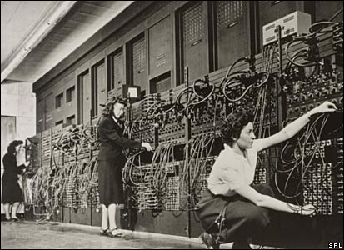
1.2 History of Operating Systems
It all started with computer hardware in about 1940s.
ENIAC 1943

Slide 18
1.2 History of Operating Systems
ENIAC (Electronic Numerical Integrator and Computer), at the U.S. Army's Aberdeen Proving Ground in Maryland.
  built in the 1940s,
  weighed 30 tons,
  was eight feet high, three feet deep, and 100 feet long
  contained over 18,000 vacuum tubes that were cooled by 80 air blowers.

Slide 19
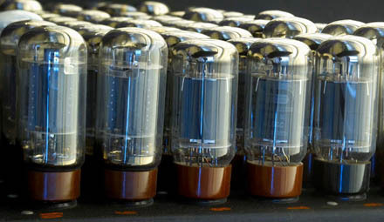
1.2 History of Operating Systems
Computers were using vacuum tube technology.
ENIAC’s vacuum tubes

Slide 20
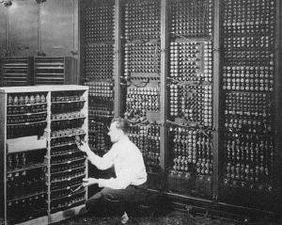
1.2 History of Operating Systems
ENIAC’s backside

Slide 21
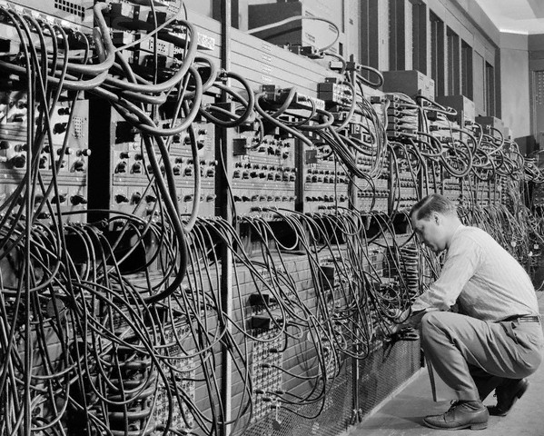
1.2 History of Operating Systems
Programs were loaded into memory manually using switches, punched cards, or paper tapes.
ENIAC : coding by cable connections

Slide 22
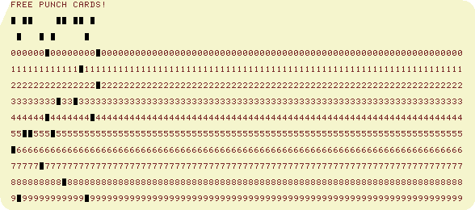
1.2 History of Operating Systems
punch card

Slide 23
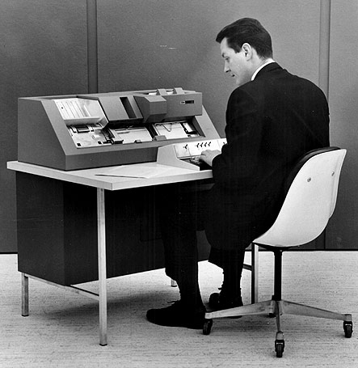
1.2 History of Operating Systems

Slide 24
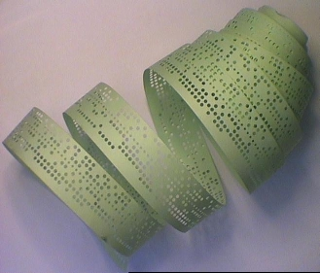
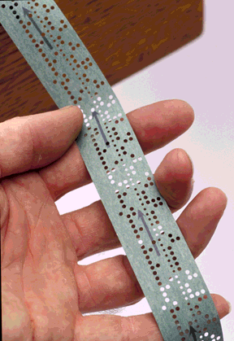
1.2 History of Operating Systems
Paper tape

Slide 25
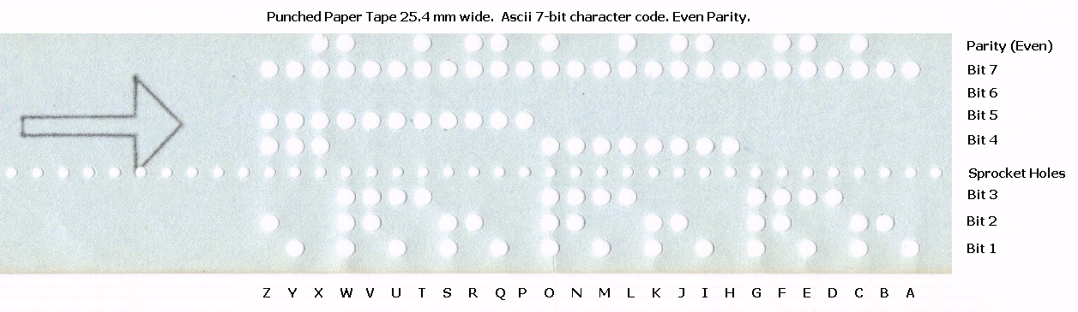
1.2 History of Operating Systems

Slide 26
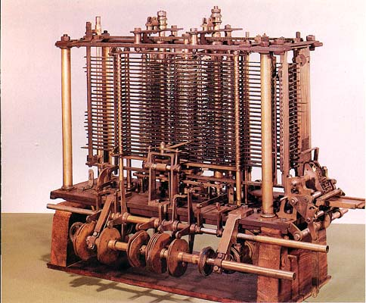
1.2 History of Operating Systems
Babbage’s analytical engine
(designed in 1840’s by Charles Babbage, but cold not be constructed by him.
An earlier and simpler version is constructed in 2002, in London )
http://www.computerhistory.org/babbage/

Slide 27
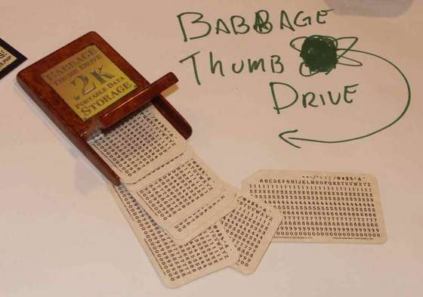
1.2 History of Operating Systems
Ada Lovalence (at time of Charles Babbage) wrote code for analytical engine to compute Bernulli Numbers

Slide 28
1.2 History of Operating Systems
As time went on, card readers, printers, and magnetic tape units were developed as additional hardware elements.
Assemblers, loaders and simple utility libraries were developed as software tools.
Later, off-line spooling and channel program methods were developed sequentially.

Slide 29
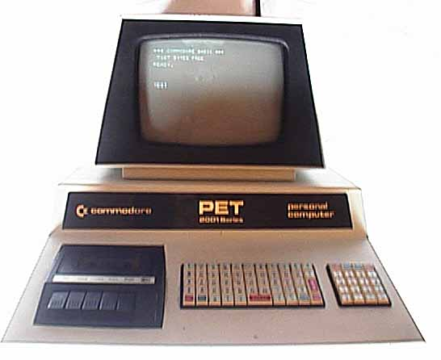
1.2 History of Operating Systems
Commodore PET, 1977

Slide 30
1.2 History of Operating Systems
Finally, the idea of multiprogramming came.
Multiprogramming means sharing of resources between more than one processes.
By multiprogramming the CPU time is not wasted, because, while one process moves on some I/O work, the OS picks another process to execute till the current one passes to I/O operation.

Slide 31
1.2 History of Operating Systems
With the development of interactive computation in 1970s, time-sharing systems emerged.
In these systems, multiple users have terminals (not computers) connected to a main computer and execute her task in the main computer.

Slide 32


1.2 History of Operating Systems
Main computer; having a CPU executing processes by utilization of the OS, (e.g. UNIX).
Terminals are connected to the main computer and used for input and output. No processing is made. They do not have CPUs.

Slide 33
1.2 History of Operating Systems
Another computer system is the multiprocessor system having multiple processors sharing memory and peripheral devices.
With this configuration, they have greater computing power and higher reliability.

Slide 34
1.2 History of Operating Systems
Multiprocessor systems are classified into two as tightly-coupled and loosely-coupled (distributed).
In the tightly-coupled one, each processor is assigned a specific duty but processors work in close association, possibly sharing the same memory.
In the loosely coupled one, each processor has its own memory and copy of the OS.

Slide 35
1.2 History of Operating Systems
Use of the networks required OSs appropriate for them.
In network systems, each process runs in its own machine but the OS have access to other machines.
By this way, file sharing, messaging, etc. became possible.
In networks, users are aware of the fact that s/he is working in a network and when information is exchanged. The user explicitly handles the transfer of information.

Slide 36

1.2 History of Operating Systems
Each is a computer having its own CPU, RAM, etc. An OS supporting networks is installed on them.

Slide 37
1.2 History of Operating Systems
Distributed systems are similar to networks. However in such systems, there is no need to exchange information explicitly, it is handled by the OS itself whenever necessary.
With continuing innovations, new architectures and compatible OSs are developed. But their details are not in the scope of this text since the objective here is to give only a general view about developments in OS concept.

Slide 38
Classification of Operating Systems
Batch systems
Interactive computer systems
Multiprogramming operating systems
Multitasking operating systems
Time sharing operating systems
Real-time operating systems (Ward, Soft)
Parallel systems
Distributed systems
Network operating systems

