Slide 2
Clock and reset circuit:-
The crystal frequency:
The frequency of the crystal oscillator connected to the XTAL1 and XTAL2 input pins is one factor in the time delay calculation. The duration of the clock period for the instruction cycle is a function of this crystal frequency.
XTAL1 and XTAL2
The ATmega32 has many options for the clock source. Most often a quartz crystal oscillator is connected to input pins XTAL1 and XTAL2. The quartz crystal oscillator connected to the XTAL1 and XTAL2 pins also needs two capacitors. One side of each capacitor is connected to the ground as shown in Figure. Notice that ATmega32 microcontrollers can have speeds of 0 Hz to 16 MHz. We can choose options for the clock source and frequency by setting some fuse bits.

Slide 3
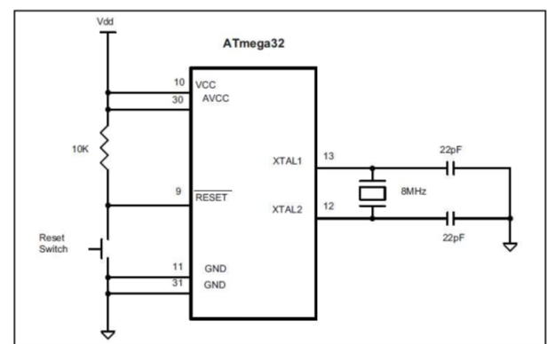
Clock and reset:-
1. Power Supply
VCC (Pin 10) and AVCC (Pin 30) are connected to Vdd, which is the positive supply voltage.
GND (Pins 11 and 31) are connected to ground.
2. Reset Circuit
RESET (Pin 9) is connected to Vdd through a 10kΩ pull-up resistor.
A reset switch is connected between the RESET pin and ground.
Pressing the switch momentarily pulls the RESET pin to ground, which resets the microcontroller.
3. Crystal Oscillator Circuit
XTAL1 (Pin 13) and XTAL2 (Pin 12) are connected to an 8 MHz crystal oscillator.
Two 22pF capacitors are connected from each pin of the crystal to ground.
These capacitors are used to stabilize the crystal oscillator, providing accurate timing for the microcontroller.

Slide 4
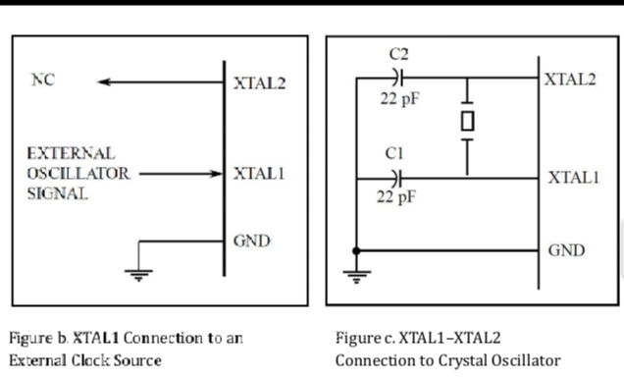
.
XTAL1 (Pin 13) is connected to an external clock signal (from an oscillator or another clock source).
XTAL2 (Pin 12) is grounded.
In this configuration, the microcontroller is using an external oscillator or clock signal to drive the microcontroller's clock rather than using a crystal oscillator.
NC (not connected) indicates that no internal crystal oscillator circuit is needed.
2. Figure (c): XTAL1–XTAL2 Connection to a Crystal Oscillator
XTAL1 (Pin 13) and XTAL2 (Pin 12) are connected to a crystal oscillator.
A crystal (between XTAL1 and XTAL2) generates a specific frequency, in this case, 8 MHz.
C1 and C2 (both 22pF capacitors) are used for stabilizing the frequency and ensuring the accurate oscillation of the crystal.
GND is connected to the circuit ground.

Slide 5
Reset :-
Pin 9 (in the ATmega32, 40-pin DIP) is the RESET pin. It is an input and is active-LOW (normally HIGH). When a LOW pulse is applied to this pin, the microcontroller will reset and terminate all activities. After applying reset, contents of all registers and SRAM locations will be cleared. Notice that after applying reset, all ports will be input because contents of all DDR registers are cleared. The CPU will start executing the program from run location0x00000 after a brief delay when the RESET pin is forced low and then released.

Slide 6
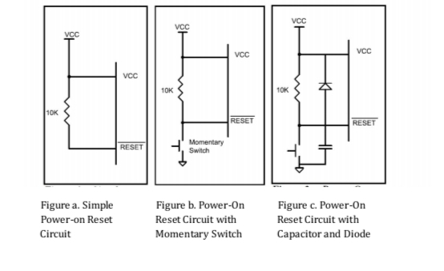

Slide 7
Figures a, b, and c show three ways of connecting the RESET pin. Figure 3b uses a momentary switch for reset circuitry. The most difϐ icult time for any system is during the power-up. The CPU needs both a stable clock source and a stable voltage level to function properly. Some designers put a 10 nF capacitor between the RESET pin and GND to ϐilter the noise during reset and working time. The diode protects the RESET pin from being powered by the capacitor when the power is off. The AVR chips come with some features that help the reset process. We can choose these features by setting the bits in the fuse bytes.

Slide 8
#define F_CPU 1000000UL // Internal clock 1 MHz #include <avr/io.h> #include <util/delay.h> int main(void) { DDRB = 0x01; // Set PB0 as output (LED) // Blink LED 3 times after reset for (int I = 0; I < 3; i++) { PORTB |= 0x01; // LED ON _delay_ms(500); PORTB &= ~0x01; // LED OFF _delay_ms(500); } while (1) { // Do nothing (can add main code here) } }

