Slide 1

AI Legal Terms Explainer Chatbot
Simplifies Legal Jargon into Layman’s Terms
AI Legal Terms Explainer
Simplifies Legal Jargon into Layman’s Terms
Presented By: Isha kumari (12504063)
Abhinav Raj (12419607)
Course code: INT428
(AI ESSENTIALS)
Guided By: Mr. Anuj Attri Sir
(Assistant professor)

Slide 2
Introduction
Legal documents often contain complex terms that are difficult for common people to understand. This creates confusion for students, beginners, and non-legal users.
Our project, AI Legal Terms Explainer, uses Artificial Intelligence to simplify legal jargon into easy and understandable language. It provides customized explanations based on the user’s selected level and format, and also supports PDF upload for quick legal text analysis.

Slide 3
Project Objective
To develop an AI-powered system that:
explains legal terms in simple language
supports multiple understanding levels
provides examples for better clarity
accepts both text input and PDF files
improves legal awareness for everyone

Slide 4
Methodology
Step 1: User Input
User either:
types legal text manually
uploads a PDF document
Step 2: PDF Text Extraction
If PDF is uploaded:
PyPDF2 reads the file
extracts text from first few pages
inserts the text into input area

Slide 5
Step 3: User Preference Selection
User selects:
explanation level (Beginner / Intermediate / Legal Student)
response format (Simple / Detailed / Bullet Points)
Step 4: Dynamic Prompt Generation
Python uses f-strings to create a customized prompt using:
legal text
selected level
selected tone
This process is called Prompt Engineering

Slide 6
Step 5: Groq API Processing
The generated prompt is sent to:
Groq API → Llama 3.1 Model
The AI processes the request and generates a simplified explanation.
Step 6: Final Output Display
The explanation is displayed in:
clean format
markdown style
user-friendly interface

Slide 7
Technologies Used
Frontend | Backend / Logic | File Processing | Deployment
Python | Groq API | PyPDF2 | Jupyter Notebook
ipywidgets | Llama 3.1 8B Instant Model |  | Voilà
HTML + CSS |  |  | Localhost

Slide 8
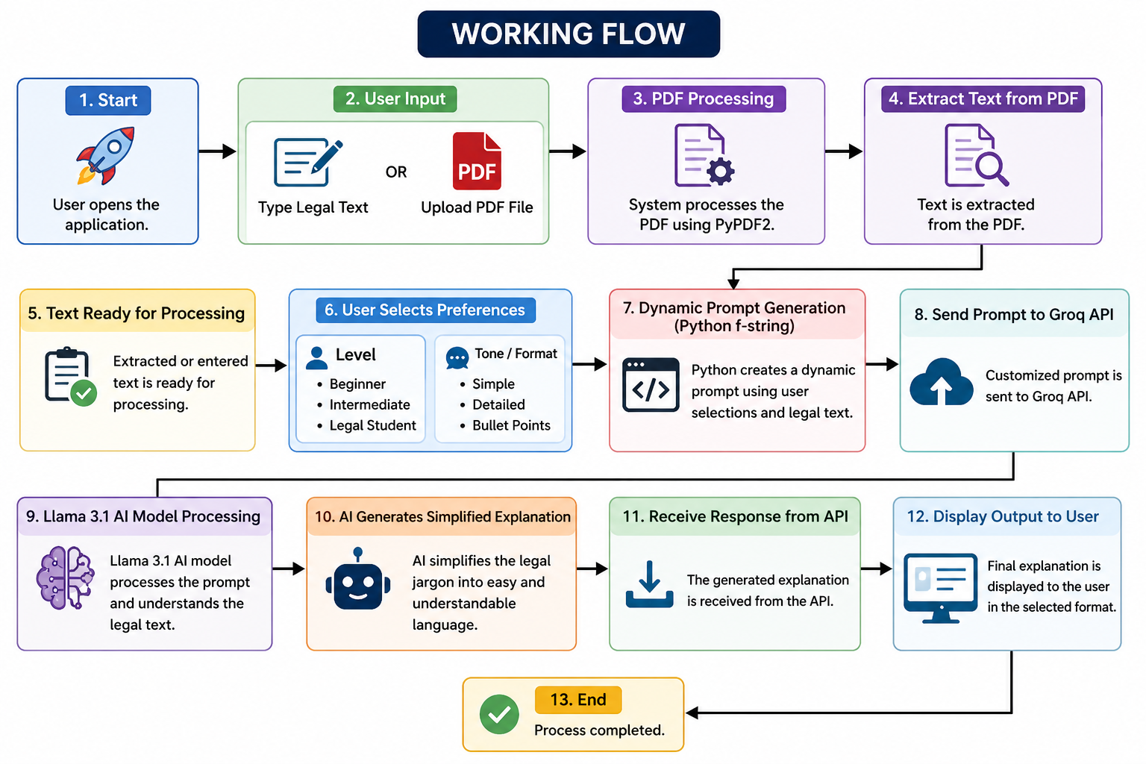
Working of the System

Slide 9
Novelty of the Project
1. AI-Based Legal Simplification
Unlike normal legal dictionaries, our system provides:
smart explanation
real-world examples
personalized understanding

Slide 10
2. Multi-Level Explanation System
Same legal term can be explained for:
beginners
intermediate learners
legal students
This makes the project useful for different users.
3. PDF-to-Explanation Feature
Users can directly upload contracts and legal PDFs instead of manually typing everything.
This makes the system practical and time-saving.
ulti-Level Explanation System
Same legal term can be explained for:
beginners
intermediate learners
legal students
This makes the project useful for different users.

Slide 11
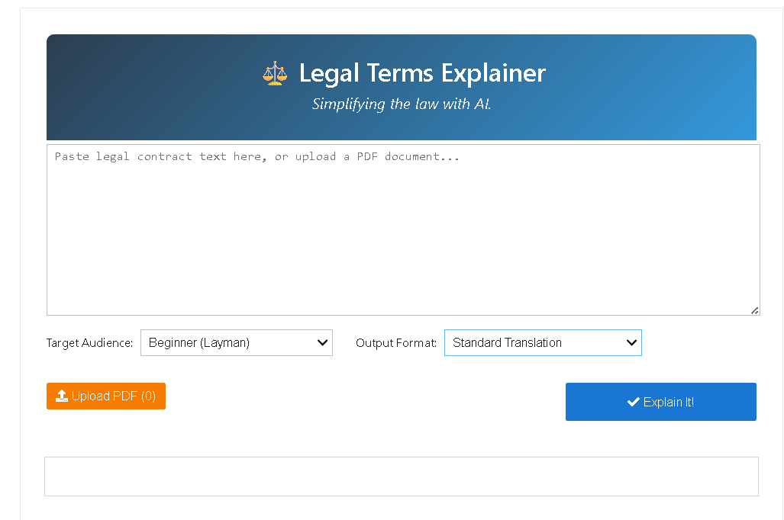
Result Demonstration

Slide 12
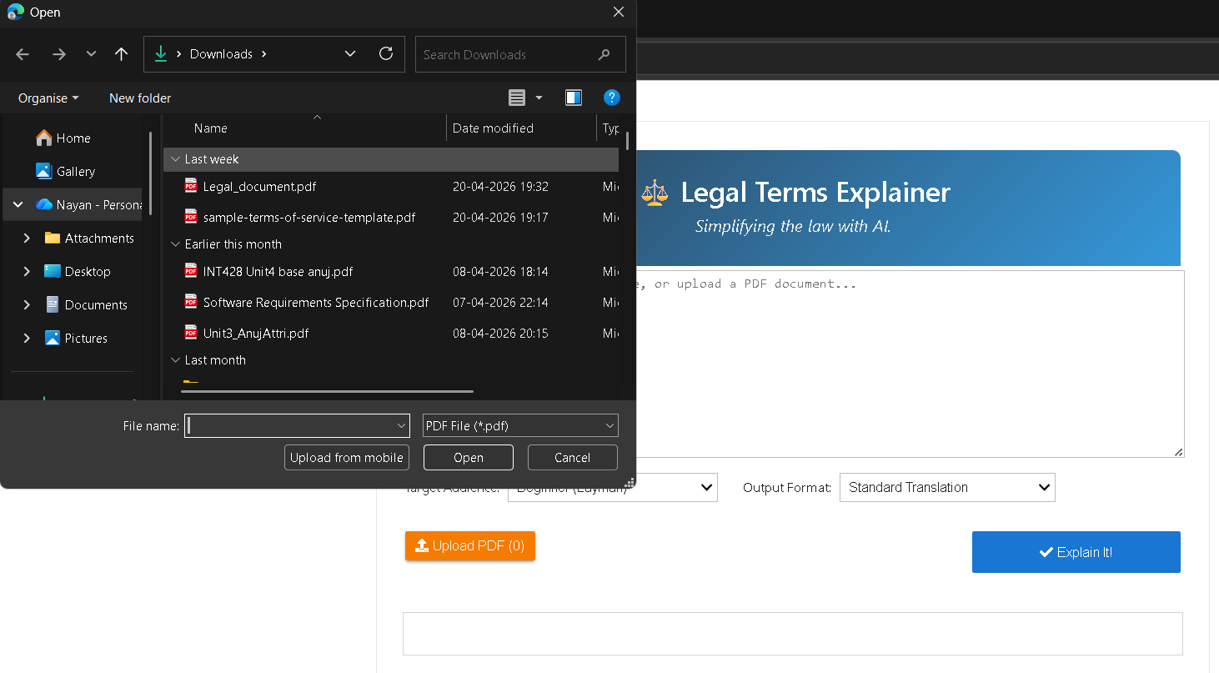

Slide 13
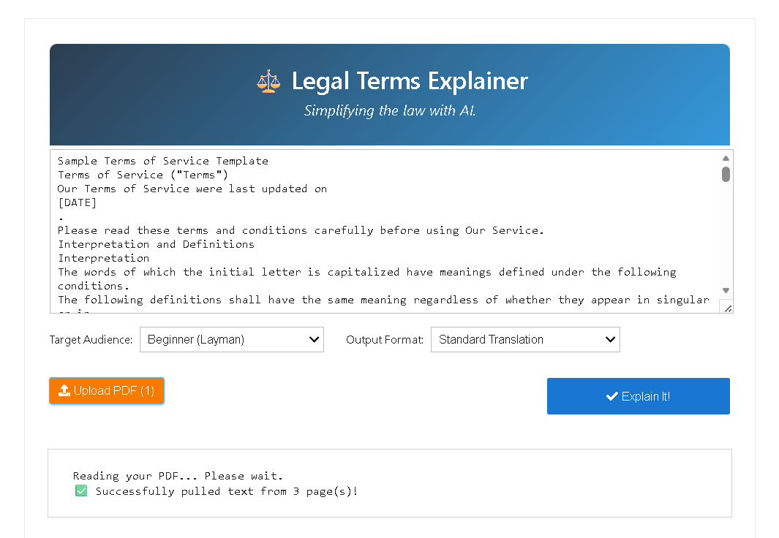

Slide 14
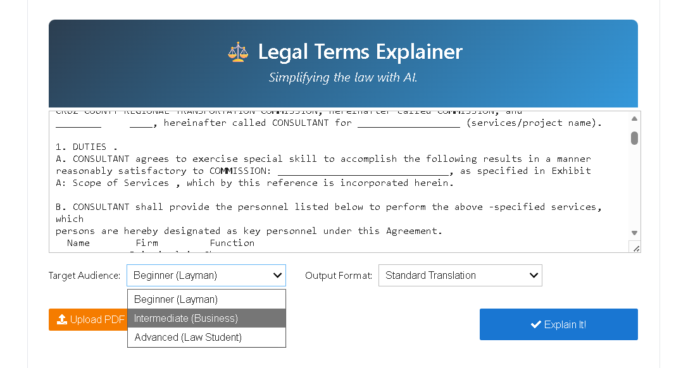

Slide 15
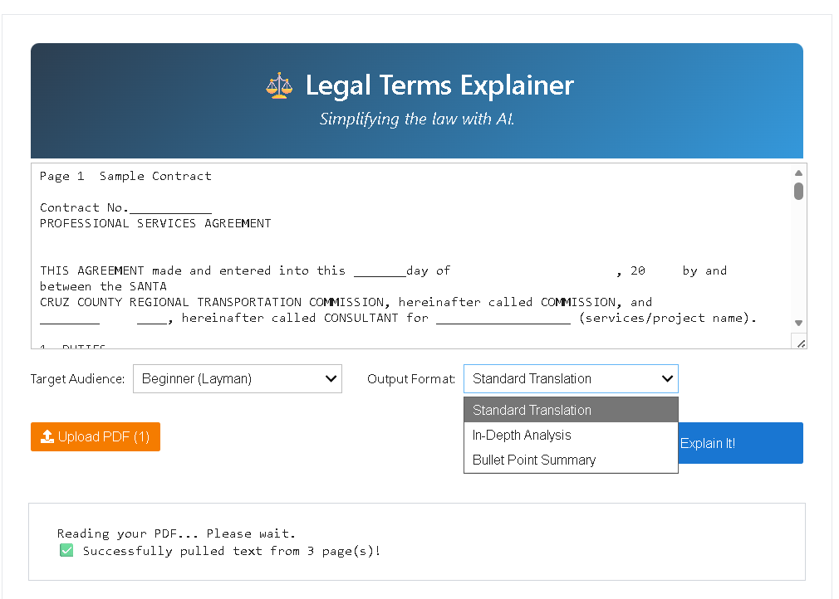

Slide 16
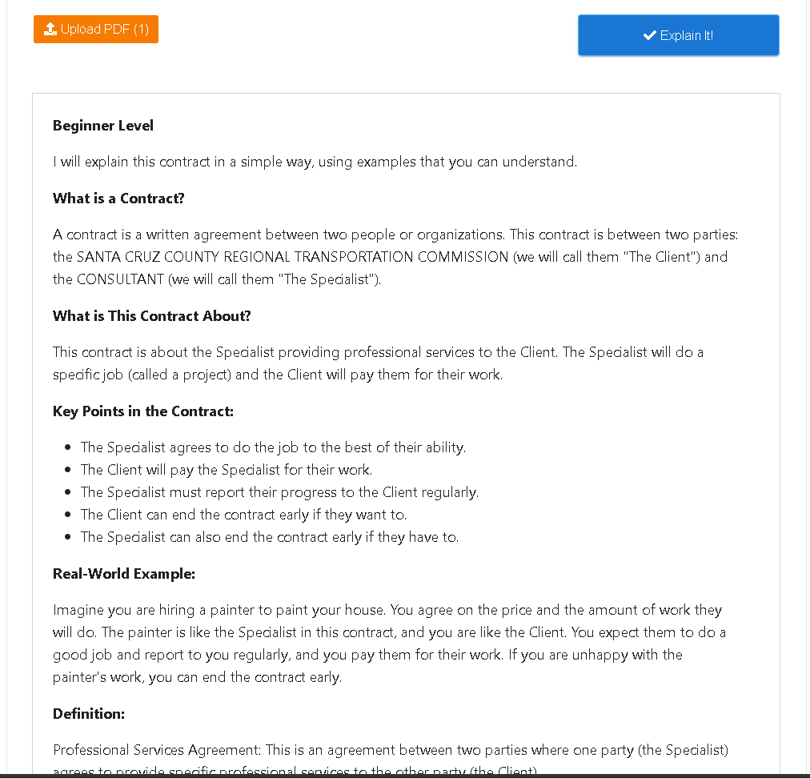

Slide 17
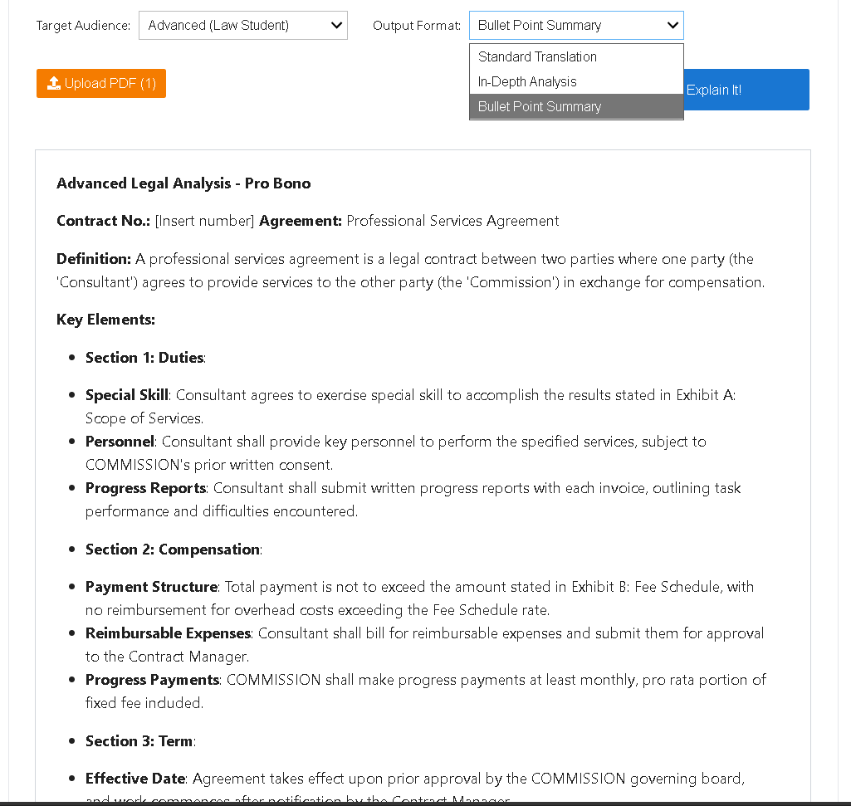

Slide 18
Conclusion
In conclusion, AI Legal Terms Explainer helps bridge the gap between legal professionals and common people.
It simplifies difficult legal language using Artificial Intelligence and makes legal understanding faster, easier, and more accessible.
This project shows how AI can be used to solve real-world problems in a practical way.

Slide 19
Than kThank You
Thank you for listening to my presentation.
You
Thank you for listening to my presentation.

