Slide 1
Scenario-Based Digital Forensic Investigation of Compromised MySQL Database -Authors: Taurai Hungwe, Hein. S. Venter, Victor R. Kebande
NAME: ISHA DHABALIA
ROLL NUMBER: 1911018, DIV: A

Slide 2
Introduction

Slide 3
There is a vast amount of data which is currently available and is being generated.
Databases act as the primary source of electronic evidence for every organization irrespective of its size and complexity and are crucial to any company or organization
Due to problems like frequent and large data security breaches, possibilities of tampered data within a database, criminal activities due to illegal access to a database and many such suspicious activities it is important to bring forensic investigation into picture.

Slide 4
Digital Forensics

Slide 5
Digital Forensics is defined as the process of preservation, identification, extraction, and documentation of computer evidence which can be used by the court of law.
Majority of the applications use high-performance databases to manage the data.
Database forensics deals with the examination of databases and its associated metadata.
Digital Forensics Investigations mainly aim to correctly identify, collect, validate, analyse, interpret, preserve, and present digital evidence.

Slide 6
4-Level Database System Architecture

Slide 7
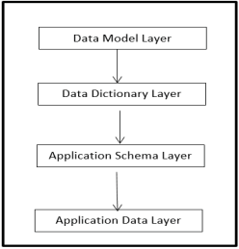
Defines the database system in terms of the database components and interactions among database components

Slide 8
Objective

Slide 9
Present four abstract layers based on the ANSI/SPARC model on a MySQL DBMS.
Modify each layer to simulate compromised database so that we can see and record the cause and effects of unauthorized modifications.
Reconstruct a compromised MySQL DBMS to see if we can forensically find evidence.
Construct forensic process by introducing configurations in MySQL database.

Slide 10
Procedure

Slide 11
Identify the four layers of MySQL DBMS.
Make unauthorized modifications on these layers directly or indirectly.
In digital forensics, unauthorised modifications produce digital records which can be located in the OS.
Reconstruct the database using uncompromised layers.
Using this forensic configurations in a MySQL database can be constructed.

Slide 12
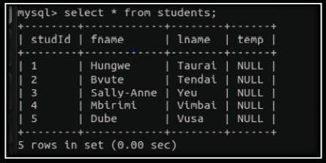
Simulated Experiment on Application Data layer
In the following scenario the first name and last name have been swapped to create a compromised database.
Therefore on performing queries incorrect output is given

Slide 13
Simulated Experiment on Data Model Layer:
MySQL directory was deleted by accessing it and it was checked if the databases created were accessible
Simulated Experiment on Data Dictionary Layer:
Data dictionary layer was located and the existing database name was changed therefore when the when the database is selected using the previous name it is not accessible
Simulated Experiment on Application Schema Layer:
The column heading or field name were altered by altering the byte values. When the field names were viewed it was noticed that it reverted to the old column heading.

Slide 14
Evaluation of Proposed Concepts

Slide 15
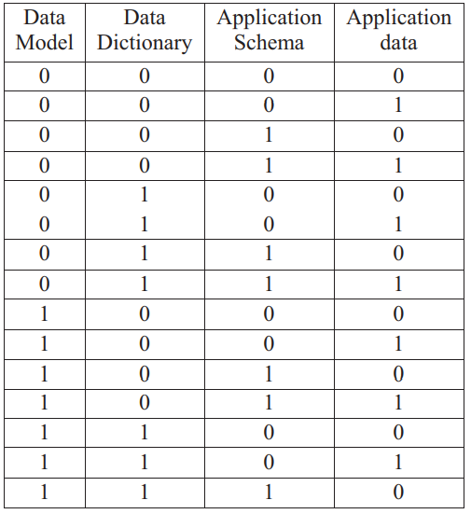
Different configurations possible:
After compromisation of the database, the next steps of forensic investigation depends on the investigator
Based on the experiments conducted through the unauthorized modifications to the layers of the DBMS the following configuration is proposed:
If a single layer is compromised that layer would be represented by a binary value “1”.
If the layer was not compromised, it would be represented by a binary value “0”.

Slide 16
Conclusion

Slide 17
It can be concluded that:
Databases store sensitive information and hence it is important to keep a check on data by utilising the concepts and tools of digital forensics to do so.
Scenario based digital forensic investigation can be performed to check if a database has been compromised.
It is mainly up to the investigator on how the investigation process is to be carried out and construct configurations accordingly.

Slide 18
Strategy

Slide 19
Create a database on which the forensic investigation is to be carried out using MySQL
Consider the scenario used in the paper or create a new scenario
Modify 2 layers out of the 4 layers to create a compromised database
Write a report to conduct the forensic investigation and analyse the database

Slide 20
Bibliography

Slide 21
Digital forensics – Wikipedia
https://www.idera.com/glossary/database-forensics
https://info-savvy.com/database-forensics-and-its-importance/#:~:text=Database%20forensics%20deals%20with%20the,of%20its%20size%20and%20complexity.
https://evestigate.com/database-forensics-database-ediscovery/

Slide 22
Al-Dhaqm, A., Razak, S., Othman, S. H., Choo, K. K. R., Glisson, W. B., Ali, A., & Abrar, M. (2017). CDBFIP: Common Database Forensic Investigation Processes for Internet of Things. IEEE Access, 5, 24401-24416.
Al-Dhaqm, A. M. R., Othman, S. H., Razak, S. A., & Ngadi, A. (2014, August). Towards adapting metamodelling technique for database forensics investigation domain. In Biometrics and Security Technologies (ISBAST), 2014 International Symposium on (pp. 322-327). IEEE.
Bria, R, Retnowardhani, A, Utama, D.N. (2018). Five Stages of Database Forensic Analysis: A Systematic Literature Review. In 2018 International Conference on Information Management and Technology (ICIMTech). (pp. 246 – 250).IEEE.
Wright, C. “SANS Blog: Forensics and Data Access Auditing,” 15 March 2009a. [Online]. Available: http://computerforensics.sans.org/blog/2009/03/15/forensics-and-data-accessauditing. [Accessed 21 April 2012].

