Slide 1

CAR INSURANCE POLICY
GENERATOR
NAME: ISHA DHABALIA
BATCH: A2
ROLL NO. : 1911018

Slide 2
TABLE OF CONTENTS
01
02
03
04
05
06
PROBLEM DEFINITION
FEATURES
OVERVIEW AND WORKING
FUTURE SCOPE
CONCEPTS USED
IMPLEMENTATION

Slide 3

PROBLEM DEFINITION
01
With increasing need of protecting ourselves from the financial risks due to accidents and other incidents, it is important to purchase a car insurance policy. The system aims to generate an insurance policy according to various factors.

Slide 4
FEATURES
REGISTER
LOGIN
PROFILE
VIEW POLICIES
GENERATE POLICY
DOWNLOAD POLICY
02

Slide 5

03
OVERVIEW AND WORKING

Slide 6
OVERVIEW
The car insurance policy is generated on the basis of various conditions which the user enters.
The installment schedule may be quarterly, half-yearly or yearly
The policy may be for self damage, third-party damage or both
The premium calculation is based on the following factors :
Gender Year of Registration
Age City
Cubic Capacity Price of car

Slide 7
FACTOR CALCULATION
Year of Registration | Factor
2013 - 2016 | 0.0030
2017 - 2019 | 0.0020
2020 - 2021 | 0.0010
Gender | Factor
Male | 0.0020
Female | 0.0015
City | Factor
Mumbai | 0.0040
Pune | 0.0035
Nagpur | 0.0030
Aurangabad | 0.0025
Nashik | 0.0020

Slide 8
FACTOR CALCULATION
Capacity(in cc) | Factor
800 - 999 | 0.0010
1000 - 1199 | 0.0020
1200 - 1300 | 0.0030
Price of car | Factor
500000 - 999999 | 0.0010
1000000 - 1999999 | 0.0020
2000000-9999999 | 0.0030
Age (in years) | Factor
20 - 39 | 0.0020
40 - 59 | 0.0015
60 - 99 | 0.0030

Slide 9
WORKING
PREMIUM BASED ON DAMAGE TYPE
INSURANCE BASED ON DAMAGE TYPE
DAMAGE | PREMIUM
SELF DAMAGE | PRICE * FACTOR * 0.8
THIRD PARTY DAMAGE | PRICE * FACTOR
BOTH | PRICE * FACTOR * 1.3
DAMAGE | INSURANCE
SELF DAMAGE | PRICE * 0.2
THIRD PARTY DAMAGE | PRICE * 0.3

Slide 10
FUTURE SCOPE
The module of making a claim can be included
Change profile details
Forgot password
The GUI application can be developed into a website and more features can be included such as making payment of premium amount
04

Slide 11
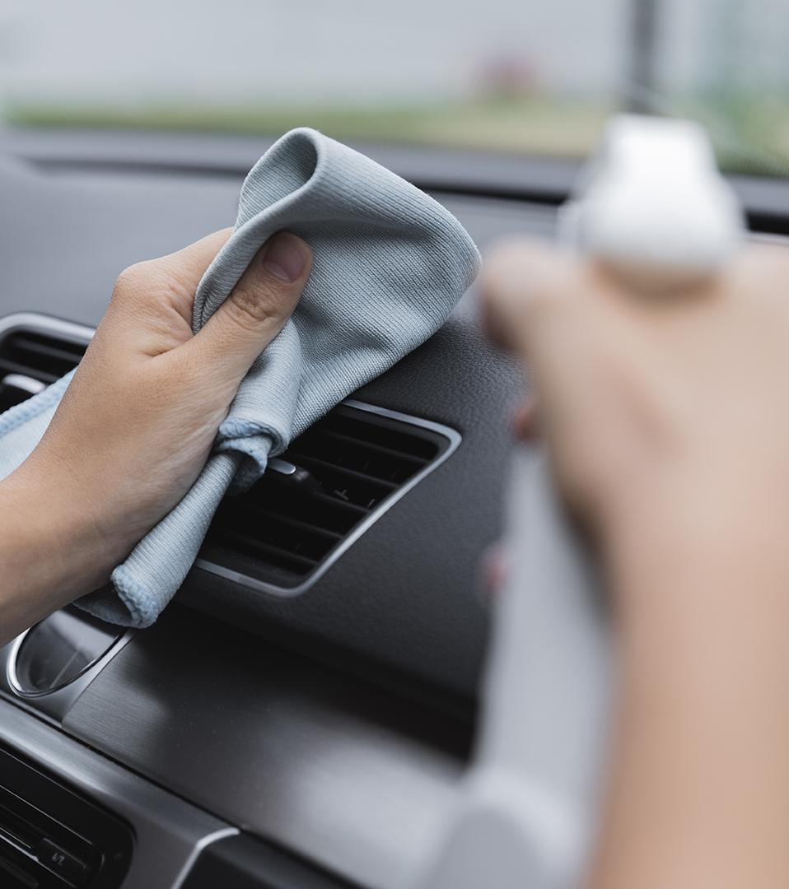
05
CONCEPTS USED

Slide 12
DATA STRUCTURES AND CONTROL STATEMENTS
GUI PROGRAMMING WITH TKINTER
REGULAR EXPRESSIONS
DATABASE ACCESS

Slide 13
06
IMPLEMENTATION

Slide 14
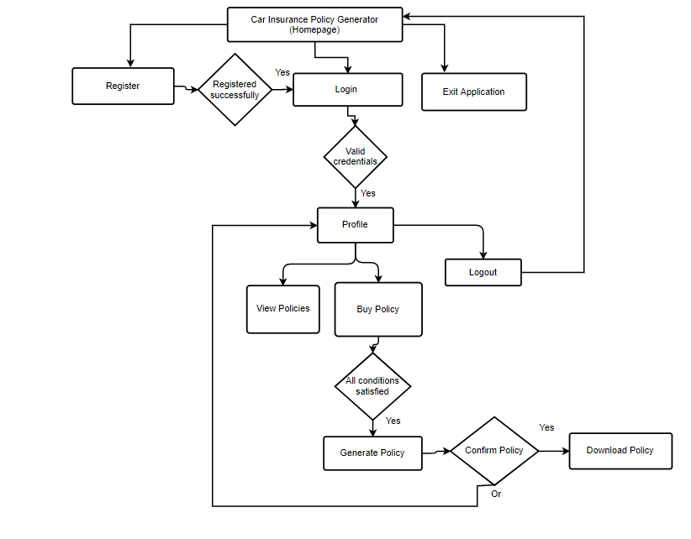
FLOW DIAGRAM

Slide 15
OVERVIEW OF CLASSES
Login_Window
Register
Profile
Contains the feature to login and option to navigate to register window
Contains feature to register
Displays the profile of the user currently logged in
Buy_Policy
View_Policies
User can enter details to generate policy
Policy_Details
User can view the policies purchased
Generates policy after user enters required details
Confirm_Window
Displays details of policy after user confirms and gives option to download policy

