Slide 1
iProfiler
Major Project Presentation 2021
Submitted By – Isha Gupta (171358)
Supervisor – Dr. Kapil Sharma and Mr. Chandra Kalva

Slide 2
INTRODUCTION
iProfiler is a profile filtering tool that helps selecting out relevant prospects from a pool of generic applicants.
It makes the life of HR personnel and the recruitment teams easier by removing the hassle out of remote recruitment process. It is very tedious process to manually screen all the resumes and filtering out potential candidates from pool of candidates. Also, it is a time consuming and counter-productive work of manually screening resumes.

Slide 3
PROBLEM STATEMENT
Scenario 1: - Evaluating each incoming application is tedious and counterproductive.
Scenario 2: - Recruiting the best candidates for the requirement of a job role can be cumbersome.
Scenario 3: - Difficulty in keeping track of promising applications which weren’t processed earlier.

Slide 4
METHODOLOGY
The project is based on the agile methodology for development.
Agile model is an incremental and iterative model of development which means that each build of the software would be independent, but the final delivered product will be incremented with that build.
The motive of developing the project based on this model is that iProfiler Application requires frequent updates due to updates in the features and its new behaviors.
Using this model will lead to develop updates and their testing independently and then integrating them with the existing product to test the final product.

Slide 5
TOOLS AND TECHNOLOGIES
Frontend
React Typescript - React is a “JavaScript library for building user interfaces”, while Typescript is a “typed super set of JavaScript that compiles to plain JavaScript.” By using them together, we essentially build our UI’s using a typed version of JavaScript.
React Bootstrap - React-Bootstrap replaces the Bootstrap JavaScript. Each component has been built from scratch as a true React component, without unneeded dependencies like jQuery.

Slide 6
Backend
Python - Python is an interpreted high-level general-purpose programming language. Python’s design philosophy emphasizes code readability with its notable use of significant indentation.
Flask - Flask is a lightweight WSGI web application framework. It is designed to make getting started quick and easy, with the ability to scale up to complex applications.
MongoDB Atlas - MongoDB Atlas is the global cloud database service for modern applications. Deploy fully managed MongoDB across AWS, Google Cloud, and Azure with best-in-class automation and proven practices that guarantee availability, scalability, and compliance with the most demanding data security and privacy standards.

Slide 7
Integrations
Email JS for Email functionality - EmailJS helps to send emails using client-side technologies only. No server is required – just connect EmailJS to one of the supported email services, create an email template, and use our Javascript library to trigger an email.
MongoDB Charts - MongoDB Charts is a modern data visualization tool that is integrated with the MongoDB cloud data platform. It is the best way to create, share and embed visualizations of MongoDB data.

Slide 8
Cloud and Deployment
Google Compute Engine Deployment - Google Compute Engine provides a scalable number of virtual machines (VMs) to serve as large compute clusters for that purpose. GCE can be managed through a RESTful API, command line interface (CLI) or Web console. Compute Engine is a pay-per-usage service with a 10-minute minimum.
GitLab CI/CD - GitLab CI/CD is a tool built into GitLab for software development through the continuous methodologies:
Continuous Integration (CI)
Continuous Delivery (CD)
Continuous Deployment (CD)

Slide 9
SCREENS DEVELOPED
Screen 1: Recruiter Login/Signup
Screen 2: Landing Page
Screen 3: Job Details
Screen 4: Apply Page
Screen 5: Pricing
Screen 6: Dashboard
Screen 7: Job Postings
Screen 8: Applicants
Screen 9: User Profile

Slide 10
WORKING
The working is categorized into two flows- HR flow and Applicant’s flow.
When an HR opens our webpage, they get to see our Landing page, which covers basic idea of why a HR needs to use our tools. Also, it portrays the process by which things are going to happen. When HR clicks on Start button, it goes to Login Page, where the user can login using its credentials or goes to signup form, where they can register themselves.
Once Logged in, a Dashboard is displayed. It portrays all applicant’s data who had applied to our web app for various job roles.

Slide 11
Each applicant displayed in the form of a card with all the basic details. HR can view details of any applicant by clicking on the concerned card, if his / her profile sounds interesting to the user, then HR can schedule a meet for next rounds. Also, HR can also invite any external candidate. The HR cam also add new Job Postings.
They receive a link to apply in their concerned email. Applicant must upload its resume, so that it can parse the document, and generate the json and pre-populate it in he Apply Page. If any details are incorrectly filled, applicant can change it before submitting the form.

Slide 12
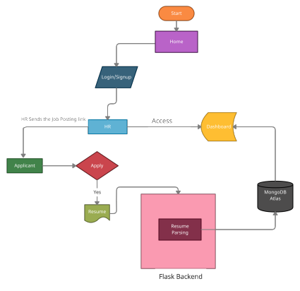
Flow Chart for iProfiler

Slide 13
GANTT CHART

