Slide 1
CIS 508 Team Assignment
House Prices: Advanced Regression Techniques
Team - B11

Slide 2
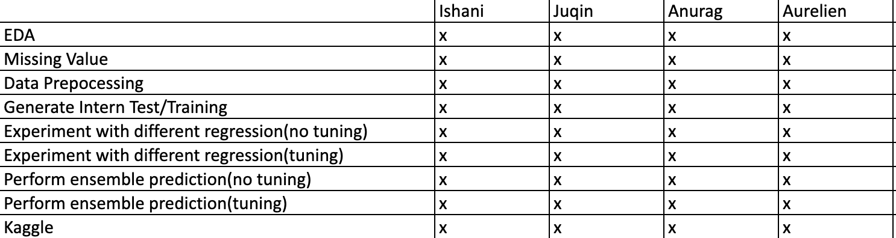
Team task contributor

Slide 3
What we did
Handling missing data & EDA
data normalization (rescaling)
Experiment with different regression methods
Experiment with different regression methods (with HT)
Perform ensemble prediction
Perform ensemble prediction (with HT)
Kaggle score/submission

Slide 4
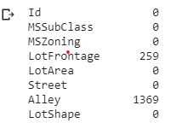
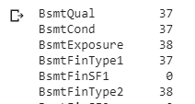



Handling missing data
Take a first look at the data
Count how many missing data
Deal with the missing value
Notes:
W have different reason(refuse to give the data) issue when you transfer the data from A to B

Slide 5
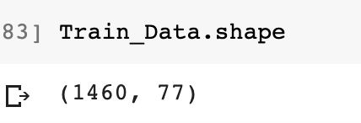
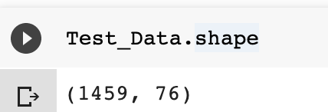
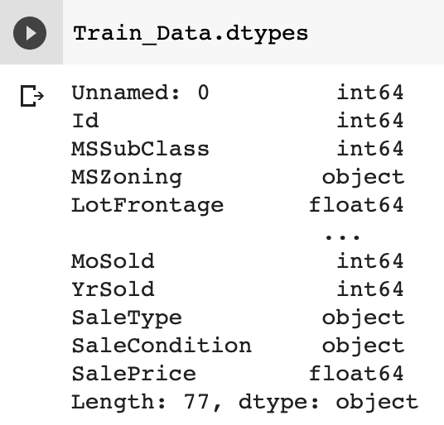
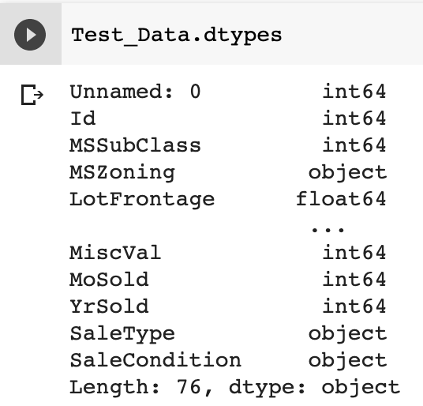
dataset

Slide 6

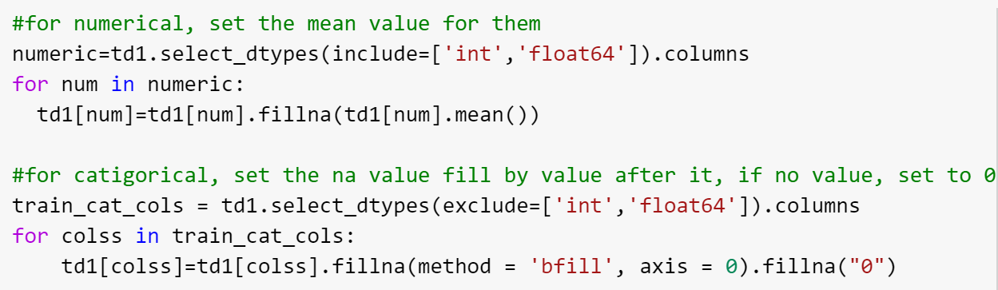
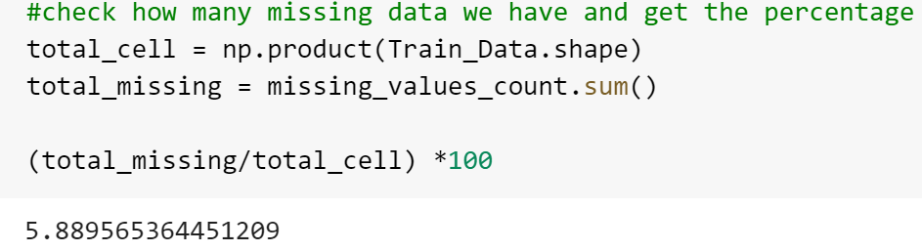
Handling Missing Value

Slide 7

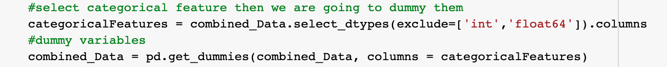
Preprocessing
Log function
Normalisation.
Rescale all th
Dummy:
Data are able to run the model
Train_Split_Test:
Notes:
Missing data treatment is very important to avoid biased results. Generally, missing data in training data set can reduce the power of the model which can lead to wrong classification/ prediction.

Slide 8
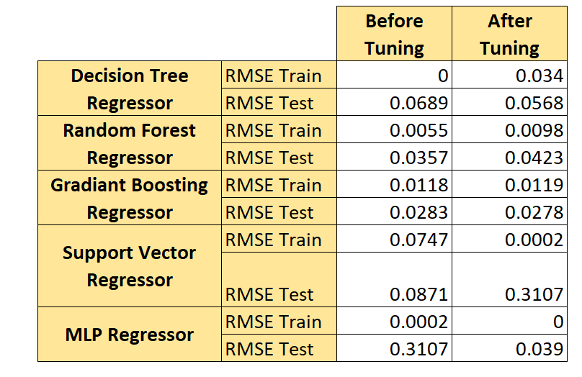
Regression Methods:
-prediction of the future
-time serie
RMSE: risk metrics related to the error lost

Slide 9
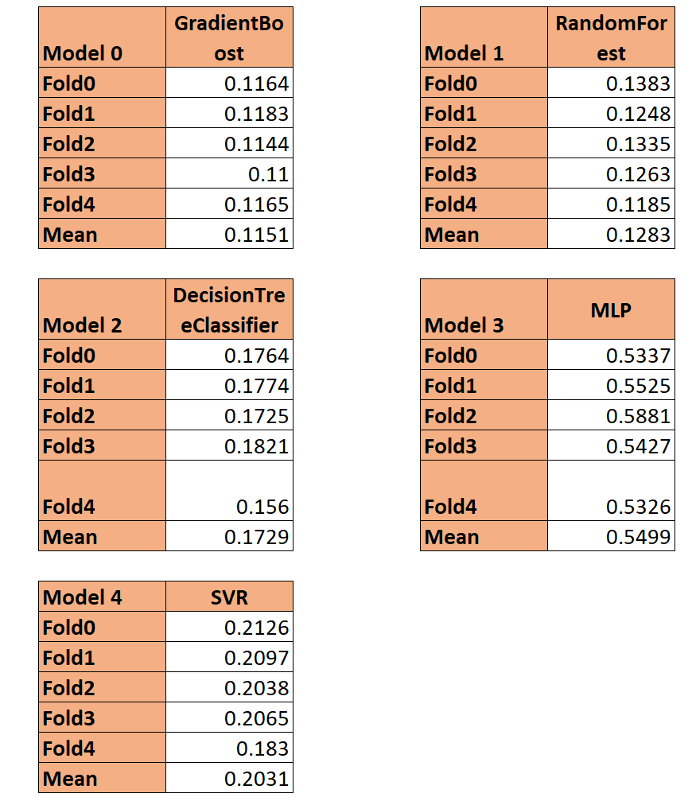
Stacking:
-Combination of multiple models
-Usually increase your accurarcy

Slide 10
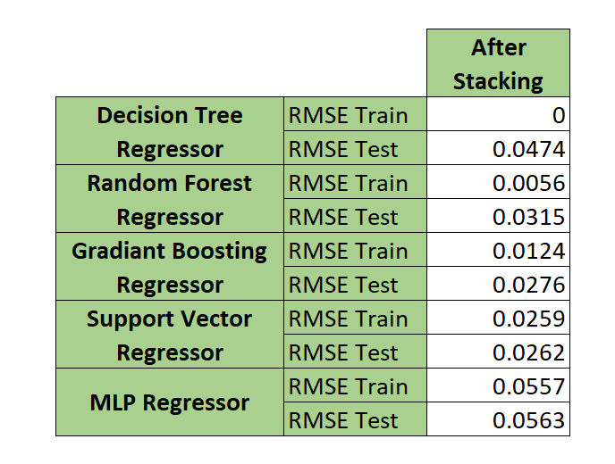
Ensemble Methods:

Slide 11

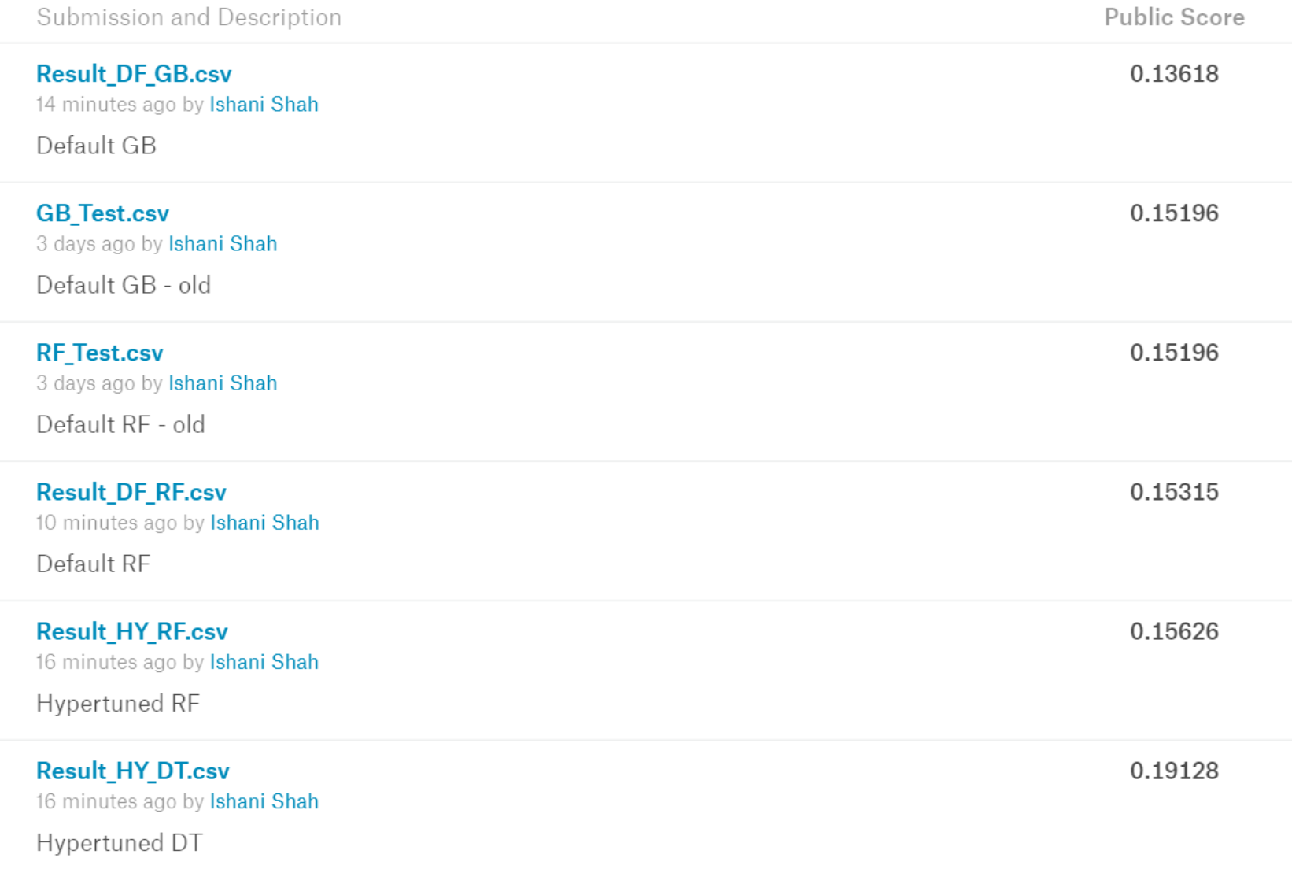




KAGGLE SCORE

Slide 12
What we learn?
Handling Missing Value: risk of inaccurate result
Normalization: enhance dataset
Preprocessing: transformation of the data before feeding the algorithm
Regression Method predict future value with historical data

