Slide 1
K-means clustering
By: Ishani Shah

Slide 2
Problem: Clustering model section using external variables

Slide 3
Tasks Completed :
Clustering on the basis of annual spending on different product types
Using hyperparameter tuning in K-means to get the best set of clusters
Interpreting the cluster characteristics by region and channel
Explaining why the selected cluster is the best

Slide 4
Creating small clusters using K – means & tuning hyperparameters to get best cluster set
Cluster Type | K value | Score
Default K-Means | 8 | silhouette_score = 0.3417007664749802
Manual Parameters tuning: n_clusters:3 | 3 | silhouette_score = 0.4783511435929511
Manual Parameters tuning: n_clusters: 3, init: k-means++, n_init:10 | 3 | silhouette_score = 0.4770179147393792
Randomized Search - Parameters tuning: n_init: 22, n_clusters: 3, max_iter: 671, init: random, algorithm: elkan | 4 | silhouette_score = 0.4783511375292279
* Excluded Region and Channel columns before creating clusters
* Rescaling not required before clustering as all the remaining column values are money values

Slide 5

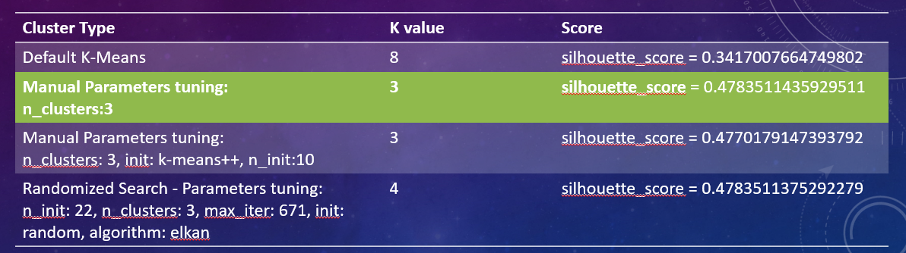
Explaining why the selected cluster is the “best”
The silhouette value is a measure of how similar an object is to its own cluster compared to other clusters.
The silhouette ranges from −1 to +1, where a high value indicates that the object is well matched to its own cluster and poorly matched to neighboring clusters.
Hence, cluster set with Maximum Silhouette score is the “Best” Cluster

Slide 6
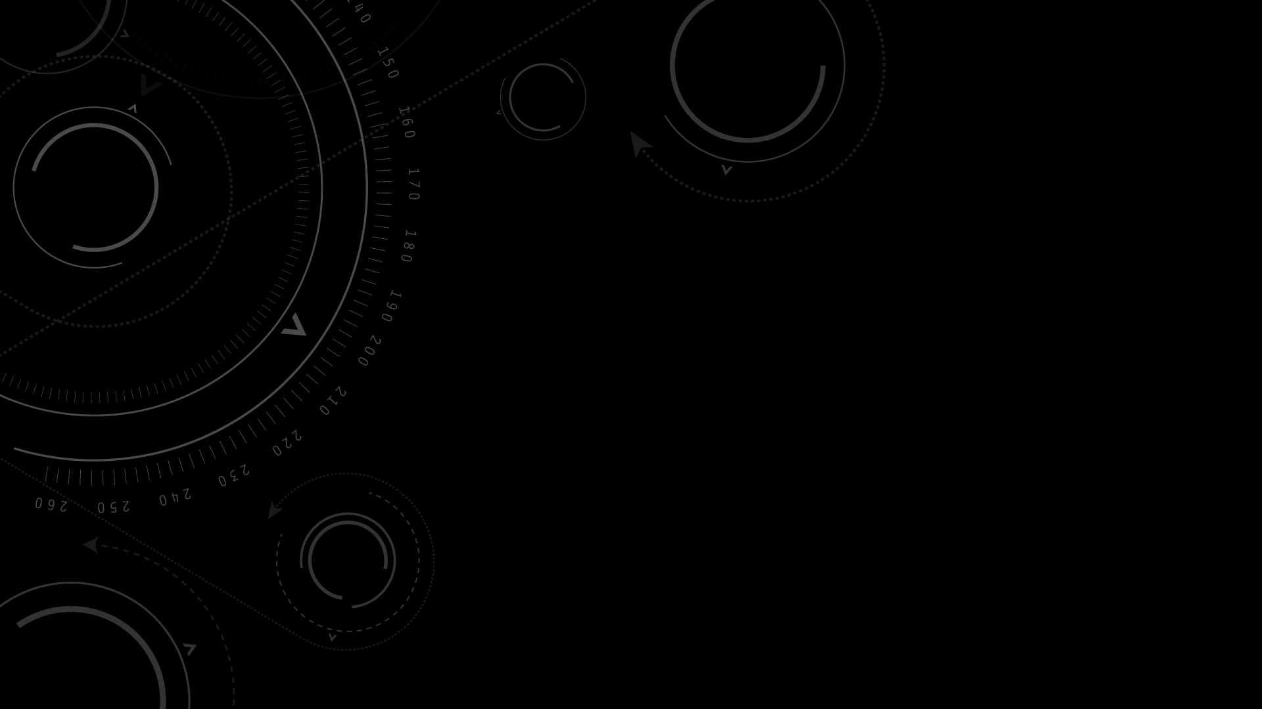
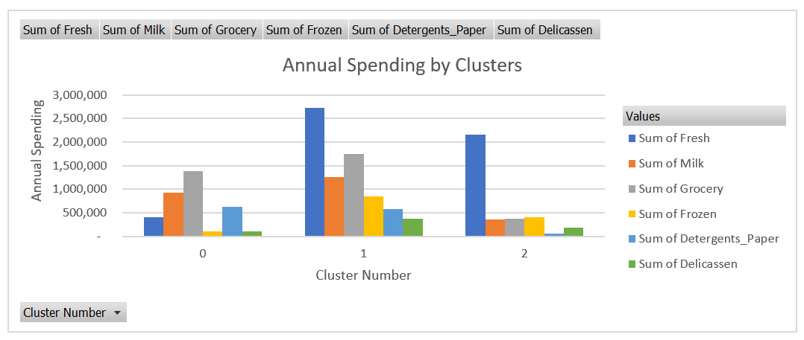
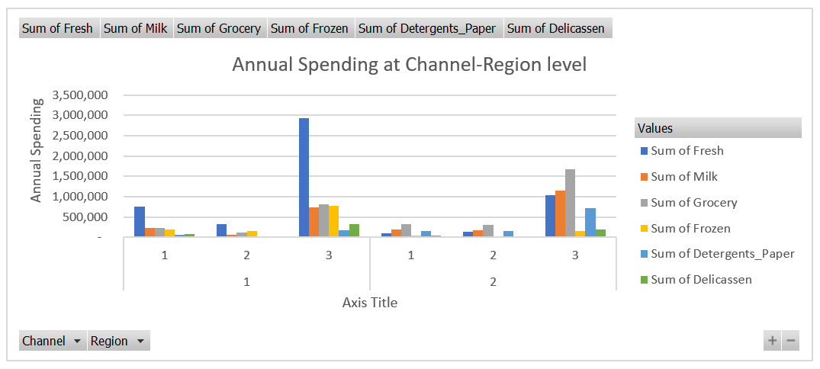
Interpreting the cluster characteristics by region and channel: For “best” cluster: k=3

Slide 7
What I learnt “new”
Creating small clusters using K – means
Completing manual tuning of hyperparameters
Identifying the best set of clusters using Silhouette score

Slide 8
Thank You
By: Ishani Shah

