Slide 1
DOE LEGO Project
Team - B11
Ishani Shah, Anurag Kumar, Juqin Liu, Aurelien Misteli

Slide 2
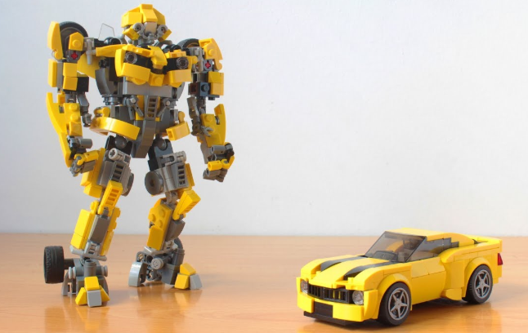
What is our goal?
To maximize the distance of our fancy, creativity, gorgeous car

Slide 3
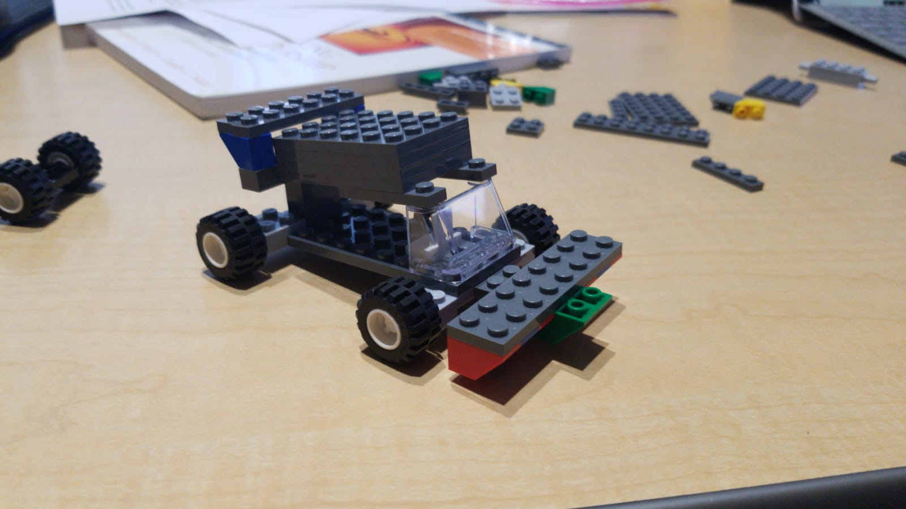
How do we set-up?
Factors
Length: short | long
Aero Dynamic: no protection | with protection
Weight: light | heavy
Wheels: small | large
2^4 = 16
Notes:
Factors chosen and a description of each factor.

Slide 4

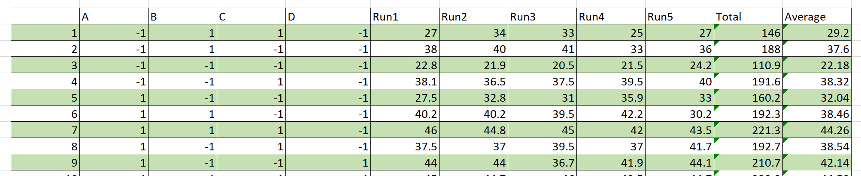
How do we measure and collect data?

Slide 5
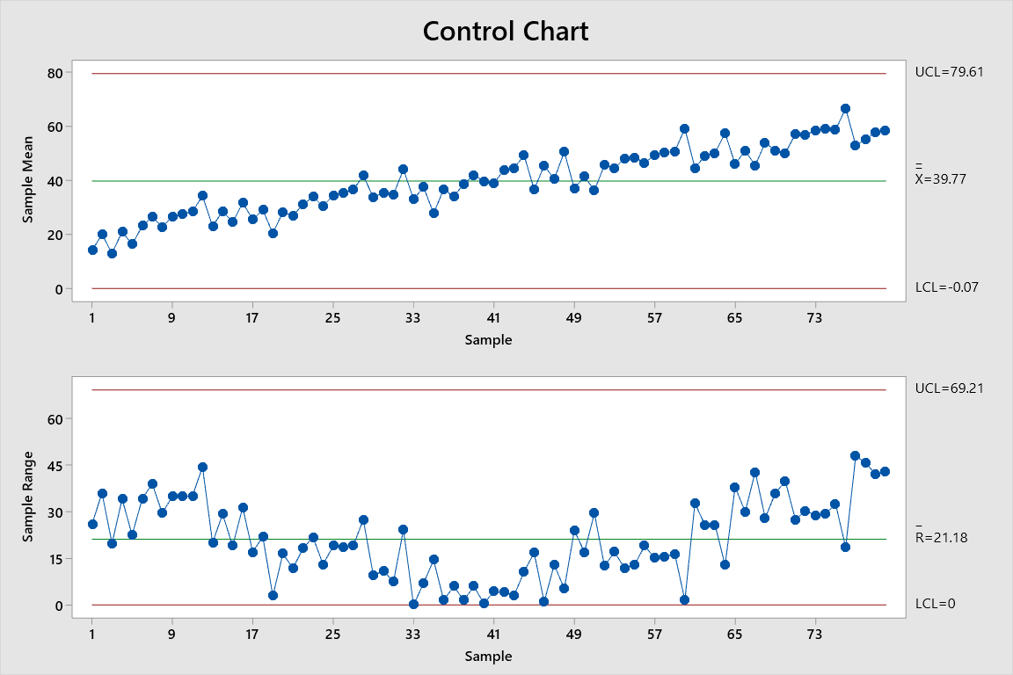
Process control

Slide 6
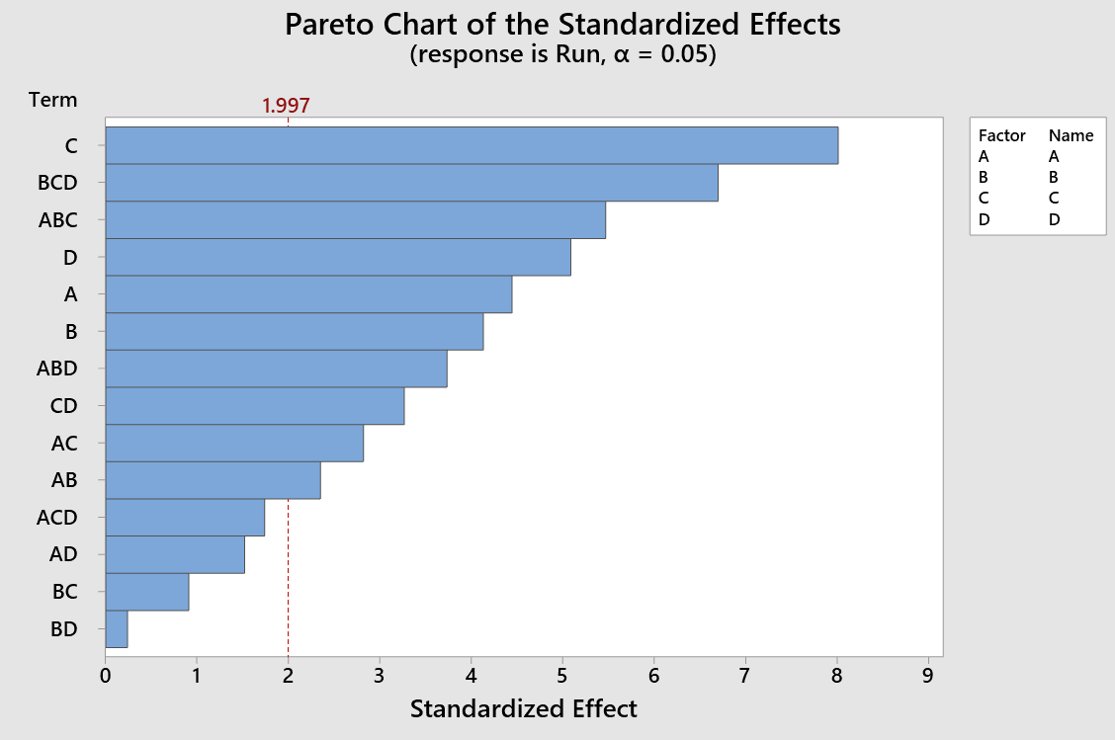
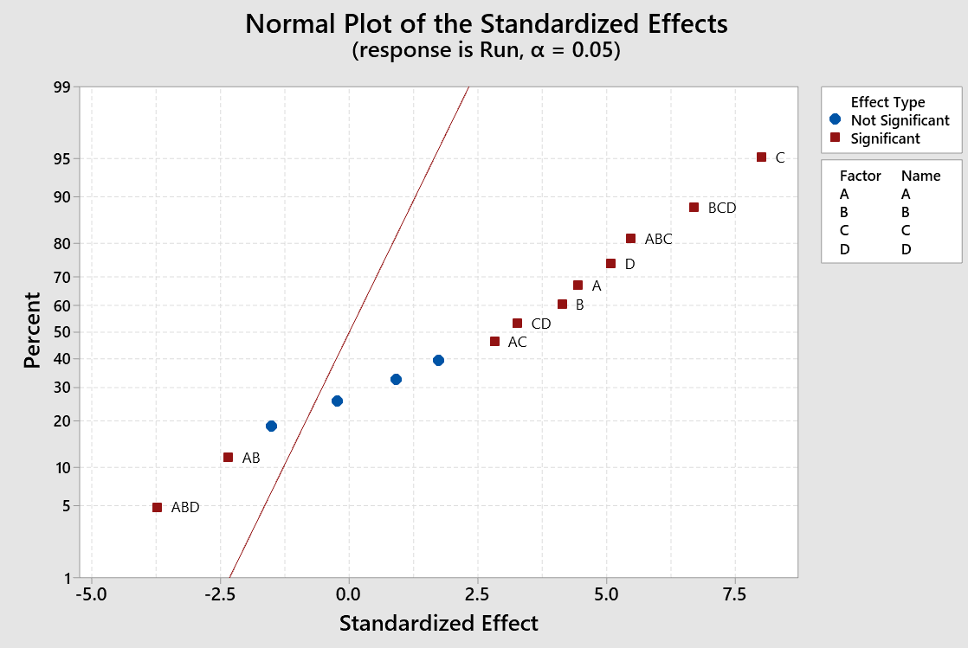
Graphical analysis
Highest to the smallest impact
4 values are non significance

Slide 7
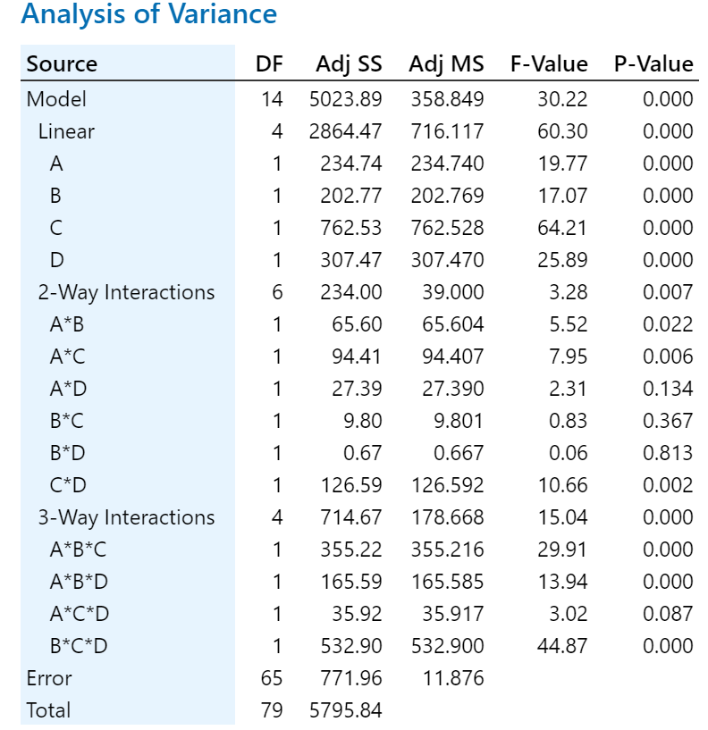
Which factors impact the output?
Confidence interval 0.95
Interactions of different factors
Reject when p-value > 0.05 (red circled)

Slide 8
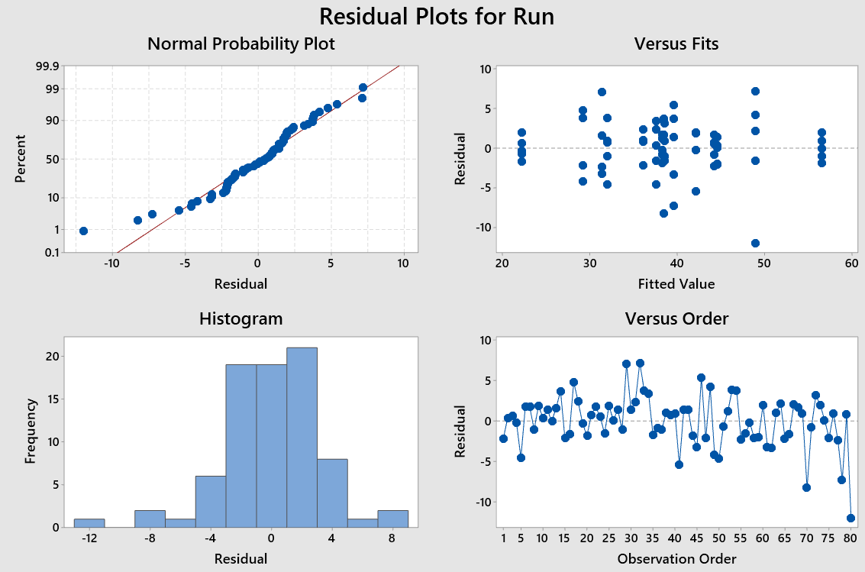
Meets the assumptions
Normal Distribution
Randomized check
Data distribution
Residualts are independants

Slide 9
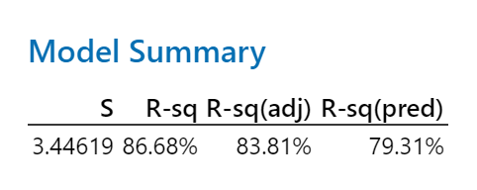
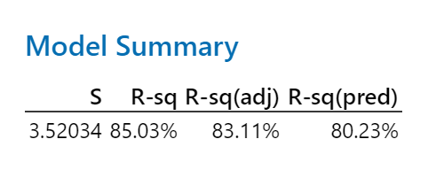
Regression
Model summary before remodel
Model summary after remodel

Slide 10
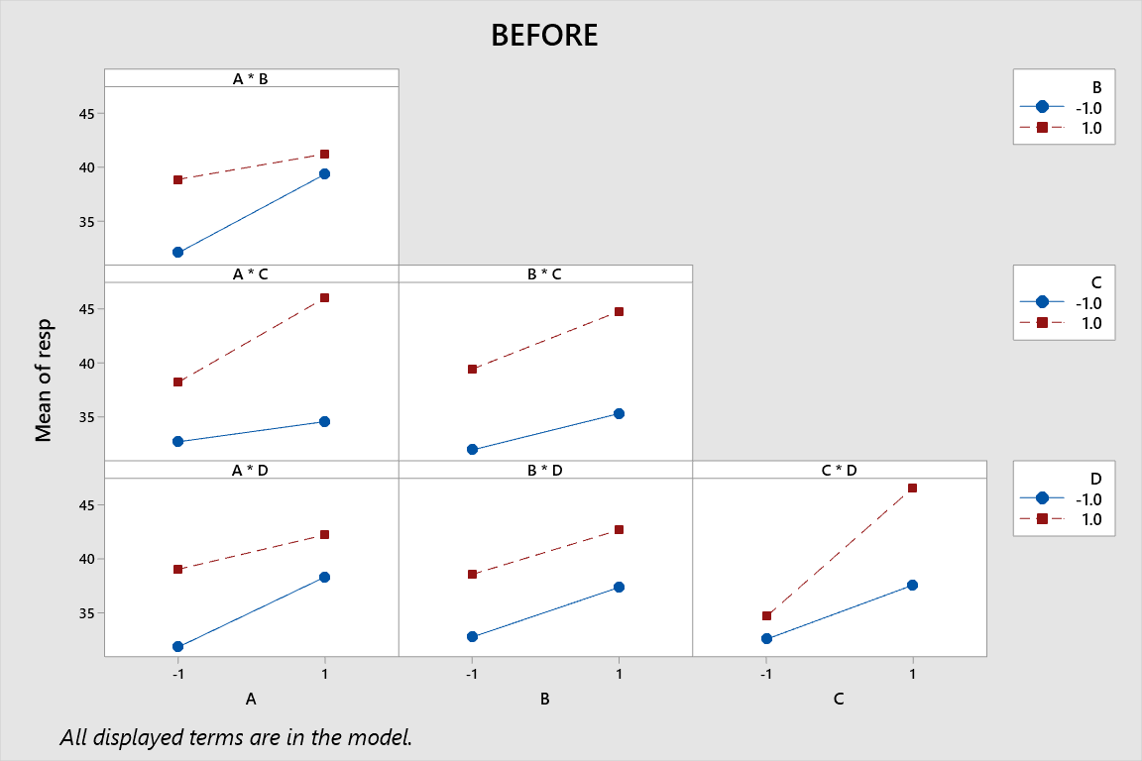
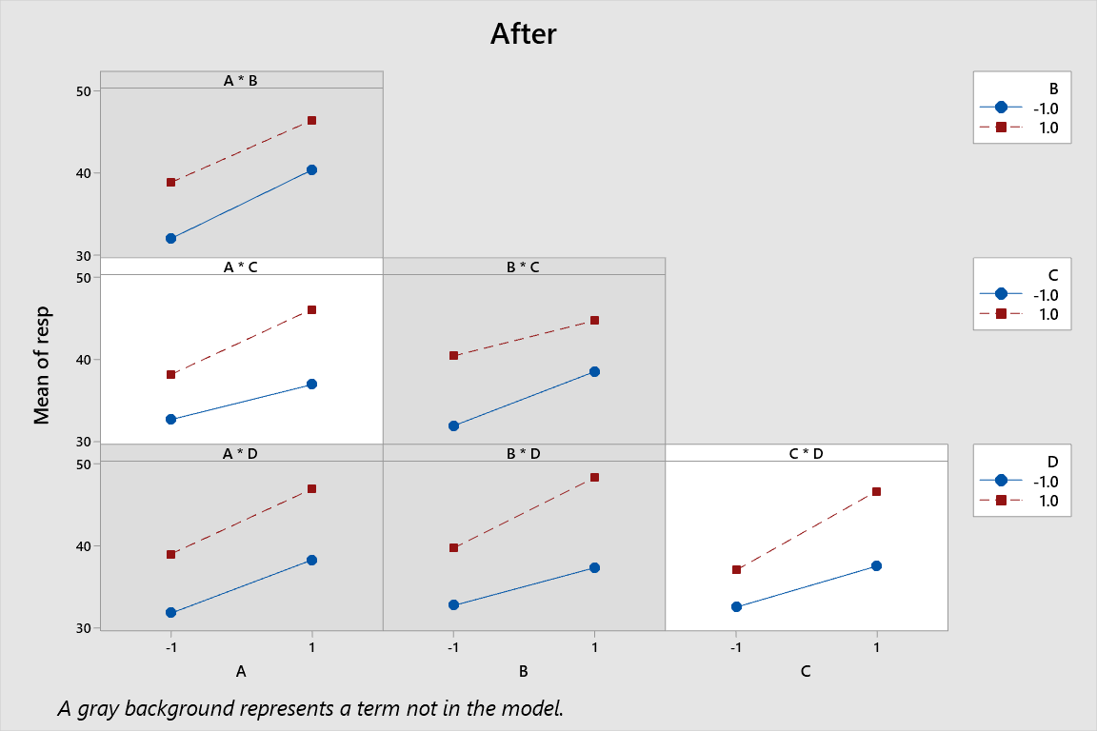
Plot of effect
Before Remodel
After Remodel

Slide 11
Conclusion

