Slide 1



Nike Business proposal
Cis 505 Project proposal
Team B-11
Foodie’s

Slide 2
Mission
The ultimate goal of Foodie’s is to increase sales (profits) and decrease costs, and there are of course several ways to achieve the goal. After certain sessions with NIKE, we understood that as a manufacturer, they do not know a lot about their consumers, and they might be missing important opportunities for not knowing enough about their customers. Therefore, they are hoping, through data analytics, to learn more about their customer profiles, to tap on opportunities, to be able to predict future trends.
Foodie’s

Slide 3
How to enhance customer loyalty through an E-commerce marketing strategy?
Which canal of data do we use? Why?
Define customer: What is our customer portrait? In other words, what is the gender, age, geolocation distributed?
What is the most popular feature based on age range, gender, etc?
What is the purchase ability range? In other words, which customers purchase the highest, based on gender, with different age range and geolocation?
What does the reviews tell us about our product?
Foodie’s

Slide 4
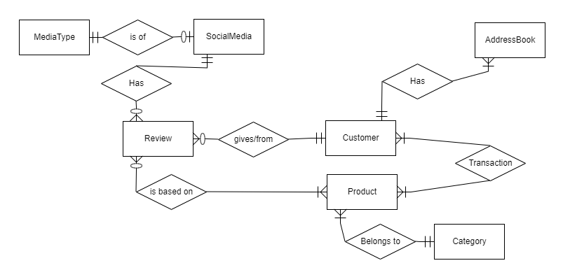
Entity-Relation diagram
Foodie’s

Slide 5
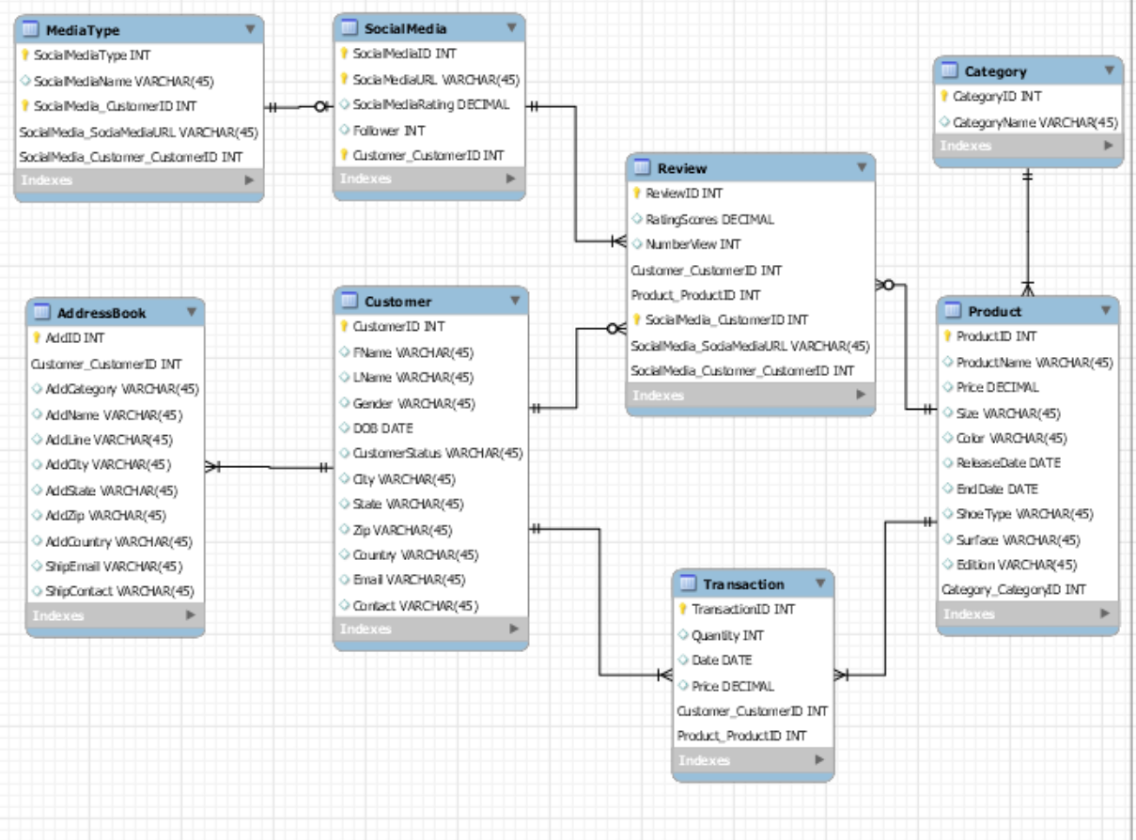
Database schema
Foodie’s

Slide 6
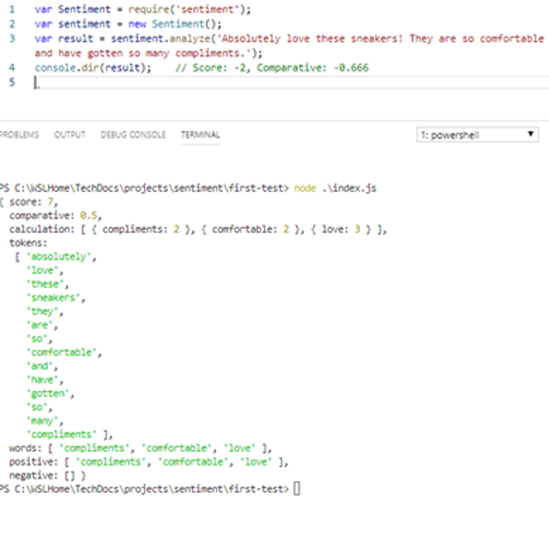
The Analytics Advantage
Minimize Cost - The purpose is to understand consumer behavior, their needs then see how it’s evolved across time according to our strategy plan; If it work or not. The shoes manufacturing can anticipate its needs, produce the appropriate amount of product, focus on what the clients’ desire. The company may not increase its sales , but it will obtain a significant decrease in its production’s cost.
Expand Market - Analyzing the Transactional Data, Customer Data along with Address Data can help us answer questions like what age groups are our major customers? Which geographical locations can we expand to? What is the purchase ability range? In other words, which customers purchase the highest, based on gender, with different age range and geolocation
Expand Customer Database - Collecting and analyzing data from different media platforms thereby having an opportunity to expand the customer database through e-commerce and get insights on the customer experience as well.
Sentiment Analysis - Use this tools algorithm with python that grades every comments. It programs to asses each word by group by then in positive(+2) or negative meaning(-1).
Foodie’s

Slide 7
Thank you! Questions?
Foodie’s

