Slide 1
Feature Selection: Text Mining
ISHANI SHAH

Slide 2
To Do List:
Stemmer
Use NLTK library stemmers, such as the Porter, Lancaster and Snowball Stemmers and find out the total number of stemmed words produced by each. Use the word tokenizer to tokenize words before stemming.
TD Matrix
Construct the term-document matrix. Eliminate stop words when constructing the term document matrix.
TF-IDF
Construct the TF-IDF matrix from the term-document matrix.
Combine
Combine the TF-IDF matrix with Customer data. Then do one-hot encoding on the categorical variables.
Split
Split the combined dataset into a training (80%) and a test set (20%). Use the best set of features from each method (filter and wrapper), build new classification models and evaluate them on the test data.
Classify
Use different classification algorithms to build models on different feature sets and evaluate them based on accuracy on the combined data.

Slide 3
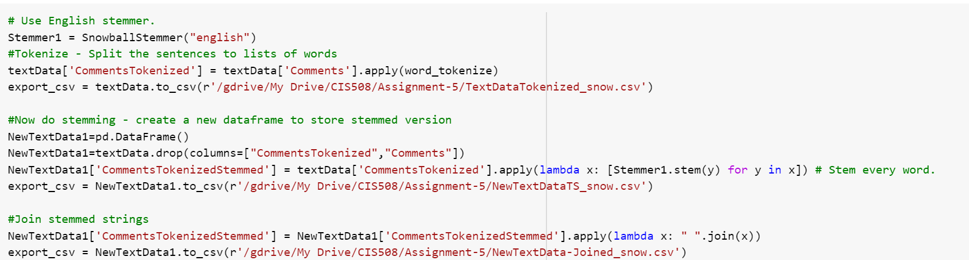
Task 1.
Tokenize words in the comments
Use stemmers from NLTK library to stem the words

Slide 4
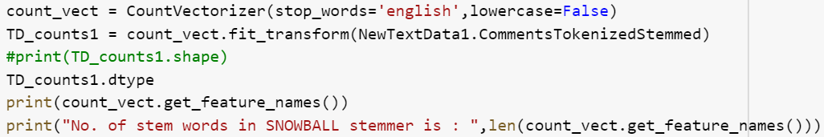
Total number of stemmed words produced by each stemmer are as shown below:
Stemmer | Stem Words
Snowball | 354
Porter | 366
Lancaster | 364

Slide 5
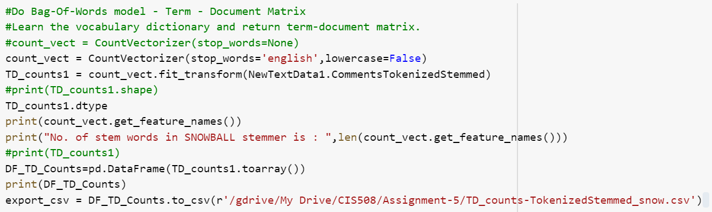
Task 2.
Eliminate stop words after stemming
Construct the term-document matrix.

Slide 6
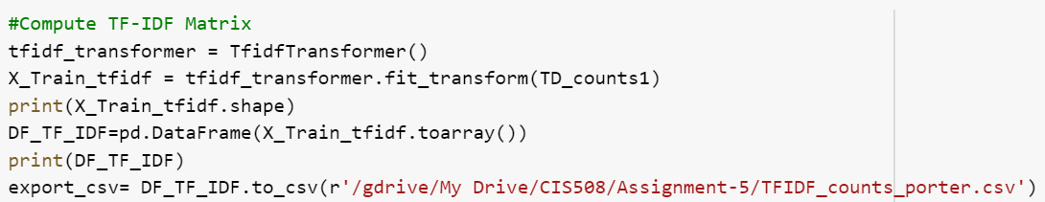
Task 3.
Construct the TF-IDF matrix from the term-document matrix.
Have created this matrix for the term-document matrix with minimum stem words, that is Snowball Stemmer

Slide 7
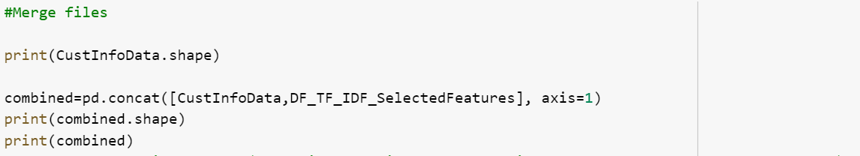
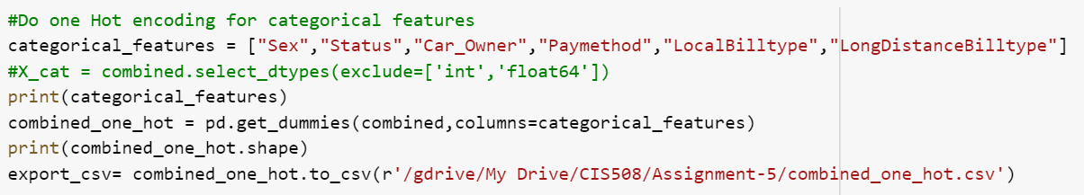
Task 4.
Combine the TF-IDF matrix with Customer data.
Then do one-hot encoding on the categorical variables.

Slide 8
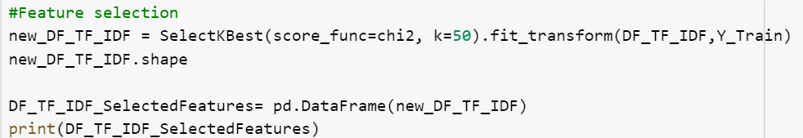
Task 5.
Filter type - Use Python's SelectKBest module to find the K best features. Use a variety of K values to determine the best set of features for the combined data

Slide 9
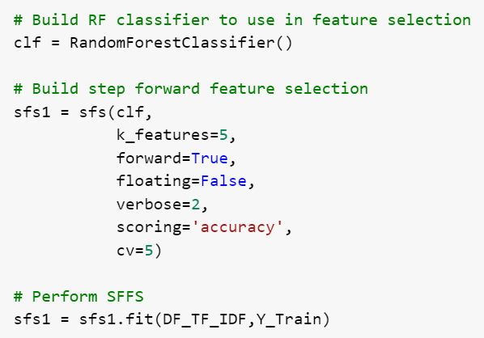
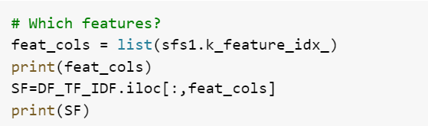
Task 5.
Wrapper type - Use the Step Forward Feature Selection method in Python (see reference above) to find the best set of features on the combined data. Use cross-validation.

Slide 10
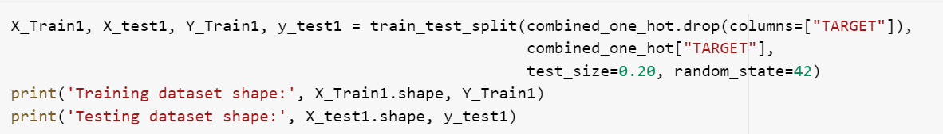
Task 6.
Split the combined dataset into a training (80%) and a test set (20%).
Use the best set of features from each method (filter and wrapper),
Build new classification models and evaluate them on the test data.

Slide 11
After applying filter feature selection, we get:
Classifier Type | Accuracy Score
Random Forest Classifier | 0.842995
Decision Tree Classifier | 0.821256
Gradient Boosting Classifier | 0.845411

Slide 12
After applying wrapper feature selection, we get:
Classifier Type | Accuracy Score | AUC Score
Random Forest Classifier | 0.859903 | 0.9212805810298018
Decision Tree Classifier | 0.801932 | 0.8285344865745948

Slide 13
What we learnt new?
Solved a real life semi-structured machine learning problem: Text + Structured data
Used Python's Natural Language Tool Kit (NLTK): Tokenizer, Stemmers
Created TD matrices and TF-IDF matrices
Performed two types of feature selection (wrapper and filter type) and compared them

Slide 14
Thank You!
Ishani Shah

