Slide 1
Hyperparameter Tuning
ISHANI SHAH

Slide 2
Direct Marketing
Target Marketing by cross-selling term-deposits to existing customers

Slide 3
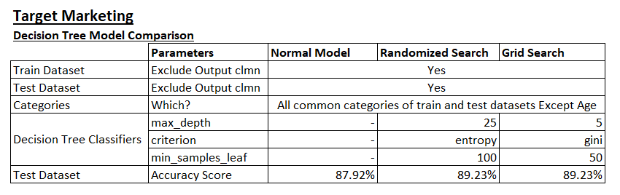
Decision Tree based models
Using Pre-defined parameters:
Normal Model
Using Hyperparameter tuning:
parameters=
{'min_samples_leaf' : range(10,200,10),
'max_depth': range(5,40,5),
'criterion':['gini','entropy’] }
Randomized Search
Grid Search

Slide 4
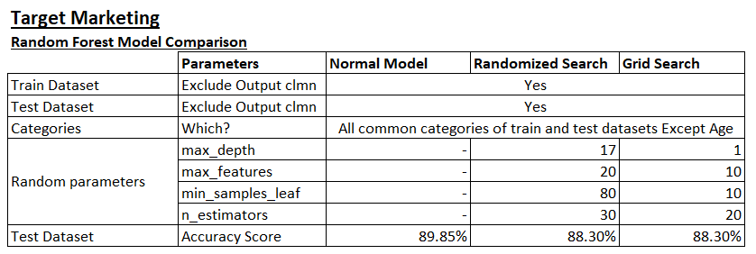
Random Forest based models
Using Pre-defined parameters:
Normal Model
Using Hyperparameter tuning:
rand_parameters=
{'min_samples_leaf' : range(10,200,10),
'max_depth': range(1,20,2),
'max_features':range(10,100,10),
'n_estimators':[20,30,40]}
Randomized Search
Grid Search

