Slide 1
Time Series & Clustering
By: Ishani Shah

Slide 2
Problem: Finding similar time series in Sales Transaction Data

Slide 3
Tasks Completed :
Creating small clusters using K – means
Completing manual tuning of hyperparameters and getting the best set of clusters
Validating similarity of time-series by plotting line charts in Excel
Identifying K-value using Elbow technique in Python

Slide 4
Creating small clusters using K – means & tuning hyperparameters to get best cluster set
Cluster Type | K value | Score
Default K-Means | 8 | silhouette_score = 0.0399
Manual Parameters tuning: n_clusters:3 | 3 | silhouette_score = 0.2554
Manual Parameters tuning: n_clusters: 3, init: k-means++, n_init:10 | 3 | silhouette_score = 0.1635
Randomized Search - Parameters tuning: n_clusters: 4, init: k-means++, algorithm: auto | 4 | silhouette_score = 0.1045
** Have used 52 normalized data columns

Slide 5

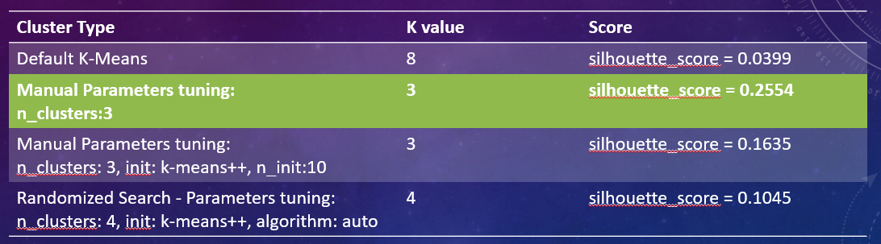
Explaining why the selected cluster is the “best”
The silhouette value is a measure of how similar an object is to its own cluster compared to other clusters.
The silhouette ranges from −1 to +1, where a high value indicates that the object is well matched to its own cluster and poorly matched to neighboring clusters.
Hence, cluster set with Maximum Silhouette score is the “Best” Cluster

Slide 6
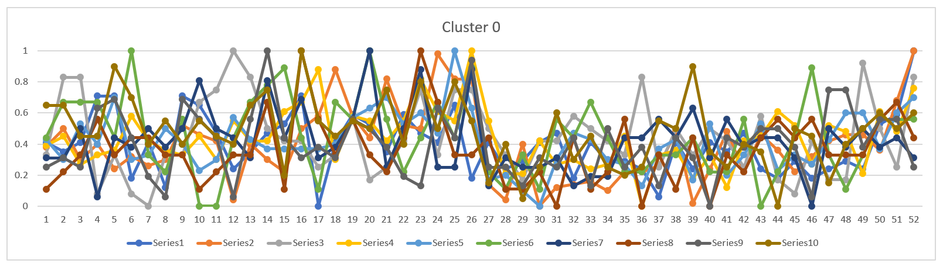
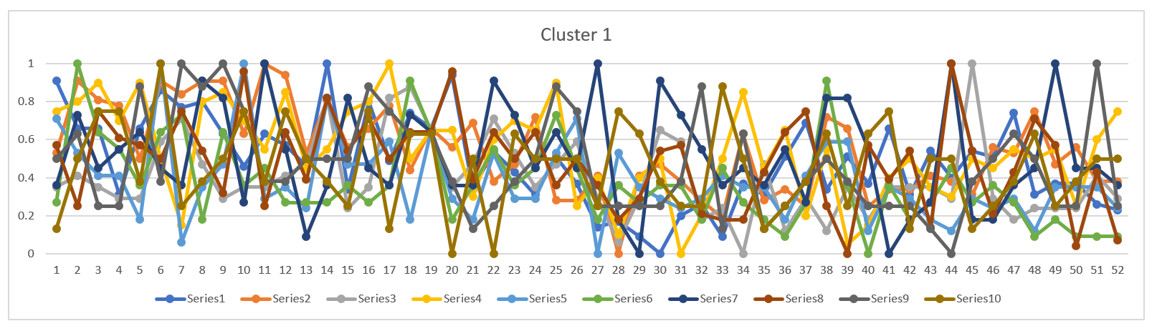
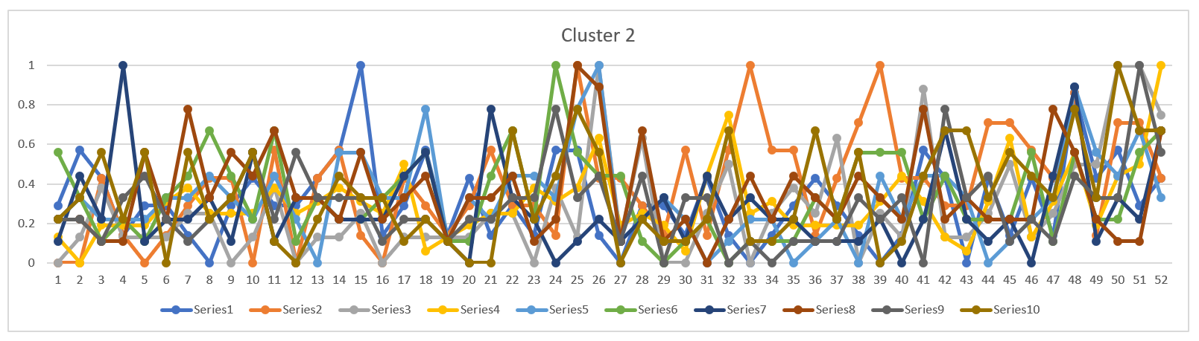
Validating similarity of time-series by plotting line charts in Excel: For “best” cluster: k=3

Slide 7
Identifying K value using Elbow technique
Minimum Sum of Squared Errors
Maximum Silhouette score

Slide 8
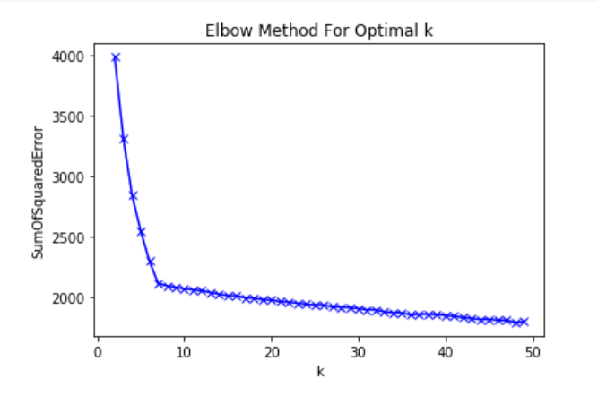
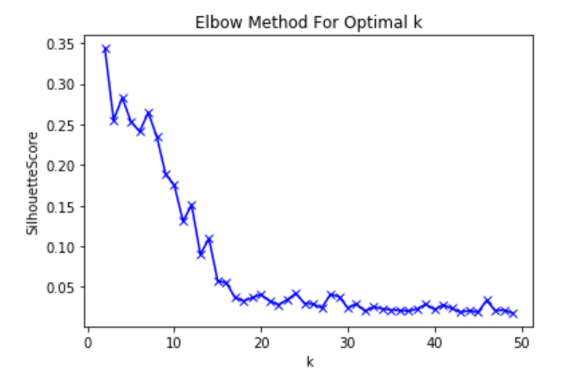
For K = range(2,50), using elbow technique
Sum of Squared Error plot
Silhouette Score plot
The optimal value of K is 8

Slide 9
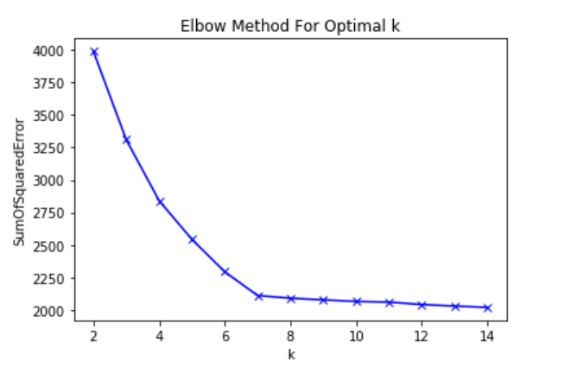
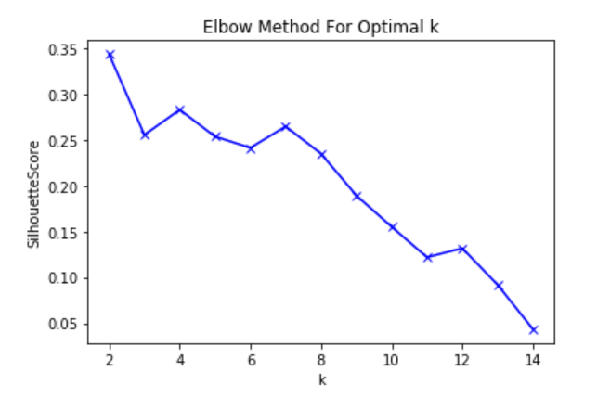
For K = range(2,15), using elbow technique
Sum of Squared Error plot
Silhouette Score plot
The optimal value of K is 7

Slide 10
What I learnt “new”
Creating small clusters using K – means
Completing manual tuning of hyperparameters
Identifying the best set of clusters using Silhouette score
Validating similarity of time-series by plotting line charts in Excel
Identifying K-value using Elbow technique in Python

Slide 11
Thank You
By: Ishani Shah

