Slide 1
Sales and product

Slide 2
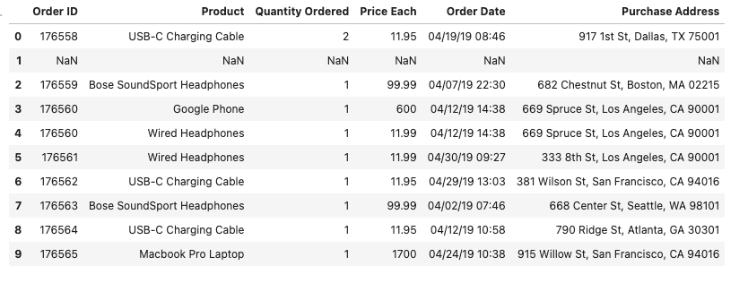
The dataset contains information about Sales in april month

Slide 3
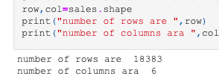
the number of rows and columns in dataset.

Slide 4
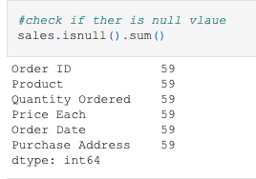

Slide 5
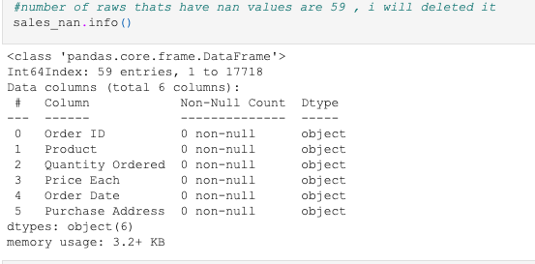

Slide 6
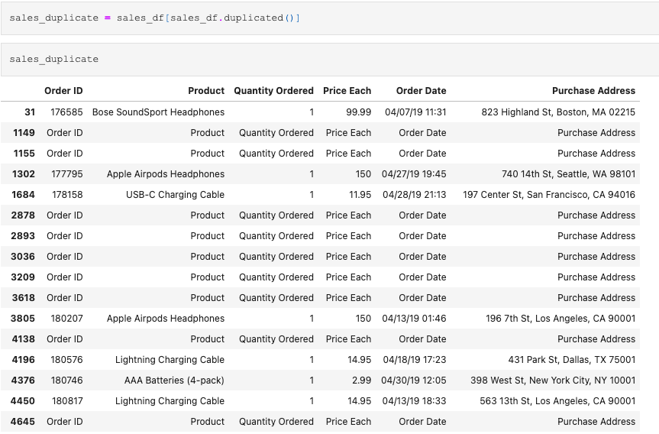

Slide 7
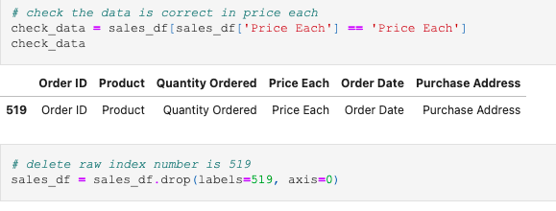

Slide 8
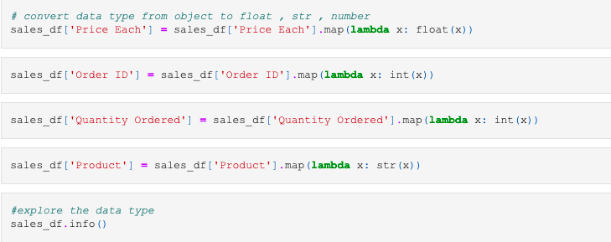

Slide 9
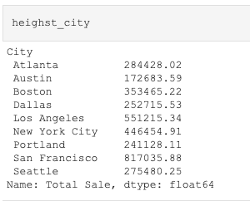
Q1 :What City has the highest number of sales?
It’s San Francisco

Slide 10
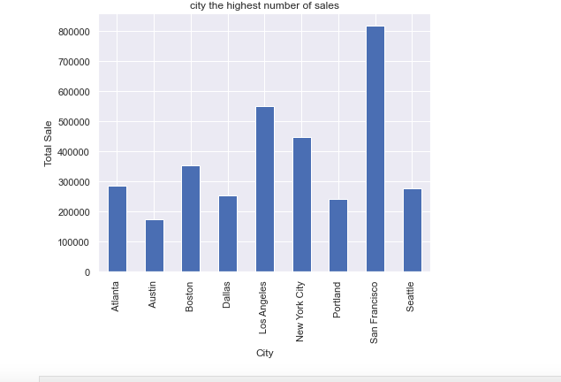
Q1: What City has the highest number of sales?

Slide 11
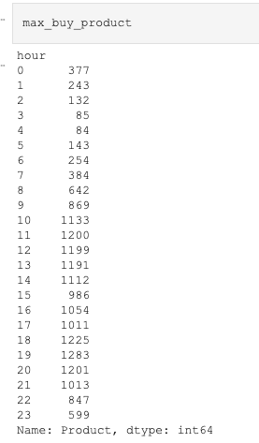
Q2 : what time should we display advertisements to maximize likelihood of customer buying product ?

Slide 12
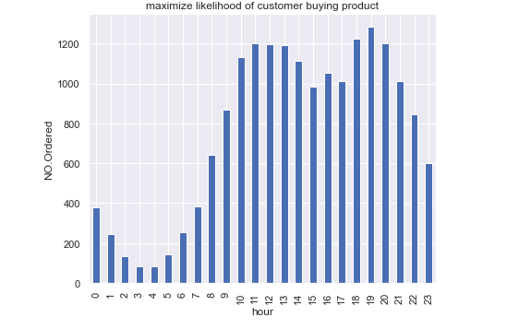
Q2 :what time should we display advertisements to maximize likelihood of customer buying product ?
7 p.m

Slide 13
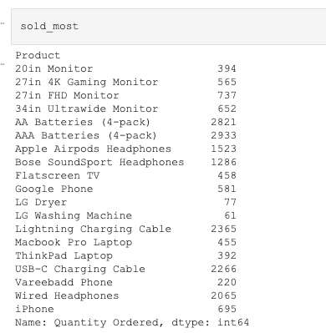
Q3: what product sold the most ?

Slide 14
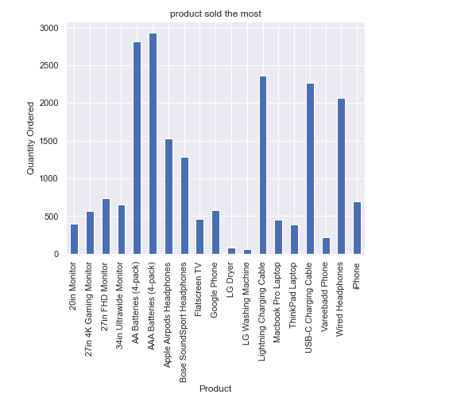
Q3: what product sold the most ?
AAA Batteries (4-pack)

Slide 15
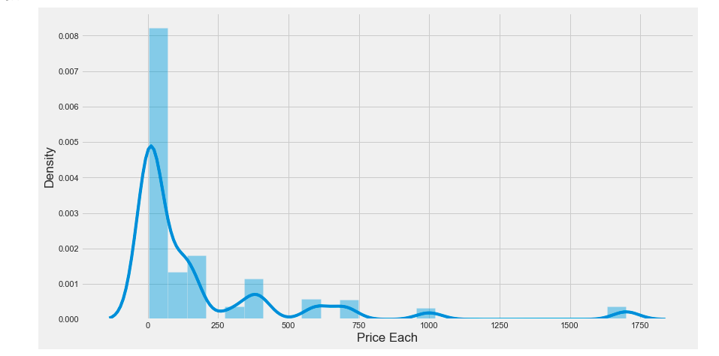

Slide 16
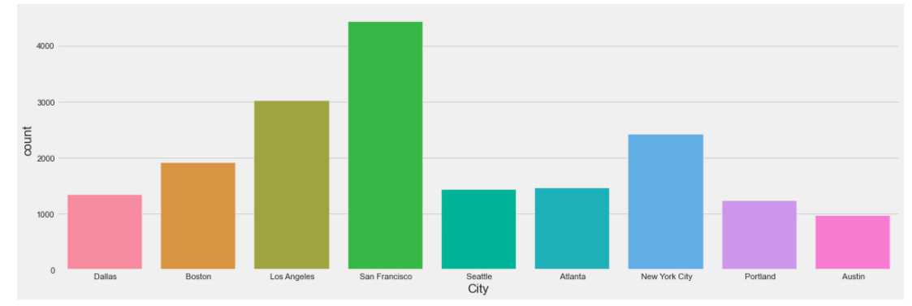

Slide 17
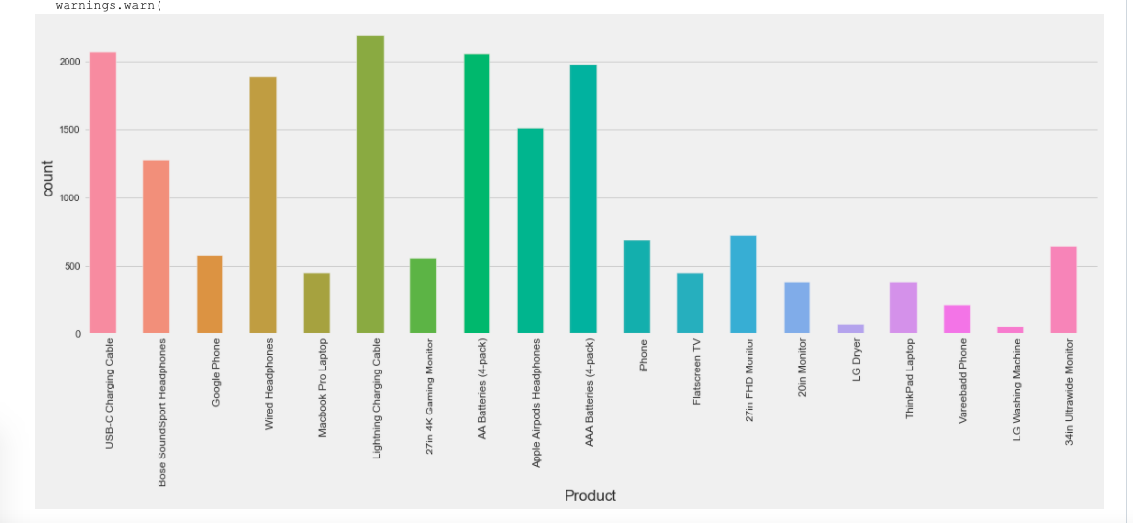

Slide 18
