Slide 1

Design Optimization of Coil Springs: Problem Statement and Formulation

Slide 2
GROUP MEMBERS Group Name: Fusion Beast
Divyanshi Pandey 20226055 ME
Isha Jaiswal 20226067 ME
Divyanshi 20226054 ME

Slide 3

Problem Statement
Problem Statement: Coil springs are used in numerous practical applica- tions. Detailed methods for analyzing and designing such mechanical components have been developed over the years. The purpose of this project is to design a minimum mass spring (shown in Figure) to carry a given axial load (called tension-compression spring) without material failure and while satisfying two performance requirements: the spring must deflect by at least A and the frequency of surge waves must not be less than 00 (Hertz, Hz).
Objective: Achieve an optimal balance between stiffness, strength, weight, and manufacturing cost.

Slide 4

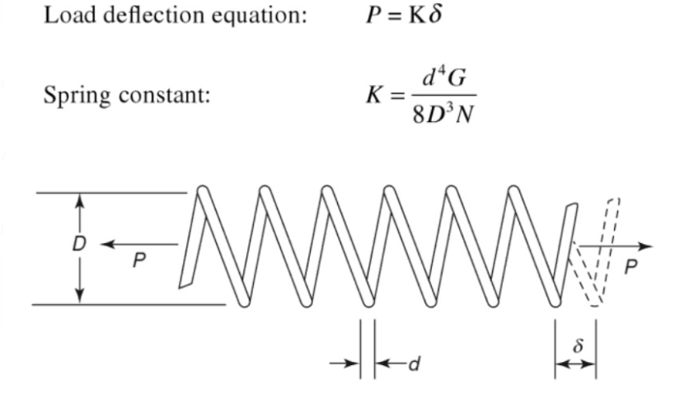

Slide 5

Formulation of Design Variables
- Wire Diameter (d): Represents the diameter of the wire used to form the coil.
- Coil Diameter (D): Indicates the overall diameter of the coil.
- Number of Coils (N): Determines the number of turns in the coil.

Slide 6
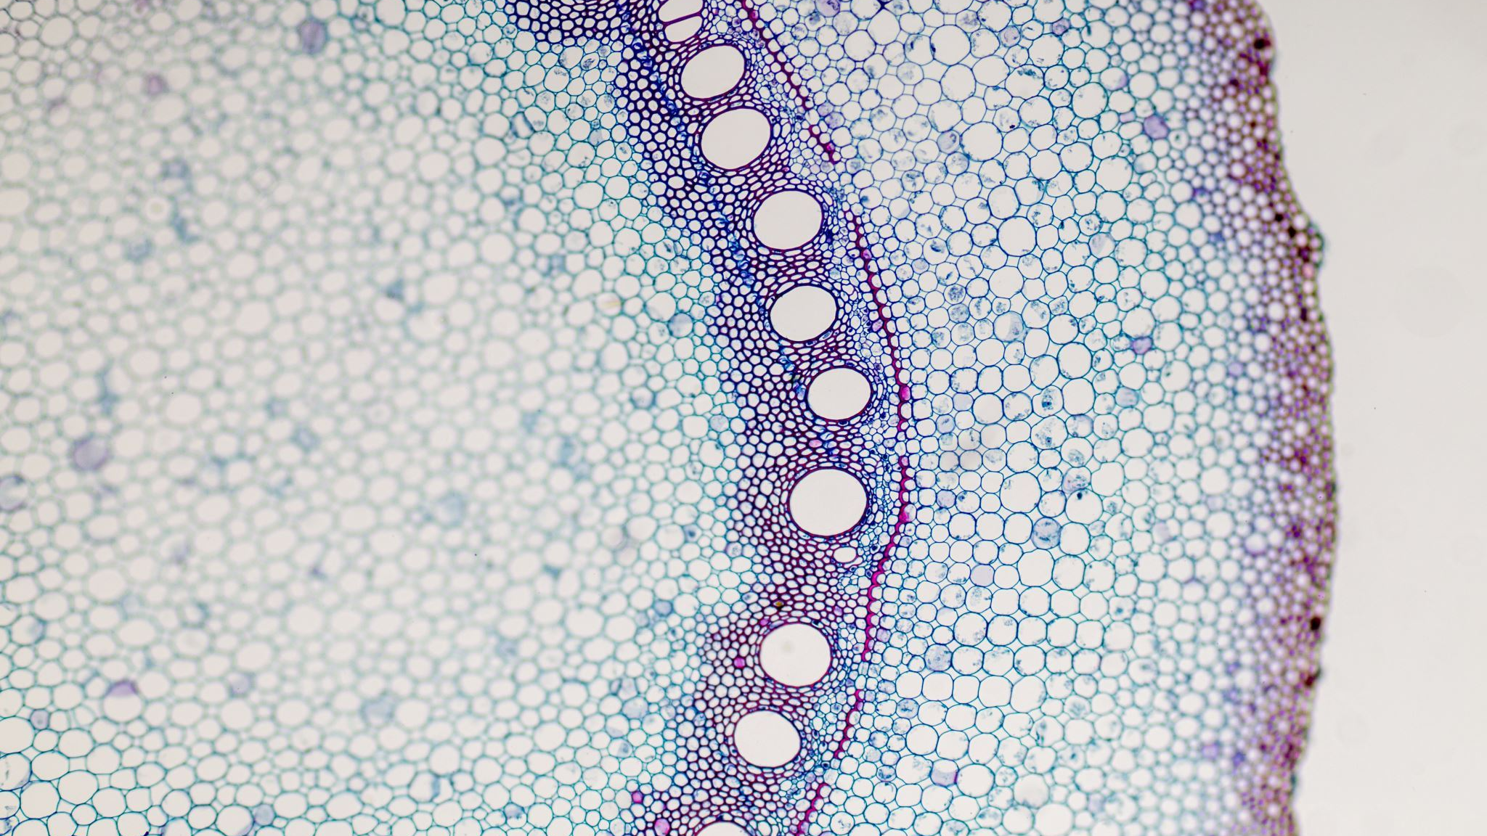

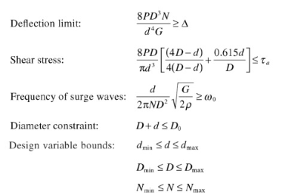
Cost Function
Constraints

Slide 7
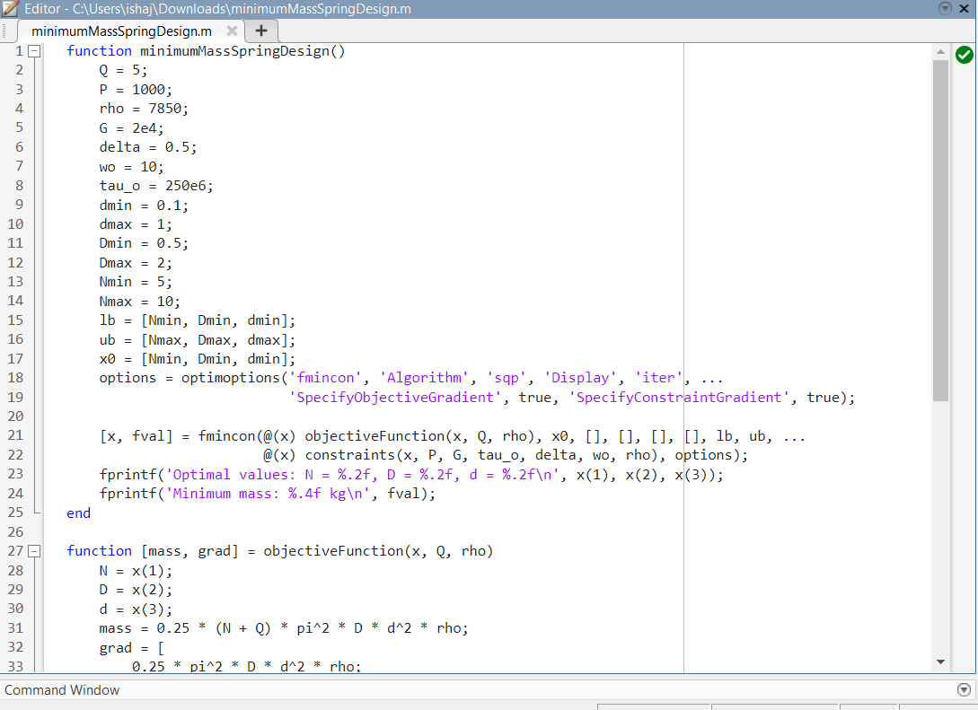
Code

Slide 8
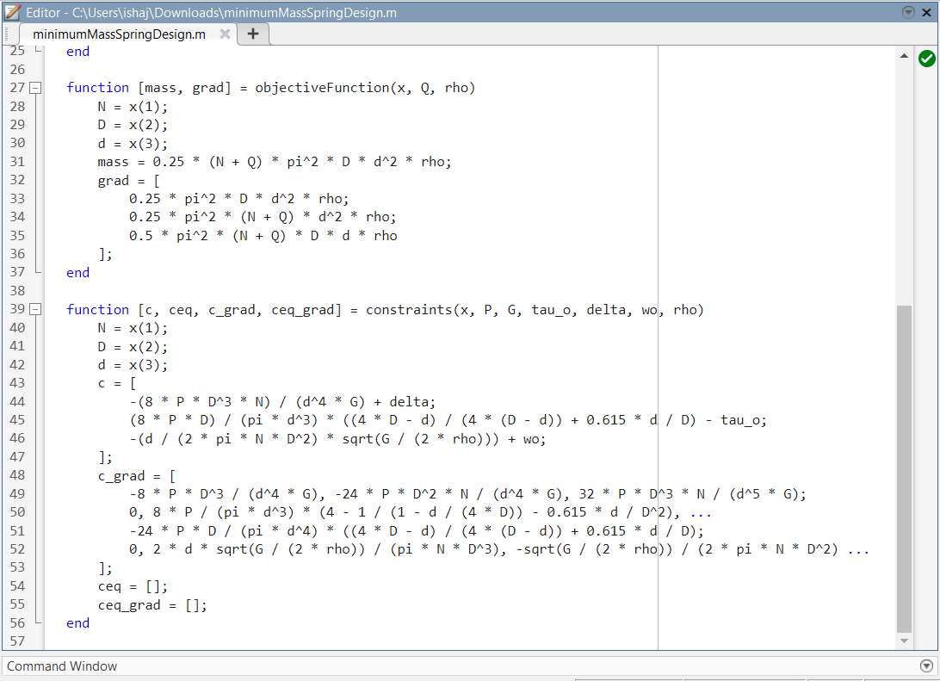

Slide 9
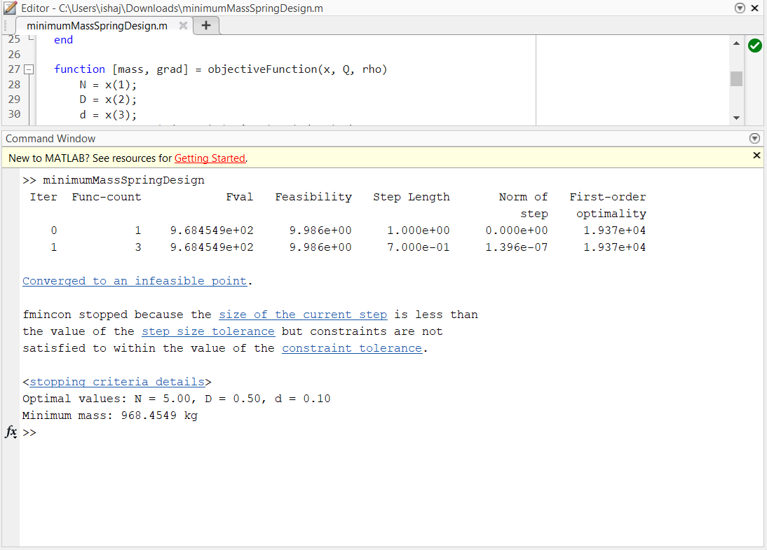
Output

Slide 10
Thank You

