Slide 1
DATA MINING • UNSUPERVISED LEARNING
Customer
Segmentation
K-Means Clustering on Online Retail Data
UCI Online Retail Dataset | Orange Data Mining
Isha Kumawat
3rd Year • CSAI • Section B • Roll No. 87
JECRC FOUNDATION
01

Slide 2
01 • PURPOSE
Why customer segmentation?
The project turns raw purchase history into meaningful customer groups.
01
02
03
GROUP
UNDERSTAND
ACT
Find customers with similar purchasing behavior.
Compare segments using a common set of behavioral features.
Use the segments to support targeted decisions.
CORE IDEA
Identify meaningful customer segments using an unsupervised K-Means model.
BEHAVIOR
CLUSTERS
INSIGHT
02

Slide 3
02 • DATA
The dataset
A transaction-level retail dataset is transformed into customer-level behavior.
541,909
4,372
8
transactions
customers
original variables
ORIGINAL FIELDS
InvoiceNo • StockCode • Description • Quantity
InvoiceDate • UnitPrice • CustomerID • Country
CustomerID becomes the grouping key, reducing 541,909 transactions to 4,372 customer records.
03

Slide 4
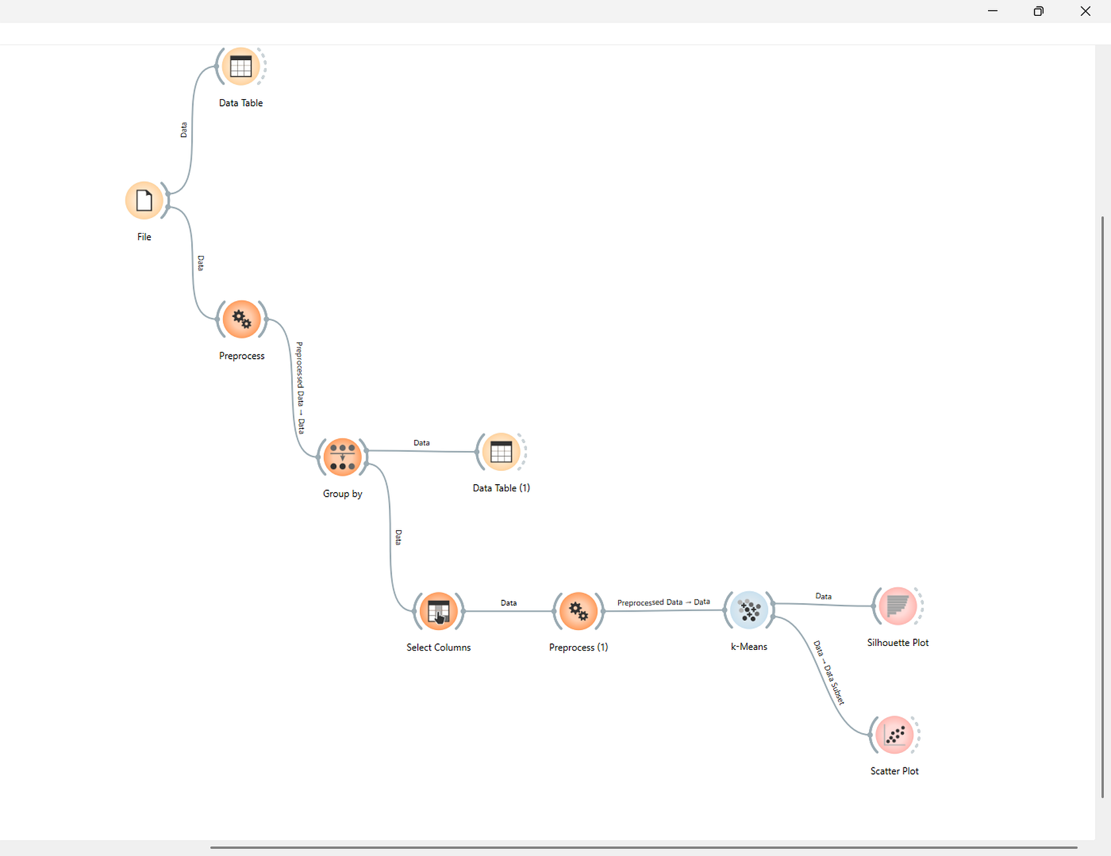
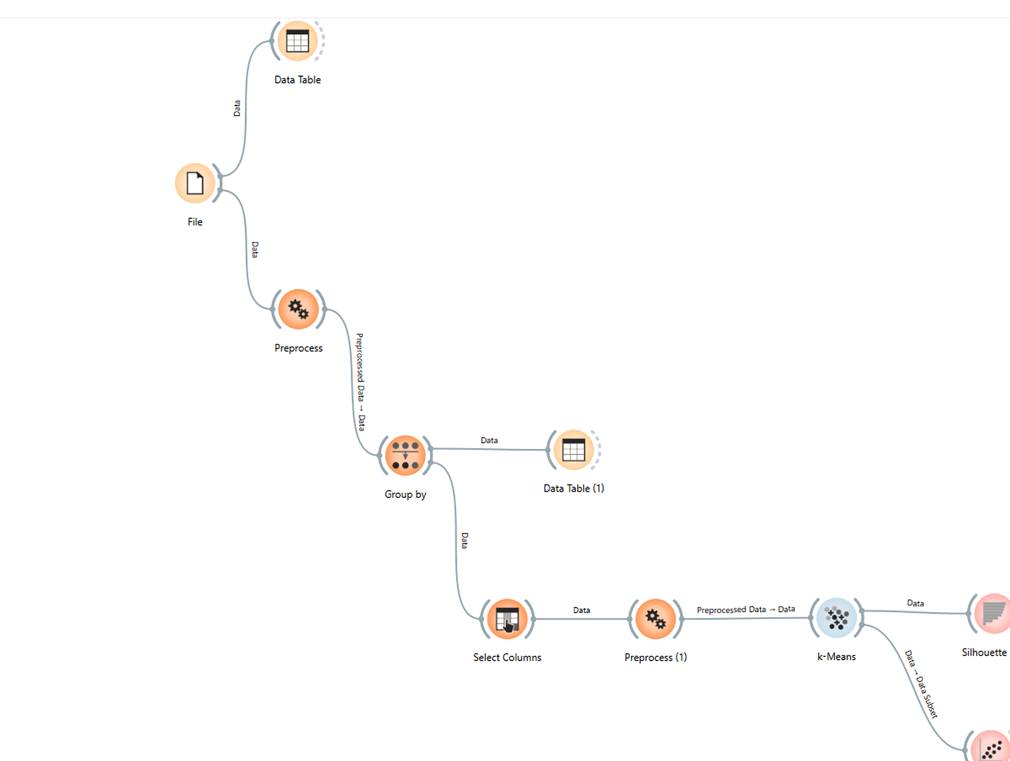
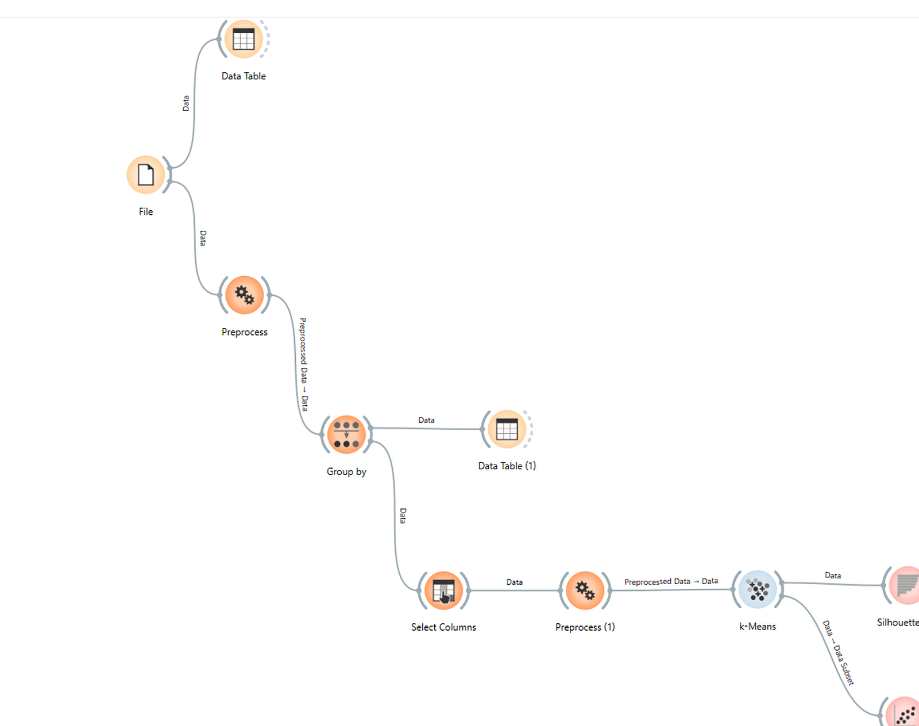
03 • PROCESS
From raw transactions to customer segments
Complete Orange workflow — every node is visible.
PIPELINE
01
PREPROCESS
Missing values
02
GROUP BY
CustomerID
03
SELECT
4 features
04
NORMALIZE
Standard scale
05
K-MEANS
3 clusters
OUTPUT → customer-level data
04

Slide 5
04 • FEATURES
Build the customer-level feature set
Four behavioral variables are retained for clustering.
01
Quantity - Sum
02
UnitPrice - Mean
Total quantity purchased
Average unit price
03
InvoiceNo - Count
04
StockCode - Count
Transaction count
Product-code count
Normalize the four features so large numeric scales do not dominate K-Means distance calculations.
05

Slide 6
05 • MODEL
K-Means configuration
Fixed K = 3 with standardized customer features.
NUMBER OF CLUSTERS
01
CLUSTER INPUT
RE-RUNS
3
Quantity - Sum
UnitPrice - Mean
InvoiceNo - Count
StockCode - Count
10 runs for more stable initialization.
C1 • C2 • C3
02
KMeans++ initialization
MAX ITERATIONS
Up to 300 iterations for convergence.
06

Slide 7
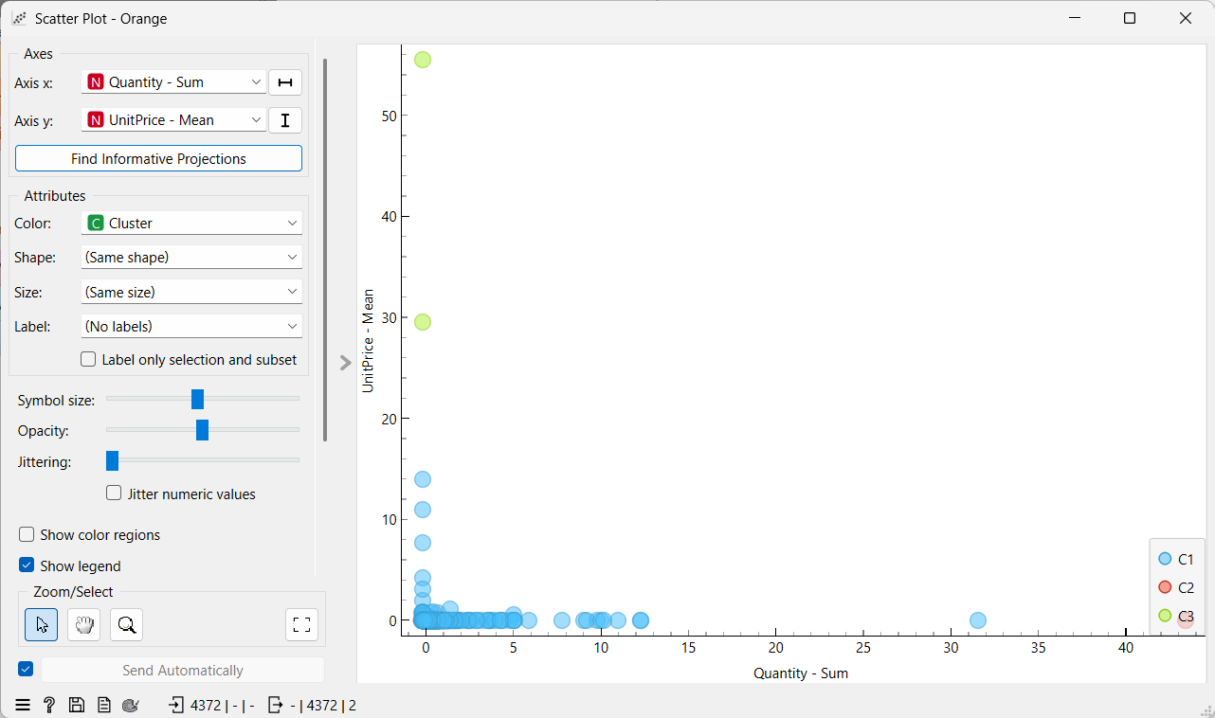

06 • RESULT
Cluster visualization
Each customer is colored by its K-Means cluster.
CLUSTER MAP
C1
baseline / regular
C2
high-volume
C3
high-value
X: Quantity • Y: UnitPrice
07

Slide 8
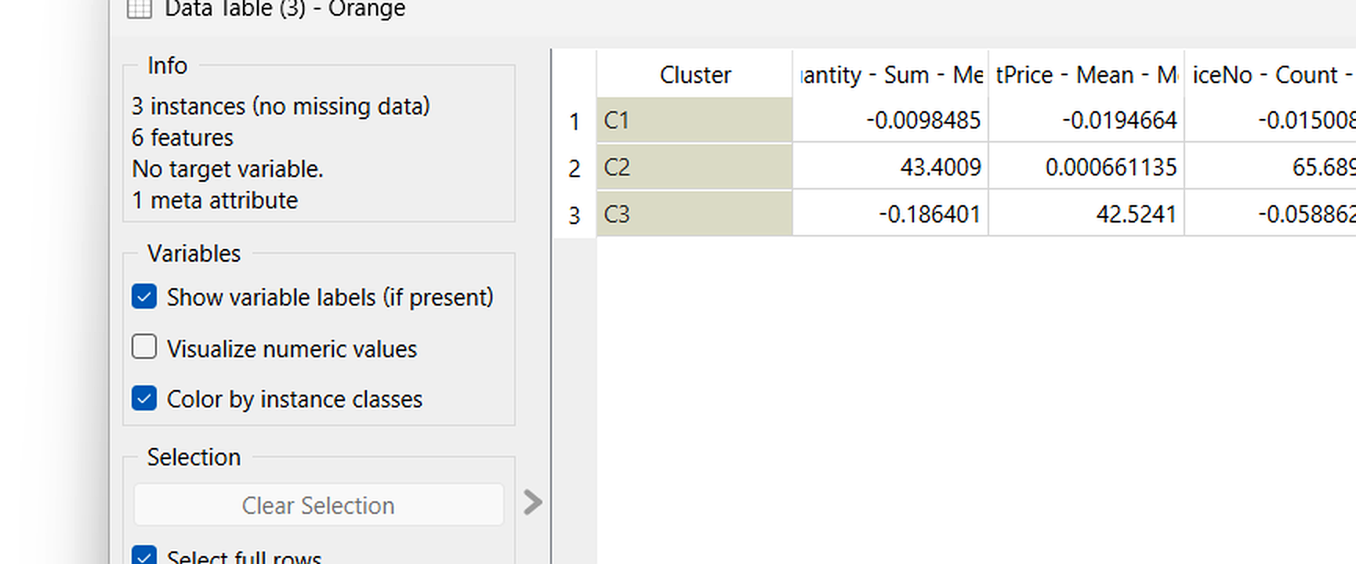
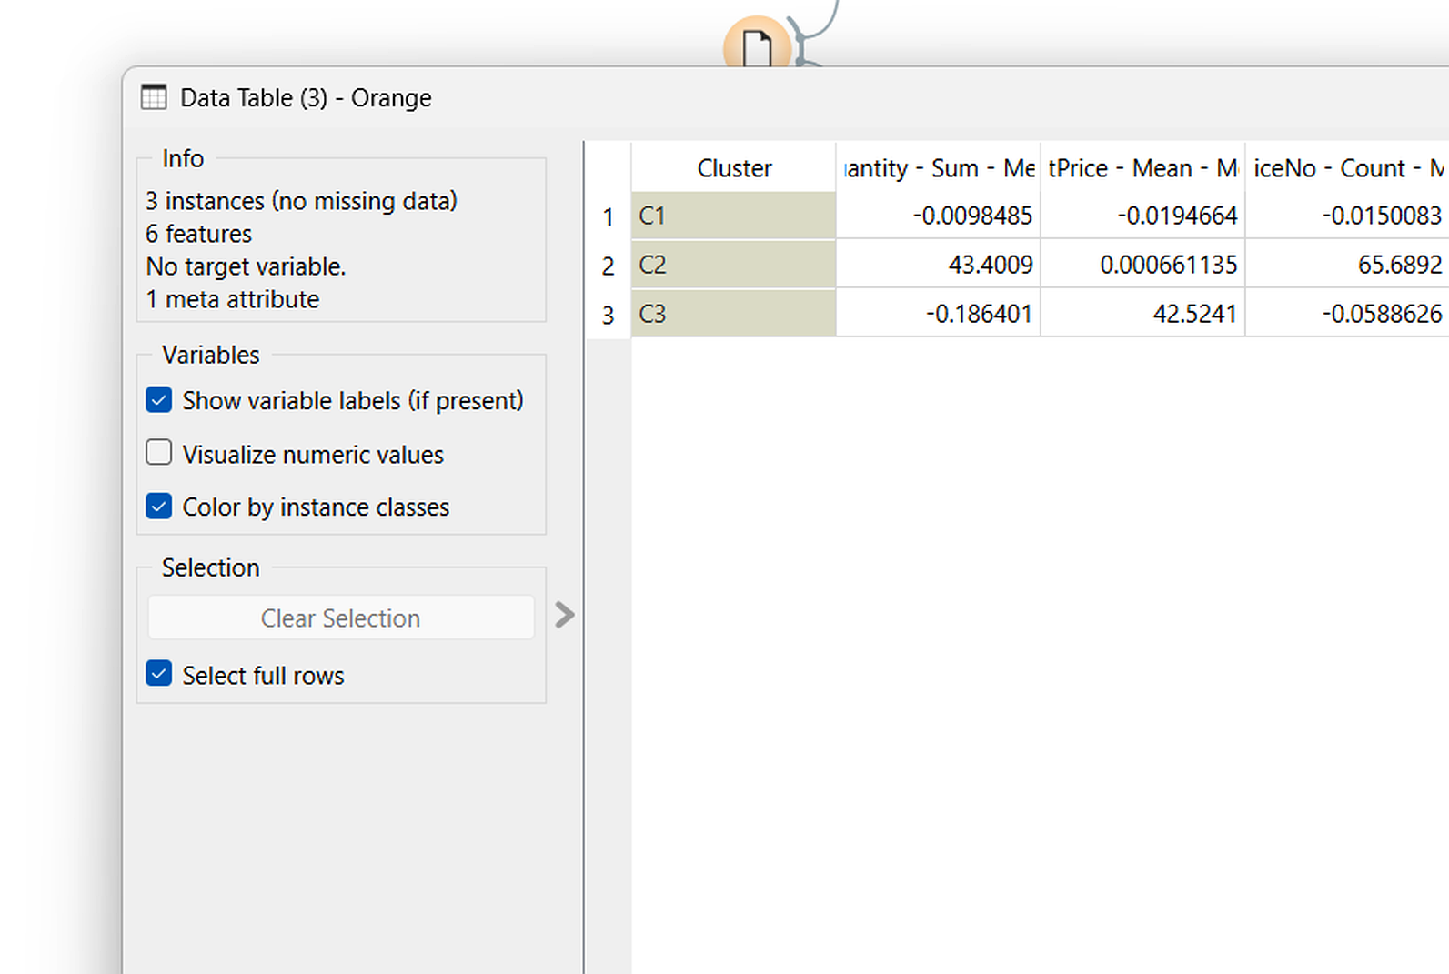
07 • RESULT
Cluster summary
The cluster centers show the dominant purchasing behavior of each segment.
KEY DIFFERENCES
C1
Near the standardized average.
C2
Very high quantity and count measures.
C3
Very high average unit-price value.
3 clusters • 4,372 customers
08

Slide 9
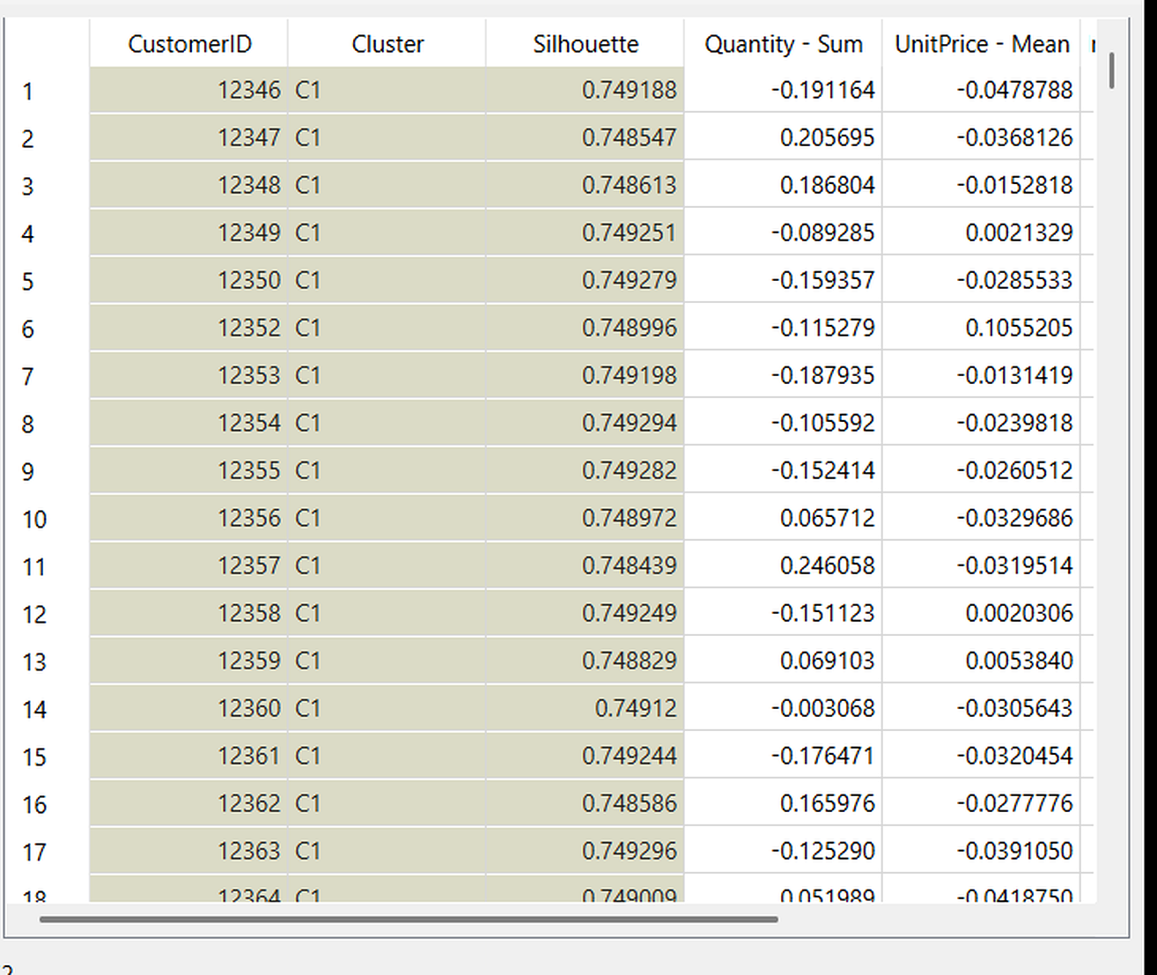
08 • RESULT
Customer assignments
Each customer receives a cluster label and silhouette score.
OUTPUT CHECK
4,372
customer rows
C1 • C2 • C3
The output keeps the cluster label and an individual silhouette value for evaluation.
09

Slide 10
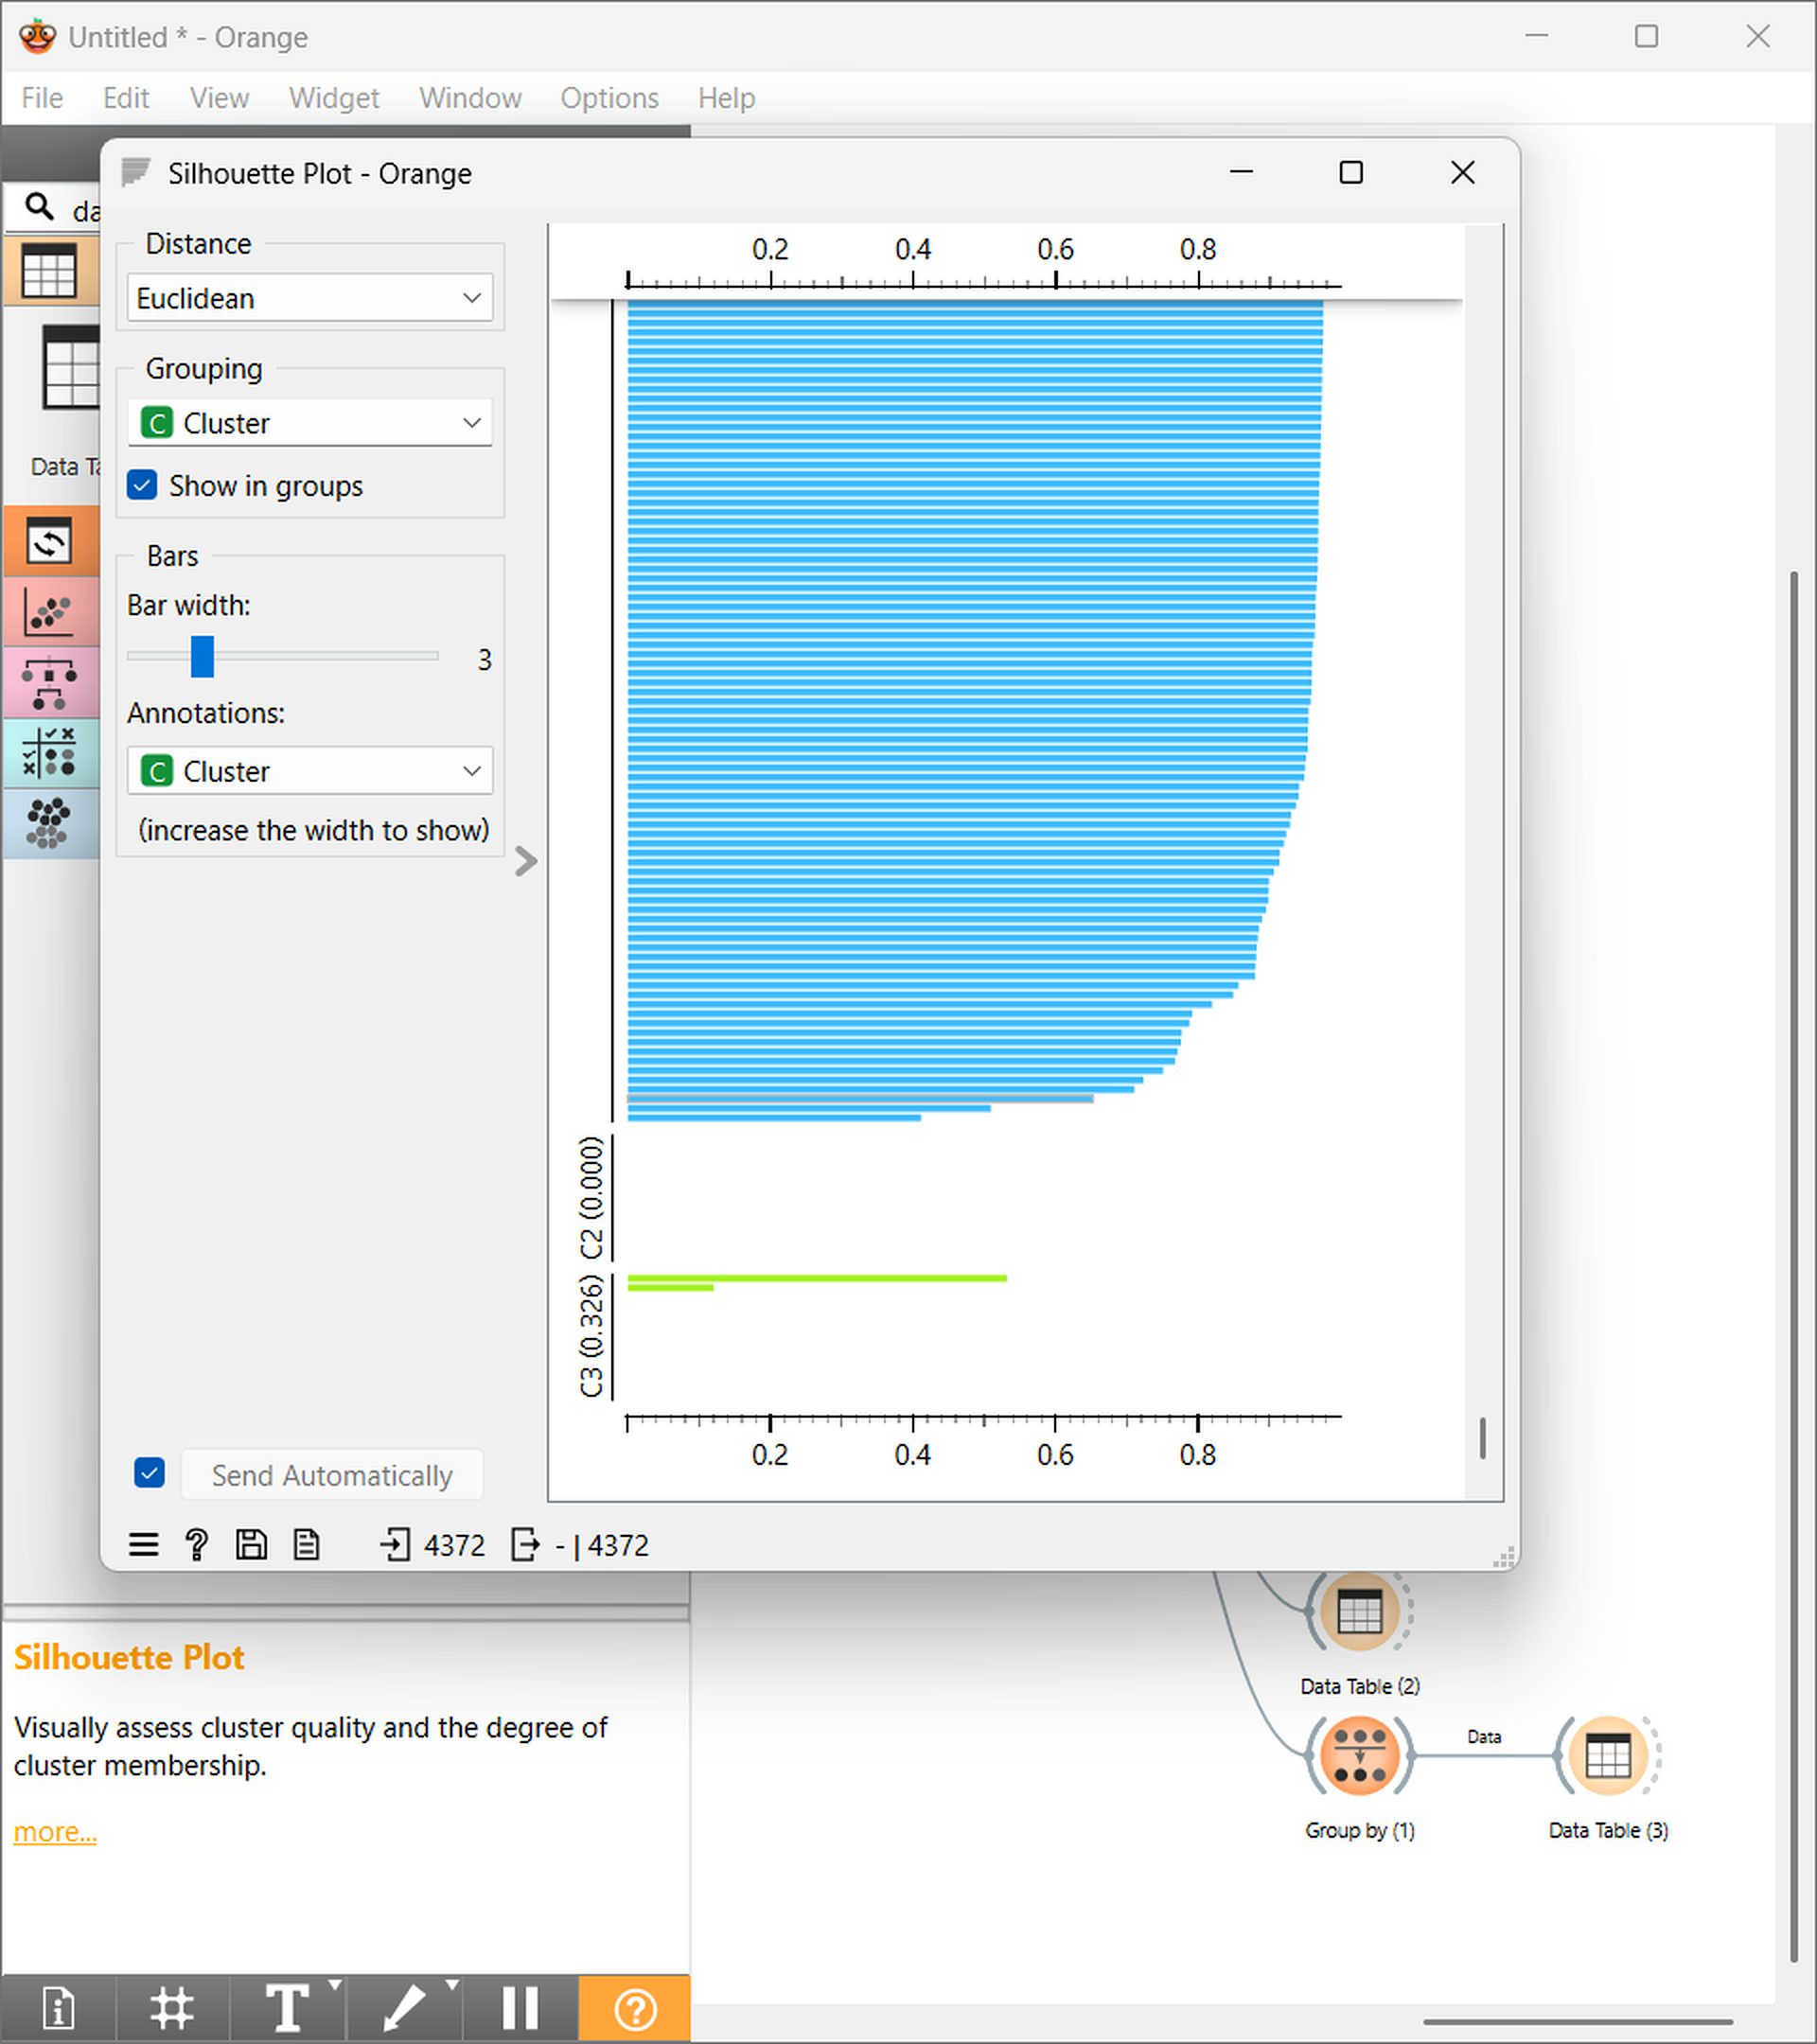
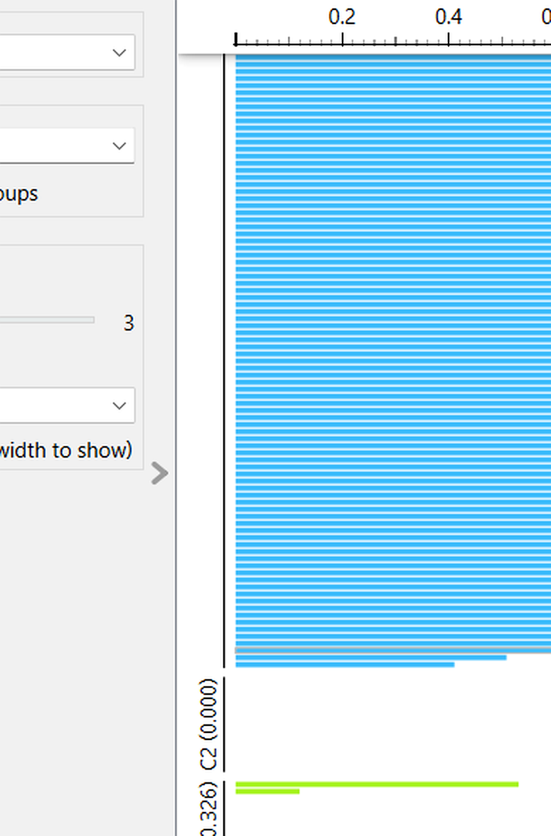
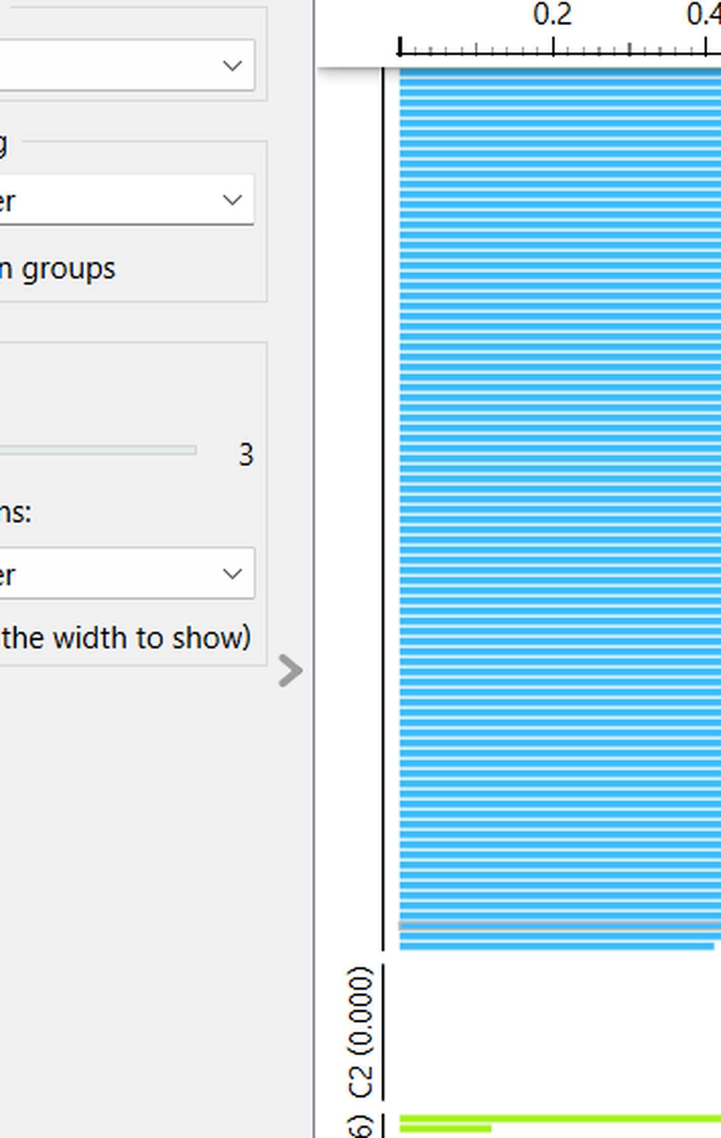
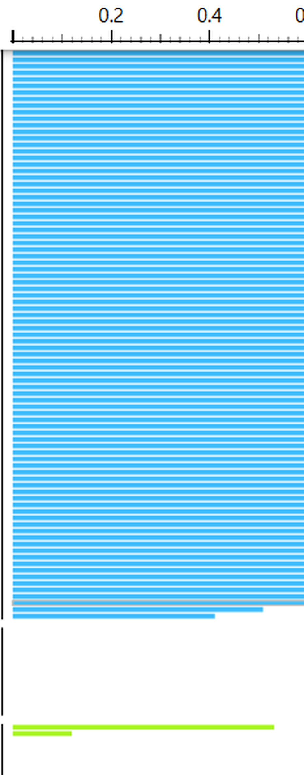
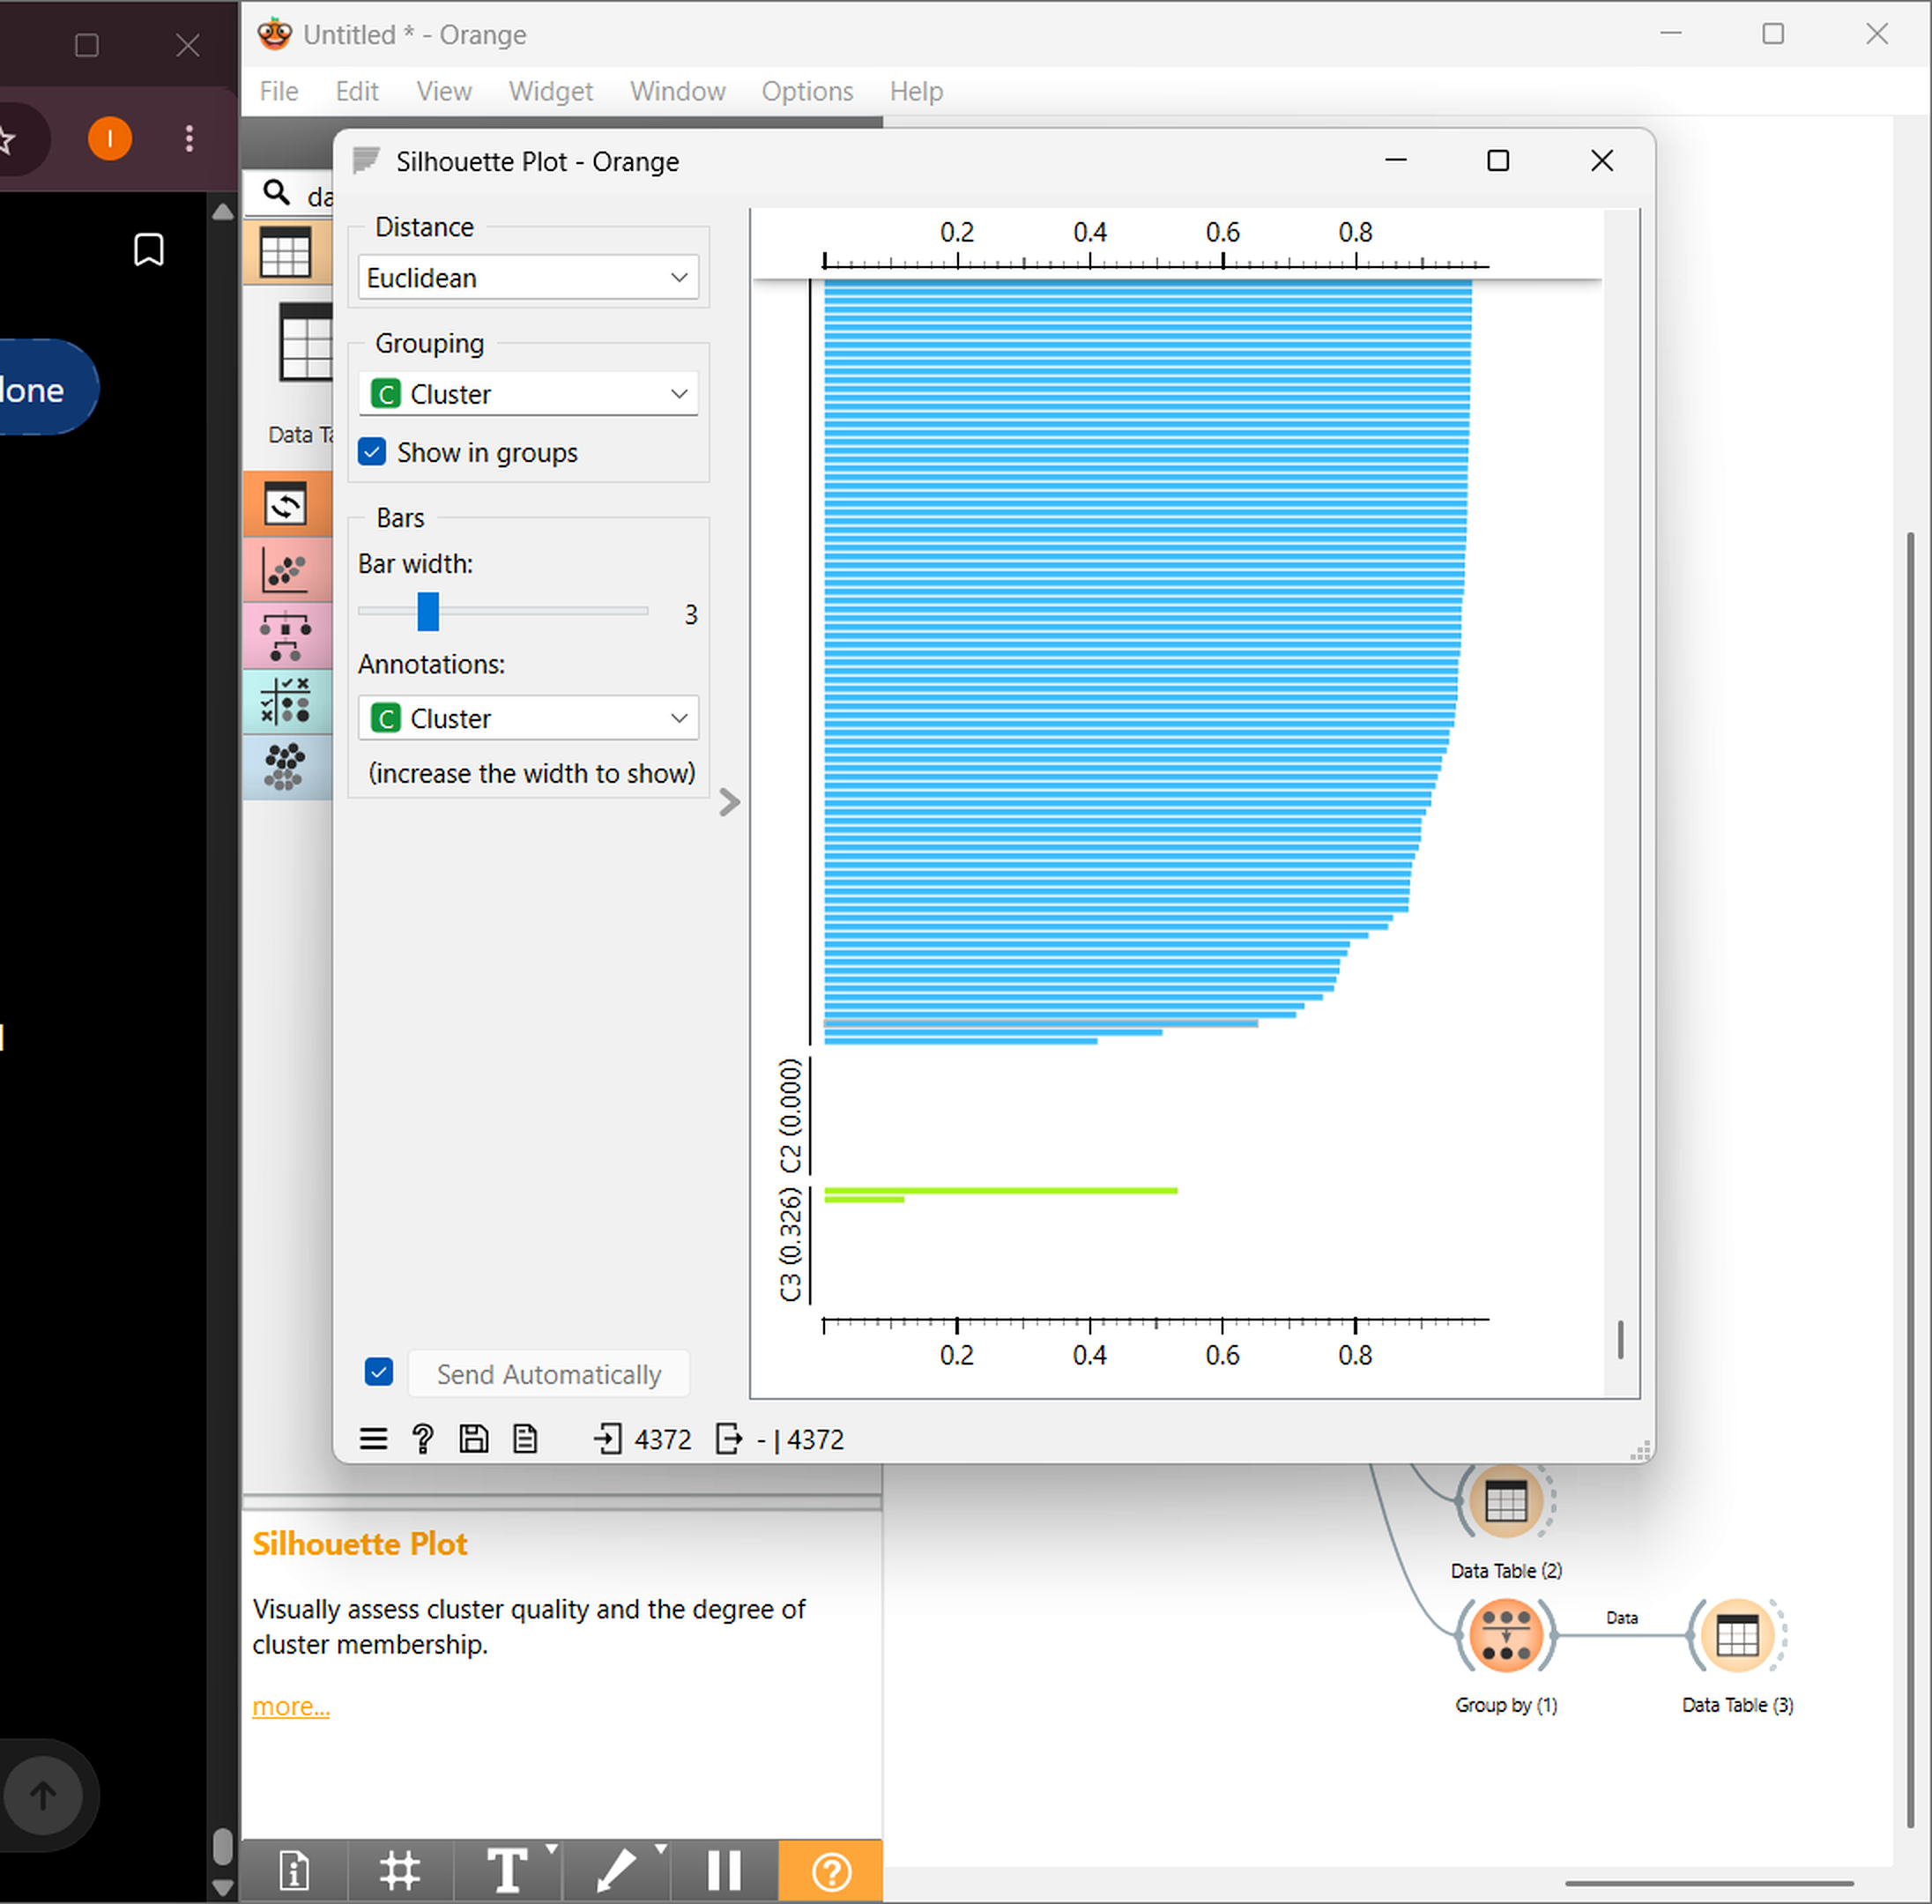
09 • EVALUATION
Silhouette analysis
Full Orange screenshot — ChatGPT and the red annotation are removed.
CLUSTER SCORES
C1
0.749
C2
≈ 0.000
C3
0.326
C1 • strong separation
C2 • weak separation
C3 • moderate separation
10

Slide 11
10 • INSIGHT
What do the clusters mean?
Translate model output into a simple customer story.
C1
C2
C3
REGULAR
HIGH VOLUME
HIGH VALUE
Relatively average purchasing behavior.
Very high quantity and count measures.
Very high average unit-price value.
RETENTION
BULK / PRIORITY
PREMIUM / PERSONALIZE
11

Slide 12
11 • TAKEAWAY
From data to decisions
The project demonstrates an end-to-end customer segmentation workflow.
1
541,909 transactions were reduced to 4,372 customer-level records.
FINAL TAKEAWAY
Four purchasing-behavior features were standardized for clustering.
DATA
↓
PATTERNS
↓
SEGMENTS
↓
DECISIONS
2
3
K-Means divided customers into three segments.
4
Silhouette scores reveal strong, moderate and weak separation.
Customer segmentation turns transaction history into actionable insight.
5
The resulting segments can guide targeted customer strategies.
THANK YOU
12

