Slide 1
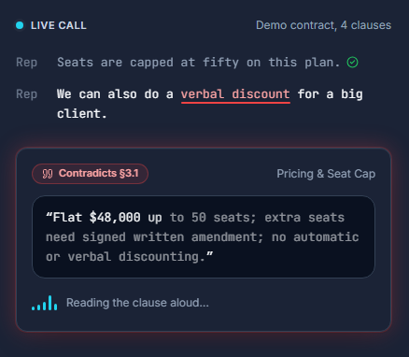
CLAUSECATCHER
Your reps go off-script.
Your contract doesn't.
ClauseCatcher listens to live sales calls, catches any line that contradicts the signed contract, and reads the exact clause aloud while the customer is still on the line.
AssemblyAI Streaming STT v3
AssemblyAI Voice Agent
github.com/ishal1410/clausecatcher
Notes:
Open cold with the line on screen, no team intro. A rep on a live call can promise something the contract does not allow, and today nobody catches it until the call is long over. ClauseCatcher catches it while the call is still happening.

Slide 2
THE PROBLEM
02 / 10
A promise said out loud becomes the deal
REP SAID, ON THE CALL
1
Nobody checks the call live
“If you sign this week, we can do a verbal discount on the extra seats.”
2
The gap surfaces after signing
SIGNED CONTRACT §3.1 SAYS
“Flat $48,000 up to 50 seats; extra seats need signed written amendment; no automatic or verbal discounting.”
3
Then it's a dispute, not a correction
Notes:
This is the demo contract used throughout. The rep offers a verbal discount the contract explicitly forbids. The moment it is said, it becomes the customer's expectation. Fixing it after the call means legal, not a sentence.

Slide 3
THE SOLUTION
03 / 10
Listen. Check. Speak the clause.
01
→
02
→
03
LISTEN
CHECK
SPEAK
AssemblyAI Streaming STT v3
Gemini claim-check
AssemblyAI Voice Agent
Always-on transcript of the rep, seeded with keyterms from the contract.
Each finished sentence is checked. The model returns a verdict and a clause ID, never text.
Reads the contract's literal clause aloud, and the cockpit shows the alert card.
Notes:
Three parts. Always-on transcription, a per-sentence contradiction check against the contract, and a spoken correction in the contract's own words, not a summary of them. Now let me show you.

Slide 4
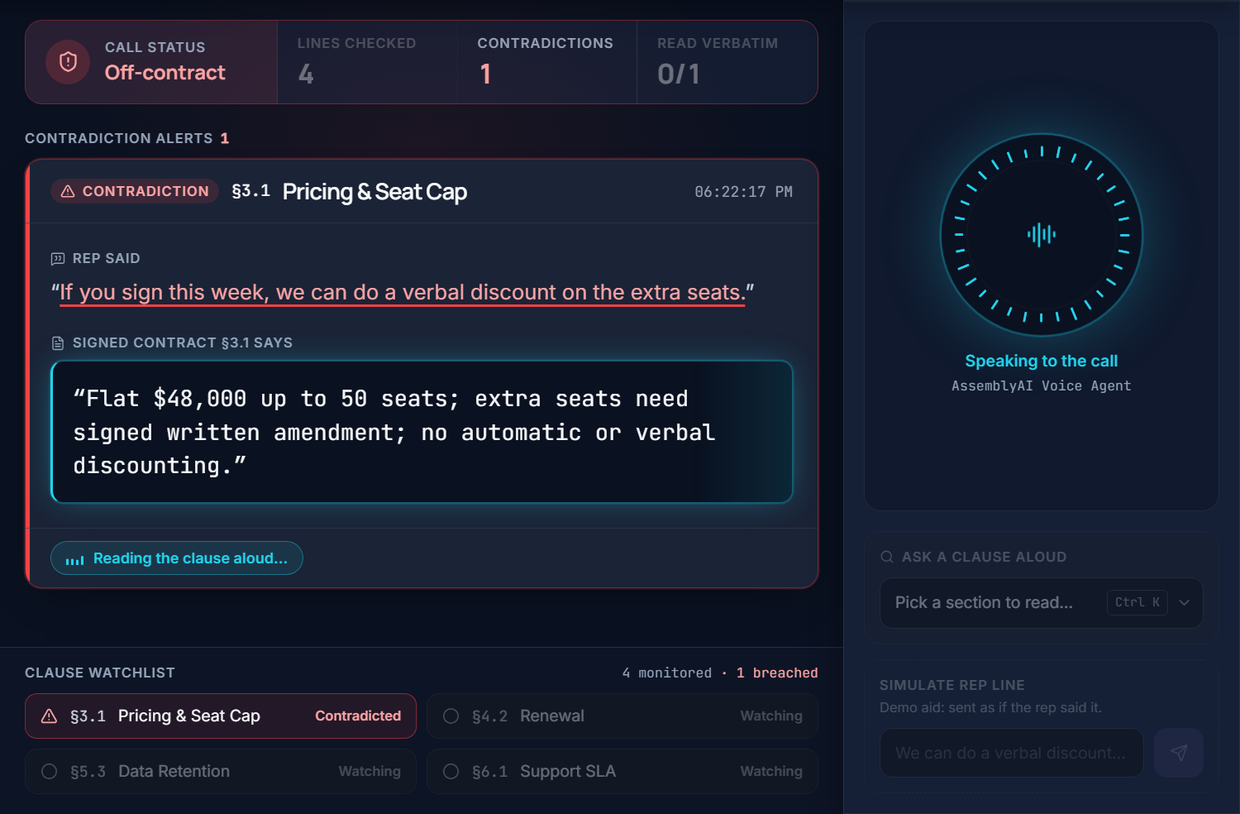
LIVE DEMO
04 / 10
Caught mid-call.
Spoken back
word for word.
Rep offers a verbal discount
§3.1 flagged in ~5 s
Voice Agent reads §3.1 aloud
Marked spoken verbatim
Notes:
Play roughly 1:00 to 1:35 of the demo video here. The rep offers an unauthorized discount, ClauseCatcher flags section 3.1 about two seconds after the sentence ends, and the AssemblyAI Voice Agent speaks the clause back word for word. Let the audio play without talking over it.

Slide 5
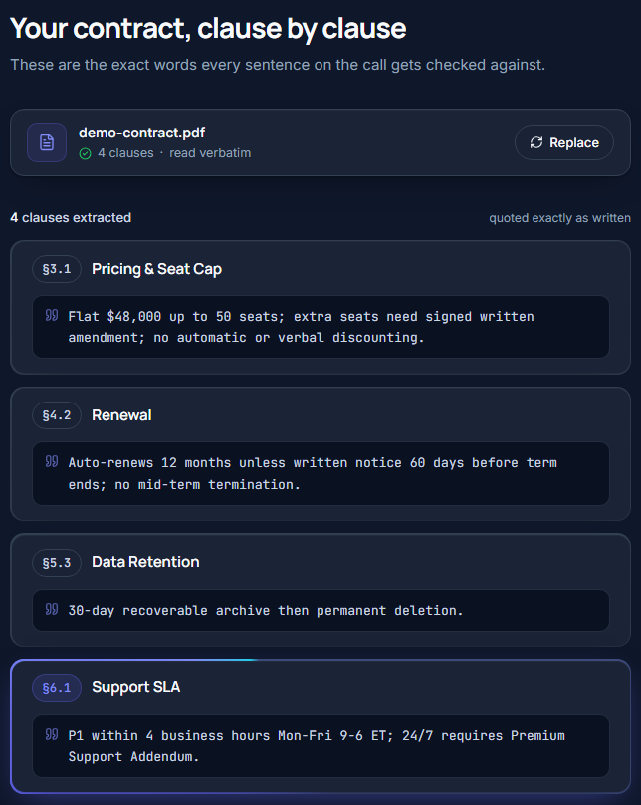
BEFORE THE CALL
05 / 10
Upload the contract.
Every clause, quoted exactly.
§
Clauses extracted once, at upload
The words on screen are the words in the PDF.
K
Clause language seeds STT keyterms
Contract-specific terms transcribe more reliably.
✓
Consent confirmed before listening
The call can't start until disclosure is checked.
Notes:
Setup takes one upload. The PDF's numbered clauses are extracted once and shown exactly as written; those are the only words the app can ever show or speak. The same clause language seeds AssemblyAI's keyterms, and the operator must confirm everyone on the call was told it is monitored.

Slide 6
ARCHITECTURE
06 / 10
Two AssemblyAI connections, one job each
ASSEMBLYAI
ASSEMBLYAI
Rep mic
→
Streaming STT v3
→
Gemini check
→
FastAPI server
→
Voice Agent
PCM16 audio
listens, never replies
returns clause ID only
looks up literal text
reply.create, say exactly
↑
Signed contract clauses: the only source of spoken words
Why split? One Voice Agent session doing both jobs was tested live and started replying over the rep, even with a silence prompt. Streaming STT has no reply behavior, so silence is structural, not prompted. (ADR-0001)
Notes:
Rep audio goes to AssemblyAI Streaming STT v3 for an always-on transcript. Each finished sentence goes to Gemini with the contract's clauses, and Gemini returns only a verdict and a clause ID. On a contradiction the server looks up that clause's literal text and has the AssemblyAI Voice Agent speak it. We tried one Voice Agent session for both jobs first; it replied over the rep on its own. Splitting the connections removed that failure instead of prompting around it. It is written up in the repo's ADR.

Slide 7
WHY ASSEMBLYAI, SPECIFICALLY
07 / 10
We tested the easy paths. Both failed.
TRIED AND DROPPED
SHIPPED
One Voice Agent session for everything
Streaming STT v3 listens all call
Auto-started 4 replies despite a silence prompt
Pure transcription: nothing to talk over
Alert injected as a fake user message
Voice Agent reply.create: “say exactly”
Agent ignored the injected content
Spoken alert matched the clause, similarity 1.0
Both products are load-bearing. Cut Streaming STT and there is no transcript to check. Cut the Voice Agent and the alert is a silent card instead of an interruption the rep hears.
Notes:
We did not guess at this. A single Voice Agent session with a system prompt telling it to stay silent still started four replies during rep audio. Injecting the alert as a fake conversation message made the agent ignore the content. Instructing the agent directly, through reply.create, to say a fixed string word for word is what produced a verbatim match: similarity 1.0 against the contract text.

Slide 8
SAFETY BY DESIGN
08 / 10
It never puts words in a rep's mouth
§
?
!
Literal clause text only
Errors ≠ accusations
Evidence, or no alert
Everything spoken or shown comes from the uploaded contract. The LLM only picks which clause applies.
A failed, timed-out or unparseable check resolves to “unclear”, never a contradiction.
Every alert cites a specific clause ID. Each clause fires at most once per 20 seconds.
A false accusation is worse than a missed one.
Notes:
A tool that puts words in a rep's mouth, or falsely accuses them, is worse than one that occasionally misses something. So the model's only job is choosing which clause applies. It never writes what gets said or shown, and anything uncertain resolves to unclear, not to an alert.

Slide 9
MEASURED, NOT PROJECTED
09 / 10
Live end-to-end runs, real connections
~5 s
1.0
~0.2 s
~$0.15
sentence end to alert (4–6.5 s, five alerts)
agent transcript vs. clause text
speak request to first audio (78–890 ms)
API usage, full call ($0.08–$0.15)
False claims on §3.1 and §6.1 both caught; consistent lines raised nothing
A monitor's spoken question about §4.2 answered correctly by voice
151 server tests passing
Runs of 2026-09-15 to 2026-09-17: real AssemblyAI Streaming STT, Voice Agent and Gemini connections, scripted rep lines fed through the pipeline.
Notes:
These are the actual numbers from one end-to-end run with real AssemblyAI and Gemini connections, not projections. Alerts arrived about two seconds after the sentence. The server's own check confirmed the spoken alert matched the contract text exactly. First voice audio came back about 78 milliseconds after the speak request, and the whole call used about twelve cents of API usage. Be straight if asked: the rep lines were scripted into the pipeline for that run.

Slide 10
WHO IT'S FOR, AND WHAT'S NEXT
10 / 10
BUILT FOR
NEXT
Sales-ops teams running live calls
Browser-mic path, hardened end to end
Compliance teams who own the contract
A hosted, deployed instance
$0.08–$0.15 API usage per call
Multiple contracts per call
The correction a rep hears is the contract itself, spoken while the call is still happening.
github.com/ishal1410/clausecatcher · Built solo for the AssemblyAI Voice Agent Hackathon
Notes:
The buyer is the team that owns what gets promised on calls: sales-ops and compliance. It is cheap to run, about twelve cents of API usage for the demo call. Next is finishing what the demo does not yet cover live: the real browser-microphone path end to end, a hosted deployment, and multiple contracts. Close on the line on screen: the correction a rep hears is the contract itself, spoken while the call is still happening.

