Slide 1

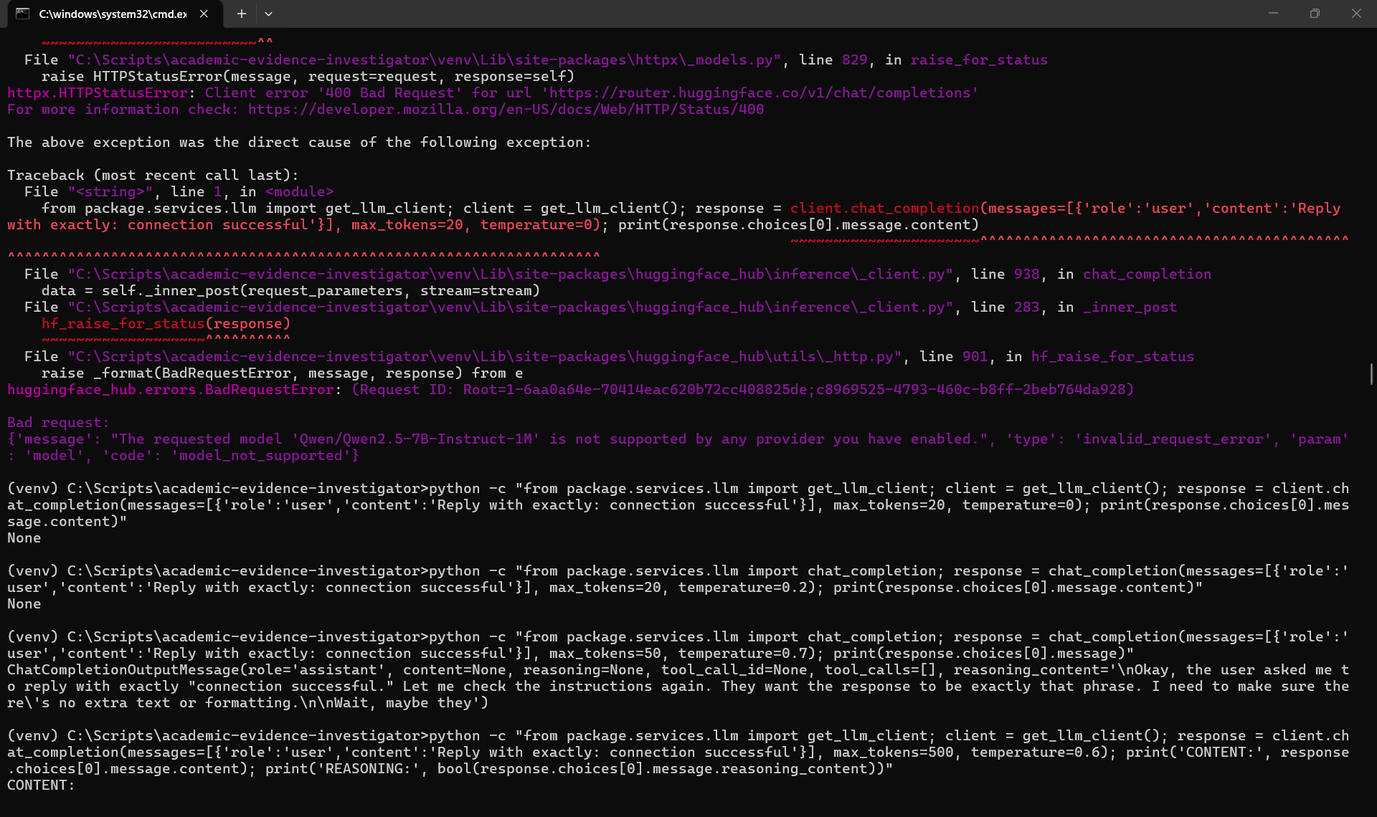
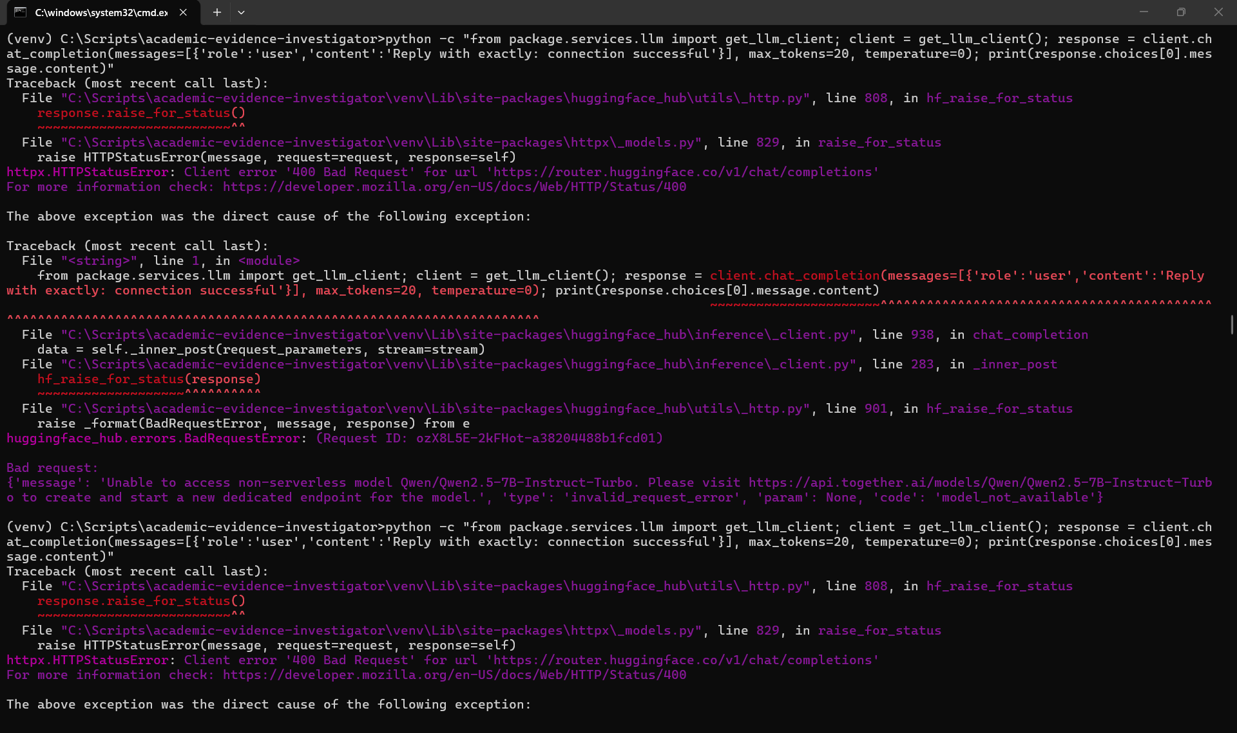
Evidence A
Model / Provider Compatibility
Referenced in Slide 6: Qwen2.5-7B-Instruct was unavailable through Hugging Face.

Slide 2
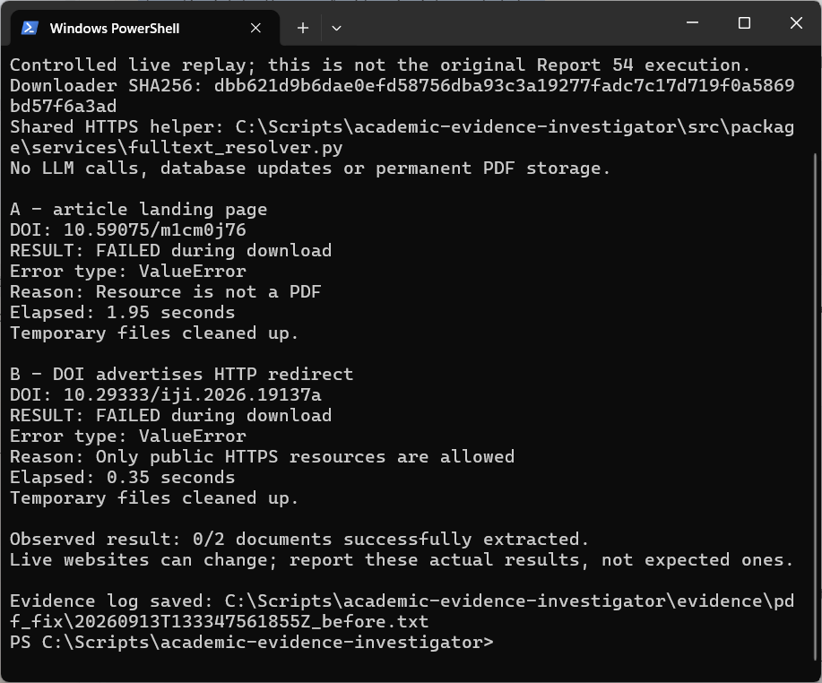
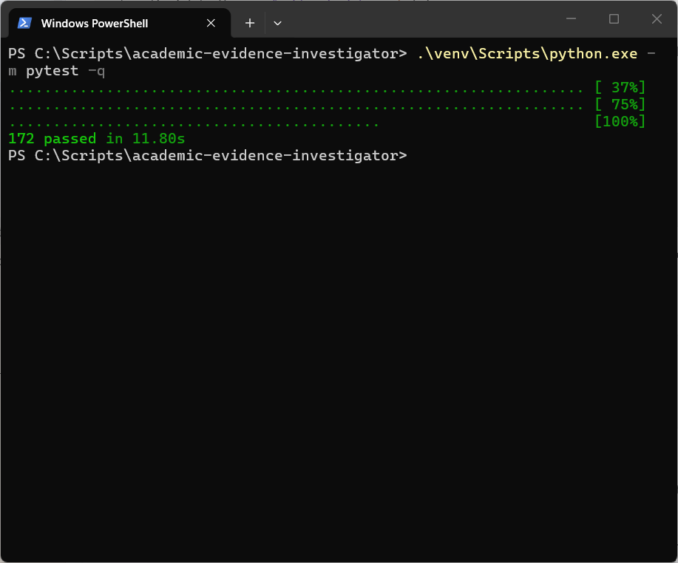
Evidence B
Full-Text Recovery
Referenced in Slide 6: Access/download failures appeared as PDF extraction failures, and some available full text was missed.
Issue Fixed

Slide 3
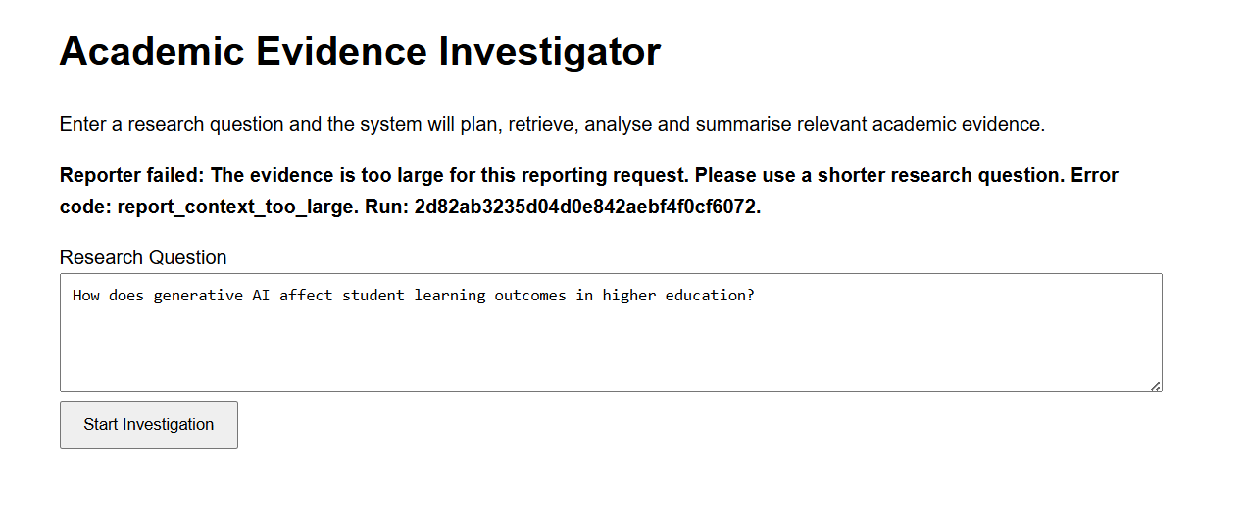
Evidence C
Oversized Reporting Request
Referenced in Slide 6: Summary completed, but the Findings request exceeded the 24,000-character budget.

Slide 4
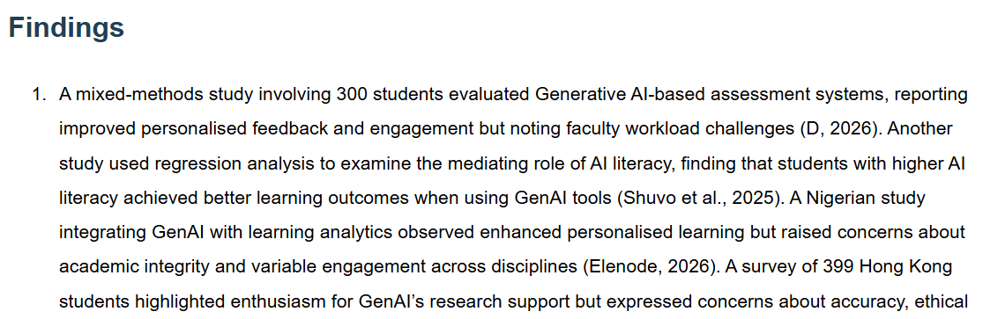
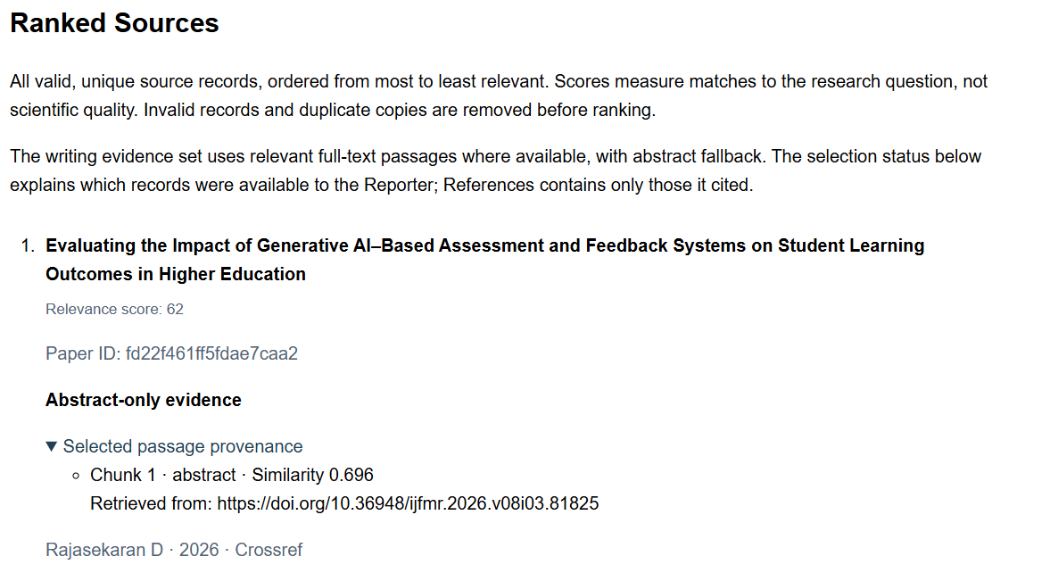
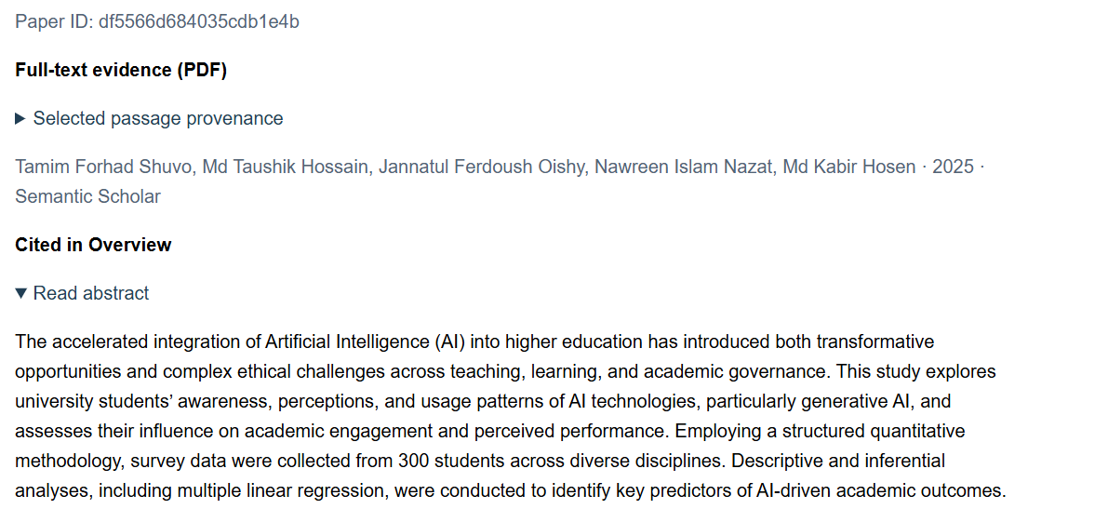
Evidence D
Claim Grounding
Referenced in Slide 6: Report 56 showed details crossing between sources. Full report saved in evidence/saved_reports/report_56_2026-09-13_19-37-27.html
The generated finding attributes a 300-student sample to D (2026).
D (2026) was available as abstract-only evidence; its supplied abstract does not state a sample size.
The 300-student sample appears in Shuvo et al. (2025), indicating a suspected cross-source attribution error.

Slide 5
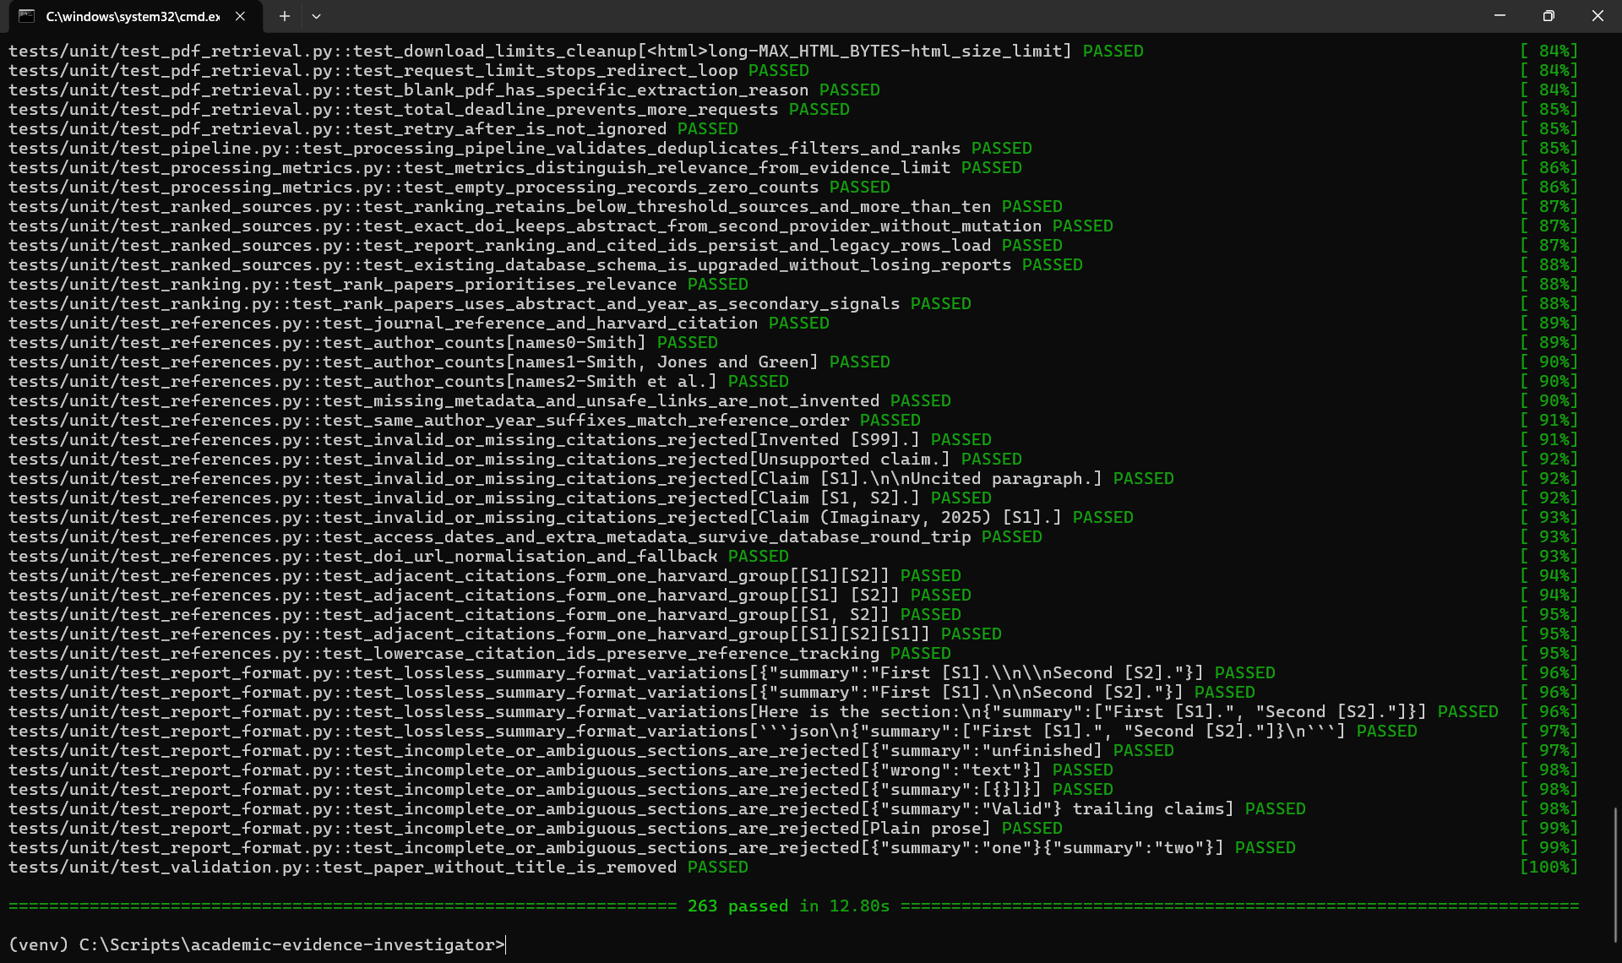
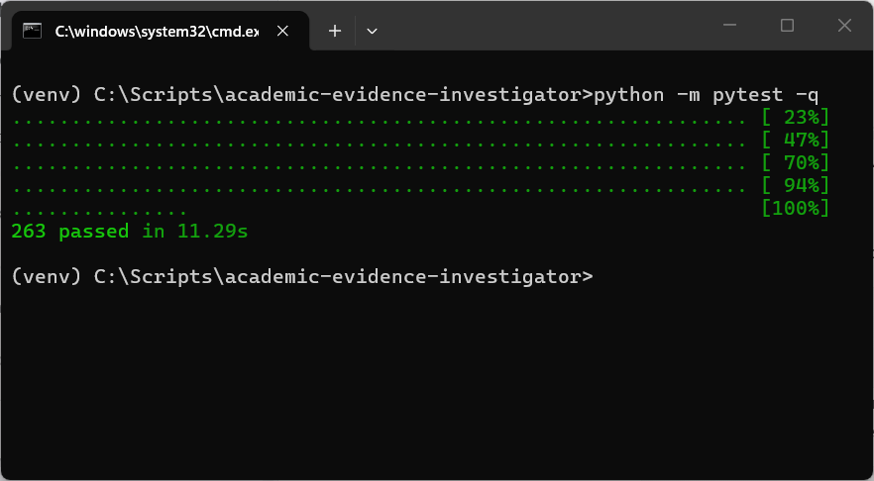
Evidence E
Testing, Verification and Functionality
Referenced in Slide 7: 263 Python tests passed in 11.29s. Full test saved in evidence/test_results/05_final_pytest_results.txt

Slide 6
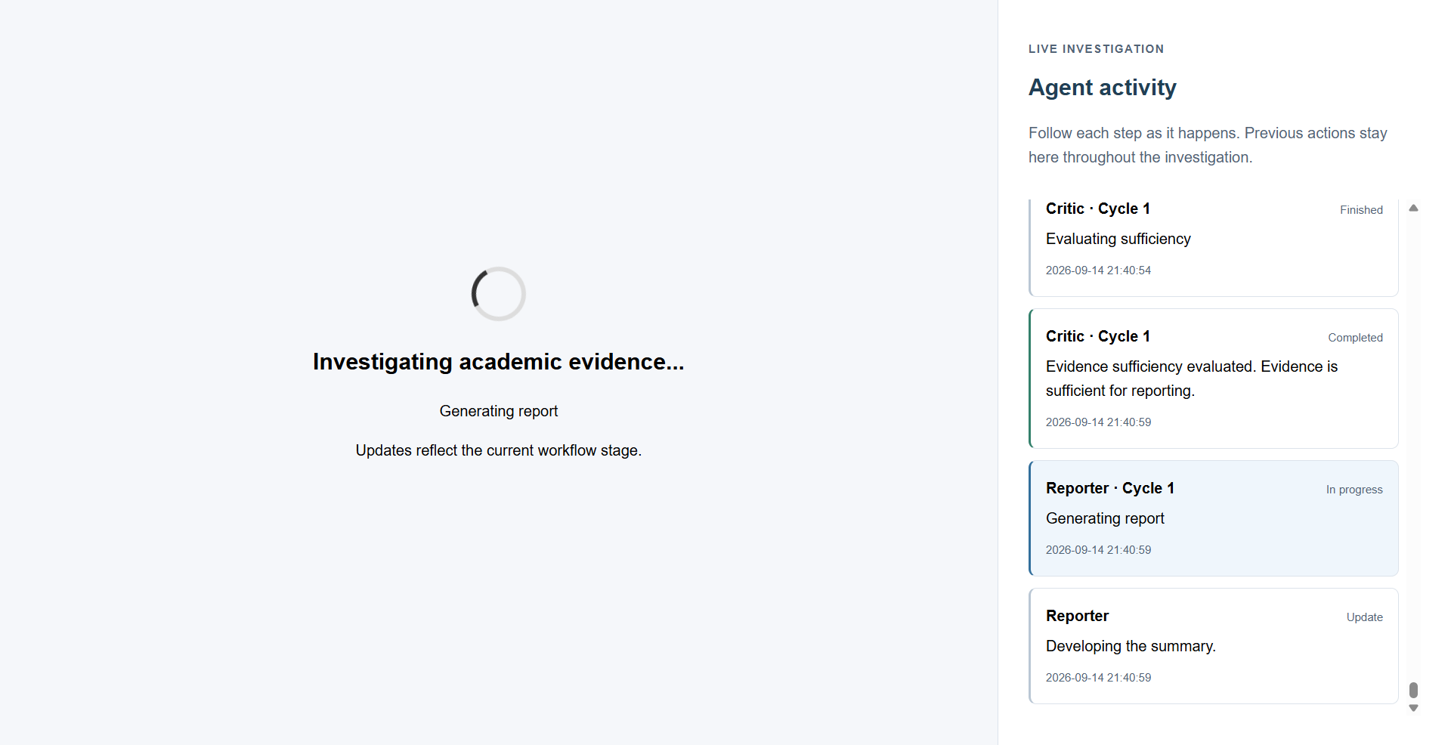
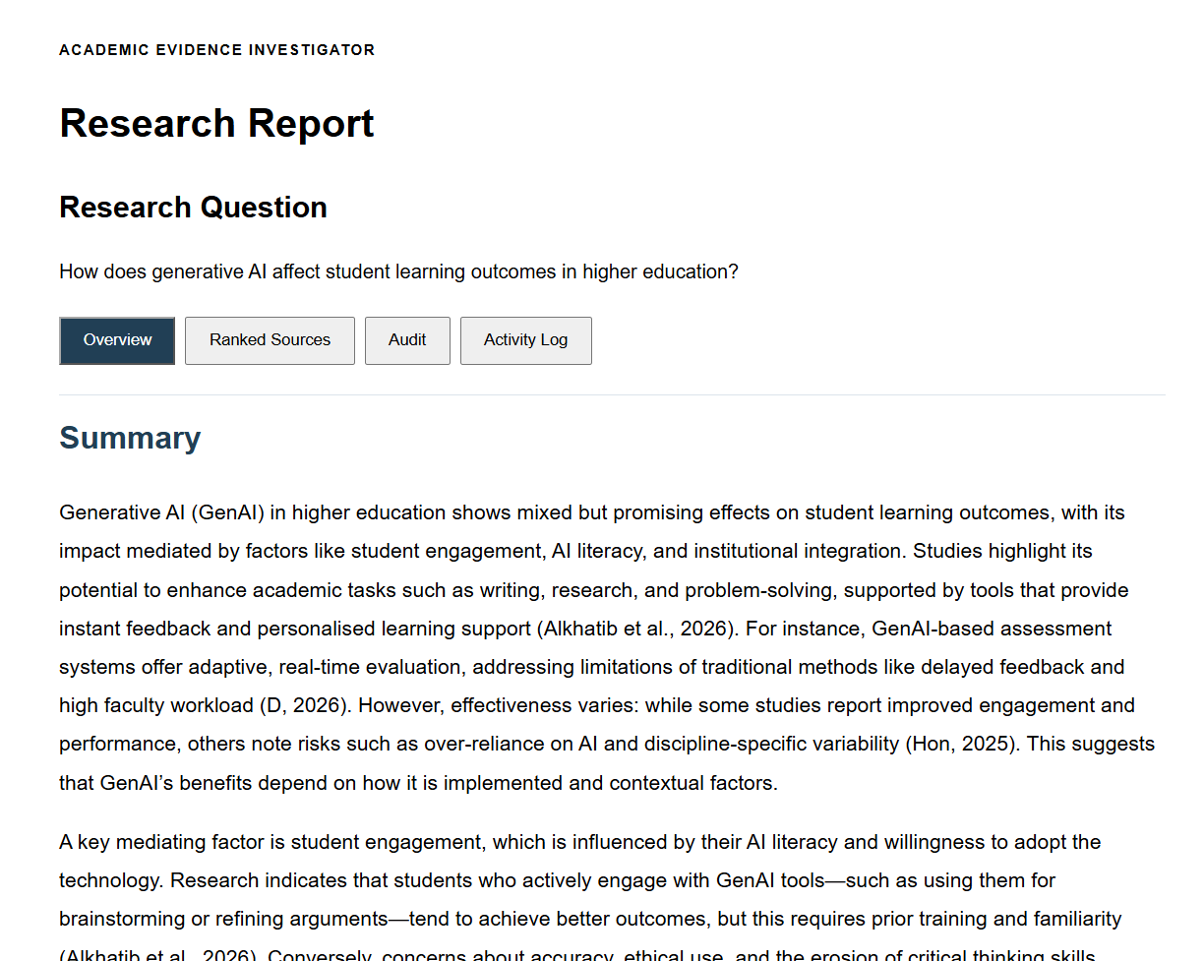
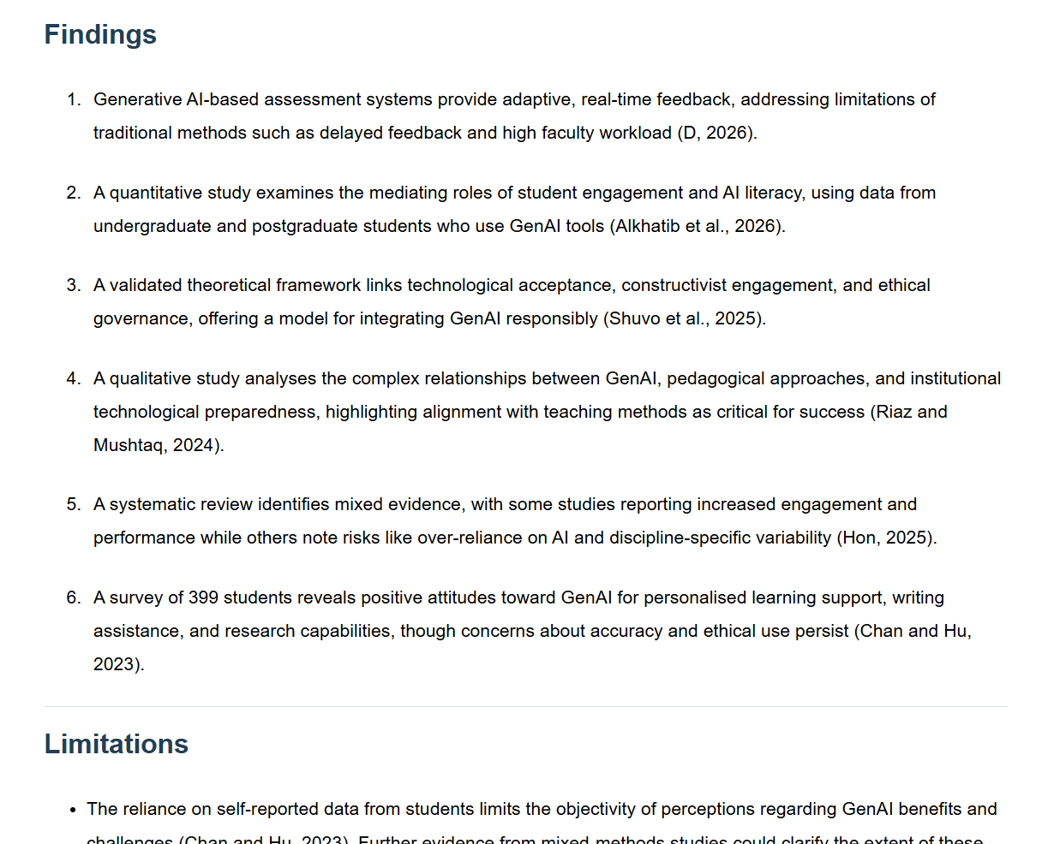
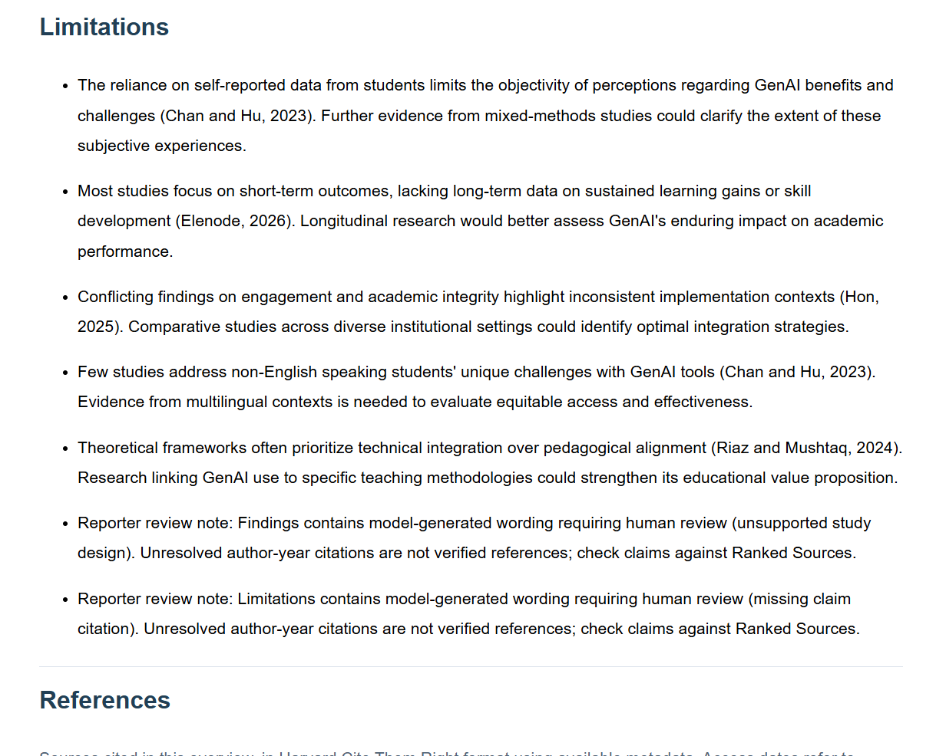
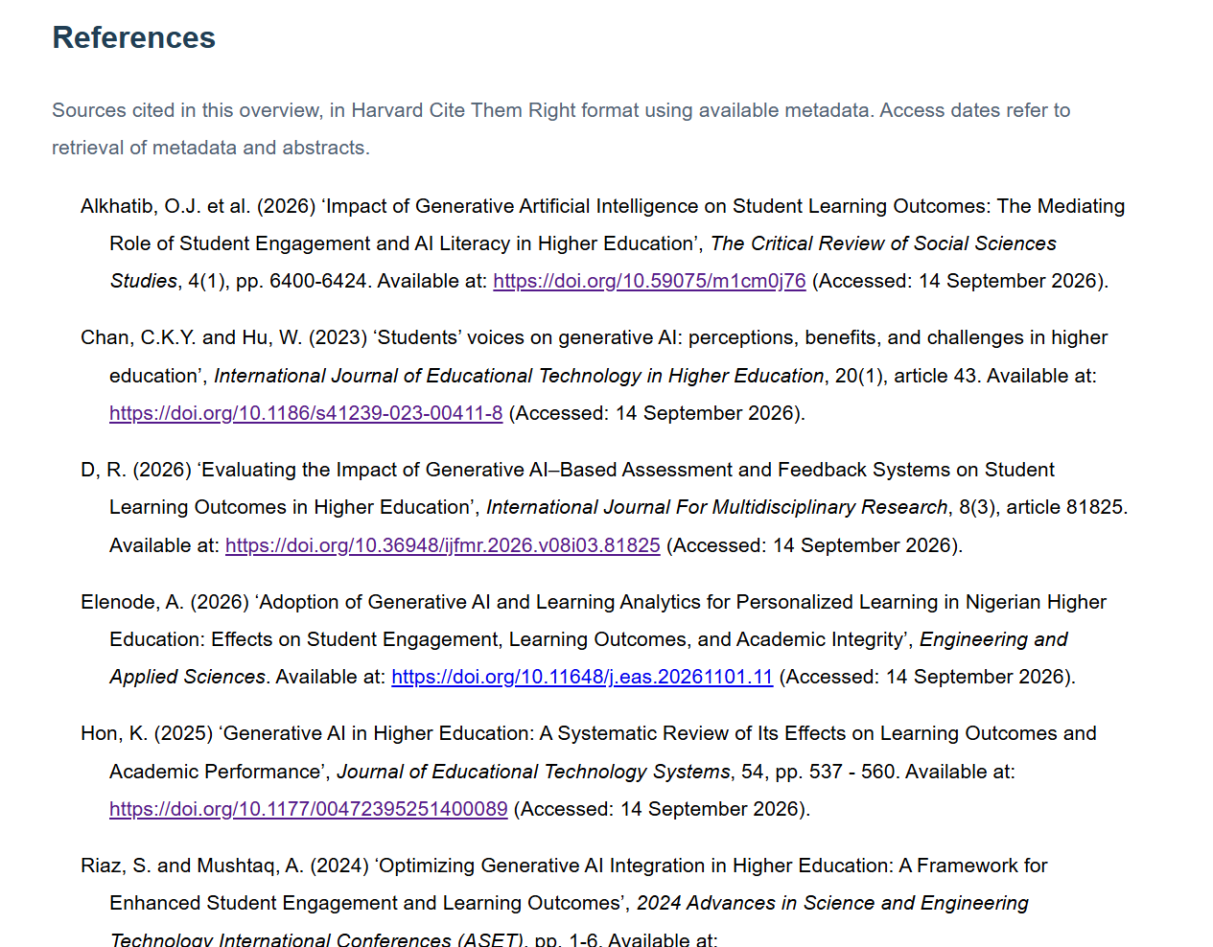
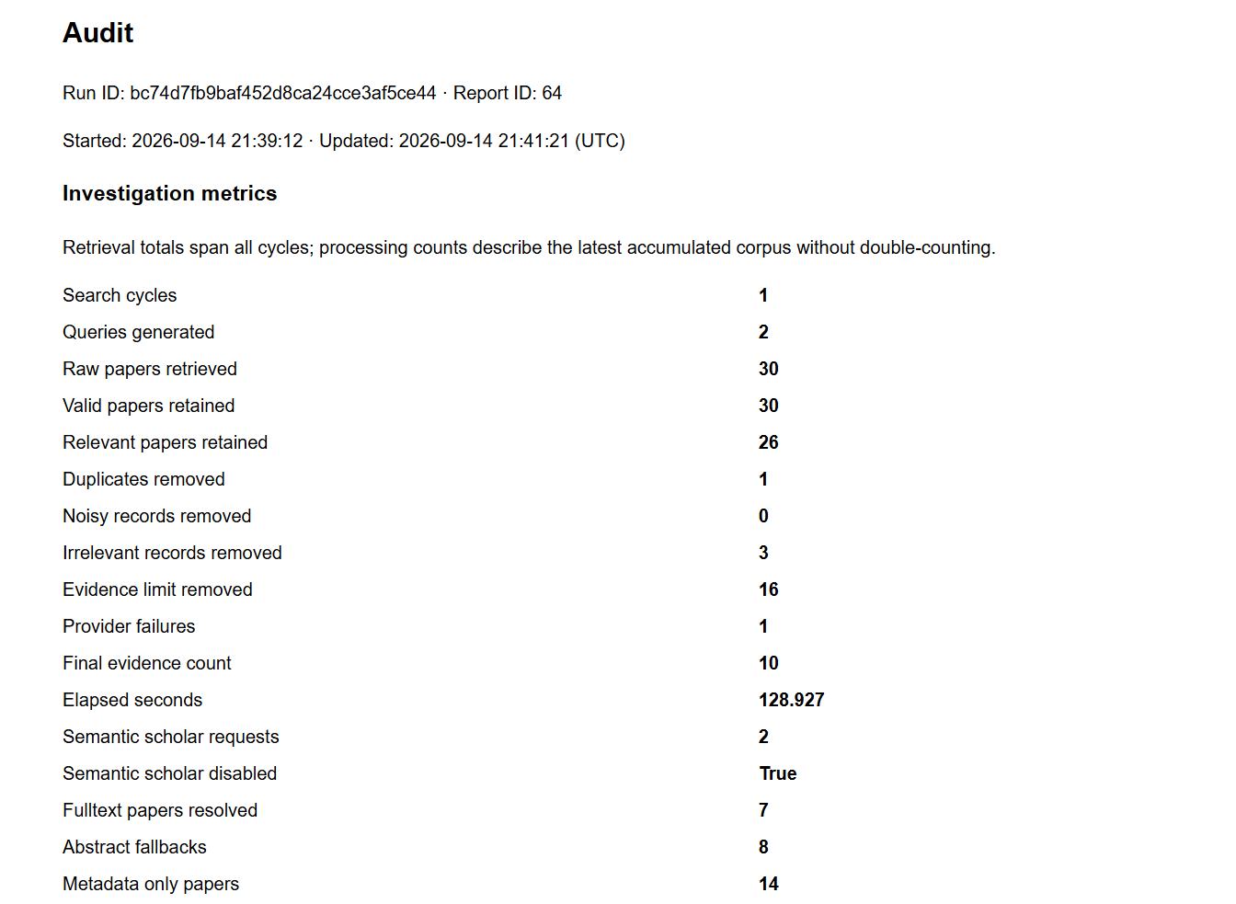
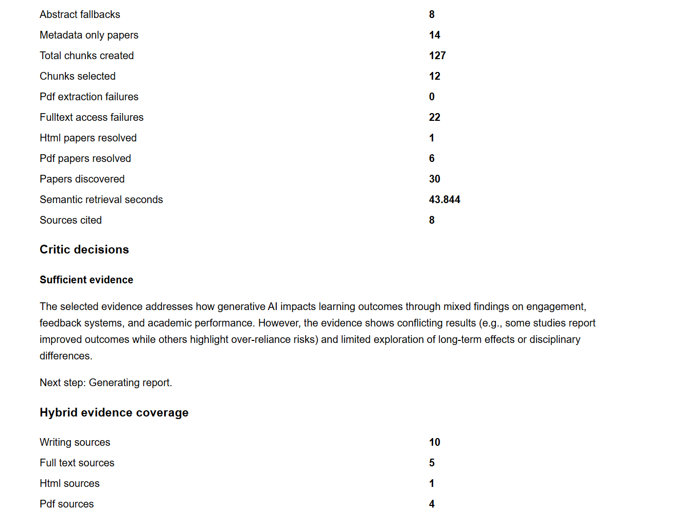
Evidence F1
Final Live Execution and Auditability
Referenced in Slide 8: Full report saved in evidence/saved_reports/report_64_2026-09-14_21-41-21.html

Slide 7
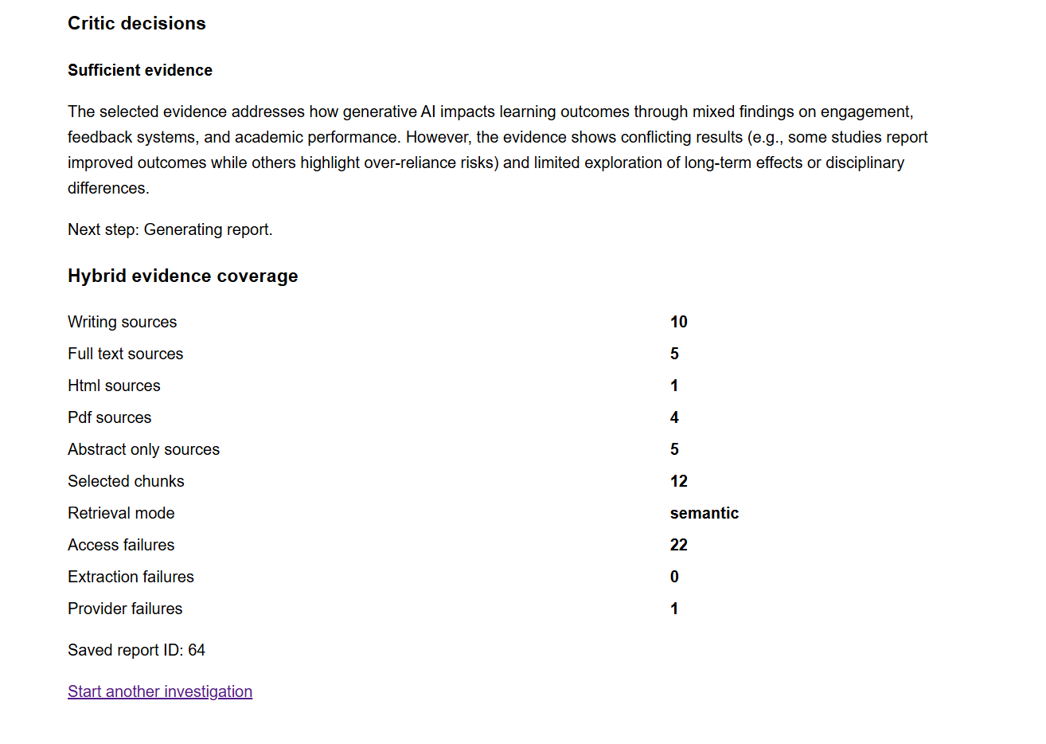
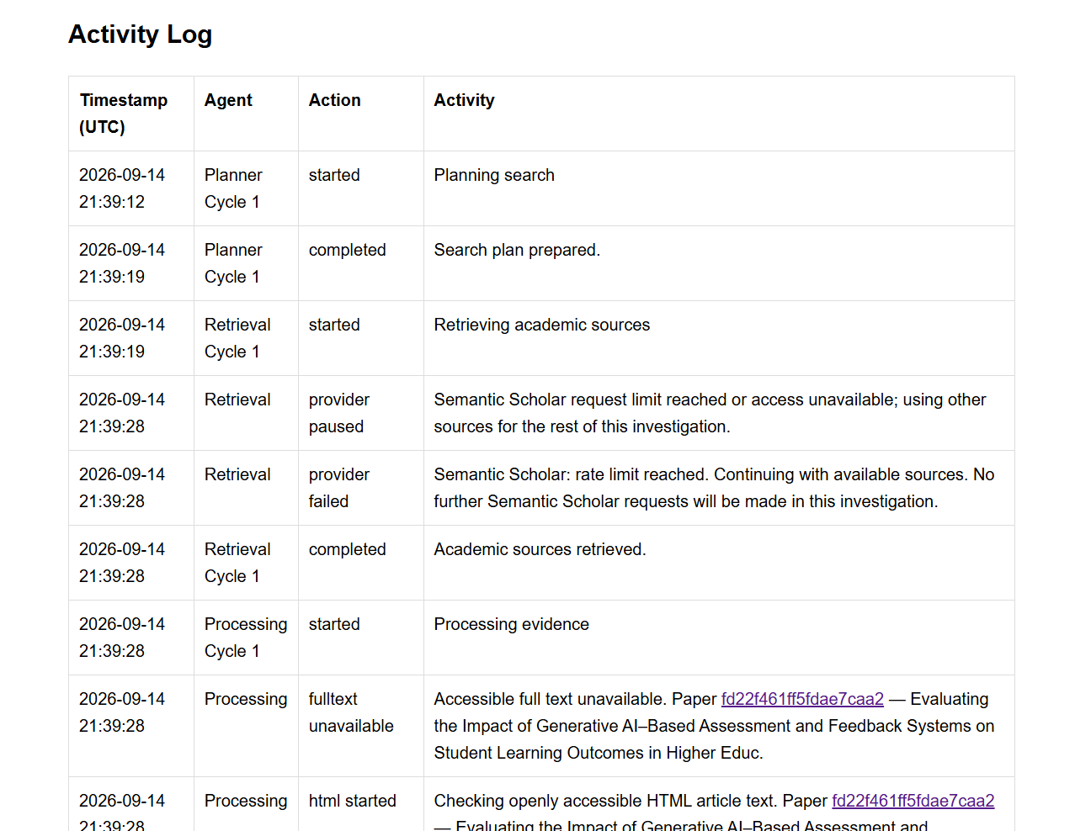
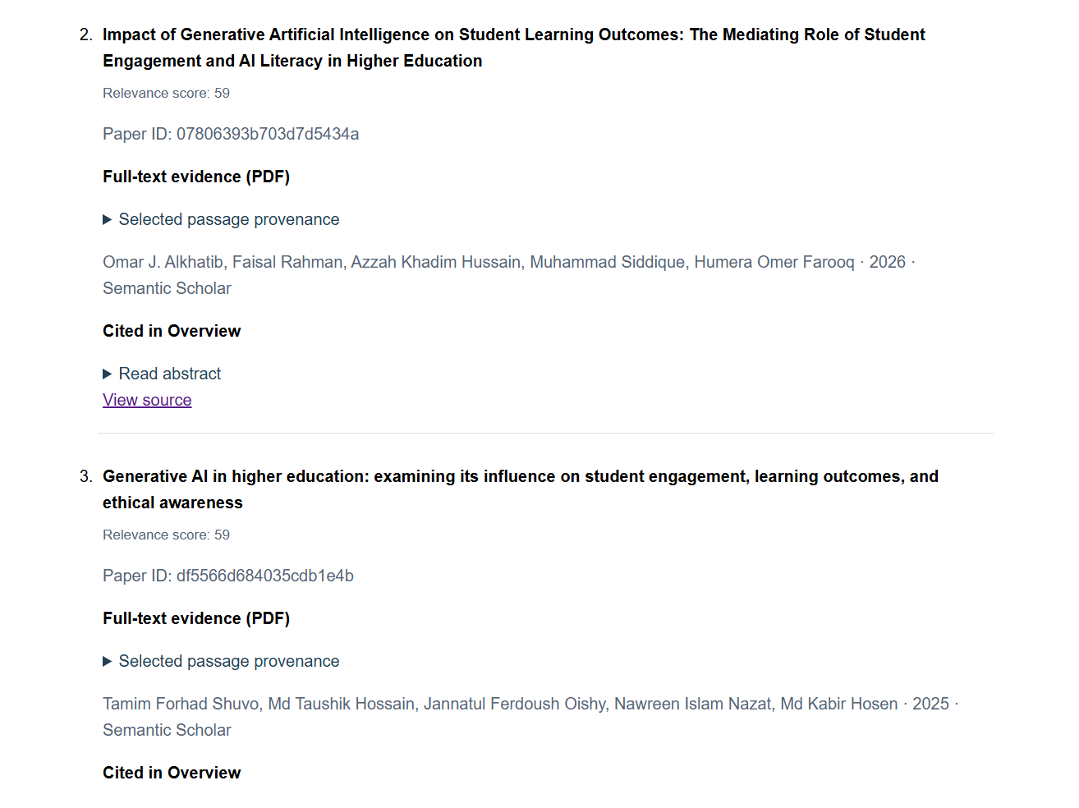
Evidence F2
Final Live Execution and Auditability
Referenced in Slide 8: Full report saved in evidence/saved_reports/report_64_2026-09-14_21-41-21.html

Slide 8
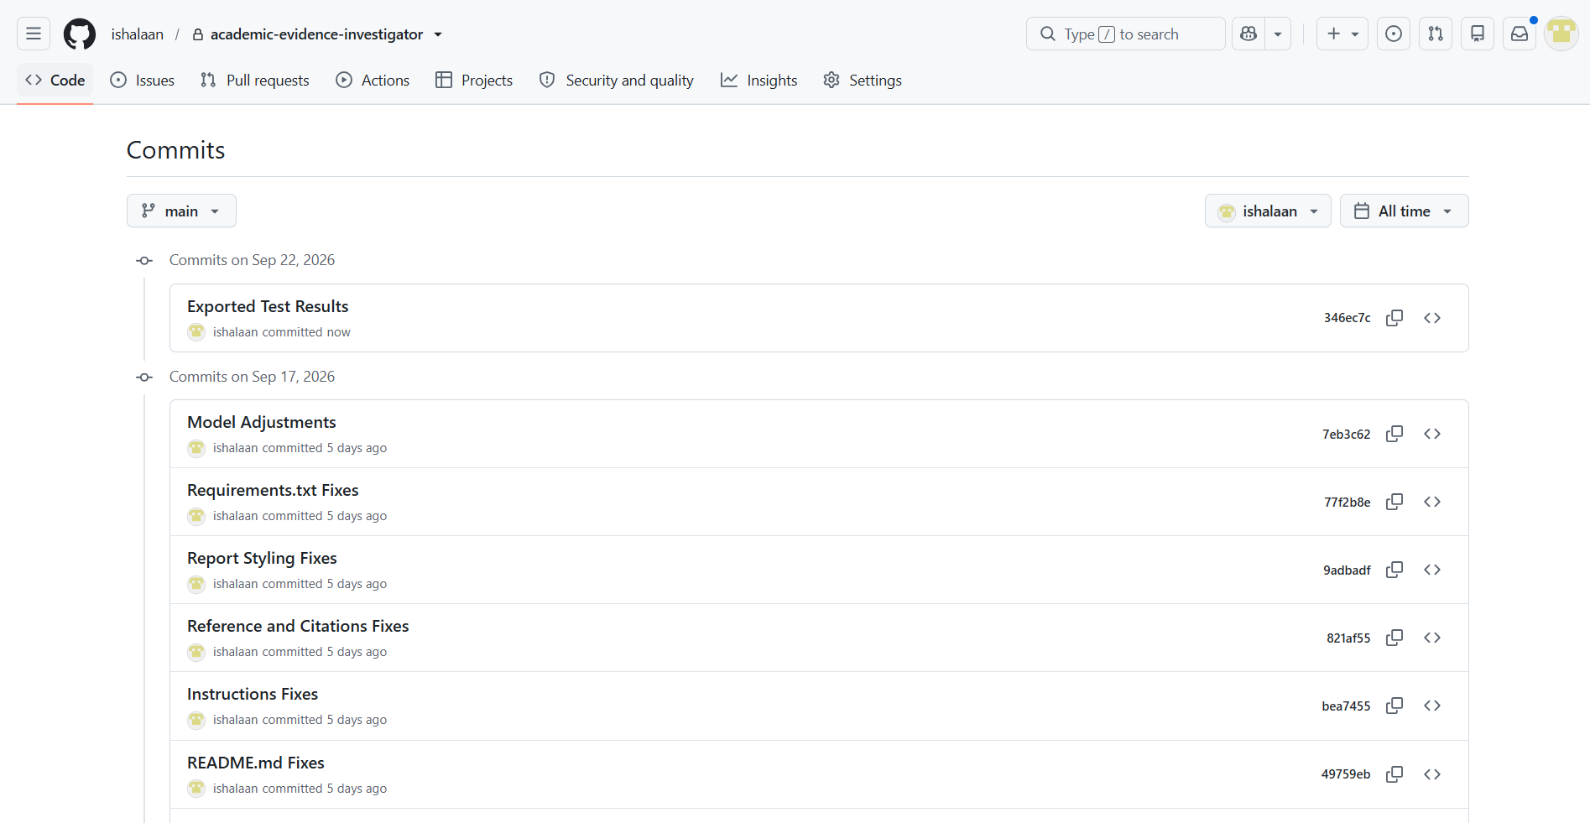
Evidence G
GitHub Commit Evidence
Referenced in Slide 10: https://github.com/ishalaan/academic-evidence-investigator

