Slide 1
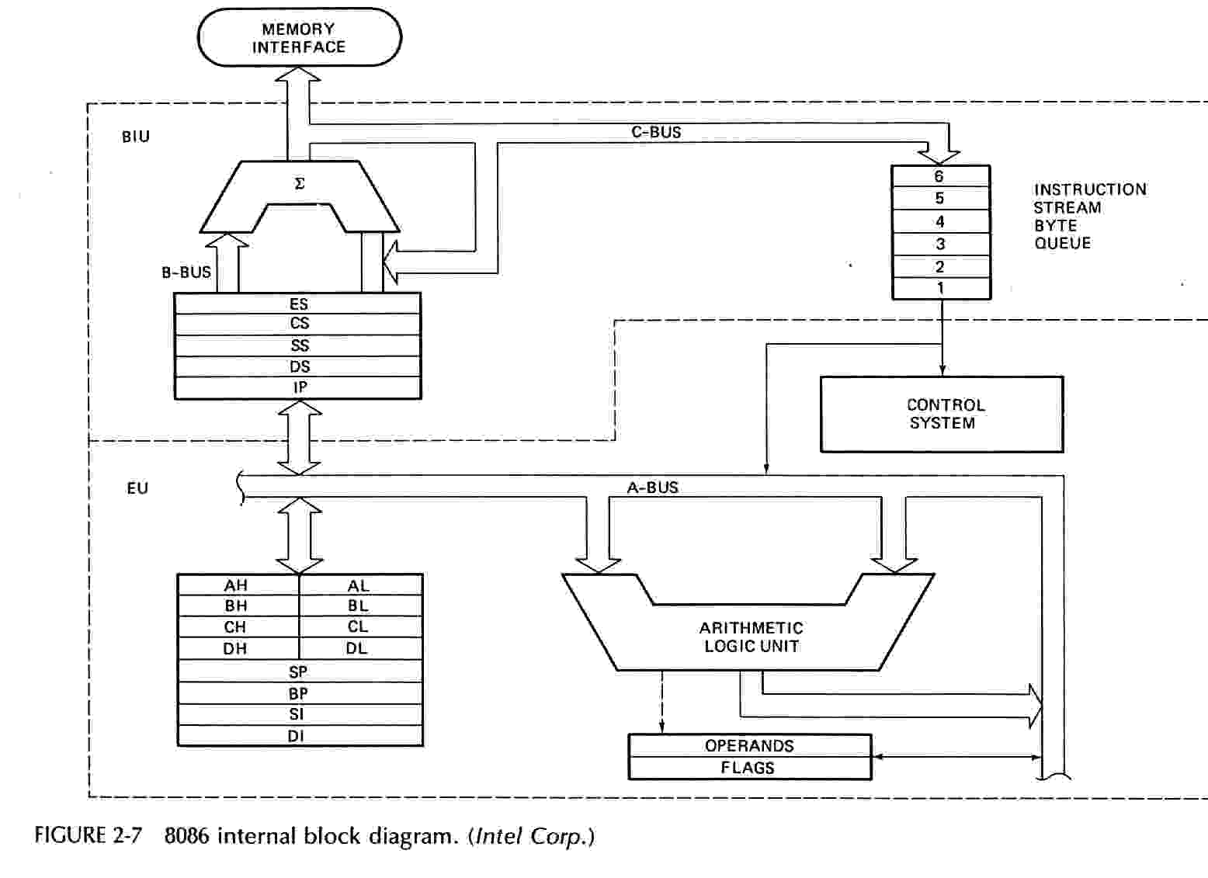
Block diagram of 8086

Slide 2
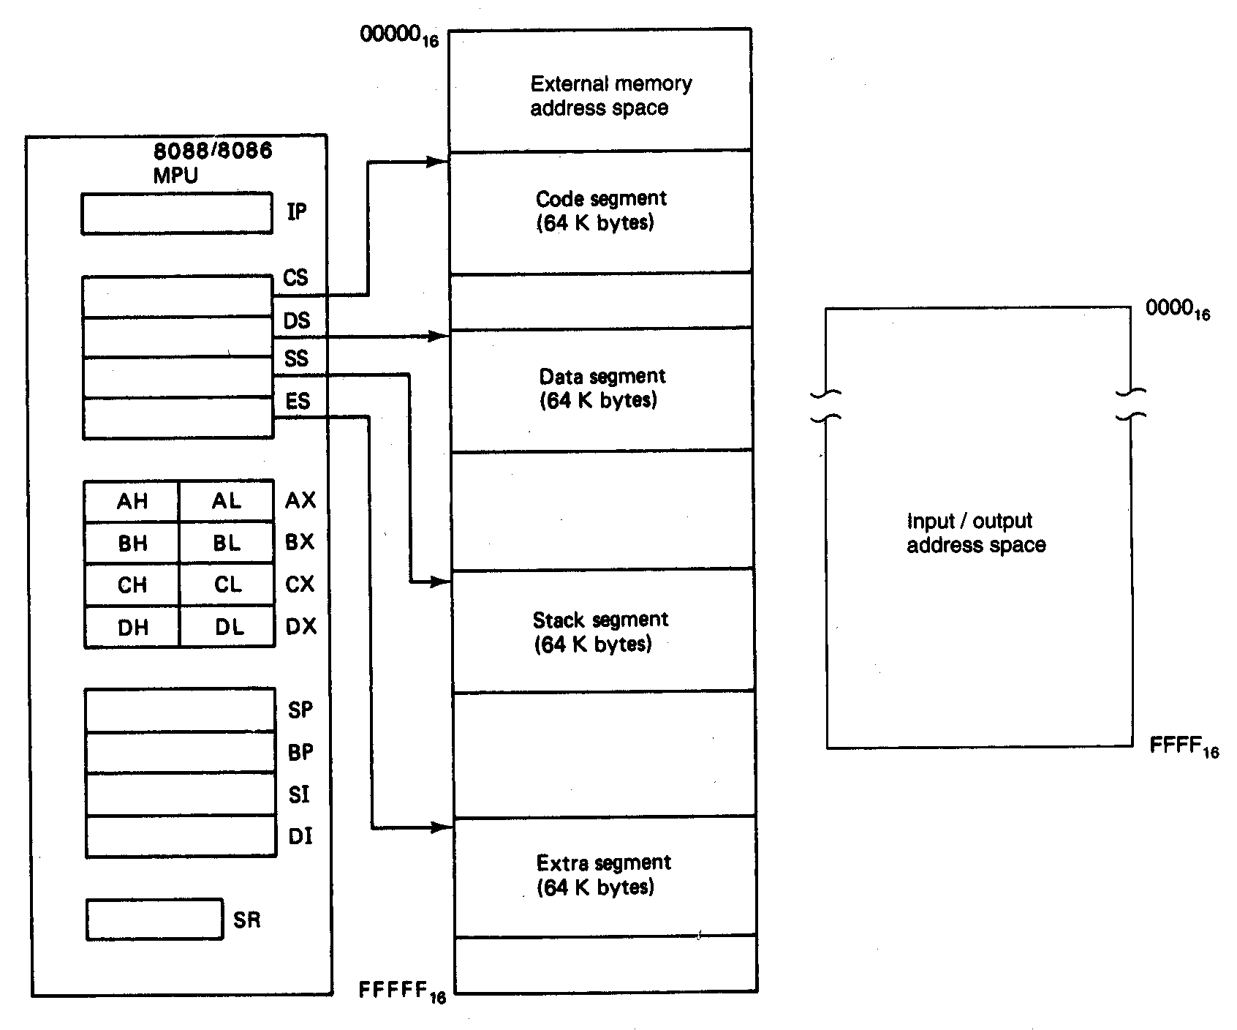
Software Model of the 8086 Microprocessors

Slide 3
General Purpose Registers
AX
  Accumulator Register
  Preferred register to use in arithmetic, logic and data transfer instructions because it generates the shortest Machine Language Code
  Must be used in multiplication and division operations
  Must also be used in I/O operations
BX
  Base Register
  Also serves as an address register

Slide 4
General Purpose Registers
CX
  Count register
  Used as a loop counter AND REP in string instruction
  Used in shift and rotate operations
DX
  Data register
  Used in multiplication and division
  Also used in I/O operations

Slide 5
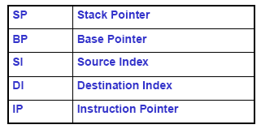
Pointer and Index Registers
All 16 bits wide, L/H bytes are not accessible
Hold offset and are associated with seg. Reg. to calculate 20 bit PMA.
  Example: MOV AH, [SI]
    Move the byte stored in memory location whose address is contained in register SI to register AH
IP is not under direct control of the programmer

Slide 6
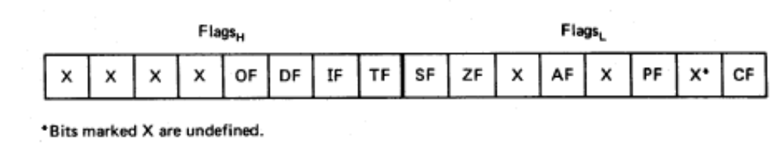
Flag Register
Overflow
Carry
Direction
Parity
Interrupt enable
Auxiliary Carry
Trap
Zero
6 are status flags
3 are control flag
Sign

Slide 7
8086 Programmer’s Model
ES
Extra Segment
_{BIU registers}
_{(20 bit adder)}
CS
Code Segment
SS
Stack Segment
DS
Data Segment
IP
Instruction Pointer
_{EU registers}
AX
AH
AL
Accumulator
BX
BH
BL
Base Register
CX
CH
CL
Count Register
DX
DH
DL
Data Register
SP
Stack Pointer
BP
Base Pointer
SI
Source Index Register
DI
Destination Index Register
FLAGS

Slide 8
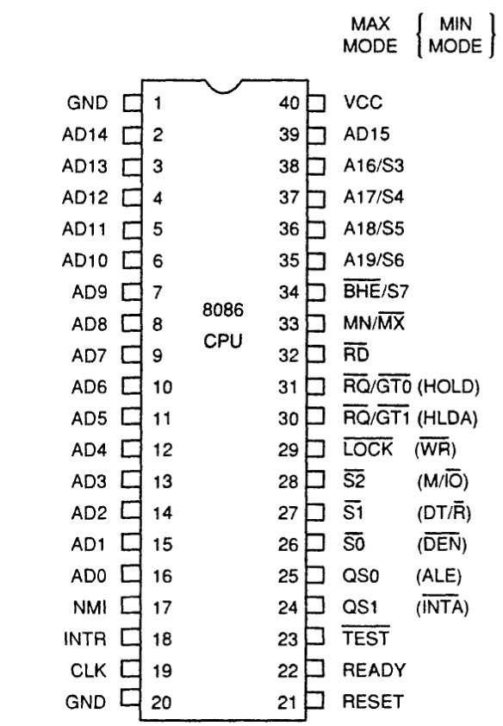
INTEL 8086 - Pin Diagram

Slide 9
INTEL 8086 - Pin Details
Power Supply
5V ± 10%
Ground
Reset
Registers, seg regs, flags
CS: FFFFH, IP: 0000H
If high for minimum 4 clks
Clock
Duty cycle: 33%

Slide 10
INTEL 8086 - Pin Details
Address/Data Bus:
Contains address bits A₁₅-A₀ when ALE is 1 & data bits D₁₅ – D₀ when ALE is 0.
Address Latch Enable:
When high, multiplexed address/data bus contains address information.

Slide 11
INTEL 8086 - Pin Details
INTERRUPT
Non - maskable interrupt
Interrupt acknowledge
Interrupt request

Slide 12
INTEL 8086 - Pin Details
Direct Memory Access
Hold
Hold acknowledge

Slide 13
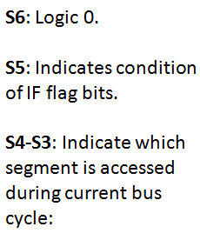
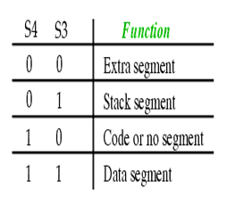
INTEL 8086 - Pin Details
Address/Status Bus
Address bits A₁₉ – A₁₆ & Status bits S₆ – S₃

Slide 14
INTEL 8086 - Pin Details
BHE’, A₀:
0,0: Whole word (16-bits)
0,1: High byte to/from odd address
1,0: Low byte to/from even address
1,1: No selection
Bus High Enable/S7
Enables most significant data bits D₁₅ – D₈ during read or write operation.
S₇: Always 1.

Slide 15
INTEL 8086 - Pin Details
Min/Max mode
Minimum Mode: +5V
Maximum Mode: 0V
Minimum Mode Pins
Maximum Mode Pins

Slide 16
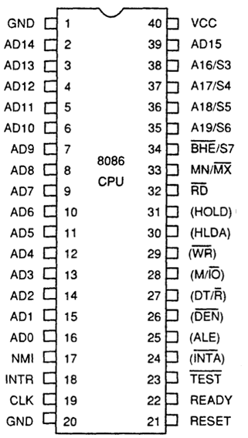
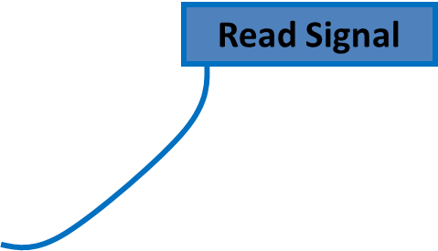




Minimum Mode- Pin Details

Slide 17
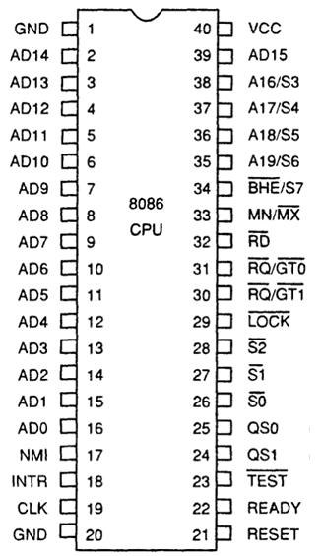
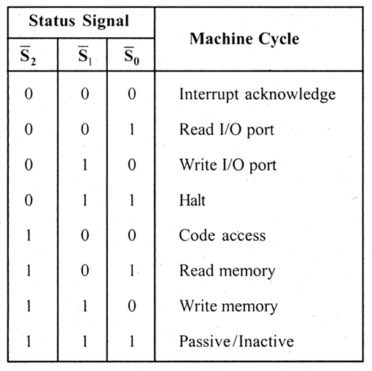
Maximum Mode - Pin Details
Status Signal
Inputs to 8288 to generate eliminated signals due to max mode.

Slide 18
Maximum Mode - Pin Details
Lock Output
Used to lock peripherals off the system
Activated by using the LOCK: prefix on any instruction
DMA Request/Grant
Lock Output

Slide 19
Maximum Mode - Pin Details
QS1 QS0
00: Queue is idle
01: First byte of opcode
10: Queue is empty
11: Subsequent byte of opcode
Queue Status
Used by numeric coprocessor (8087)

Slide 20
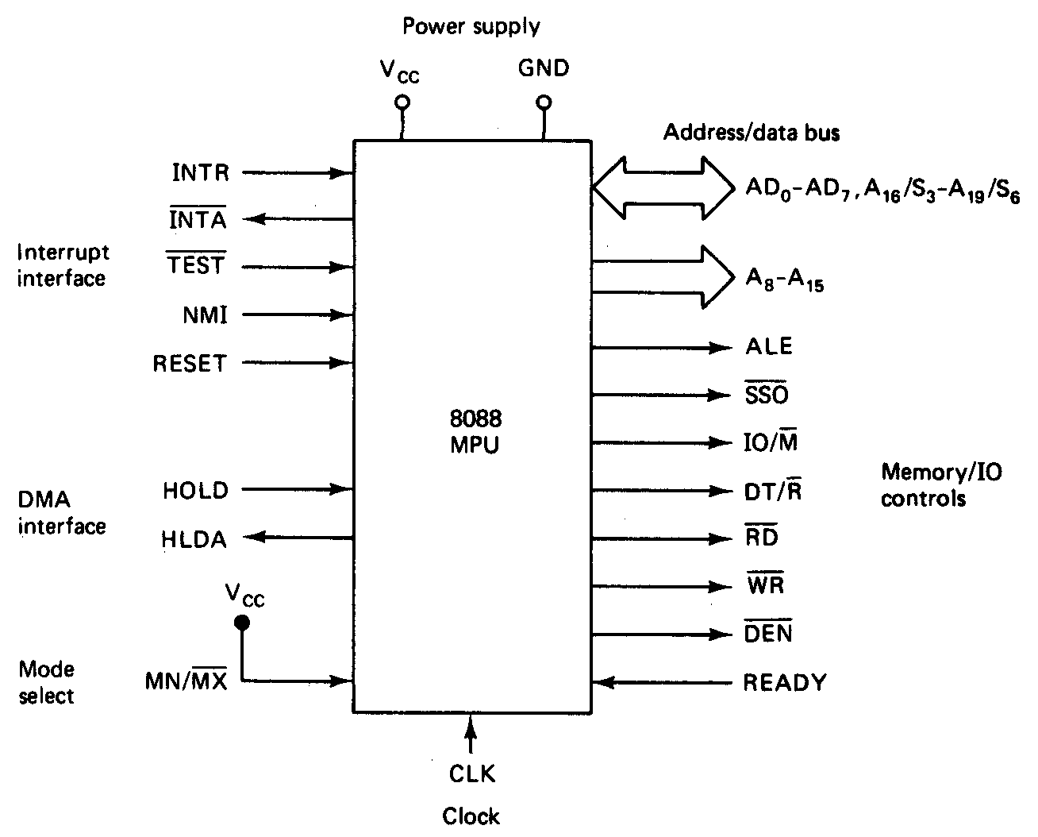
Minimum Mode 8086 System

Slide 21
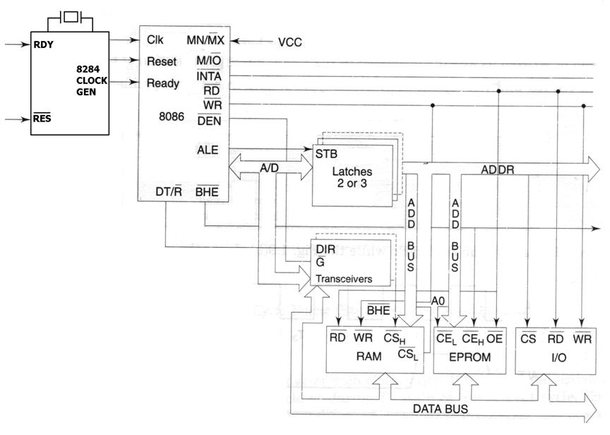
Minimum Mode 8086 System

Slide 22
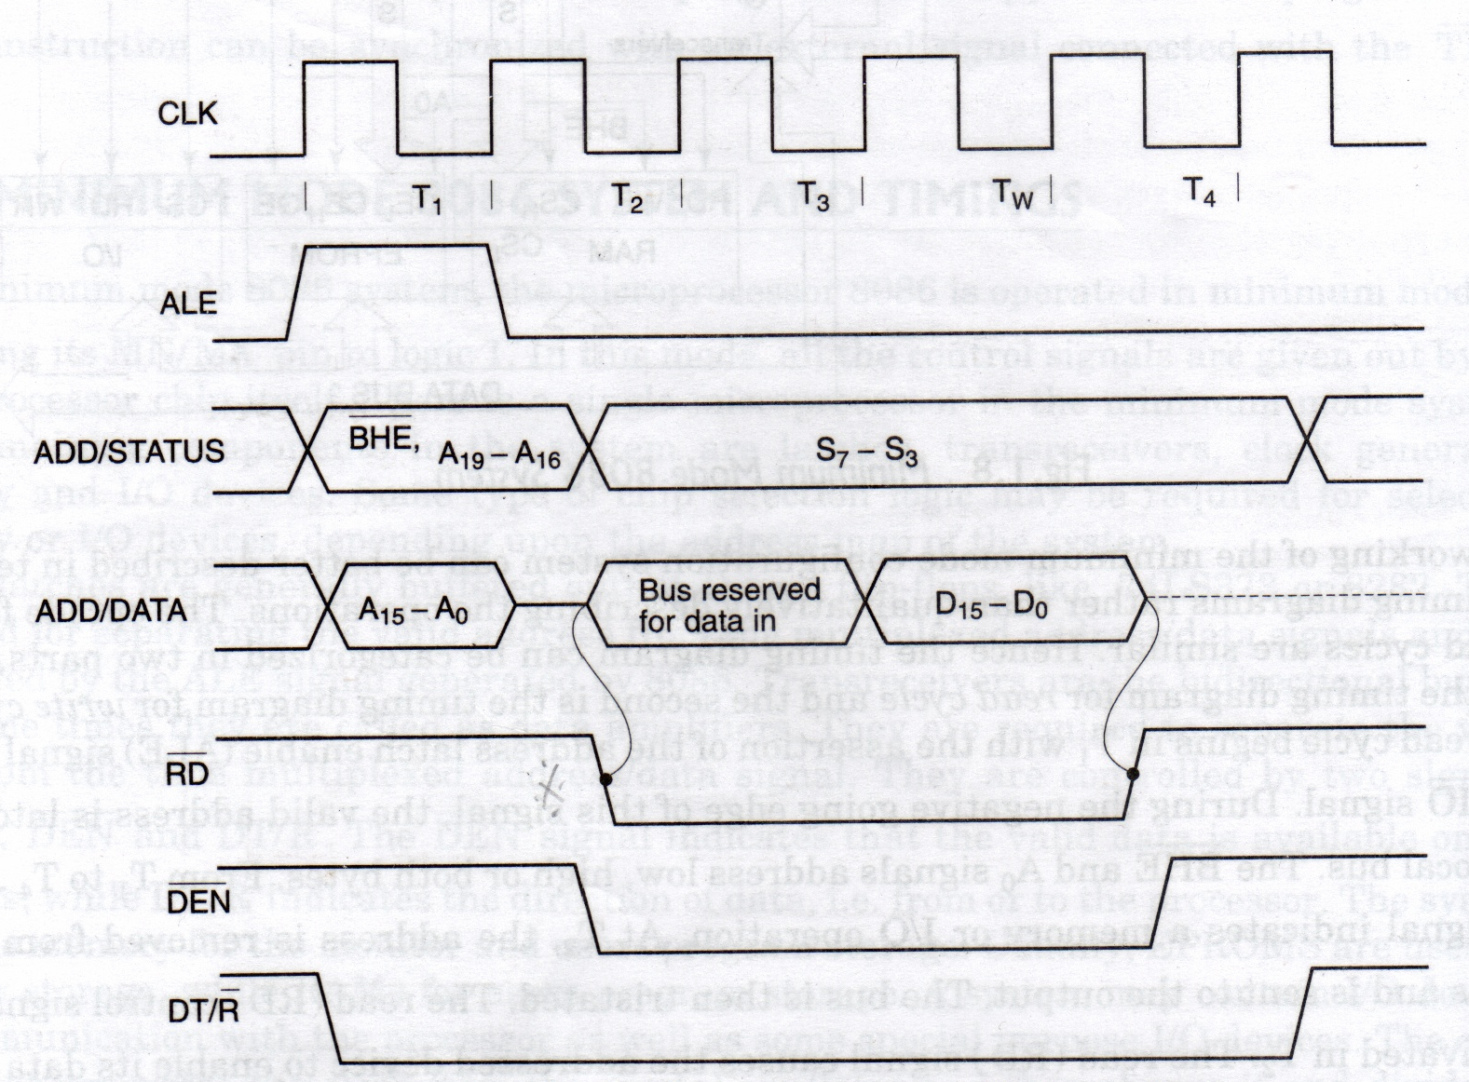
‘Read’ Cycle timing Diagram for Minimum Mode

Slide 23
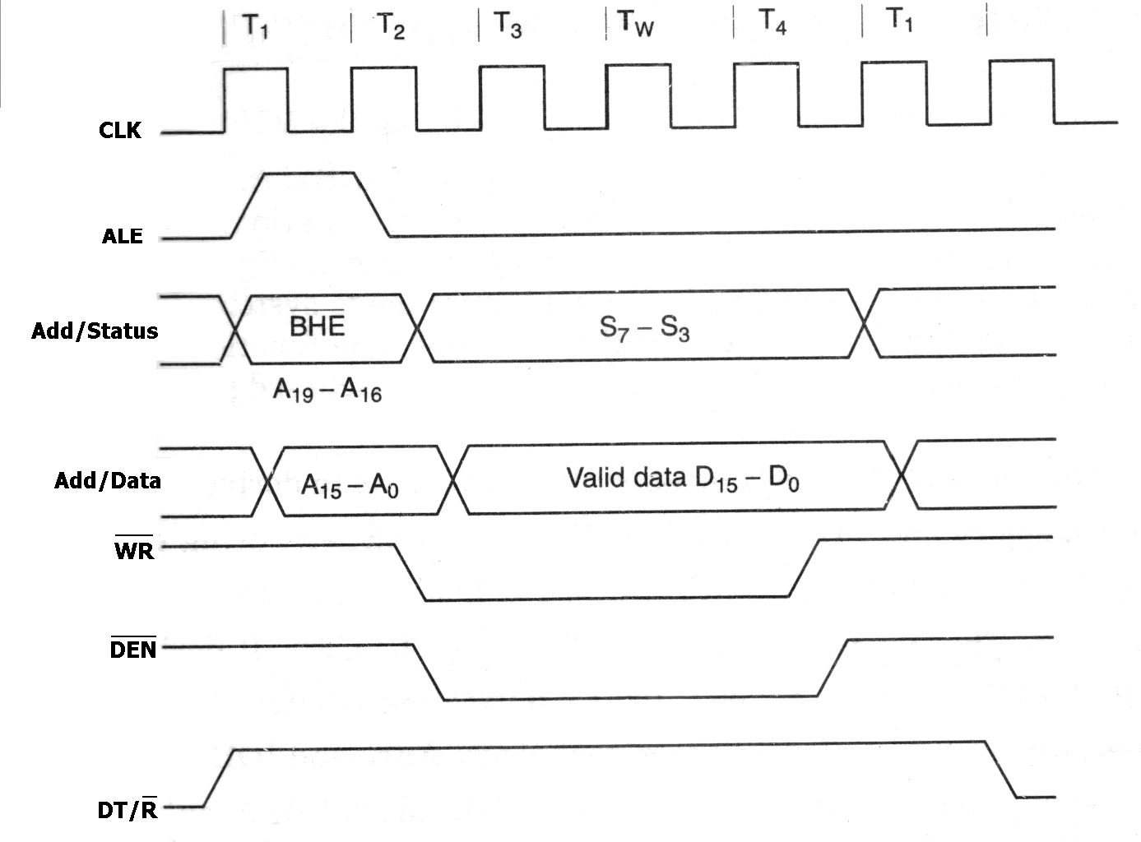
‘Write’ Cycle timing Diagram for Minimum Mode

Slide 24
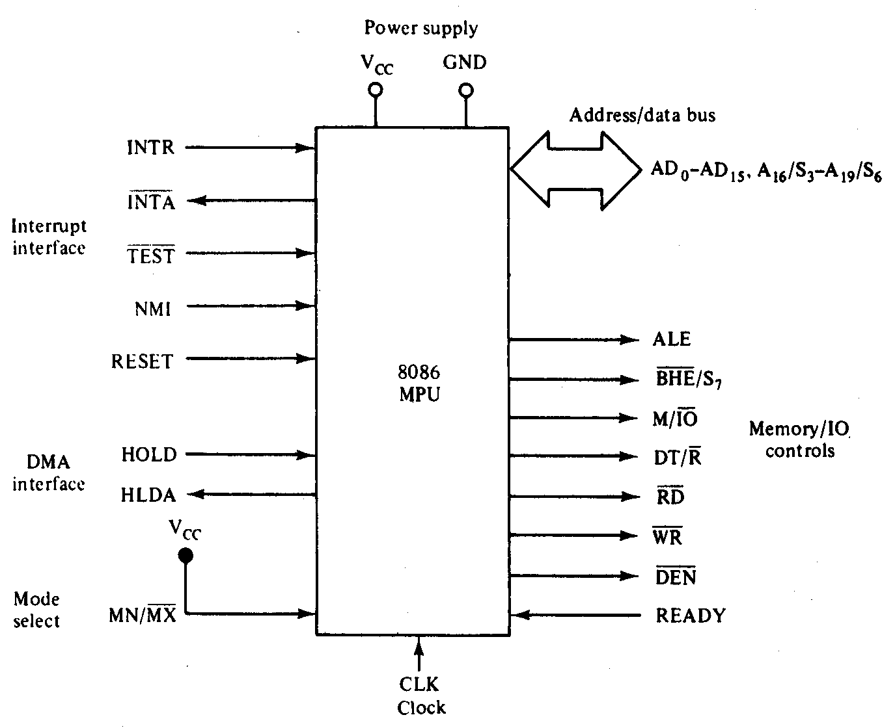
Maximum Mode 8086 System

Slide 25
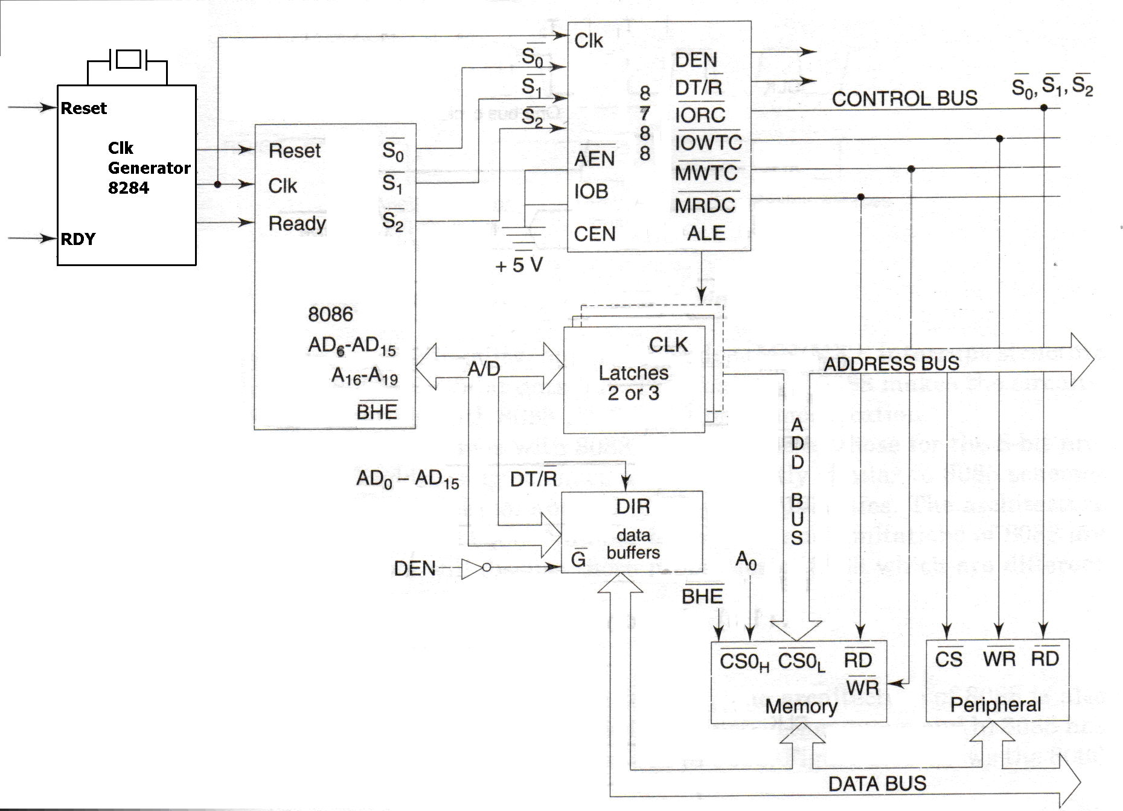
Maximum Mode 8086 System

Slide 26
Maximum Mode 8086 System
Here, either a numeric coprocessor of the type 8087 or another processor is interfaced with 8086.
The Memory, Address Bus, Data Buses are shared resources between the two processors.
The control signals for Maximum mode of operation are generated by the Bus Controller chip 8788.
MN/MX’=0

Slide 27
8086 Control Signals
ALE
BHE
M/IO
DT/R
RD
WR
DEN

Slide 28
TEST pin of 8086
Used in conjunction with the WAIT instruction in multiprocessing environments.
This is input from the 8087 coprocessor.
During execution of a wait instruction, the CPU checks this signal.
If it is low, execution of the signal will continue; if not, it will stop executing.

Slide 29
Differences between 8086 and 8088 Microprocessors
Though the architecture and instruction set of both 8086 and 8088 processors are same,
still we find certain differences between them They are
(i) 8086 has 16-bit data bus lines whereas 8088 has 8-data lines.
(ii) 8086 is available in three clock speeds namely 5M.Hz,8M.Hz and 10 M.Hz whereas 8088 is available is only available only in two speeds namely 5M.Hz and 8M.Hz.
(iii) The memory address space of 8086 is organized as two 512kB banks whereas 8088 memory space is implemented as a single 1MX 8 memory bank.
(iv) 8086 has a 6-byte instruction queue whereas 8088 has a 4 byte instruction queue

Slide 30
Differences between 8086 and 8088 Microprocessors
(v) In 8086 the memory control pin ( M/ IO’) signal is complement of the 8088 equivalent signal (IO/M’)
(vi) The 8086 has BHE’(Bank high enable) whereas 8088 has SSO status signal .
(vii). 8086 can read or write either 8-bit or 16-bit word at a time ,whereas 8088 can read only 8-bit data at a time.
(viii) The I/O voltage levels for 8086 are , Vol is measured at 2.5mA and for 8088 it is measured at 2.0mA.
(ix) 8086 draws a maximum supply current of 360 mA and the 8088 draws a maximum of 340 mA.

Slide 31
INTERRUPTS
Hardware interrupt: NMI and INTR
Software Interrupts: INT n where n= type (00 to FF)
Intel predefined or dedicated interrupts
TYPE 0: Interrupt corresponds to divide by zero situation
TYPE 1: Interrupt corresponds to Single step execution during the debugging of a program.
TYPE 2: Interrupts to non-maskable NMI interrupt.
TYPE 3: Interrupt corresponds to break point interrupt.
TYPE 4: (INTO) Interrupt corresponds to Overflow interrupt.

Slide 32
INT Type
SP=SP-2
FR→MAss
IF=0,TF=0
SP=SP-2
cs→Mass
SP=SP-2
IP→Mass
IP=0000:TYPE X 4
CS=0000:(TYPE X 4) +2
MAss=SS X 10H + SP

