Slide 1
Quotes by the great
Hisham

Slide 2
William Shakespeare

Slide 3
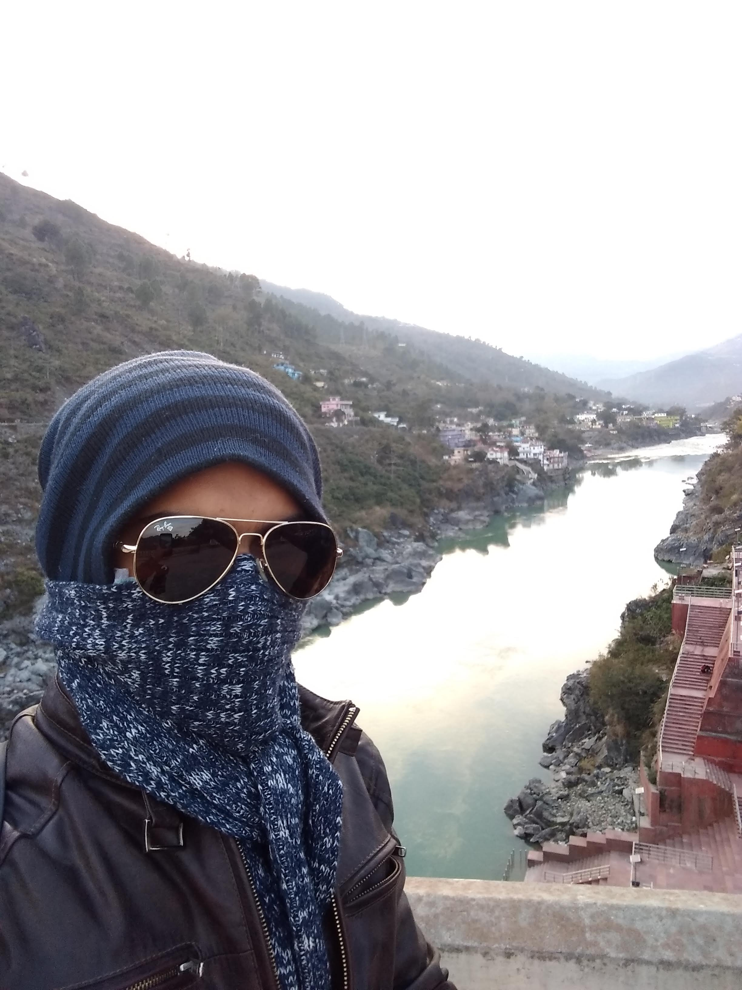
Mohandas Karamchand Gandhi

Slide 4
Quotes table
24 | 63 | 22 | 75
35 | 24 | 48 | 87
69 | 48 | 32 | 33

