Slide 1
Quotes by the great
Hisham

Slide 2
William Shakespeare

Slide 3
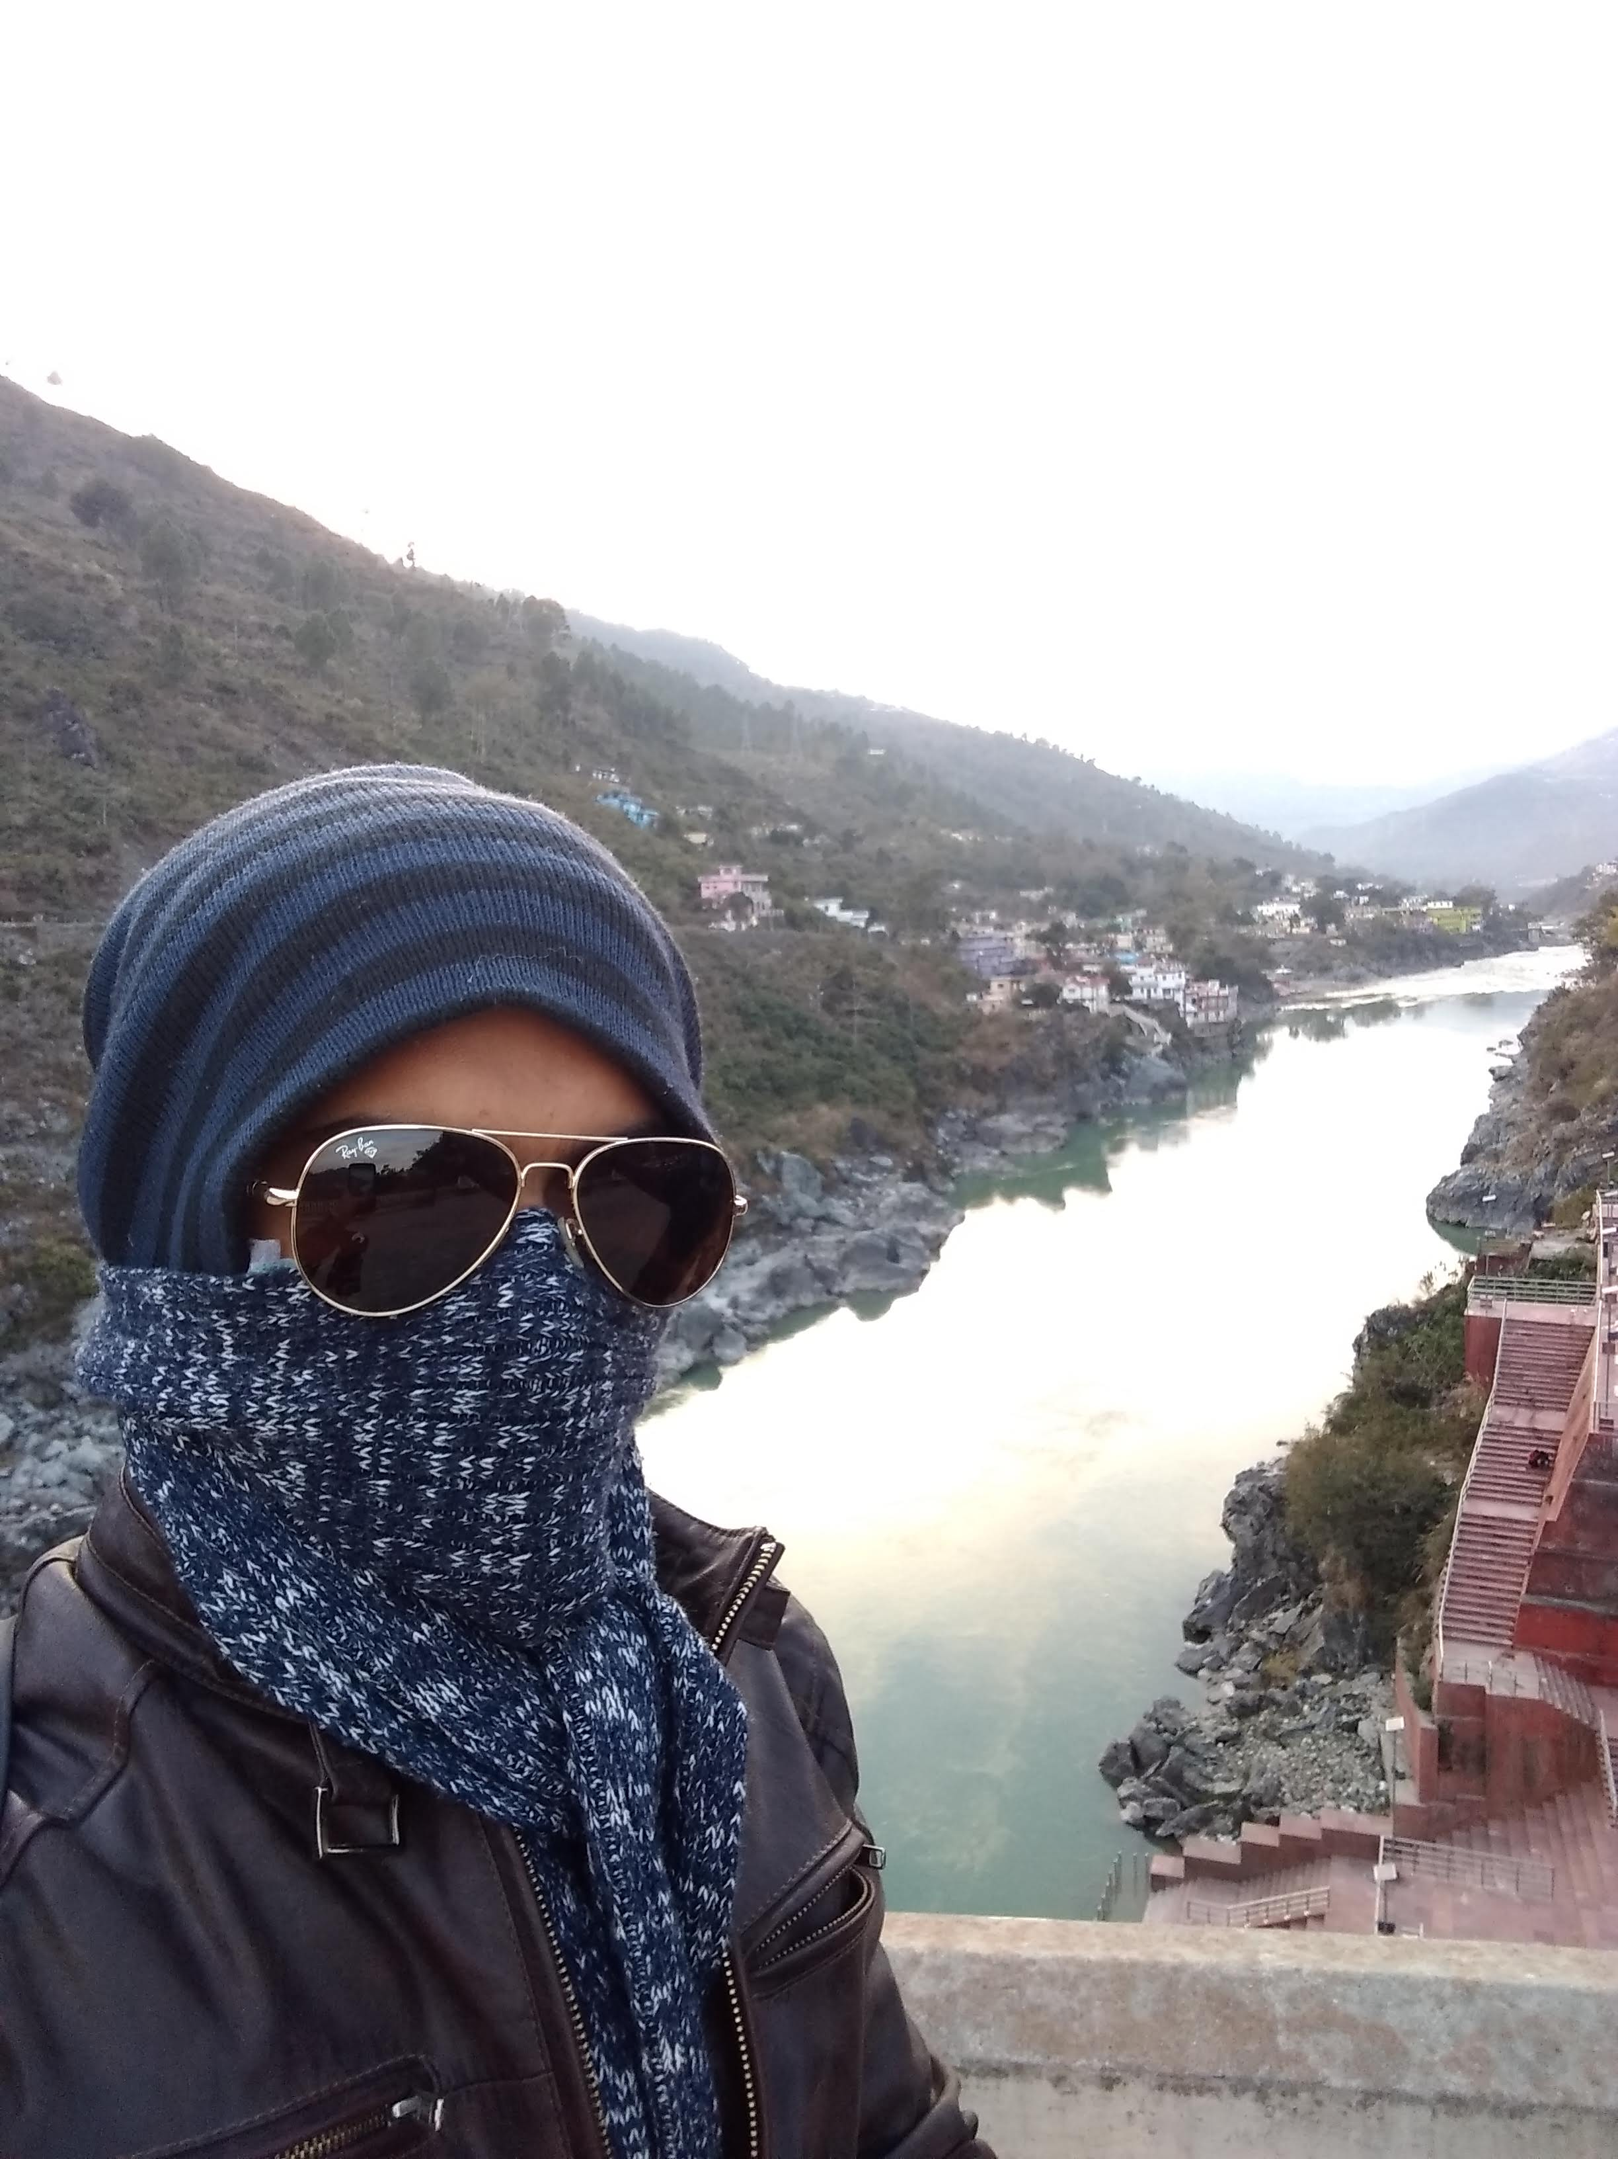
Mohandas Karamchand Gandhi

Slide 4
Quotes table

