Slide 1
Advertisement Data Prediction
Leon Zhang, Ishan Miglani, Qing Shen, Keya Keya

Slide 2

Online Advertisement for Mobile Apps
Meetsocial, overseas marketing service for Chinese business
Small-to-medium enterprises, mobile apps
Advertising strategy advisory based on historical data on previous ads
A model outputs predicted clicks/installs with features of ad
Features: spend, channel, os, device, targeting people.
Goal: cut down unnecessary spend on ads
Notes:
Hey guys my name is Leon, our team’s project is prediction of online advertisement data. The data we use is a real world data set from a marketing company called meetsocial where one of my teammates used to work for. This company provides overseas marketing service for mobile apps and the dataset we have is the historical data of its online ads. The data in general shows how much money was spent on one ad, what kind of channel, os, device the ad was put on, what group of people the ad was targeting at, and finally the result of ad: number of impressions, clicks, app installs, even purchases. As a group of data scientists, we would like to build a model to predict the impressions, clicks, and installs of future ads with corresponding feature provided, so that we can provide advisory about whether we should spend such money on this ad and weather we should put on the ad.

Slide 3
Action, Prediction, & Decision-Making
The Action Optimizing advertising settings (targeting ages,genders, budget) for SME campaigns.
The Prediction: Forecasting clicks, installs, and purchases based on campaign settings.
The Decision: Data-backed recommendations to maximize chosen target metric (e.g., maximize clicks within budget constraints).
Notes:
To be specific about the action and decisions. Meetsocial's clients need to know the optimal campaign settings (target audience, platform, budget, duration) to maximize clicks, installs, and ultimately purchases within their budgetary restrictions. Our model will predict: Expected Clicks, Installs, Purchases. And we will use the prediction to compare the ad setting, optimize the budget, and prioritize the targeting audience.
The actual datasets we have are pretty messy and we have spent a lot of time on DAE and data preprocessing, I’m handing over to my teammate Ishan to talk more about this now.

Slide 4
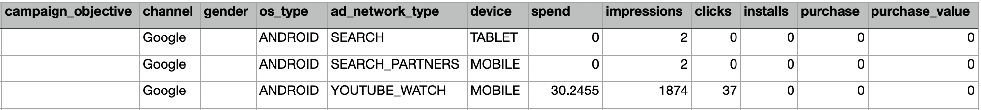
Data Source
Table 1: 320000 rows with many NAN values, product info, methods, spend, clicks/installs of ad

Slide 5
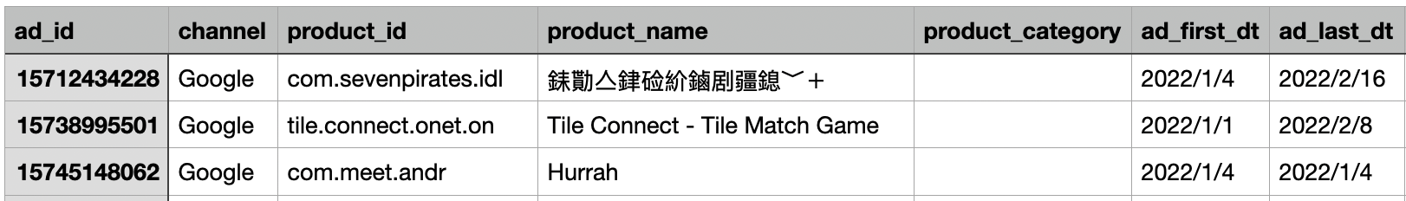
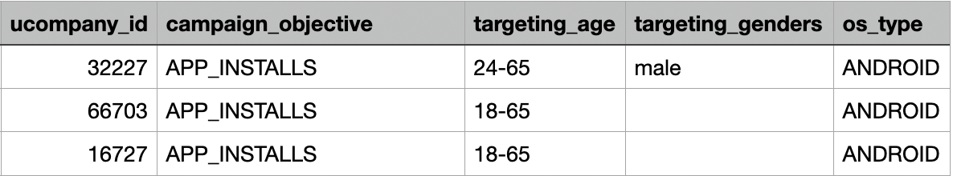
Data Source
Table 2: 30000 rows intersecting table 1 with “ad_id”, providing more information about different ad groups - ( targeting age, gender, campaign_objective, etc.)

Slide 6
EDA and Feature Engineering
Huge target variance and skewed distribution
Merged two tables by their corresponding “ad_id”
Scraped ratings out of 5, number of ratings and number of reviews
Built 2 different scrapers for Google Play store and IOS store
Also scraped categorical information about the apps - whether they are games or productivity apps (eg. categories - PUZZLE, CASUAL, SINGLE PLAYER, STYLIZED, OFFLINE, ROLE PLAYING, BOARD, ABSTRACT STRATEGY, ETC.)

Slide 7
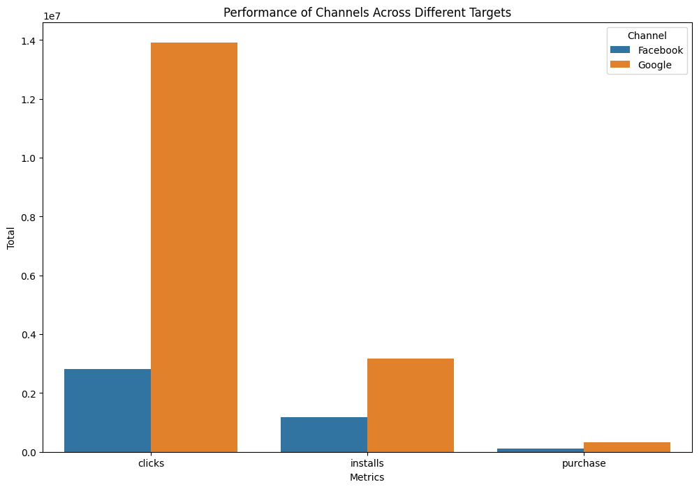
Data Preprocessing
Handling Missing values
Remove rows with null values
Create dummy values for categorical features
Left with ~27K rows and 59 features
Addressing Skewness: Log Transformations
Feature Scaling : StandardScaler

Slide 8
Modeling Overview
Model Tested | RMSE | R²
Linear Regression (Baseline) | 1.770 | 0.478
Random Forest | 0.818 | 0.889
SVR | 1.516 | 0.617
XGBoost | 0.778 | 0.899
Decision Tree Regression | 1.064 | 0.812
Ensemble Model (RF + XGBoost) | 0.799 | 0.894
56%
88%
Target: Clicks
Model selection: Performance metrics of the models - RMSE and R²
Notes:
Overview of your modeling and the relative performance (typically a table …).Which models did you try?If you have some more elaborate modeling setup We examined the comparative performance of various models in predicting clicks for our online advertising datasets.
Started with a baseline Linear Regression model and then explored more complex algorithms like Random Forest, Support Vector Regression (SVR), XGBoost, Decision Tree Regression, and an ensemble of Random Forest and XGBoost.
What metric is the most relevant given your objective.
The RMSE (Root Mean Square Error) and R² (Coefficient of Determination) metrics provided us with a dual lens for evaluation.
A lower RMSE is desirable as it reflects a smaller average error in the model’s predictions, which is crucial when precision is valued.
On the other hand, a higher R² value, approaching 1, indicates that our model’s predictions are closely aligned with the actual data, capturing a larger portion of the variance in clicks.
Upon review, we can see that our XGBoost model, shows a promising balance with an RMSE of 0.778 and an R² of 0.899, suggesting it’s quite effective at predicting click outcomes while maintaining a low error rate.Moreover, compared to our baseline, we could see 56% and 88% improvement in metrics, respectively.

Slide 9
XGBoost Regression Model
Targets | RMSE | R²
Clicks | 0.778 | 0.899
Installs | 0.775 | 0.860
Purchase | 0.756 | 0.896
Click/Impression (CTR) | 0.869 | 0.738
Impressions | 0.903 | 0.916
Similar to Clicks, our other targets performed better in XGBoost compared to the other models we tested.
Notes:
Similar to Clicks, our other targets performed better in XGBoost compared to the other models we tested.

Slide 10
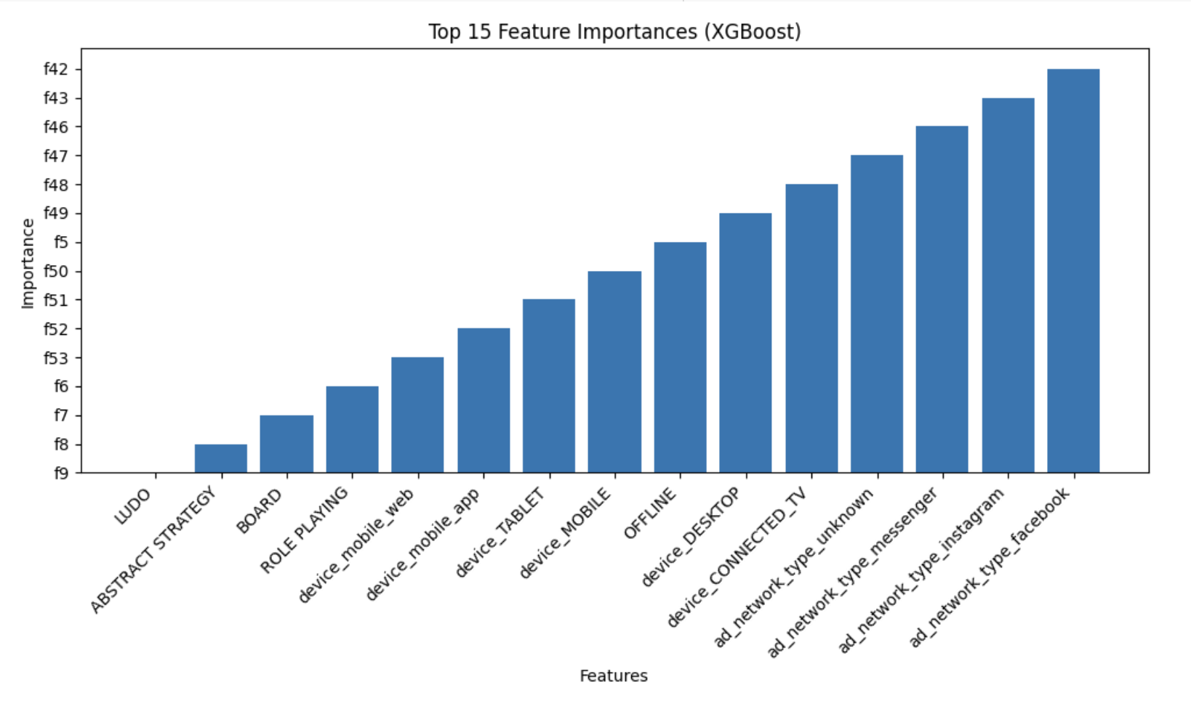
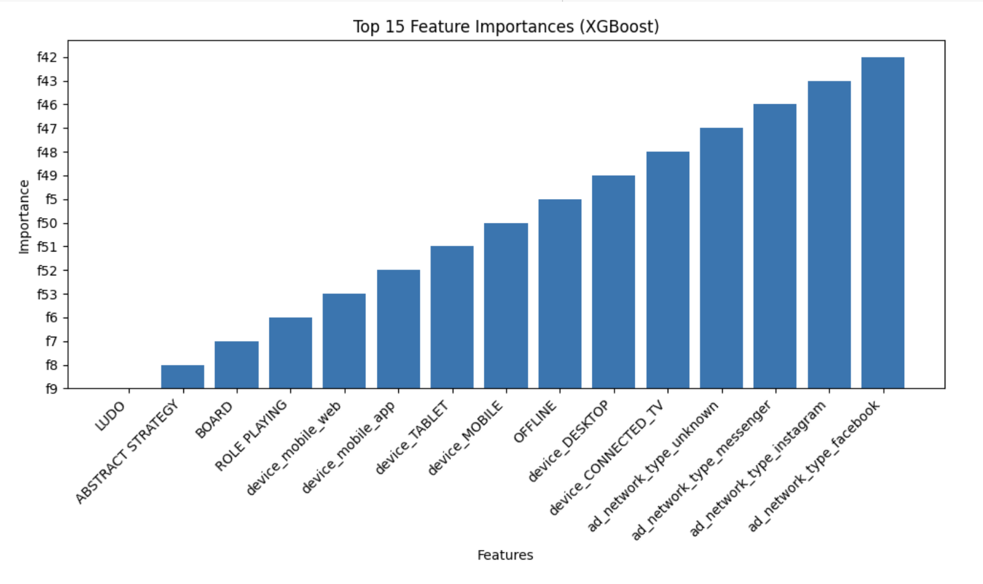
Feature Importance
Clicks
Installs
Notes:
Our analysis with the XGBoost model reveals key insights into feature importance across different advertising objectives.
For both 'Clicks' and 'Installs,' mobile devices and social networks like Facebook and Instagram dominate, indicating that mobile optimization and targeted social media campaigns are critical for driving user engagement and conversions.

Slide 11
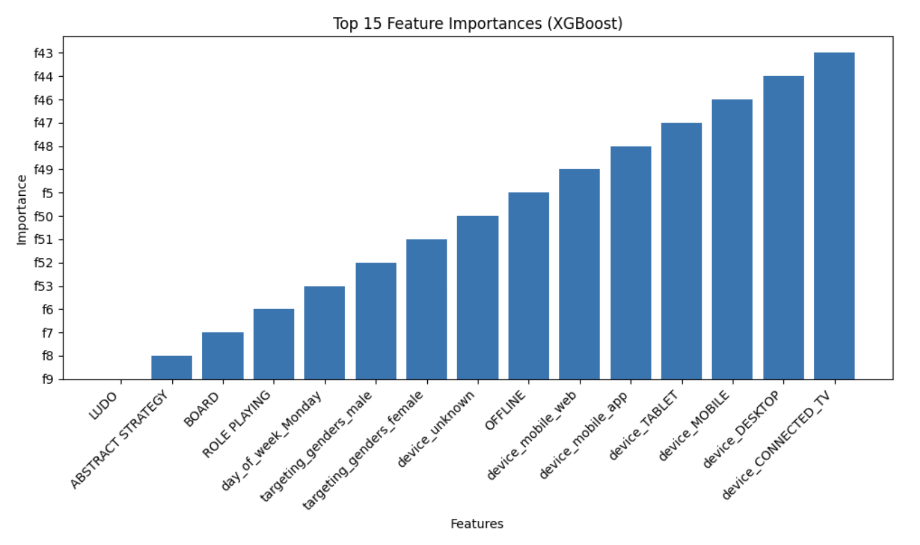
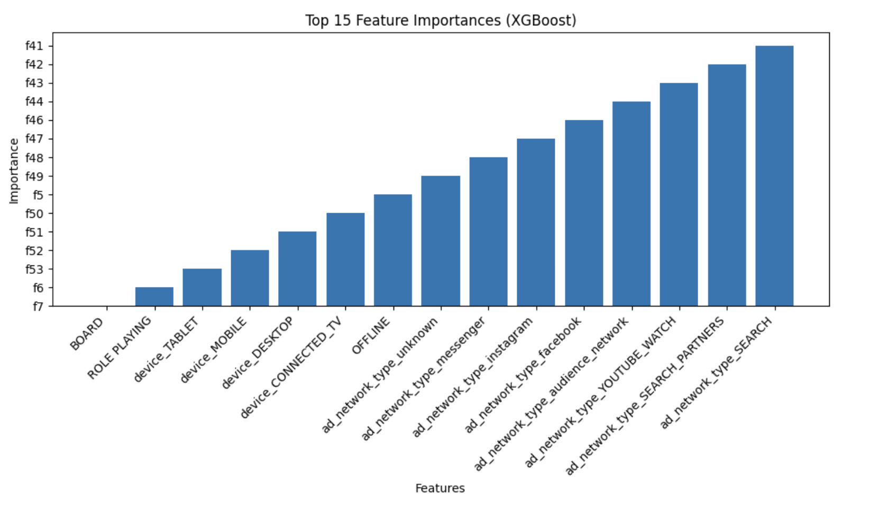
Feature Importance
Impressions
Purchase
Notes:
In contrast, 'Impressions' benefit from a broader approach, with desktops and connected TVs also playing significant roles, emphasizing the need for cross-platform visibility.
Meanwhile, 'Purchase' decisions are strongly influenced by engagement on high-impact social platforms, highlighting their role in converting impressions into sales.
The feature importance analysis reveals that certain features have a more pronounced effect on specific outcomes.These patterns suggest a strategic focus on device-specific optimization and platform-specific content to maximize each campaign’s effectiveness from initial engagement to final purchase. By focusing on these key features, marketers can tailor their strategies to not only attract more clicks but also to convert these into meaningful actions like installs and purchases. This tailored approach ensures that advertising budgets are spent more efficiently, targeting the right factors that drive user engagement and conversion.

Slide 12
Deployment Plan
Integration with Business Systems: The model will be integrated into existing business systems through APIs, allowing it to access real-time data and provide on-the-fly predictions. This integration ensures that the model's insights are directly usable in the decision-making process.
Cloud Deployment: To handle scalability and ensure accessibility, the model will be deployed on a cloud platform. This approach provides the necessary computational resources and allows for easy scaling as data volume and user base grow.
User Interface: A user-friendly dashboard will be developed to display the model's predictions and insights. This dashboard will allow business users to interact with the model's outputs easily, customize inputs, and visualize data in an understandable format.
Notes:
Our predictive model integrates seamlessly with business systems via APIs for real-time data access, deploys on a scalable cloud platform for handling growth, and features a user-friendly dashboard that allows easy interaction with model predictions, enhancing decision-making processes across the organization

Slide 13

Embedding the model in real business scenarios
We generated the 23,040 different combinations by multiplying the number of possible choices for each spend level.
Total Combinations=(Number of Age Combinations)×(Number of Campaign Objectives)×(Number of Channel Google Options)×(Number of OS Type iOS Options)×(Number of Ad Network Types per Channel Google Option)×(Number of Device Types)×(Number of Gender Combinations)
Data range: 01-12-2022 to 31-12-2022
Category: Casino
Rating: 4.6255
Num_comments: 12842
Num-rating: 84247
Notes:
To know better how our model can help in a real
In order to know what advertising strategy is optimal for this app at a given budget level, the

Slide 14
Model’s strategy v.s. Human’s strategy
With a single ad budget of $2 a day, based on the same budget, the updated ad strategy is expected to result in a 41.9% lift in the number of clicks.
Settings | New Strategy | Previous Strategy
target_age | 13-26 | 45-65
channel | Facebook | Google, Facebook
os_type | Andriod | Andriod
campaign_objective | CONVERSIONS | APP_INSTALLS
ad_network_type | audience_network | All
device | CONNECTED_TV | mobile_app
targeting_genders | female | female,male
spend | predicted_clicks | previous_clicks
2 | 2.173 | 1.531
4 | 2.208 | 1.676
6 | 2.251 | 1.974

Slide 15
Way Forward
Data Collection: Advertiser's Side
Ad Creative Data:
Types and styles of images and videos.
Tone and content of text descriptions.
Advertiser Profile Data:
Company size and industry type.
Advertising budget levels.
Brand reputation metrics.
Data Collection: User Side on the Platform
User Behavioral Data:
Whether a user clicked on an ad link.
Duration of ad viewing by the user.
Duration of user's stay on the landing page post-click.
User interactions with content
Richer User Profiles
Improved Segmentation
Contextual Relevance
Competitor Data Analysis
Further we can do:

Slide 16
Way Forward
Model evaluation with experts
Although the model can generate the best advertising strategies, whether these strategies are applicable in real scenarios and whether the recommended parameters are usable still require human evaluation.
Improvements in Predictive Modeling
Advanced Predictive Models: more complex models like neural networks or transformers
Hybrid Models: Combine different types of models, such as machine learning models with rule-based systems
Enhancements in Deployment
Dynamic Feedback Mechanisms: Instead of exhausting all possible combinations in a predictive model, integrate deep reinforcement learning to add dynamic feedback mechanisms

