Slide 1

Lovely Professional University
Project Topic : AI Environmental Campaign Generator
Name : Ishan Walia
Roll No: 42

Slide 2
PROJECT OVERVIEW
This project focuses on promoting environmental awareness using AI. It monitors air quality, gives environmental tips, detects waste, and generates posters • Monitor real-time Air Quality Index (AQI) • Get environmental tips • Detect waste using AI • Generate eco posters • Chat with AI assistant Goal: Promote environmental awareness using technology

Slide 3


PROJECT INTERFACE
This is the project interface. It includes multiple screens like Home, Chatbot, Waste Detection, Poster Generator, and AQI tracking, with a simple and user-friendly design

Slide 4
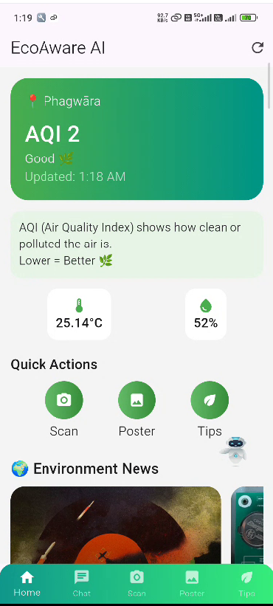
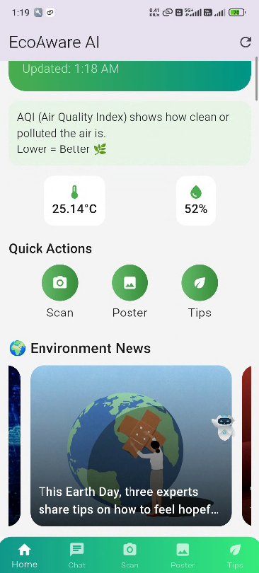
HOME SCREEN
This home screen uses the latest OpenWeather API to fetch real-time AQI and weather data based on the user’s GPS location, and it also displays the latest environmental news to keep users informed.
Features:
• Live AQI using GPS
• City auto-detection
• Smart eco suggestions
• Refresh button
• Clean UI with gradients

Slide 5
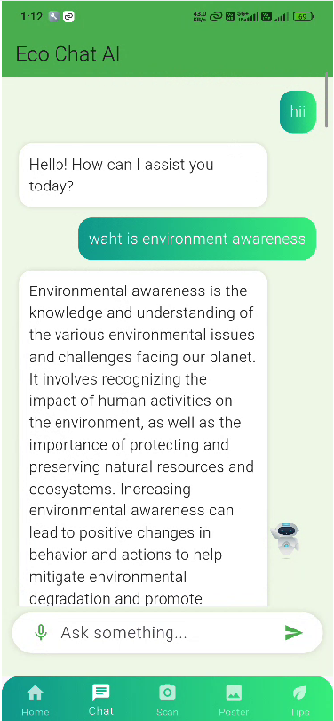
AI CHATBOT
This feature is an AI chatbot that allows users to ask environmental questions. It provides AI-generated responses and also supports voice input for better interaction
Features: • AI-generated responses • Voice input supported Example: “What is environmental awareness?”

Slide 6
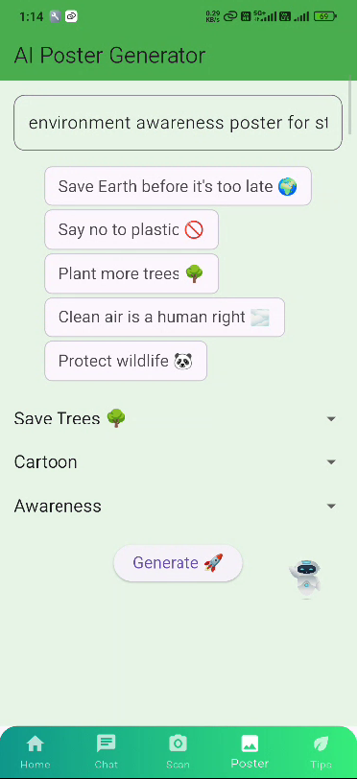
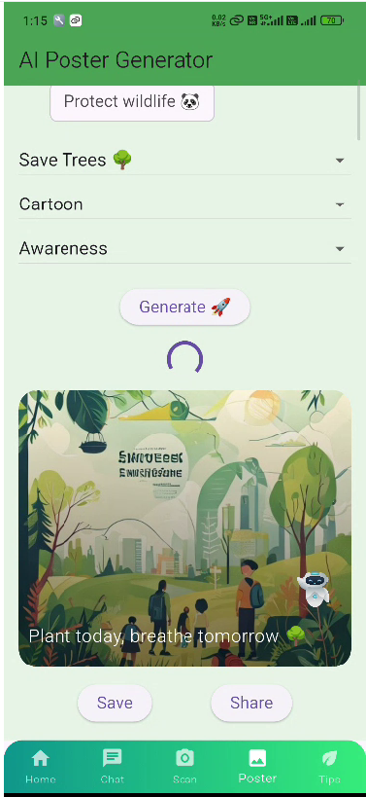
POSTER GENERATOR
This feature allows users to generate eco-friendly posters using AI. Users can enter custom text like ‘Save Earth’, and the app creates a poster automatically..
Features: • Generate eco posters using AI • Custom input (e.g., "Save Earth") • Download poster Purpose: Spread awareness through visuals

Slide 7
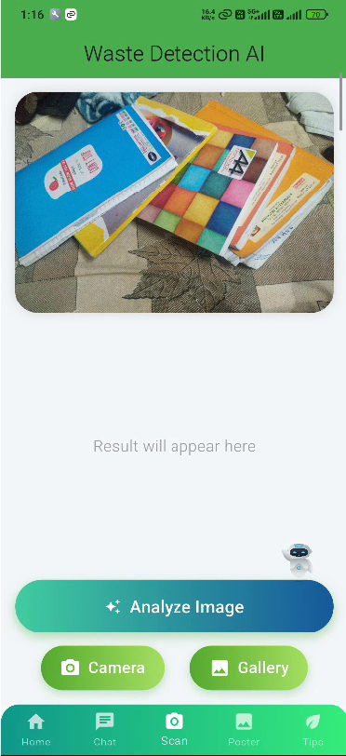
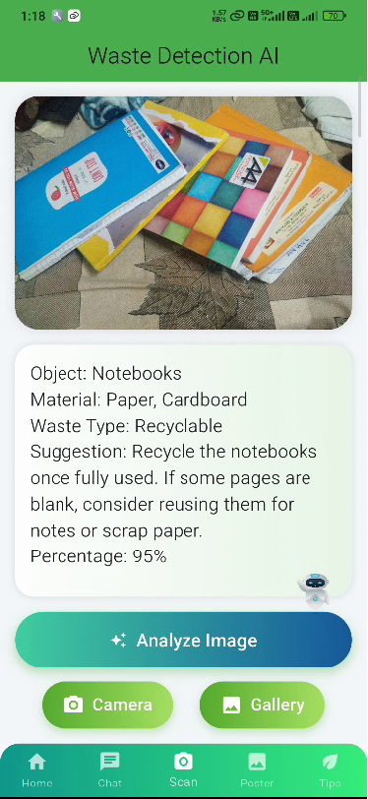
WASTE DETECTION AI
This feature uses AI to identify waste from images and tells the correct way to handle it
Features: • Camera / Gallery input • Object detection using AI • Waste classification • Disposal suggestions
Purpose: Promote proper waste management

Slide 8
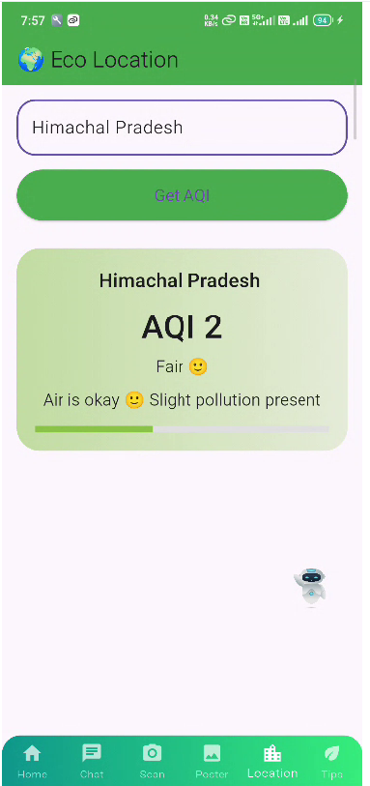
LOCATION AQI
Users can set any city to check air quality. It helps understand pollution levels in different areas
Features: • set city • Get AQI data • Pollution status Purpose: Check environmental condition of any location

Slide 9
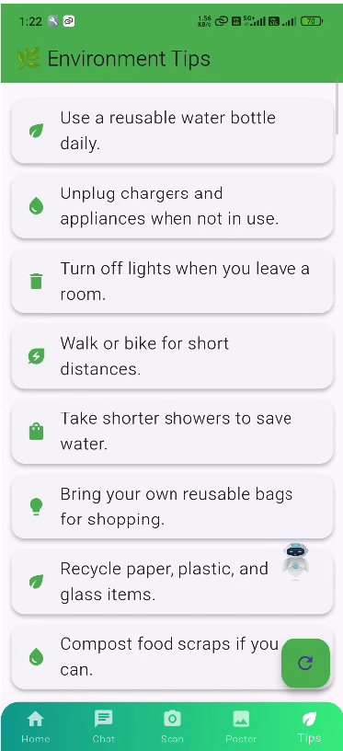
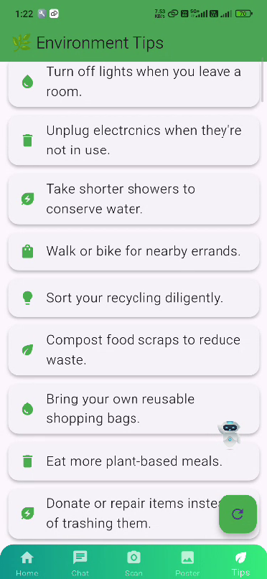
ENVIRONMENT TIPS
The app provides daily eco-friendly tips.
Features: • Daily eco-friendly tips • Dynamic suggestions • Simple and clean UI Examples: • Save water • Use reusable bags Purpose: Encourage sustainable habits

Slide 10
What is AQI?
AQI means Air Quality Index. It tells us how clean or polluted the air is.
AQI Levels (Simple Explanation)
AQI 1 – Good Air is very clean. Safe for everyone. Outdoor activities are fine.
AQI 2 – Fair Air has a little pollution. Safe for normal people. Sensitive people should be careful.
AQI 3 – Moderate Pollution is noticeable. People with asthma or kids should be careful. Mask can be helpful.
AQI 4 – Poor Air is unhealthy. Avoid going outside.
AQI 5 – Very Poor Air is very dangerous. Everyone is at risk. Stay indoors.

Slide 11
Technologies Used
This project uses Flutter, OpenWeather API, Gemini AI, Google Maps API, and OpenAI API.”
GitHub Link: https://github.com/ishan-walia/ecoaware-ai-app
Releases Link : https://docs.google.com/uc?export=download&id=1Yf3relNBtIKHILmSa2JGcf_V7f9rVTxA

