Slide 1
Explainable AI-Based Resume–Job Matching Using Semantic and Skill-Aware Ranking
TF-IDF · BGE semantic embeddings · student-designed Skill-Aware Hybrid, evaluated on leakage-safe resume-grouped splits
[Student name] · [Roll number]
[Course] · AI Lab Project
[Faculty supervisor] · [Department, Institute]
Academic research prototype — not for use as the sole basis of employment decisions.
Notes:
Open with the research question, not the tool: can explicit requirement-aware features improve on lexical and semantic matching, and can the result be explained? Fill in the name / roll number / course placeholders before presenting.

Slide 2
Problem: similarity is not the same as fit
Lexical matching (TF-IDF)
Semantic matching (BGE)
What a recruiter needs
Counts shared words
“REST APIs in Flask” ≠ “backend services” — synonyms get no credit
No notion of required vs optional
Compares meaning of whole documents
A resume can be “about” the job yet miss a mandatory skill
One vector per document: no evidence of what is missing
Are the required skills present?
Is experience sufficient?
Has the candidate done similar duties?
Why did the candidate score this way?
Illustration (not a result)
Job requires:
✓ Python
✓ PyTorch
✗ AWS
Candidate has Python and PyTorch. Semantic similarity can still be high — the missing AWS requirement is invisible to it.
Notes:
Motivation in one sentence: lexical similarity misses meaning, semantic similarity misses requirements. The AWS example is an illustration, not a result. Viva: 'why not just use BGE?' — because one embedding per document cannot say which mandatory requirement is missing, and the evaluation later shows explicit features add ranking signal on top of BGE.

Slide 3
Research question and objectives
Does combining semantic similarity with explicit skill coverage, experience compatibility and responsibility alignment improve resume–job matching compared with TF-IDF and pure semantic matching?
1
Build a leakage-safe dataset resume-grouped train / validation / test splits; detect and reject the leaky original split
2
Implement three approaches TF-IDF baseline, BGE semantic baseline, Skill-Aware Hybrid (student-designed)
3
Compare them fairly same pairs and jobs, ranking metrics first (NDCG, MRR, MAP), classification second; ablation; repeated splits
4
Explain and demonstrate faithful, evidence-based explanations served through a FastAPI + React application
H0: the hybrid does not improve on semantic matching. H1: it does, because it models requirements explicitly.
Notes:
Objectives map to the rubric: problem formulation (RQ), algorithms (2), comparison (3), demo (4). Note the hypotheses were stated before results; the outcome is answered honestly on the conclusion slide (supported for ranking, not for classification).

Slide 4
System overview
Dataset
Clean + group
Grouped split
Models
Evaluation
FastAPI
React UI
HF resume–job fit
pinned revision
dedupe, labels,
near-duplicate groups
train / val / test
no resume overlap
TF-IDF · BGE ·
Skill-Aware Hybrid
ranking + classif.,
ablation, 5 splits
serves frozen
models + results
match, compare,
research pages
Data / ML
Python · pandas · scikit-learn (TF-IDF) · sentence-transformers (BGE) · rule-based feature extraction (no LLM)
Evaluation
NDCG@5/10, MRR, MAP, P@k; macro F1 via validation thresholds; job-level bootstrap; leakage, privacy and explainability checks
Application
FastAPI backend (BGE loaded once, shared by semantic + hybrid) · React + TypeScript + Recharts frontend
Notes:
One pipeline, three models. Everything learned is learned on train (TF-IDF vocabulary) or validation (hybrid weights, scaling bounds, classification thresholds); test is scored once. The application never re-runs experiments; it serves the frozen models and reads committed result files.

Slide 5
Dataset and experimental design
8,000
7,987
643
351
raw resume–job pairs
pairs after cleaning
unique resumes
unique jobs
Leakage-safe resume-grouped split (seed 42)
Train
5,537
Validation
1,259
Test
1,191
Removed 1 exact duplicate and 12 conflicting-label rows
643 resumes → 593 groups: 50 near-duplicates merged (TF-IDF cosine ≥ 0.9)
Whole groups go to one split; test has 157 jobs usable for ranking (≥ 2 candidates, ≥ 2 labels)
Source: results/dataset_stats.json · dataset cnamuangtoun/resume-job-description-fit (pinned revision 08978e2)
Notes:
Key point: only 643 resumes and 351 jobs generate 7,987 pairs, so each resume appears in many pairs — which is exactly why splitting by row would leak. Labels are No / Potential / Good Fit; for NDCG they are graded 0/1/2. Ranking unit = one job and its candidates in the split.

Slide 6
Critical finding: the original split leaks resumes
Original dataset split
Project methodology
476 of 477
Resume identity = hash of normalised text
Near-duplicate resumes merged into groups
Split by group: a resume is in exactly one of train / validation / test
Leakage check: 0 overlapping resume IDs, groups and normalised texts across all splits
Repeated evaluation: 5 more grouped splits, all leakage-free
original test resumes also appear in the original training data
99.79% of test resumes leaked
A model can be “tested” on resumes it has already seen → optimistic, invalid evaluation. This split was rejected.
Leakage check: PASS (original split and all repeated splits)
Source: results/original_split_leakage.json, results/dataset_stats.json, results/repeated_grouped_meta.json (ml/evaluation/leakage_check.py)
Notes:
Why it matters: with 476 of 477 test resumes already in training, any score on the original test split mostly measures memorisation of seen resumes. Jobs DO repeat across our splits by design: the realistic task is ranking unseen candidates for a known job. Professor question 'is job overlap leakage?' — no, we split by candidate; anything learned (TF-IDF vocabulary, weights, thresholds) never sees test resumes.

Slide 7
Three AI approaches
1 TF-IDF + cosine
2 BGE semantic
3 Skill-Aware Hybrid
Traditional lexical baseline
Transformer baseline (zero-shot)
Student-designed improvement
score = cos(TF-IDF(r), TF-IDF(j))
score = cos(E(r), E(j))
score = Σ wᵢ·fᵢ / Σ wᵢ (available fᵢ)
Unigrams + bigrams, sublinear TF
Vocabulary and IDF fitted on train only
Keeps tokens like c++, c#, node.js
BAAI/bge-base-en-v1.5, revision a5beb1e
768-d normalised embeddings, no fine-tuning
First 512 tokens (truncate chosen over chunk-averaging on validation)
BGE semantic similarity
+ required / preferred skill coverage
+ experience match + responsibility alignment
Same protocol for all three: identical pairs and jobs, same metric code; everything learned comes from train or validation, and test is scored once.
Code: ml/models/tfidf.py, ml/models/semantic.py, ml/models/hybrid.py · configs: experiments/config/*.json · scores are similarities, not probabilities
Notes:
TF-IDF: term frequency × inverse document frequency; cosine of L2-normalised vectors = dot product. BGE: transformer encoder trained contrastively; cosine of [CLS] embeddings; no query instruction because both sides are long documents (per model card). BGE reads 512 tokens, so about 58–60% of resume text (validation/test) is never seen — validation chose truncate (0.8114) over chunk-mean (0.8083) by a rule fixed in advance. Hybrid: components that cannot be measured are left out and the remaining weights renormalised.

Slide 8
Student-designed improvement: Skill-Aware Hybrid
Required / preferred skills
178-skill taxonomy with aliases (ReactJS→React); status from sentence cues (“must have”, “a plus”) and section headings; evidence sentence kept
Experience match
min(1, candidate years ÷ required years); years from employment date ranges, overlaps merged
Responsibility alignment
each job duty matched to its most similar experience sentence (BGE), averaged
hybrid = Σ wᵢ · fᵢ / Σ wᵢ
Missing ≠ zero
if the job states no years or no required skills, that term is left out, not scored 0
over the measurable components fᵢ ∈ [0, 1] → score ∈ [0, 1]
Weights: config/matching_weights_parserfix.json — best validation NDCG@10 (0.8093) of 6 weight sets declared before any result; deterministic extraction, no LLM
Notes:
This is the student-designed contribution for this project — not claimed as a novel research algorithm (hybrid scoring and skill matching are established ideas). Weights were picked on validation only from 6 pre-declared configurations; the semantic-heavy set won. Required skills always weighted above preferred. Viva: 'why 0.60 on semantic?' — it was the best of the pre-declared sets on validation, which itself tells us explicit features are complementary, not a replacement.

Slide 9
Results on the leakage-safe held-out test split
Ranking (primary) vs Classification (secondary)
Model | NDCG@10 | NDCG@5 | MRR | MAP | Macro F1
Random ordering | 0.7582 | 0.6944 | 0.7141 | 0.6670 | —
TF-IDF | 0.7945 | 0.7249 | 0.7638 | 0.7179 | 0.3938
BGE semantic | 0.8231 | 0.7653 | 0.7870 | 0.7531 | 0.4226
Skill-Aware Hybrid | 0.8419 | 0.7948 | 0.8276 | 0.7803 | 0.4385
Hybrid +0.0188 NDCG@10 over BGE; BGE +0.0286 over TF-IDF
But on the validation split the hybrid (0.8093) did not beat BGE (0.8114) → one split is not enough (next slide)
Source: results/final_model_comparison.csv · served hybrid = corrected parser (Phase 6); the earlier Phase 5 hybrid scored NDCG@10 0.8459 on the same test split
Notes:
Why this matters: all approaches are scored on the same 1,191 pairs and 157 rankable jobs with the same metric code, so the comparison is fair. NDCG@10 rewards putting Good/Potential candidates near the top; macro F1 is a post-hoc conversion of scores into three classes using thresholds learned on validation — a different objective. Accuracy is not used as the headline because always predicting 'No Fit' scores 0.5441 accuracy on test. Corrected vs Phase 5 hybrid: a general parser fix for requirement words glued to the next word ('RequiredSQL') changed results only marginally (0.8459 → 0.8419); we report the corrected, served model.

Slide 10
Robustness: 5 independent resume-grouped splits
NDCG@10 on each held-out test split (re-fitted / re-selected per split)
Hybrid − BGE · NDCG@10
Split | Random | TF-IDF | BGE | Hybrid | Hybrid − BGE
1 | 0.7769 | 0.8224 | 0.8413 | 0.8521 | +0.0108
2 | 0.7771 | 0.8073 | 0.8161 | 0.8389 | +0.0228
3 | 0.7595 | 0.8045 | 0.8118 | 0.8192 | +0.0074
4 | 0.7776 | 0.8295 | 0.8697 | 0.8745 | +0.0048
5 | 0.7749 | 0.8324 | 0.8219 | 0.8279 | +0.0060
Mean ± SD | 0.7732 ± 0.0077 | 0.8192 ± 0.0127 | 0.8322 ± 0.0238 | 0.8425 ± 0.0217 | +0.0104
+0.0104
95% CI [+0.0017, +0.0194]
positive in 5 of 5 splits
Hybrid − BGE · MRR
+0.0172
95% CI [+0.0009, +0.0338]
positive in 5 of 5 splits
Mean ± SD | MRR | MAP | Macro F1
TF-IDF | 0.7888 ± 0.0152 | 0.7499 ± 0.0201 | 0.4052 ± 0.0098
BGE | 0.8065 ± 0.0274 | 0.7709 ± 0.0323 | 0.4122 ± 0.0142
Hybrid | 0.8237 ± 0.0254 | 0.7831 ± 0.0286 | 0.4062 ± 0.0234
Classification is different
BGE has the best mean macro F1 (0.4122); the hybrid's is 0.4062. The hybrid's advantage is in ranking only.
Source: results/repeated_grouped_*.csv · 20 stratified grouped folds, disjoint test sets, 809 test-job units · CI: job-level bootstrap within each split (10,000 resamples)
Notes:
Why this matters: the original split gave mixed evidence (test favoured the hybrid, validation did not). Re-running the WHOLE method on 5 independent grouped splits — TF-IDF refitted, hybrid weights and all thresholds re-selected on each split's validation — the hybrid beats BGE in every split. The effect is small (+0.0104 NDCG@10) but the 95% interval excludes zero. Note: in split 5 TF-IDF beats both. Viva: the repeated-split hybrid re-selects its weighting per split (experience-heavy ×3, semantic-heavy, skill-heavy), so this tests the method, not the fixed 0.60 weights. CI method: resample jobs (not candidate rows) within each split, average over splits; no multiple-comparison correction.

Slide 11
Ablation and error analysis
Adding required skills alone lowers ranking (−0.0073); preferred skills too (−0.0060)
Experience / responsibilities add little (+0.0026, +0.0028); the validation-selected combination is best (+0.0101)
Required-skill coverage still matters for the explanation (missing requirements)
Hybrid fixes 14 BGE errors, introduces 6
In 13 of 14 fixes, BGE's top pick was semantically similar but missed a required skill
19.5% of jobs: all models wrong — limits of features and labels
Sources: results/final_ablation.csv (repeated splits; stages B–E use the initial weights restricted to those parts) · results/error_analysis_summary.csv (original test, Phase 5 hybrid, top-1 relevant = success)
Notes:
Honest interpretation: features are not individually guaranteed to help ranking. Required-skill coverage on its own lowers NDCG@10 in every view (validation, test, repeated) — its value is explanatory. The final validation-selected weighting is what improves ranking. Error analysis examples were chosen by a rule fixed in advance (first 3 jobs per category by job id), not by which model won. Why it matters: it shows WHERE the hybrid helps (missing mandatory skills) and that a fifth of jobs remain unsolved by any model.

Slide 12
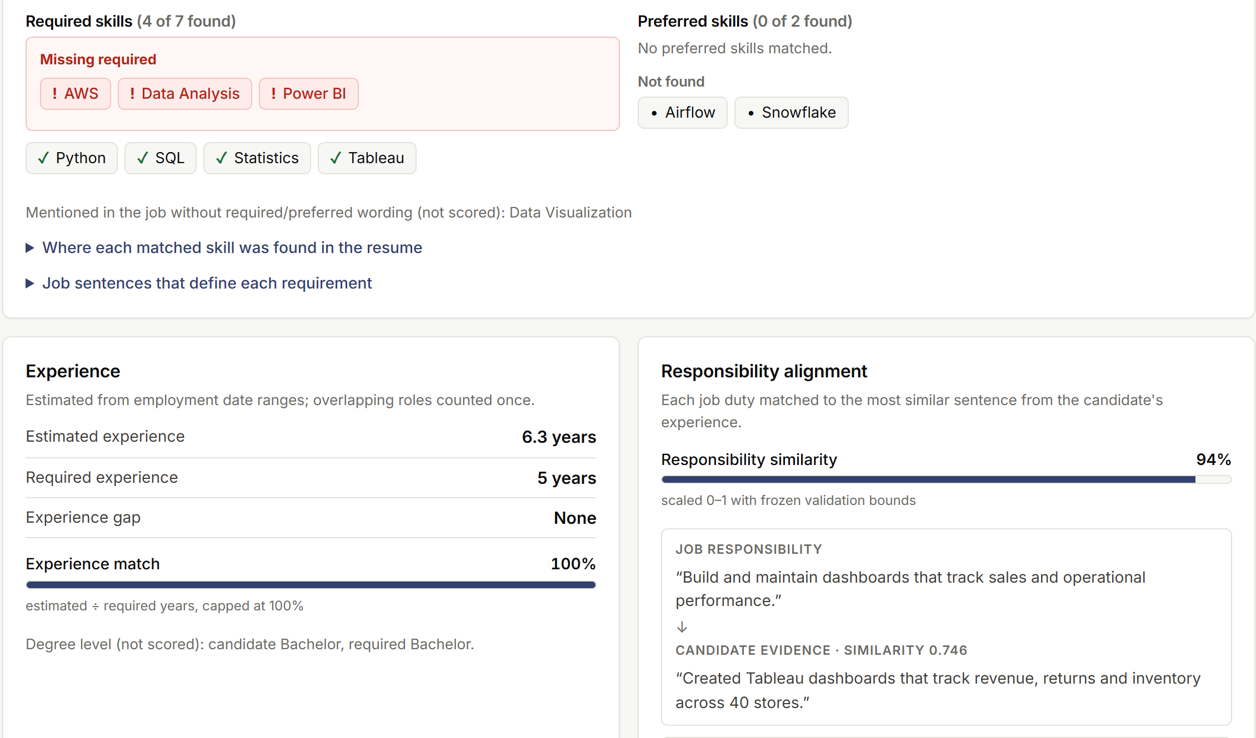
Explainable matching: why a candidate scored this way
Every explanation contains
Matched / missing required and preferred skills, with the source sentence
Estimated experience, required years and gap
Best-matching duty ↔ experience sentence pairs
Each component's value and weight
Faithfulness check
8 checks × 1,191 real test pairs: all passed
Missing skills truly absent, gaps correct, evidence present in the text, score recomposes from weights. Shows explanations are faithful to the model — not that extraction is always right.
Screenshot: served hybrid on the synthetic demo pair (real API output)
Source: results/hybrid_explainability_check.json (run on the Phase 5 frozen hybrid; same explanation code as the served model) · demo resume/job are synthetic fixtures
Notes:
Example to narrate: on a real test job with 15 candidates (documented in docs/algorithms.md, Phase 5 hybrid), BGE ranked a No-Fit candidate first; it was missing the required skill 'Agile' (job sentence: 'Must have experience working in an Agile environment'). The hybrid moved it from #1 to #4 and moved a Good-Fit candidate who had Agile from #3 to #1. Caveat to volunteer: faithfulness ≠ correctness — e.g. 'Tableau or Power BI' marks both as required, and a degree field like 'Statistics' can be read as a skill.

Slide 13
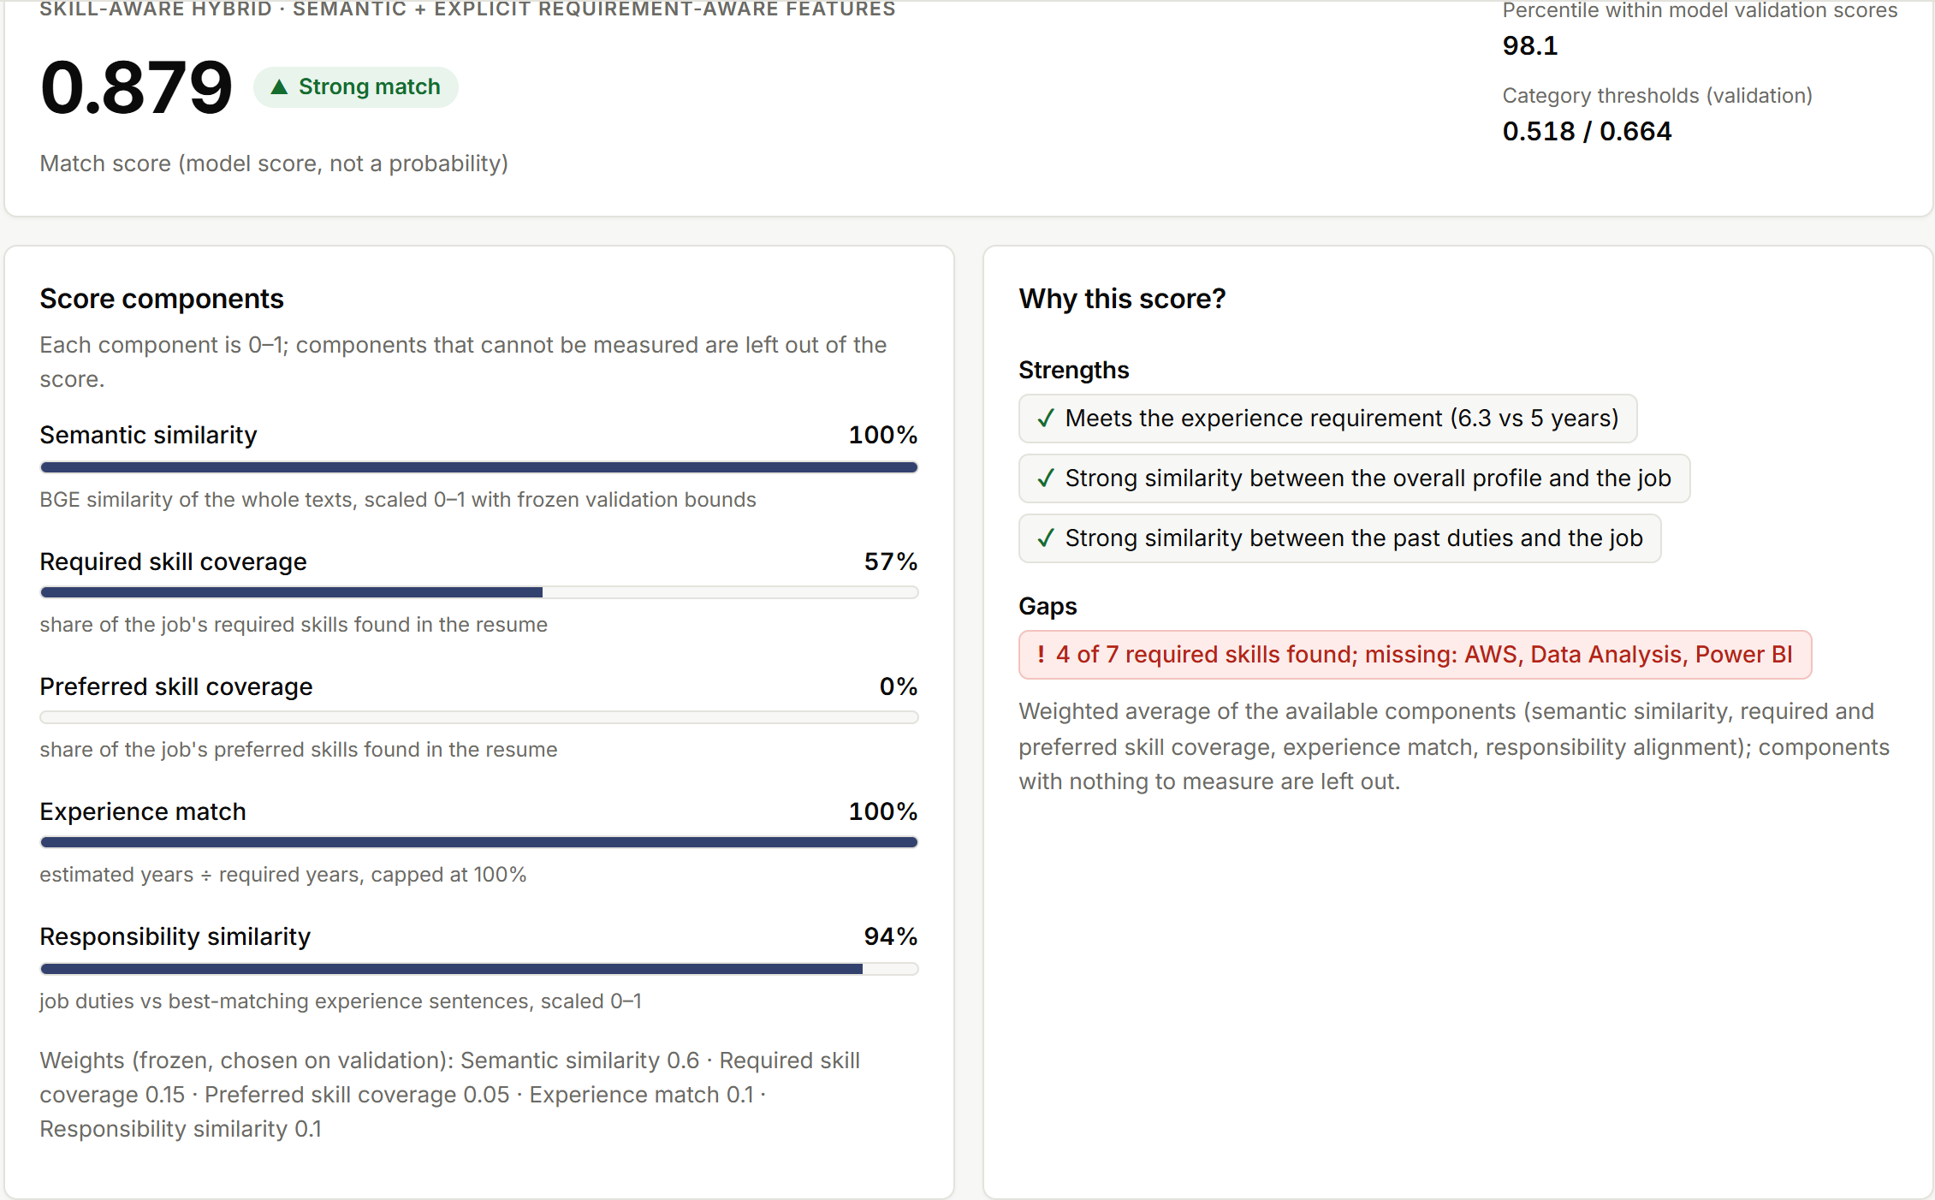
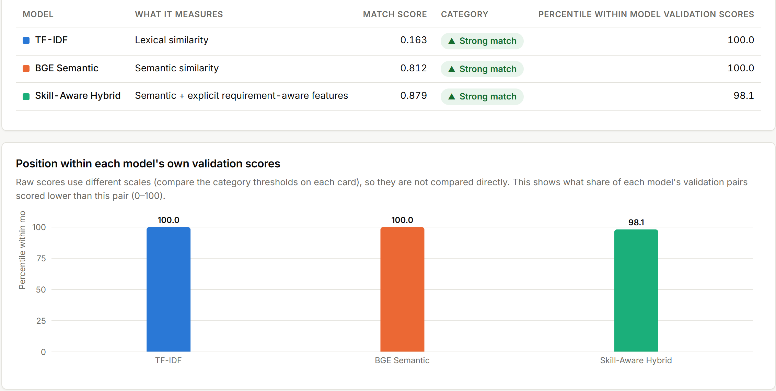
Working application
Match result (hybrid)
Model comparison (same input, all three models)
Demo flow
API and privacy
Upload (PDF / DOCX / TXT) or paste resume; paste job or Load Demo
Choose model (default: hybrid) → Analyze: score + category
Inspect explanation and evidence; compare all three models
Research pages: results, ablation, limitations
FastAPI: /api/match, /api/compare, /api/research/*; BGE loaded once
Uploads kept in memory, never stored; no resume text in logs
Model scores, not probabilities; categories from validation thresholds
Screenshots captured from the running application (React + TypeScript frontend, FastAPI backend) on the synthetic demo resume and job description
Notes:
Live demo plan (≈2 min): Match Analysis → Load Demo → Analyze Match (hybrid: 4 of 7 required skills; missing AWS, Data Analysis, Power BI) → Compare Models → Research page. Start the backend first: uvicorn backend.app.main:app --port 8000 (models load in ~10–30 s), then npm --prefix frontend run dev. The comparison ranks models by 'percentile within model validation scores' because raw scores are on different scales (TF-IDF ≈ 0.16 vs BGE ≈ 0.81 for the same pair).

Slide 14
Conclusion, limitations and future work
Supported by the evidence
Not established / limitations
Original split is leaky (476/477); grouped splits fix it
BGE > TF-IDF on ranking; both > random ordering
Hybrid ranks better than BGE in 5/5 repeated splits: +0.0104 NDCG@10, CI [+0.0017, +0.0194]
Explanations are faithful to the model's features
Gain is small; did not appear on the original validation split
Classification not improved: BGE has the best mean macro F1
Required-skill coverage alone does not improve ranking
One dataset, 643 resumes / 351 jobs; labelling undocumented
Rule-based extraction errors; experience years approximate
Answer to the research question
For ranking: yes — consistently but modestly. For classification: no. The main added value is requirement-aware, evidence-based explanation.
Future work: learn the weights on the unused train split · more datasets and annotators · cross-encoder re-ranking · better extraction (alternatives such as “X or Y”)
Notes:
Do not say 'the hybrid is the best model'. Say: best mean ranking in repeated splits by a small, statistically detectable margin; BGE keeps the best classification F1; on the original validation split the hybrid did not beat BGE. Future-work items are proposals, not results — none were run.

Slide 15
Viva: key points to explain
Leakage
TF-IDF vs BGE
Hybrid score
Why a row-level split leaks here, and how resume grouping fixes it
Lexical overlap vs semantic embeddings; cosine similarity of both
Weighted average of available components; why missing ≠ zero
Metrics
Fair selection
Robustness
NDCG / MRR / MAP rank candidates per job; macro F1 is a separate objective
Weights, scaling and thresholds from validation; test scored once
5 grouped splits, job-level bootstrap CI; small but consistent gain
Takeaway: explicit, requirement-aware features add a small but consistent ranking gain over semantic matching — and make every score explainable.
Notes:
Rubric map (internal):
Problem formulation / originality → slides 2, 3
AI concepts / algorithm implementation → slides 4, 7, 8
Comparison of AI approaches → slides 9, 10
Dataset / environment / experimentation → slides 5, 6, 10
Evaluation / interpretation → slides 9, 10, 11, 14
Student improvement / innovation → slides 8, 11, 12
Working application / demo → slides 12, 13 (+ live demo)
Viva → this slide + speaker notes; docs/PRESENTATION_NOTES.md

