Slide 1
Multi Threading in Java

Slide 2
Introduction
One of the exciting features of Windows operating system is that- it allows the user to handle multiple tasks together. This facility in Windows operating System is called Multitasking.
In Java we can write the programs that perform multitasking using the Multithreading concept.
Multithreading in java is a process of executing multiple threads simultaneously.

Slide 3
A thread is a lightweight sub-process, the smallest unit of processing. Multiprocessing and multithreading, both are used to achieve multitasking.
Java Multithreading is mostly used in games, animation, etc.
Thread is a tiny program running continuously. It is sometimes called as light weight process.
Threads are independent. If there occurs exception in one thread, it doesn't affect other threads. It uses a shared memory area.

Slide 4
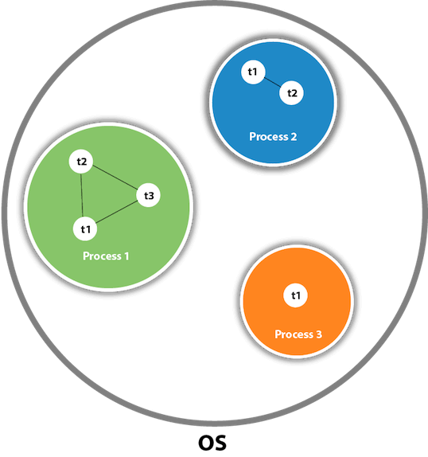

Slide 5
Difference between Thread and Process
Thread | Process
Thread is a light-weight process. | Process is a heavy weight process.
Thread do not require separate address space for its execution. It runs in the address space of the process to which it belongs to. | Each process requires separate address space to execute.

Slide 6
Thread States
Thread always exists in any one of following states.
New or Create State.
Runnable State.
Waiting State.
Timed Waiting State.
Blocked State.
Terminated State.

Slide 7
Life Cycle of Thread
Thread is life cycle specifies how a thread gets processed in java program. By executing various method. Following figure represent how a particular thread can be in one of state at any time.
New State: when a thread starts its life cycle it enters in the new state or a create state.
Runnable State: This is a state in which a thread starts executing.
Waiting State: Sometimes one thread has to undergo in waiting state because another thread starts executing.

Slide 8
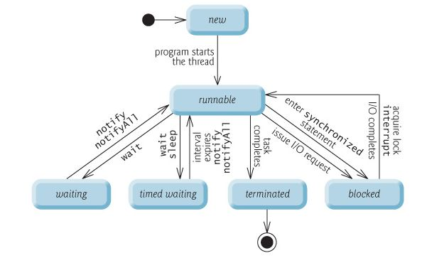

Slide 9
4) Times Waiting State: There is a provision to keep a particular threading waiting for some interval . This allows to execute high prioritized threads first. After the timing gets over, the thread in waiting state enters in runnable state.
5) Blocked State: When a particular thread issues an Input / Output request then operating system sends it in blocked state until the I/O operation gets completed. After the I/O completion the thread is sent back to the runnable state.
6) Terminated State: After successful completion of the execution the thread in runnable state enters the terminated state.

Slide 10
How to create Thread
There are two ways to create thread.
By extending Thread class.
By implementing Runnable Interface.

