Slide 1







Team Name:
Team Lead Name:
Track:
Problem Statement title:
Q-SHIELD: End-to-End Quantum Security Platform
Discover, understand, protect, and migrate quantum-vulnerable cryptography before Q-day
• Q-Hack India 2026 •

Slide 2

Problem
Today's public-key cryptography has an expiry date
1
2
3
Shor breaks RSA & ECC
Harvest now, decrypt later
No inventory, no plan
A large fault-tolerant quantum computer running Shor's algorithm derives private keys from public keys in polynomial time. RSA, ECDSA, ECDH, and Diffie-Hellman all fall.
Attackers record encrypted network traffic and exfiltrate ciphertext today to decrypt once quantum hardware scales. Long-lived financial, healthcare, and state records are exposed already.
Most organizations lack visibility into where vulnerable algorithms live across polyglot repositories, configurations, and certificates, making multi-year migrations difficult to sequence.
The clock is set: NIST standardized ML-KEM, ML-DSA, and SLH-DSA in August 2024 (FIPS 203–205) and plans to deprecate quantum-vulnerable public-key algorithms after 2030 (NIST IR 8547).
• Q-Hack India 2026 •

Slide 3
Why It Matters
The deadline is set by your data, not by quantum computers
Who faces it
Mosca's inequality: data is at risk when
1
Banks & payments
transaction records, card data, inter-bank clearing keys
X + Y > Z
Healthcare
medical records and genomic data kept for decades
X = years data must stay secret · Y = years to migrate · Z = years until Q-day
2
Example from our scan: QuantumBank payment-api
3
Government & defense
classified intelligence, citizen identity registries
records kept: 10 y
migrate: 2.3 y
Q-day ≈ 12 y
Result: 10.0 + 2.3 = 12.3 y > 12.0 y (Q-day)
RSA-protected financial records outlive their encryption today, rated high exposure. Migration has to start now.
4
Any organization
proprietary data that must stay secret for 10+ years
• Q-Hack India 2026 •

Slide 4
Proposed Solution
One platform from discovery to migration
1
DISCOVER
2
UNDERSTAND
3
PROTECT
4
MIGRATE
Crypto scanner
Risk + quantum threat
PQC gateway
Crypto-agility engine
Scans Python, Java, JS and Go code, SSH/JWT configs, X.509 certificates and committed keys into a Cryptographic Bill of Materials.
Readiness score 0–100, harvest-now-decrypt-later exposure per data class, Shor and Grover simulated.
Quantum-safe channel with ML-KEM-768 key exchange and ML-DSA-65 signatures, hybrid with X25519.
A replacement for every finding, a 4-phase roadmap and the projected readiness after each phase.
5 AI SECURITY COPILOT: Explains the risk, answers "what should we migrate first?", writes developer tickets and an executive audit report, strictly grounded in verified CBOM finding IDs.
• Q-Hack India 2026 •

Slide 5
Why Quantum?
Quantum computing is both the threat and our method
The threat
Our method
Shor's algorithm [ Broken ]
Exponential speedup for factoring and discrete logarithms: RSA and elliptic-curve keys can be derived from public keys.
Exact statevector simulation of Shor's period finding: modular exponentiation f(x) = a^x mod N, inverse QFT, measurement, then continued fractions and gcd.
Post-quantum ML-KEM and ML-DSA are built on lattice problems that resist this adversary because they lack periodic abelian structure.
Grover's algorithm [ Weakened ]
Quadratic speedup for brute-force search: AES-128 drops to about 64-bit strength; AES-256 keeps 128 bits.
Shor simulation, N = 15, a = 7: peaks occur every Q/r = 64 (s in {0, 64, 128, 192})
P=0.25
P=0.25
P=0.25
P=0.25
P=0.25
0
64
128
192
256
• Q-Hack India 2026 •

Slide 6
Implementation and Architecture
One inventory feeds every module
Inputs
FastAPI backend (Python)
Outputs
• Git repository URL
• ZIP archive upload
• Polyglot source code
• Server configurations
• Certificates & keys
Crypto scanner
Polyglot static analysis with comment stripping
Risk engine
Mosca inequality & Grover degradation calculation
• Guided console (5 stages / 7 tabs)
• Quantum-safe encrypted channel
• Executive risk audit report (Markdown)
• Developer tickets (Jira / GitHub)
• Machine-readable CBOM export (JSON)
Quantum simulator
Exact statevector Shor & multi-qubit circuits
PQC gateway
Hybrid ML-KEM-768 + ML-DSA-65 channel
Migration engine
Contextual code replacement diff generator
AI copilot
Grounded advisor validated against SQLite CBOM
Cryptographic Bill of Materials (CycloneDX 1.6 Schema) · SQLite
Stack: Python · FastAPI · pyca/cryptography (OpenSSL 3.5) for ML-KEM-768, ML-DSA-65, AES-256-GCM · NumPy statevector · SQLite · Plain JS + SVG · Docker
• Q-Hack India 2026 •

Slide 7
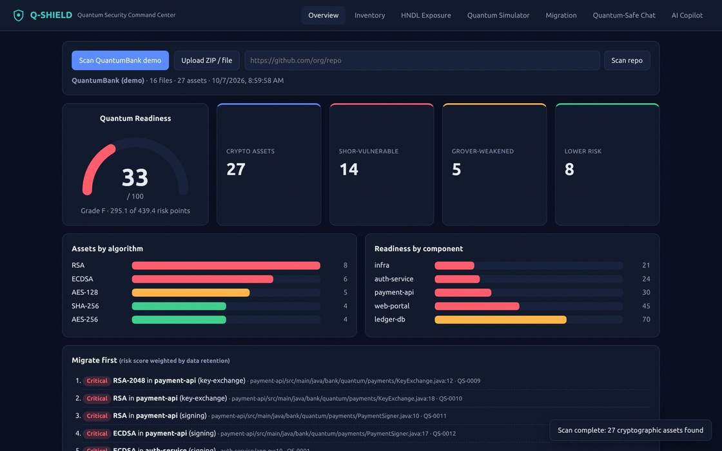
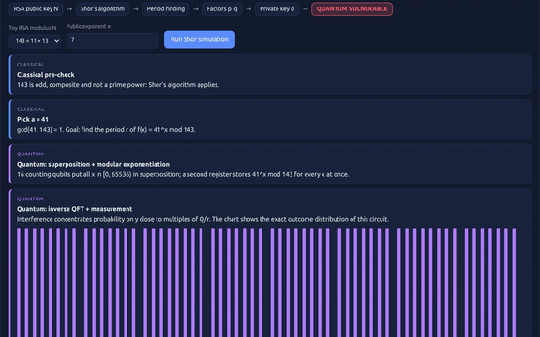
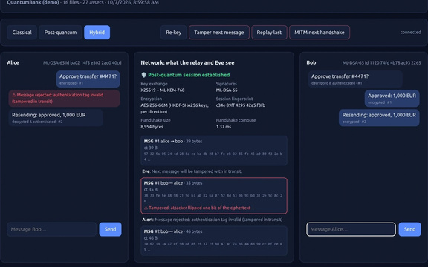
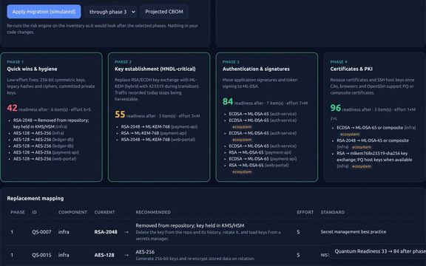
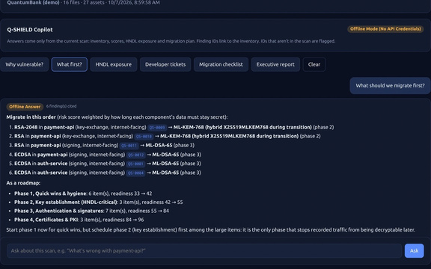
Minimal Prototype
A working platform, not a mock-up
Shor simulation on 143
ML-KEM chat, tamper rejected
Overview: scan of QuantumBank, 27 assets cataloged, readiness evaluated at 33/100
Roadmap: 33 → 84 → 96
Grounded AI copilot
• Q-Hack India 2026 •

Slide 8
Results / Validation
Validated on a seeded bank, end to end
27 / 27
33 → 84
8,954 B
84
seeded crypto assets found in QuantumBank, 0 hits on commented-out code or docs
readiness after roadmap phases 1–3 (96 after phase 4), recomputed by the risk engine
hybrid ML-KEM-768 + ML-DSA-65 handshake, a few ms of compute
automated tests passing, including tamper, replay and MITM rejection
Quantum Readiness by roadmap phase (QuantumBank)
Also validated
96.0
84.0
• Shor simulation factors 15, 21, 143, 221 and 247; peaks match theory exactly
• ML-KEM/ML-DSA wire sizes match FIPS 203/204 (1184 B key, 1088 B ciphertext, 3309 B signature)
• Copilot cites only real finding IDs; invented IDs are flagged and rejected
• ZIP-slip archives and unsafe Git URLs rejected
55.0
33.0
42.0
Today
Phase 1
Phase 2
Phase 3
Phase 4
• Q-Hack India 2026 •

Slide 9
Roadmap
From demo app to real codebases
1
2
3
4
Deeper discovery
Standards & CI
Production PQC
Real validation
• AST and data-flow analysis
• Binaries and container images
• Live TLS/SSH endpoint scanning
• CycloneDX CBOM export
• CI gate blocking vulnerable crypto
• Automated GitHub app remediation
• Hybrid TLS gateway (X25519MLKEM768)
• Post-quantum / composite certificates
• Cloud KMS and HSM integration
• Precision/recall on public repos
• Enterprise pilot with a partner bank
• Shor N = 15 on IBM Quantum hardware
Round 2 goal: scan real repositories with measured accuracy, and run the period-finding circuit on real quantum hardware.
• Q-Hack India 2026 •

Slide 10
References and Sources
Standards, Research and Foundations
Standards & research
Software & documentation
• NIST FIPS 203 (ML-KEM), 204 (ML-DSA), 205 (SLH-DSA), Aug 2024.
• NIST IR 8547 (initial public draft), Transition to Post-Quantum Cryptography, Nov 2024
• P. W. Shor, Polynomial-time algorithms for prime factorization on quantum computer, 1997
• L. K. Grover, A fast quantum mechanical algorithm for database search, STOC 1996
• M. Mosca, Cybersecurity in an era with quantum computers: will we be ready?, IEEE 2018
• C. Gidney, M. Ekerå, Factor 2048-bit RSA in 8h using 20M noisy qubits, arXiv:1905.09749
• C. Gidney, Factor 2048-bit RSA with less than a million noisy qubits, arXiv:2505.15917
• pyca/cryptography: ML-KEM, ML-DSA, AES-GCM, HKDF bindings
• FastAPI, NumPy, Pydantic, Uvicorn, SQLite
• Anthropic Claude & Google Gemini APIs (Security Copilot)
• CycloneDX 1.6 Cryptographic Bill of Materials (CBOM) specification
• Open Quantum Safe (OQS) project (architectural reference)
Originality Statement
Q-SHIELD is our team's original implementation engineered for Q-Hack India 2026. Foundational libraries are consumed as dependencies, not forked or copied.
• Q-Hack India 2026 •

