Slide 1
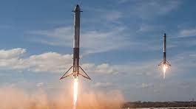
ELON MUSK
Real life Iron man

Slide 2
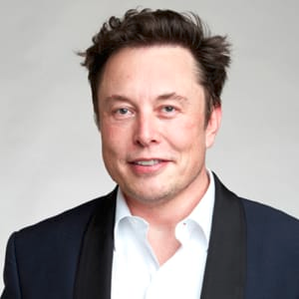
Who Is Elon Musk?
Elon Reeve Musk is a South African-born American entrepreneur and businessman who founded X.com in 1999 (which later became PayPal), SpaceX in 2002 and Tesla Motors in 2003. Musk became a multimillionaire in his late 20s when he sold his start-up company, Zip2, to a division of Compaq Computers.

Slide 3
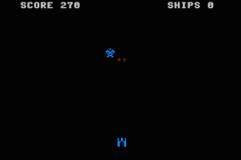
Blaster

Slide 4
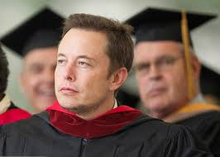
Education

Slide 5


Companies

Slide 6

Companies

Slide 7
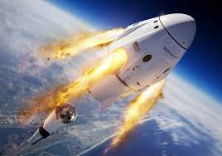
Companies

Slide 8
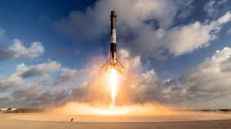
Companies

Slide 9
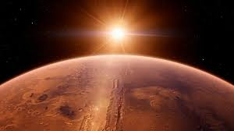
Companies
If Elon Musk is to be believed, then the firm’s first mission to send humans to Mars could be as soon as just a decade or less from now.
It’s hard to tell how serious to take the plans, but going on Elon Musk’s comments to date, it’s clear that he takes them very seriously. Thus, they clearly represent part of his overall goals.

Slide 10


Thank u !

