Slide 1


Airline Database System
Queries, Key Features and Functionality

Slide 2

Project Overview
Comprehensive Airline System managing flights, bookings, passengers, pilots, payments, and more.
Includes a live dashboard for tracking revenue, bookings, and operational stats.
Advanced SQL joins, views, triggers, and procedures for real-world functionality.
Automates rules like pilot retirement and salary protection using triggers.

Slide 3
Project Overview
Comprehensive Airline System managing flights, bookings, passengers, pilots, payments, and more.
Includes a live dashboard for tracking revenue, bookings, and operational stats.
Advanced SQL joins, views, triggers, and procedures for real-world functionality.
Automates rules like pilot retirement and salary protection using triggers.

Slide 4
Key Features
Relational schema consisting of over 12 interlinked tables.
Real-world business logic enforced using constraints, triggers, and stored procedures.
Multiple types of joins (INNER, LEFT, RIGHT, FULL) used to extract meaningful information across relationships.
Comprehensive ticket booking and payment handling system.
Dynamic dashboard for administrative insights and decision support.
Security and consistency through controlled updates, constraints, and validations.

Slide 5




Output

Slide 6
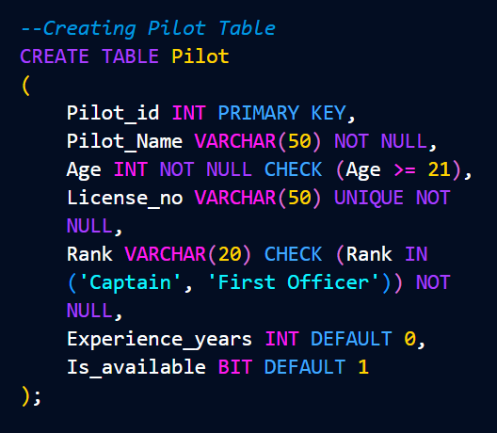
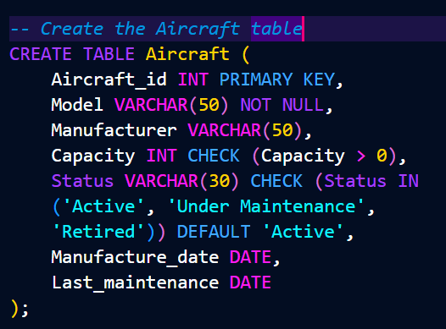
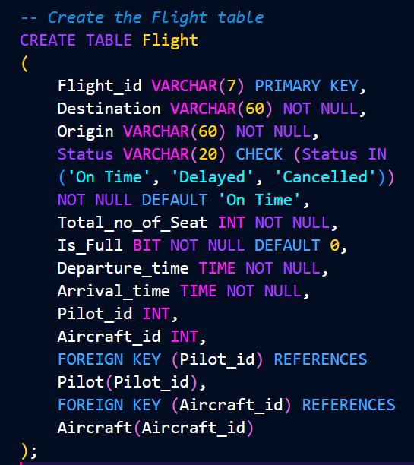
Tables
1
Pilot
2
Aircraft
3
Flight
Table 1
Table 1
Table 1
Table 1
Table 1

Slide 7
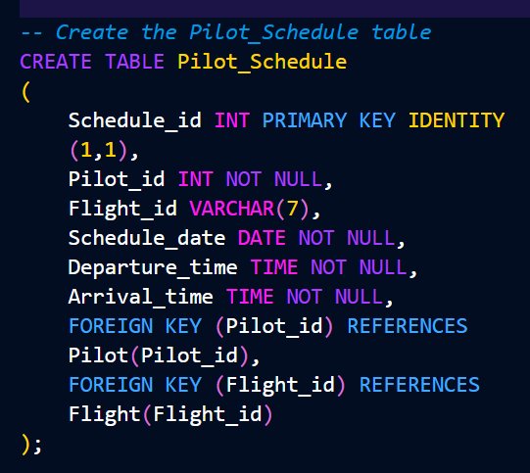
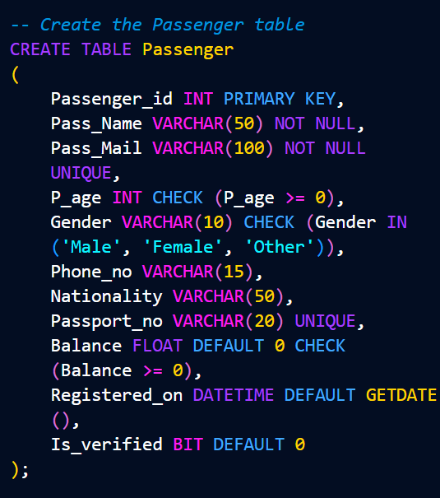
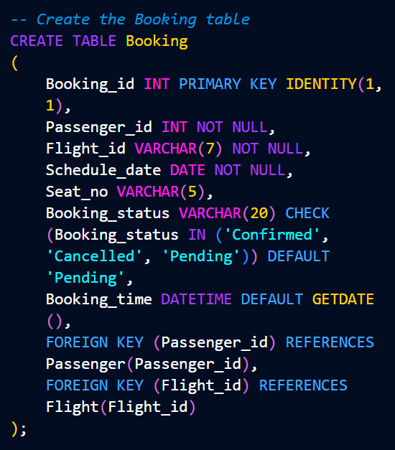
Tables
4
5
Passenger
6
Booking
Pilot_Schedule
Table 4
Table 1
Table 1
Table 1
Table 5
Table 6

Slide 8
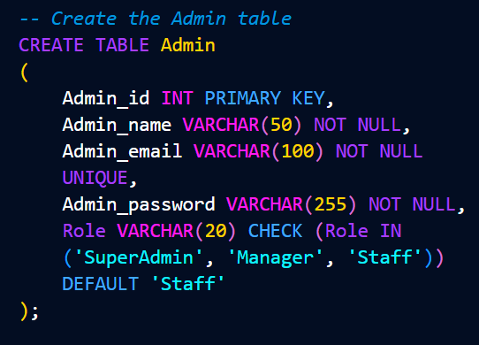
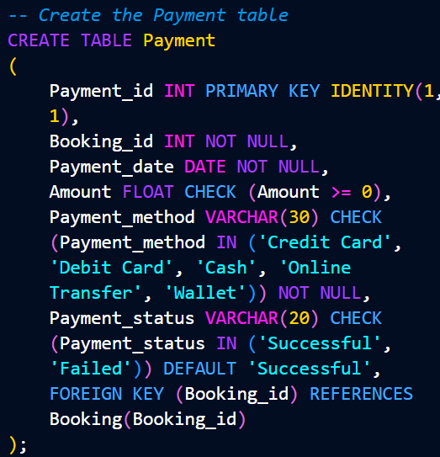
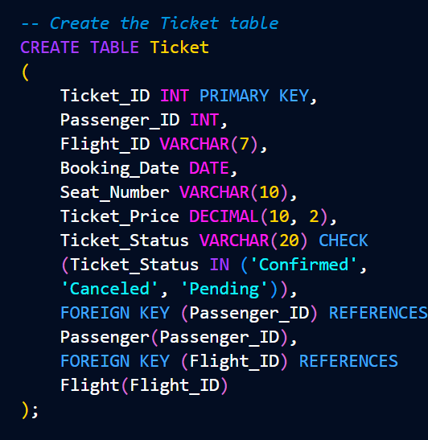
Tables
7
Admin
8
Payment
9
Ticket
Table 4
Table 1
Table 1
Table 1
Table 5
Table 6

Slide 9
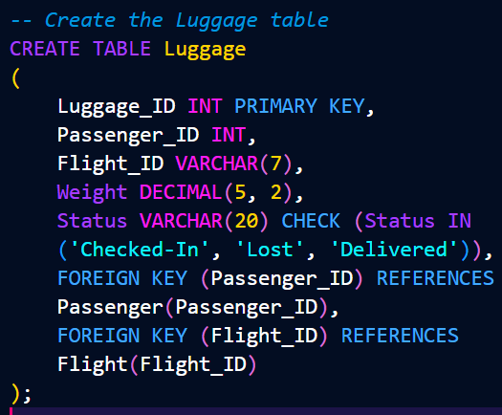
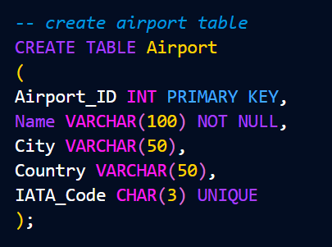
Tables
10
Luggage
11
Airport
Table 4
Table 1
Table 1
Table 5

Slide 10
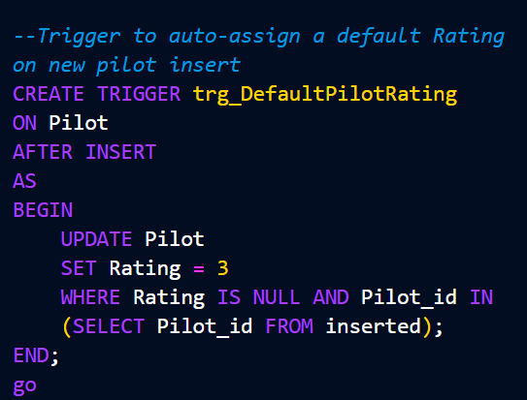
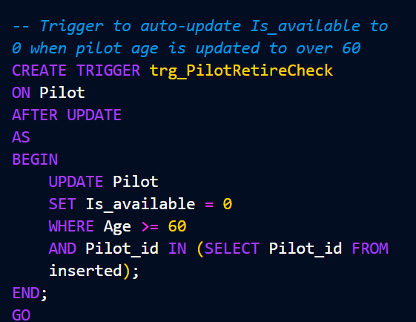
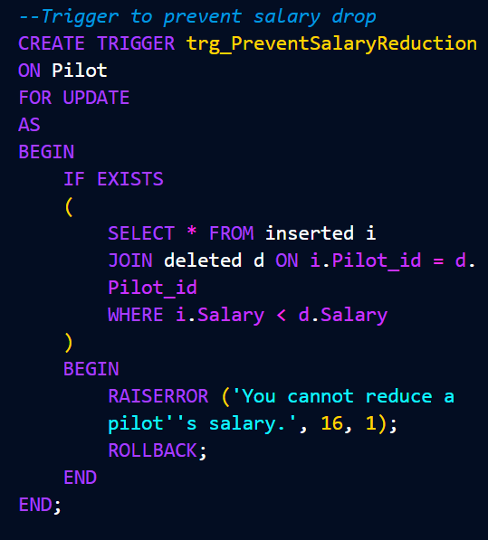
Triggers

Slide 11
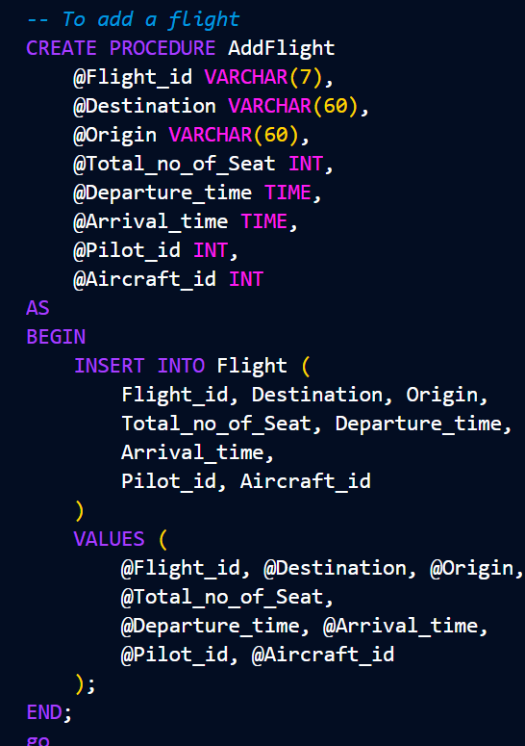
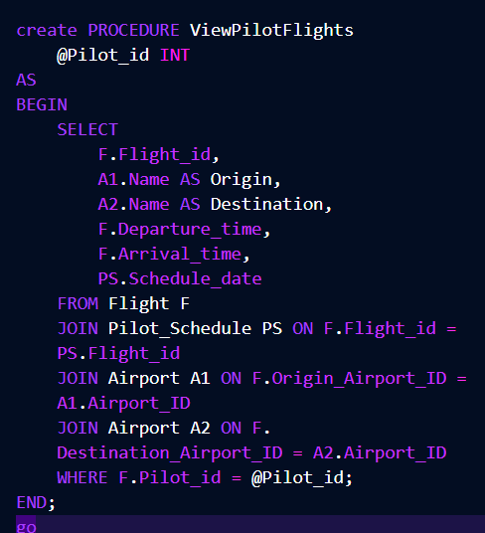
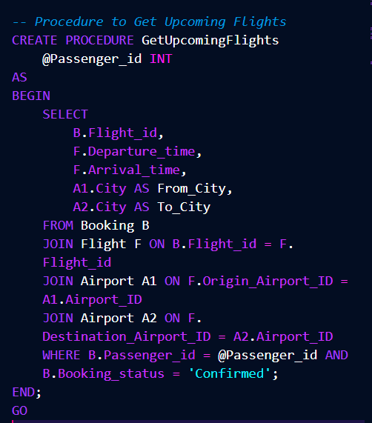
Procedures

Slide 12
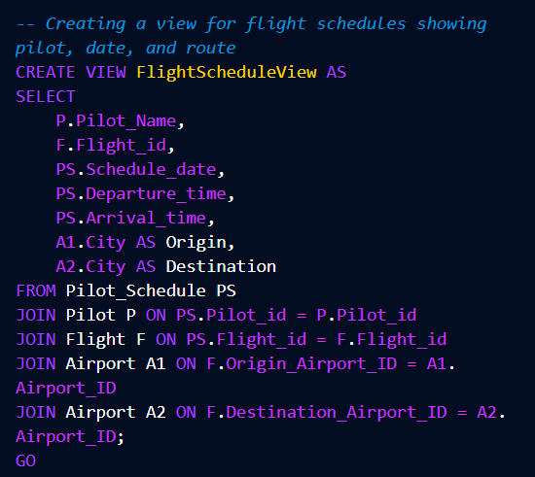
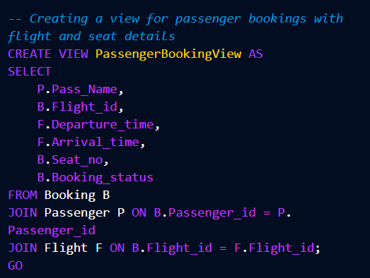
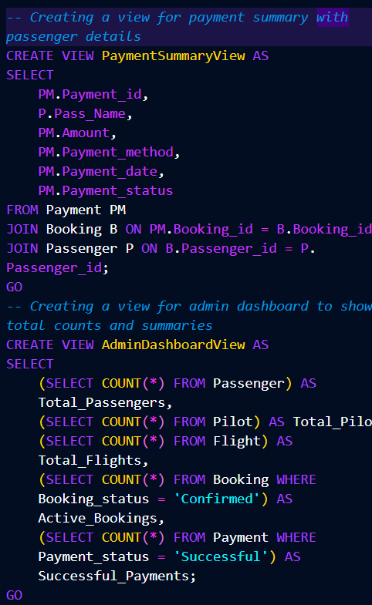
Views

Slide 13
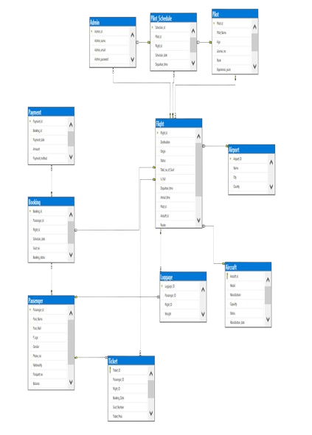
ERD

Slide 14








Output

Slide 15
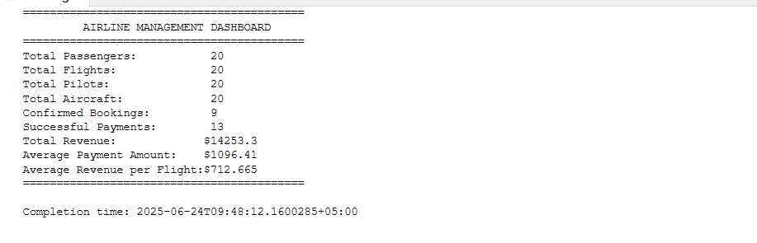

Slide 16
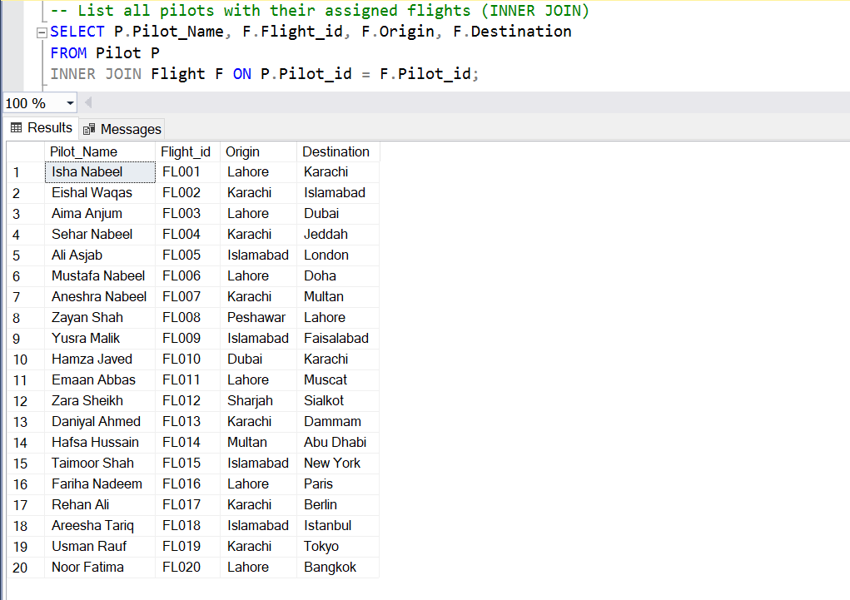

Slide 17
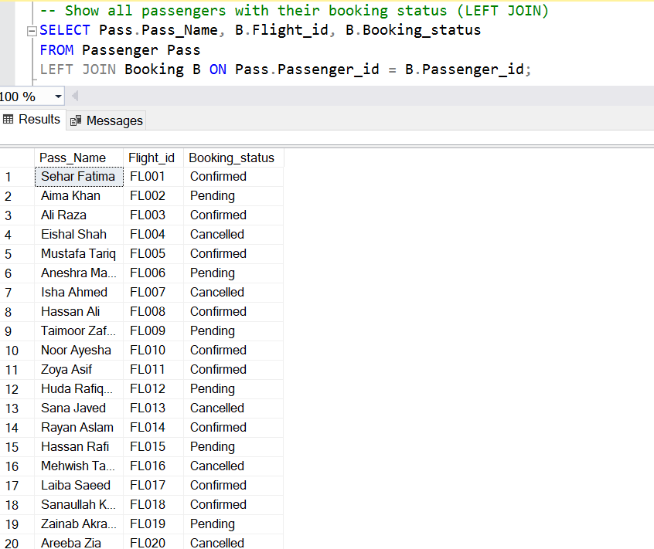

Slide 18
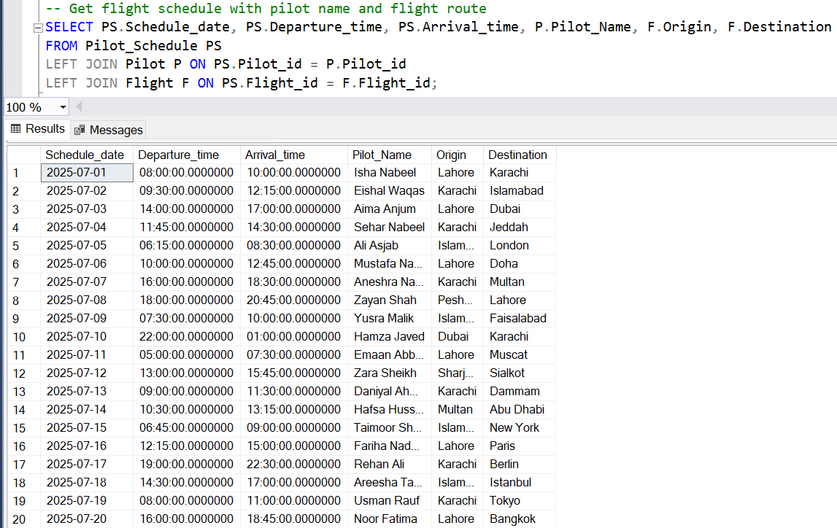

Slide 19
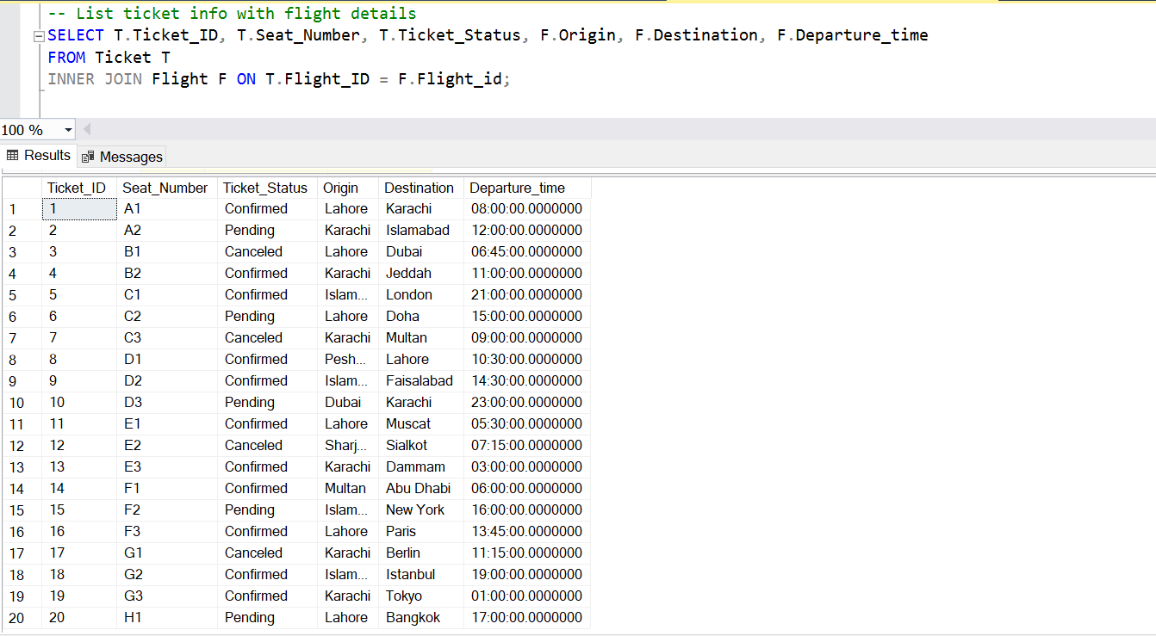

Slide 20
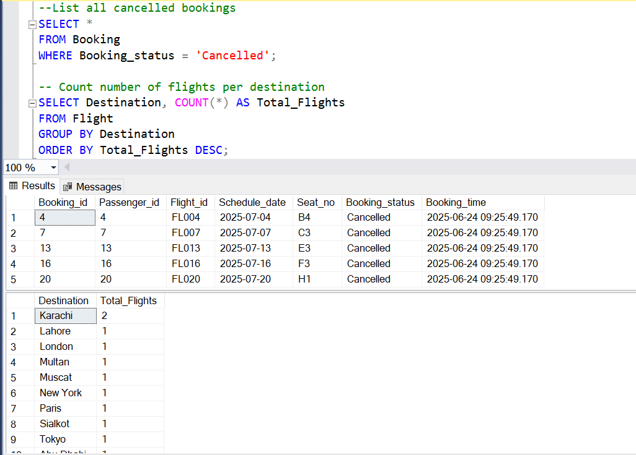

Slide 21
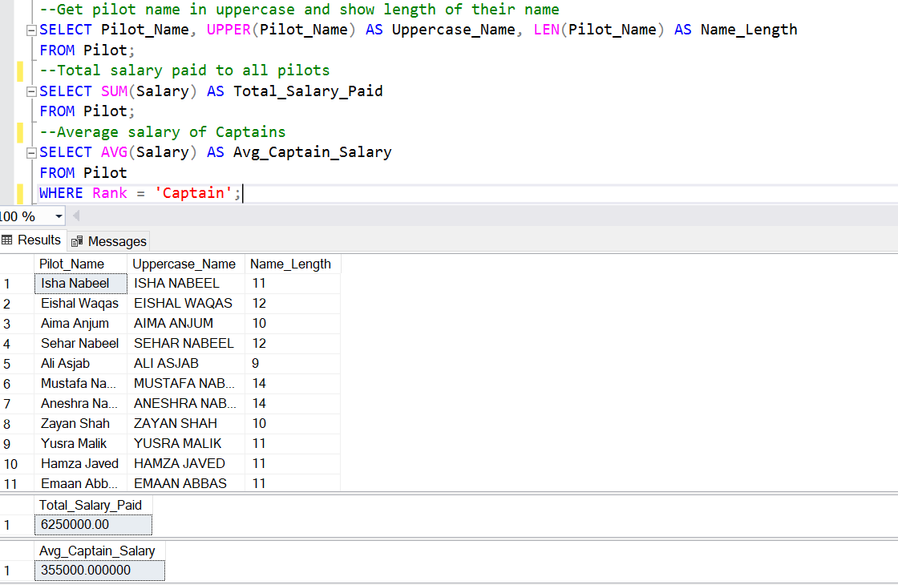

Slide 22
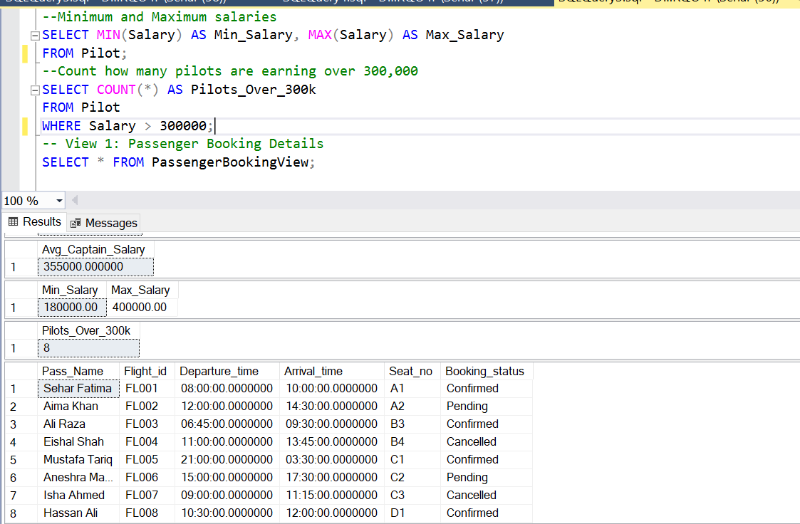

Slide 23
Thank you

