Slide 1
Driver Drowsiness
Detection System
Notes:
_morph_

Slide 2
Problem Statement
top
20–30%
High Cost
Leading cause of
road fatalities
Accidents caused by
driver drowsiness
Current solutions:
expensive hardware
Goal:
Real-time, camera-only, training-free deployment system for drowsiness detection
Notes:
_morph_

Slide 3
System Overview
Part A
Part B
CNN Baseline
Final System
Eye + Mouth classifiers
Exposes fundamental limitations
of frame-based detection
MediaPipe + EAR / MAR
+ PERCLOS Temporal Fusion
Production-ready pipeline
→
Notes:
_morph_

Slide 4
Why Not Just CNN?
01
Blink vs. Drowsy Closure
A blink (150–400 ms) looks identical to drowsy closure (2–4 s) in a single frame
02
Talking vs. Yawning
Mouth open for speech and yawning are indistinguishable at the frame level
03
No Temporal Context
Without temporal context there is no drowsiness signal — just a frozen moment
→ This motivated our temporal fusion system
Notes:
_morph_

Slide 5
Datasets
Eye CNN Training
Mouth CNN Training
MRL Eye Dataset
Yawn Dataset
18,000
5000
samples
samples
Balanced — Open / Closed classes
Balanced — Yawn / No Yawn classes
Notes:
_morph_

Slide 6
CNN Architecture
Input
Key Specs
64×64 grayscale patch
Backbone: MobileNetV2
Pretrained: ImageNet
Task: Binary classification
Input: 64×64 grayscale
Eye: Open / Closed
Mouth: Yawn / No Yawn
↓
MobileNetV2
Pretrained ImageNet backbone
↓
Fine-tuning
Binary classification head
↓
Output
Eye CNN: Open / Closed
Mouth CNN: Yawn / No Yawn
Notes:
_morph_

Slide 7
CNN Results
Model | Accuracy | Precision | Recall | F1
Eye CNN | 92.2% | 92.6% | 92.2% | 92.2%
Mouth CNN | 91.7% | 92.4% | 91.7% | 91.6%
Both models achieve >91% accuracy with balanced precision and recall across both classes — strong baselines that expose the frame-level limitation.
Notes:
_morph_

Slide 8
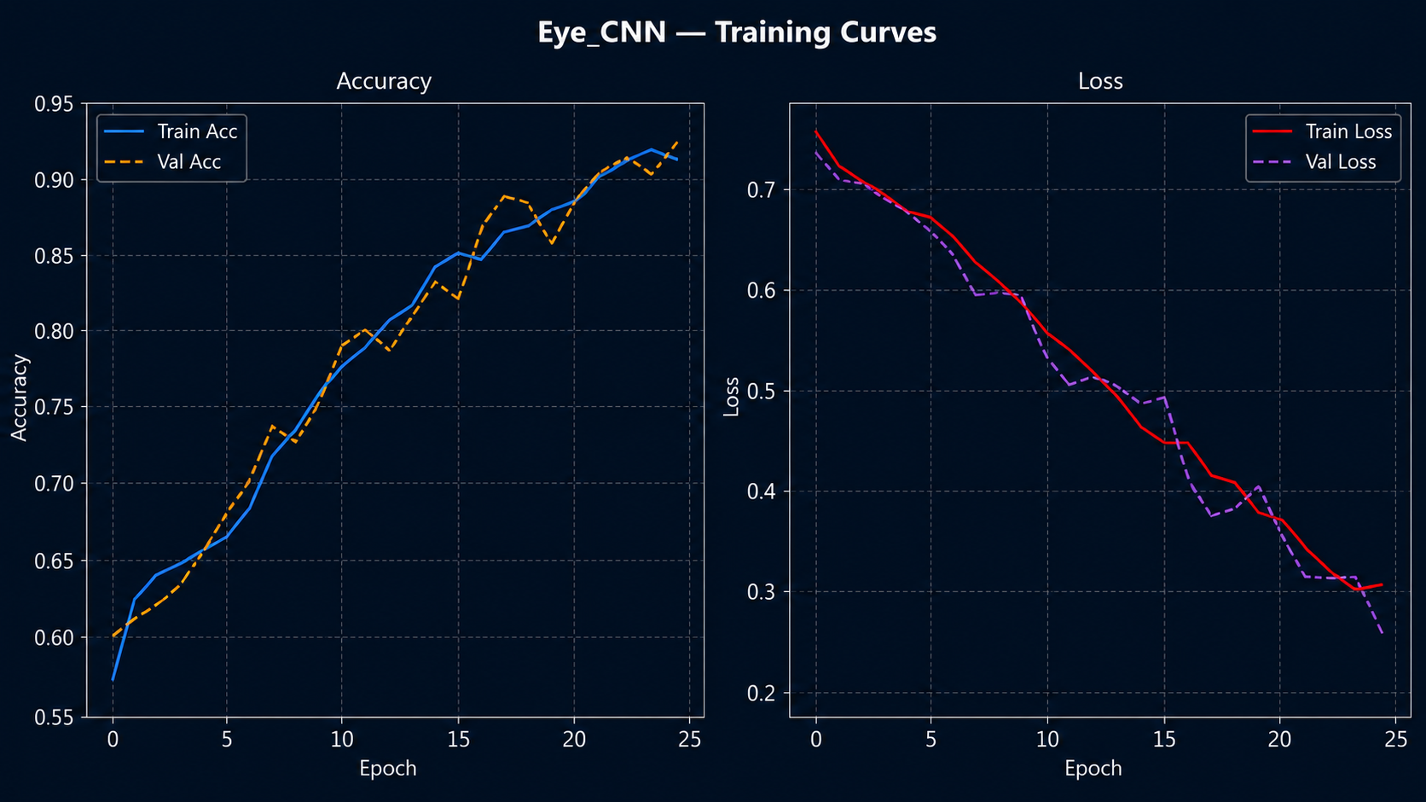
Notes:
_morph_

Slide 9
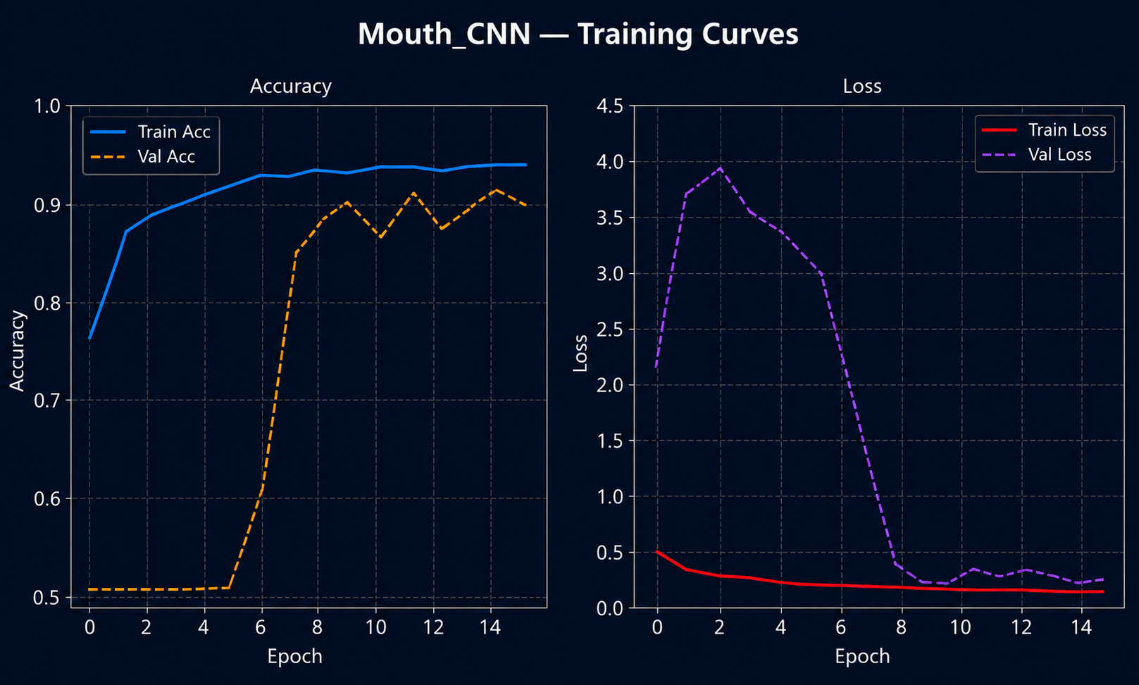

Slide 10
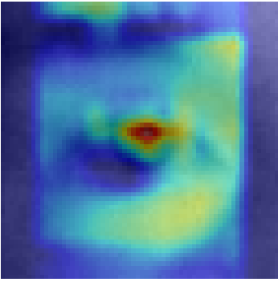
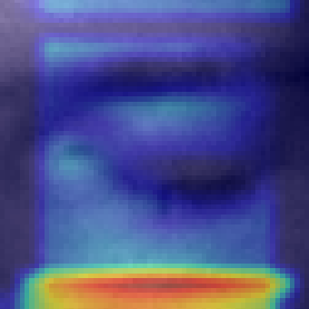
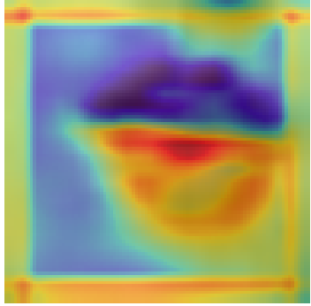
GradCAM Visualization
Open Eye
Closed Eye
Yawn
Heat on iris / lid boundary
Heat on lid edge
Heat on mouth opening
Model correctly focuses on iris/lid boundary — confirming learned features are anatomically meaningful, not background artifacts.
Notes:
_morph_

Slide 11
Final System: How It Works
MediaPipe Face Mesh
PERCLOS
468 landmarks detected per frame — no training required
Rolling 30-second window — fraction of frames where eye was closed
EAR — Eye Aspect Ratio
Yawn Detection
Computed per frame from 6 eye landmarks
MAR > threshold sustained for 1.5 s = yawn event
MAR — Mouth Aspect Ratio
Computed from 4 mouth landmarks per frame
Notes:
_morph_

Slide 12
Temporal Fusion Logic
ALERT
PERCLOS < 0.35 · No yawning
Driver is awake and attentive
WARNING
PERCLOS 0.35–0.60 OR Yawn rate ≥ 2/min
Early signs of fatigue — audible chime
CRITICAL
PERCLOS > 0.60 OR Yawn rate ≥ 4/min
Severe drowsiness — strong alert triggered
Notes:
_morph_

Slide 13
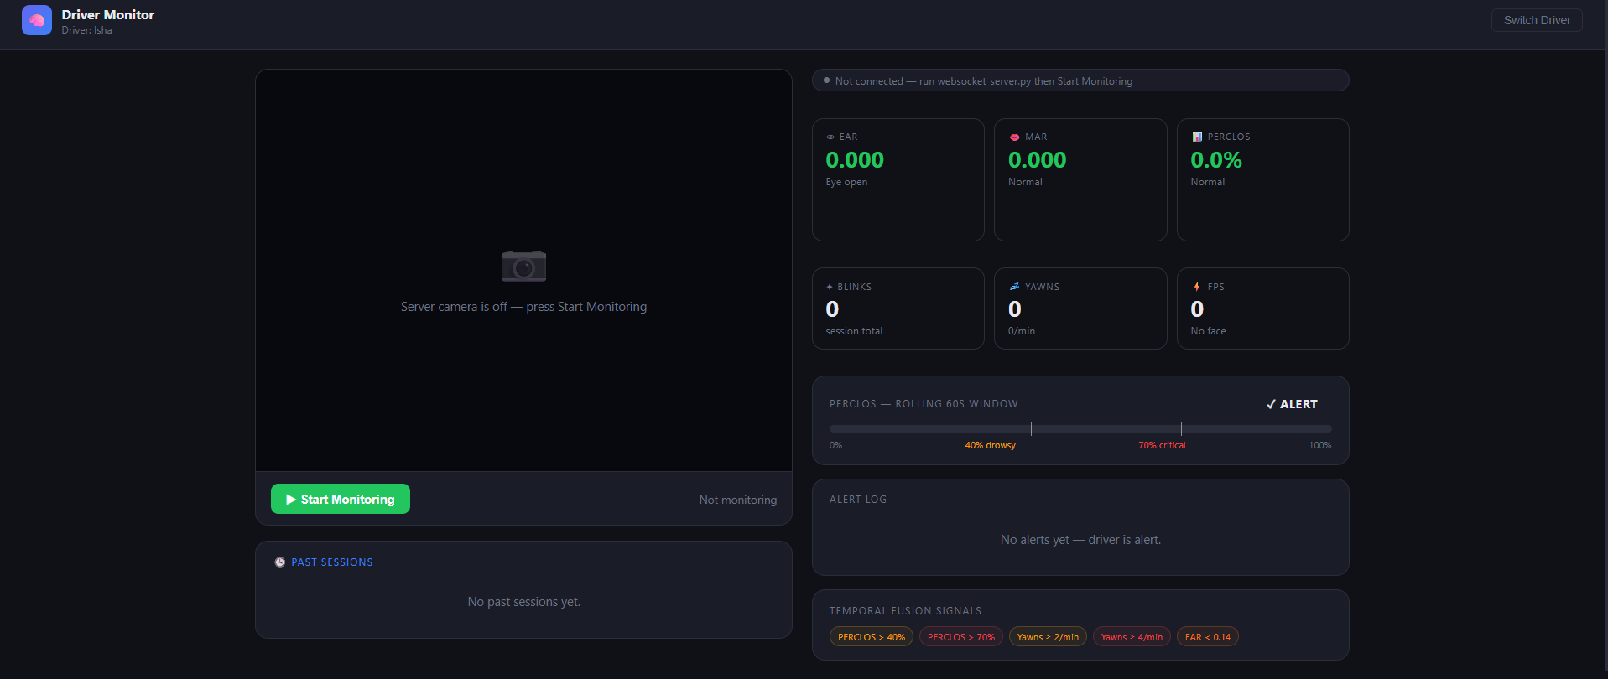
Notes:
_morph_

Slide 14
Why This Design?
Aspect | CNN Only | Our System
Temporal context | ✗ | ✓
Training required | ✓ | ✗
Blink vs closure | ✗ | ✓
Real-time speed | Slow | Fast
Generalisation | Poor | Better
Notes:
_morph_

Slide 15
Limitations
30-second Warm-up
EAR Threshold Sensitivity
PERCLOS window needs 30 seconds to accumulate enough frames before it becomes meaningful.
Eye aspect ratio threshold may vary per person — glasses, eye shape, and lighting affect baseline.
No Benchmark Evaluation
Single Frontal Camera
The system has not yet been evaluated on a standard benchmark dataset (e.g., NTHU).
Assumes a frontal-facing camera setup; extreme head angles or profile views are not supported.
Notes:
_morph_

Slide 16
Conclusion
01
CNN baseline proved that frame-level detection is fundamentally insufficient for drowsiness
02
Temporal fusion with PERCLOS and MAR directly addresses the core temporal problem
03
Real-time system runs on a standard webcam — no specialised hardware required
Future: NTHU benchmark evaluation · CNN-LSTM temporal model
Notes:
_morph_

Slide 17
?
Thank You
Questions?
Driver Drowsiness Detection System
Notes:
_morph_

