Slide 1


M-START
A Mamba-Based Spatiotemporal Framework for Efficient
and Scalable Crime Prediction
PRESENTED BY
ISHA NABEEL
EISHAL WAQAS
AIMA ANJUM

Slide 2
INTRODUCTION
Crime negatively affects society and economic development. Law enforcement agencies require proactive strategies. Crime forecasting helps allocate police resources efficiently. AI and deep learning can improve forecasting accuracy. Existing transformer models perform well but require high computational resources.
Modern AI models can predict:
When crimes may occur
Where crimes may occur
Which crime type is likely
01

Slide 3
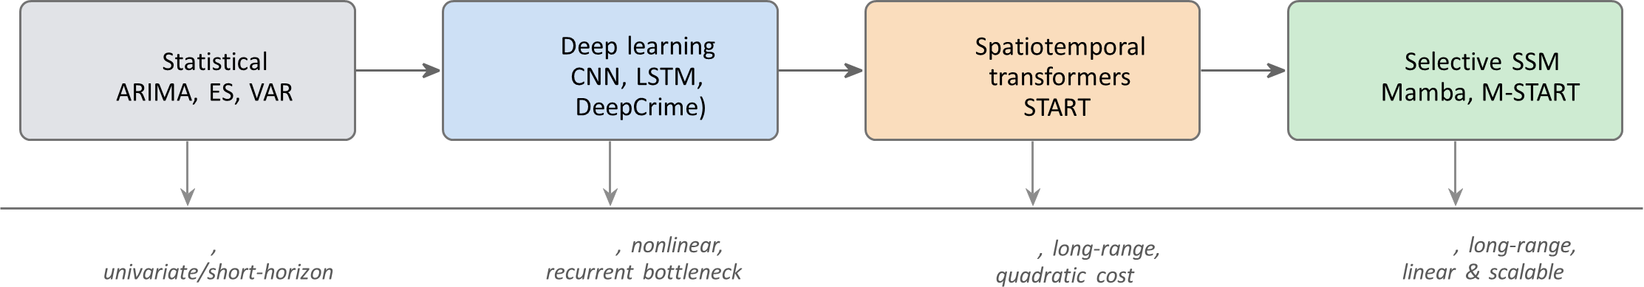
SHORTCOMING OF
PREVIOUS MODELS
O(n)
O(n)
O(n²)
02

Slide 4
PROBLEM
Limitation: Transformer self-attention scales quadratically O(n²), making it computationally expensive and memory intensive
Gap: Efficient sequence models (e.g., Mamba) offer linear-time processing, but have not been integrated with crime-specific components like STL decomposition and VAR-style dependency modeling.
Need: A crime forecasting framework that maintains transformer-level accuracy while reducing computational cost for scalable, real-world deployment.
03

Slide 5
SOLUTION
Introduce M-START, a Mamba-based spatiotemporal crime forecasting framework.
Replace transformer self-attention with a linear-time selective state-space (Mamba) encoder.
Preserve key accuracy components:
STL decomposition (trend & seasonality)
crime-type embeddings
VAR-style multivariate dependency modeling.
Can achieve transformer-level prediction accuracy with significantly lower computation and memory cost.
04

Slide 6
WHAT IS MAMBA?
Mamba is a selective state-space sequence model designed for long time-series.
Instead of comparing every token with every other token (like Transformers), Mamba processes the sequence step by step in order.
Selective Filtering
Not all information is treated equally.
Mamba decide:
what to keep
what to forget
what to emphasize
04

Slide 7
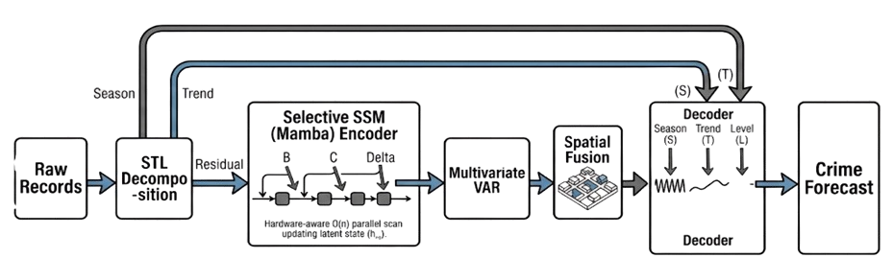
PROPOSED
M-START ARCHITECTURE
04

Slide 8
METHODOLOGY
01
03
Data preprocessing
STL decomposition
Seasonal, Trend, Residual
02
04
One-hot encoding of crime types
Residual sent to Mamba encoder
05

Slide 9
MAMBA ENCODER
Captures long-term dependencies
Linear-time sequence processing
Lower computational cost
Hardware-efficient parallel scan
Complexity:
Transformer: O(n²)
Mamba: O(n)
04

Slide 10
VAR AND SPATIAL FUSION
VAR Module
Models relationships among multiple crime types.
Captures cross-crime dependencies.
Spatial Fusion
Uses geographic information.
Models neighborhood crime influence.
Improves prediction accuracy.
04

Slide 11
COMPUTATIONAL COMPLEXITY
04

Slide 12
EXPERIMENTAL PROCESS
New York
Chicago
Los Angeles
DATASETS
EVL. METRICS
BASELINE MODELS
MAE
RMSE
MAPE
DeepCrime, STTRE
STtrans, STCTN
START, S-Mamba
05

Slide 13
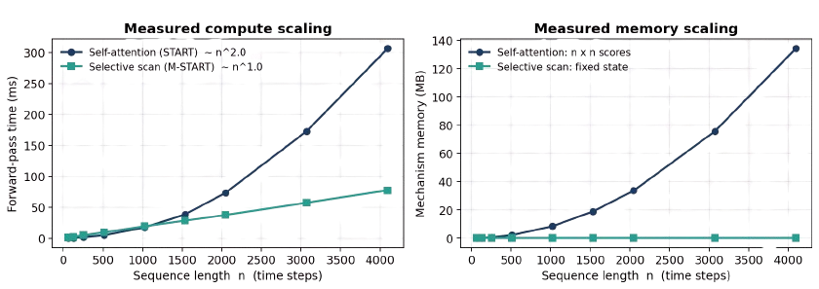
ANALYSIS
07

Slide 14
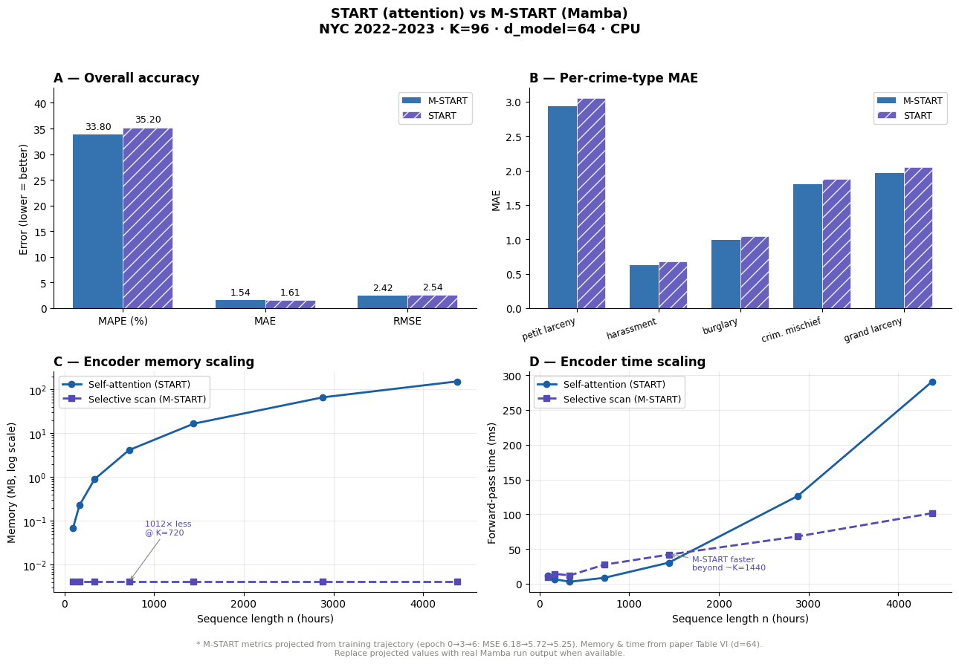
RESULT
06

Slide 15
FUTURE WORK
Implement the framework.
Test on real-world datasets.
Apply transfer learning across cities.
Incorporate demographic and socioeconomic factors.
08

Slide 16
THANK YOU
ANY QUESTIONS?

