Slide 1
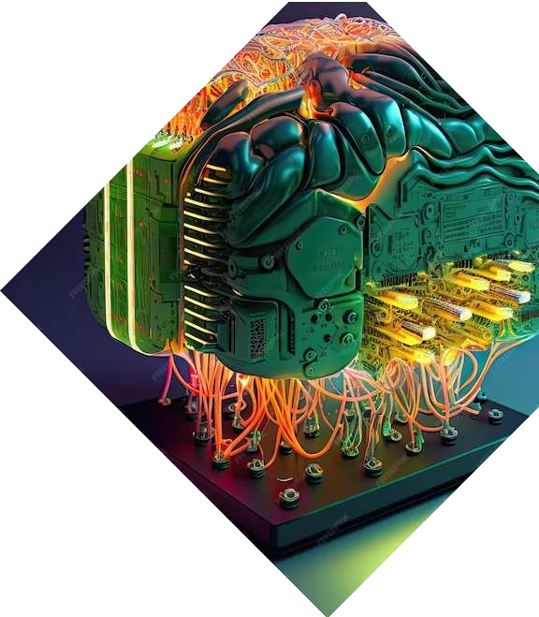
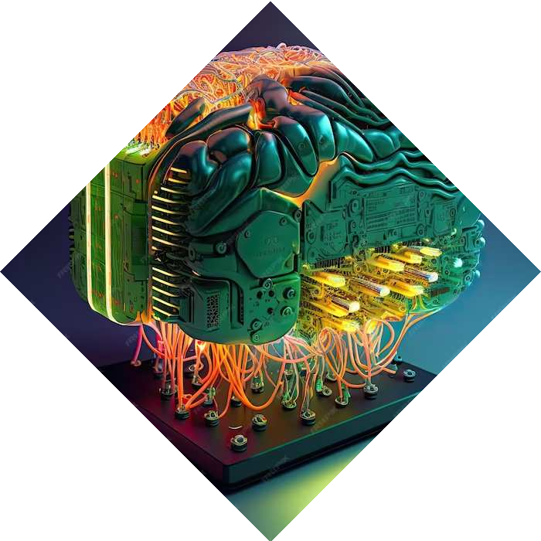
Quantum Machine Learning
Name- Ashu Ishan Sec- AI & ML
Roll-17
University Roll No.-2019468

Slide 2

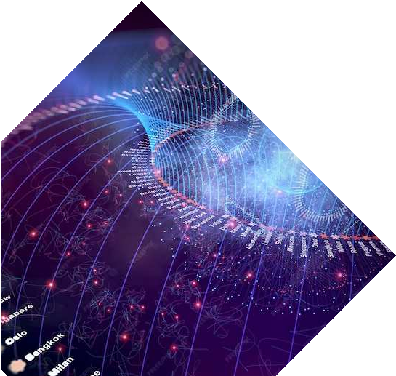
Introduction
Welcome to the world of Quantum Machine Learning where the power of quantum computing meets the intelligence of AI. This presentation will explore the potential and challenges of this groundbreaking fusion.

Slide 3

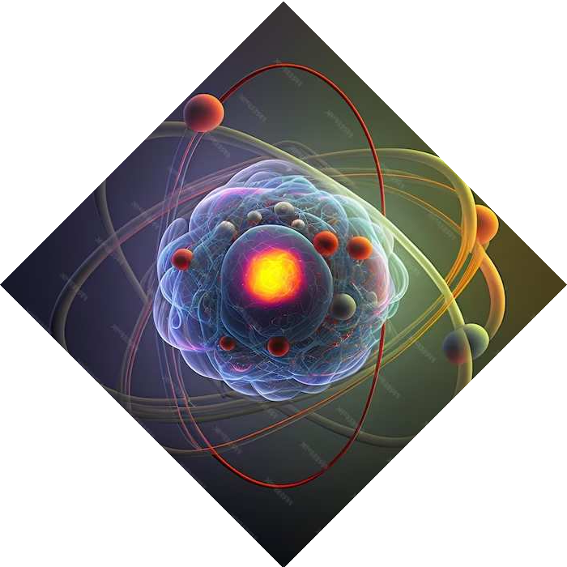
Quantum Computing
Fundamentals
Understanding the principles of quantum superposition and entanglement is crucial for grasping the potential of quantum machine learning. These phenomena form the basis of quantum computing's
power.

Slide 4
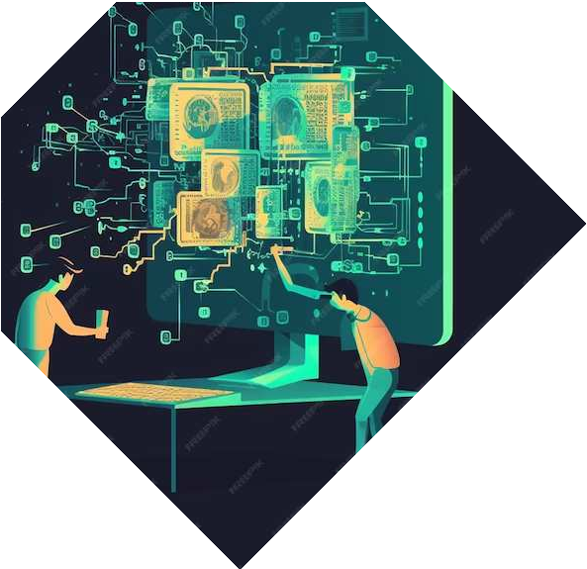

Machine Learning in Quantum Realm
Explore the application of quantum algorithms in solving complex problems, from optimization to pattern recognition. See how quantum machine learning unlocks new possibilities in AI.

Slide 5

Challenges and Opportunities
Discover the current limitations and potential breakthroughs in the ﬁeld of quantum machine learning. From hardware constraints to algorithmic innovations, the road ahead is both challenging and promising.

Slide 6


Bridging the Gap
Uncover the strategies for bridging the gap between quantum computing and artiﬁcial intelligence. From hybrid approaches to novel architectures, the fusion of these domains holds immense potential.

Slide 7

Real-world Applications
Explore the practical applications of quantum machine learning in diverse ﬁelds, from drug discovery to ﬁnancial modeling. Witness the transformative impact of this cutting-
edge technology.

Slide 8

Ethical Implications
Delve into the ethical considerations and societal impacts of quantum machine learning. From data privacy to algorithmic biases, understanding the implications is crucial for responsible deployment.

Slide 9

Conclusion
In conclusion, the fusion of quantum computing and artiﬁcial intelligence in the realm of machine learning holds immense promise. Embracing the challenges and opportunities, we stand at the forefront of a new era in computational intelligence.

Slide 10



Thanks!
Do you have any questions?
youremail@email.com
+91 620 421 838
www.yourwebsite.com @yourusername

