Slide 1
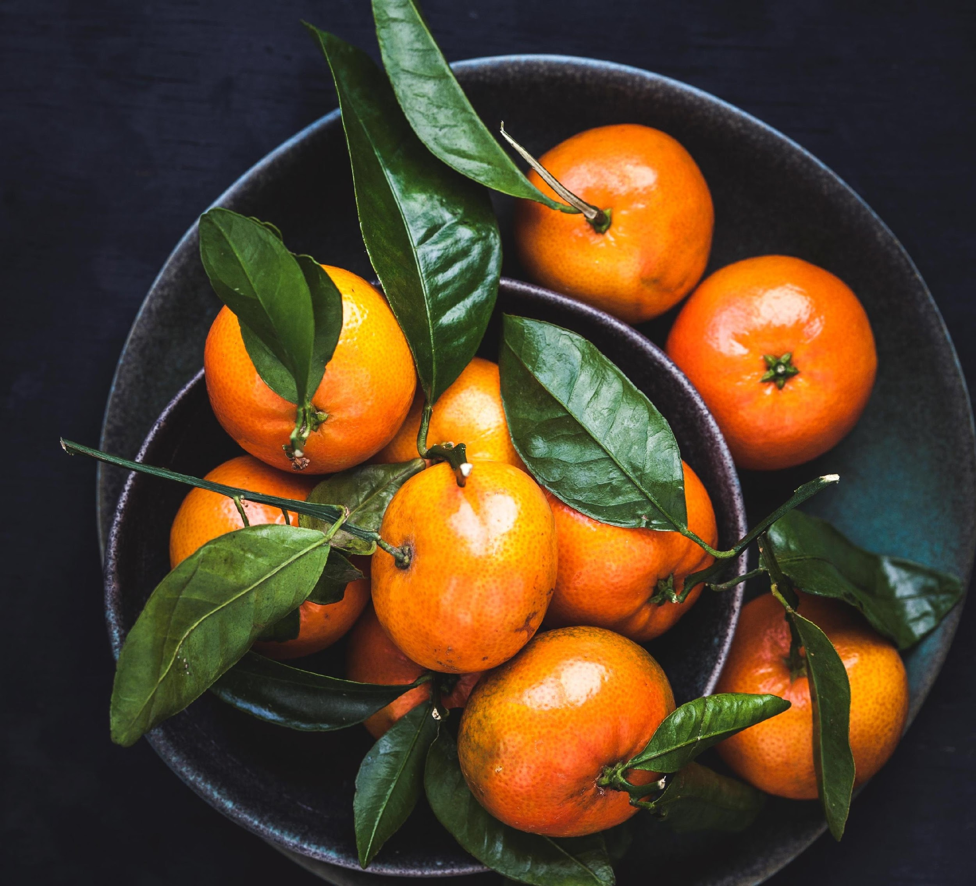
CALORIELY
TEAM-CIFRA

Slide 2
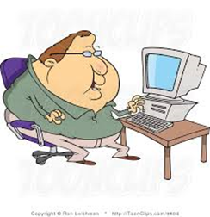
PROBLEM
There is no calorie meter suit for Sri Lankan food.
More than 65% people have pointed out of the obesity range in Sri Lanka.
Spreading of non communicable diseases in Sri Lanka.
Most of the apps regarding this matter require manual input of data and mainly focus on western food culture.

Slide 3
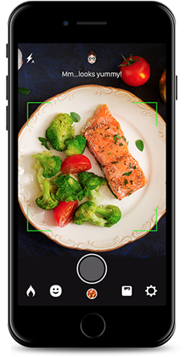
SOLUTION
We suggest a mobile application to scan the food dish.
Using deep learning algorithm to calculate the total calories.
Predict future health conditions based on pattern discovery .

Slide 4
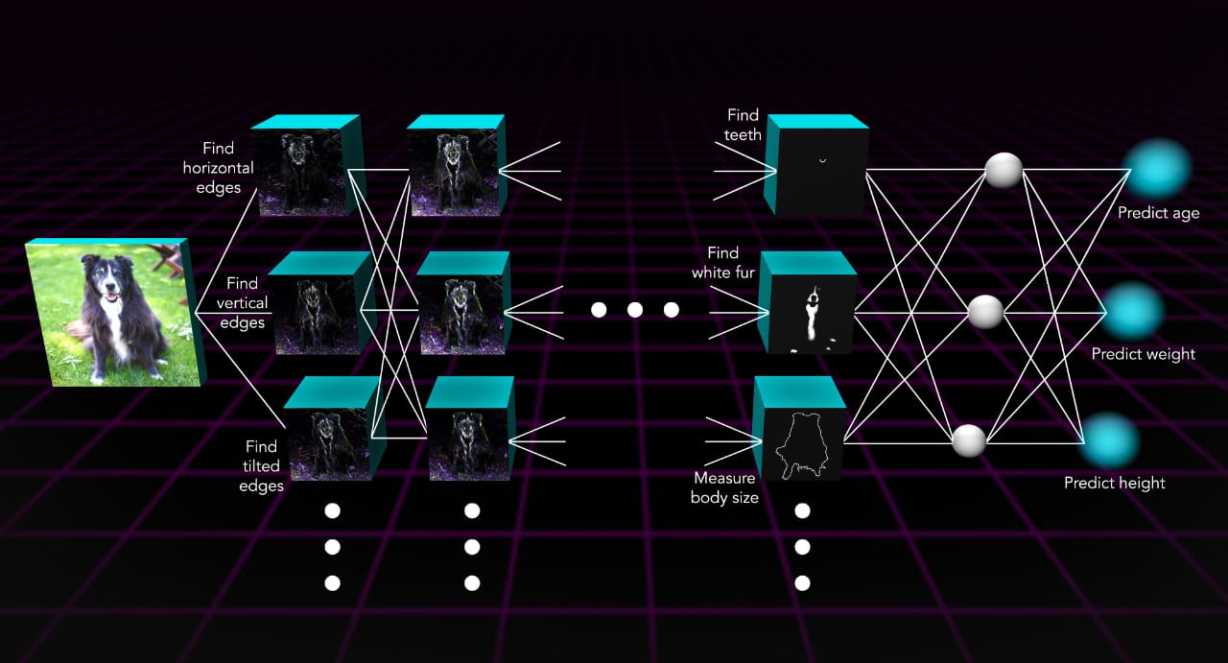
TECHNOLOGIES USED TO BUILD
Image food classification model with CNN (Python)
Volume estimation Height, width and depth calculate with OpenCV with related image classification
Calorie estimation - Use Google Colab
Integrate python code with Java android app - Use Android Studio

Slide 5
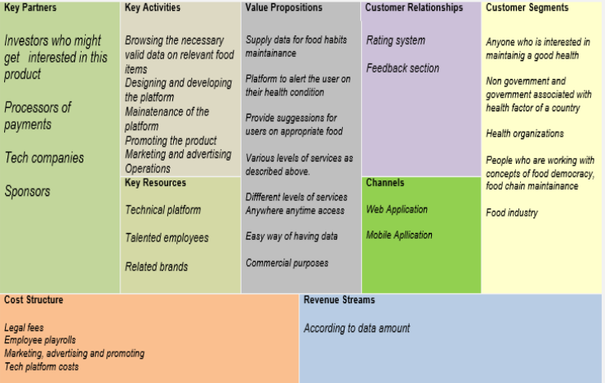
Business model Canvas

Slide 6
INITIAL BUSINESS PLAN
develop and fix the idea and develop the android app as a solution.
train the data for Sri Lankan food traditions and culture, Fix bugs, and launch to use.
train the data for the European food culture such as UK, US, Italy etc. from.third year onwards.
make this as a fully functioning App.
we hope to provide the different versions and maintain.
2020
2021
2022
train the data for the Asian food culture such as India, Pakistan, China etc.

Slide 7

WHY OUR SYSTEM IS IMPORTANT?

Slide 8

TEAM
Ishan Thathsara Weerakoon
U. Hasitha Gimhan Rodrigo
G.H.D.T.N. Gammanpila
K.A.A. Harshani Dilrukshi Amarasinghe
J.P. Vindhya Madushani

