Slide 1
Trie
tree-like data structure whose nodes store the letters of an alphabet.
words/strings can be retrieved from the structure by traversing down a branch path of the tree.

Slide 2
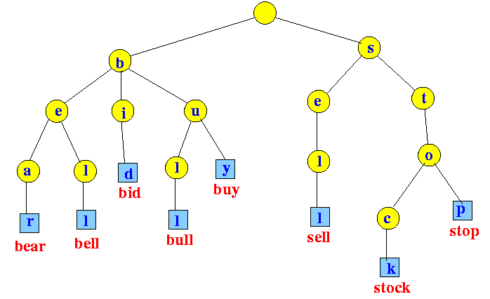
Trie

Slide 3
Applications
Auto Complete
Spell Checkers
Longest Prefix Matching
used by routers in Internet protocol(IP) networking to select an entry from a routing table.
Automatic Command completion
Network browser history

Slide 4
References
https://medium.com/basecs/trying-to-understand-tries-3ec6bede0014
http://blog.xebia.in/index.php/2015/09/28/applications-of-trie-data-structure/
https://thenextcode.wordpress.com/2015/04/12/trie-vs-bst-vs-hashtable/

