Slide 1
Looking_Fruit🍎❓

Slide 2
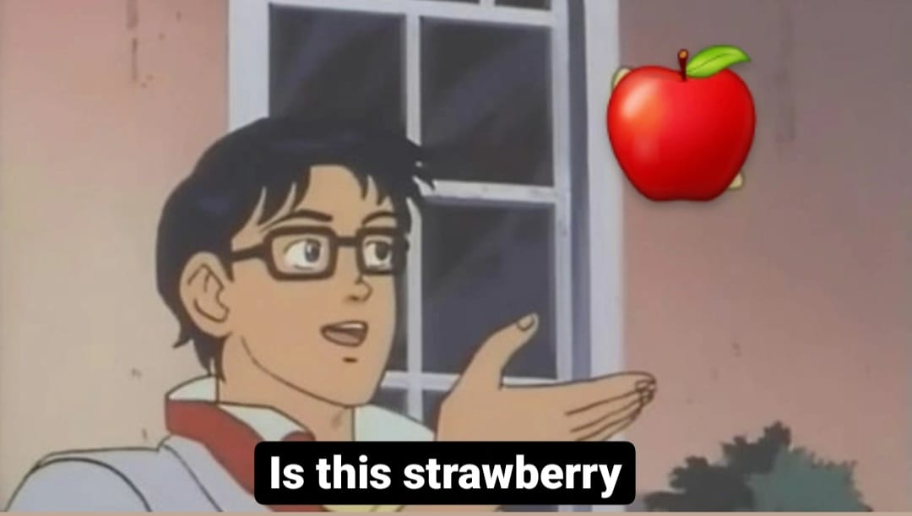
INTRODUCTION

Slide 3
DATA

Slide 4
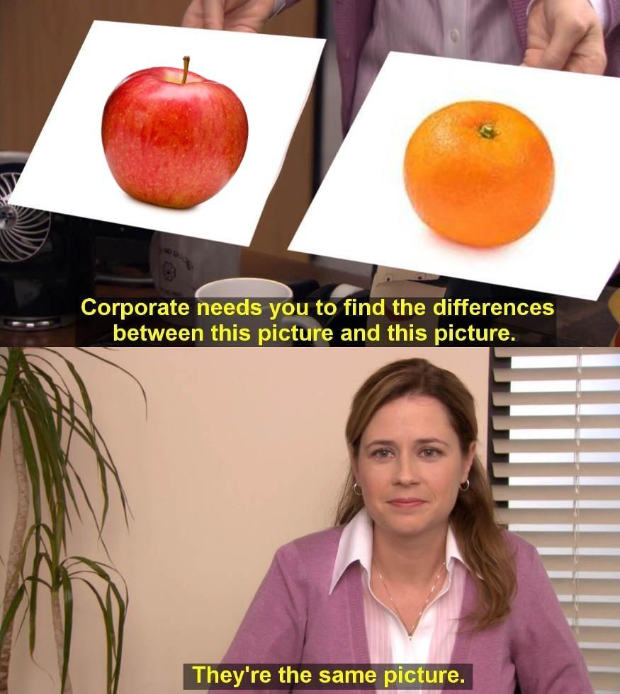
MODELS

Slide 5
CONCLUSIONS

Slide 6
THANK YOU
ISSUES AND CONTRIBUTIONS

