Slide 1


What_Am_I_Eating

Slide 2
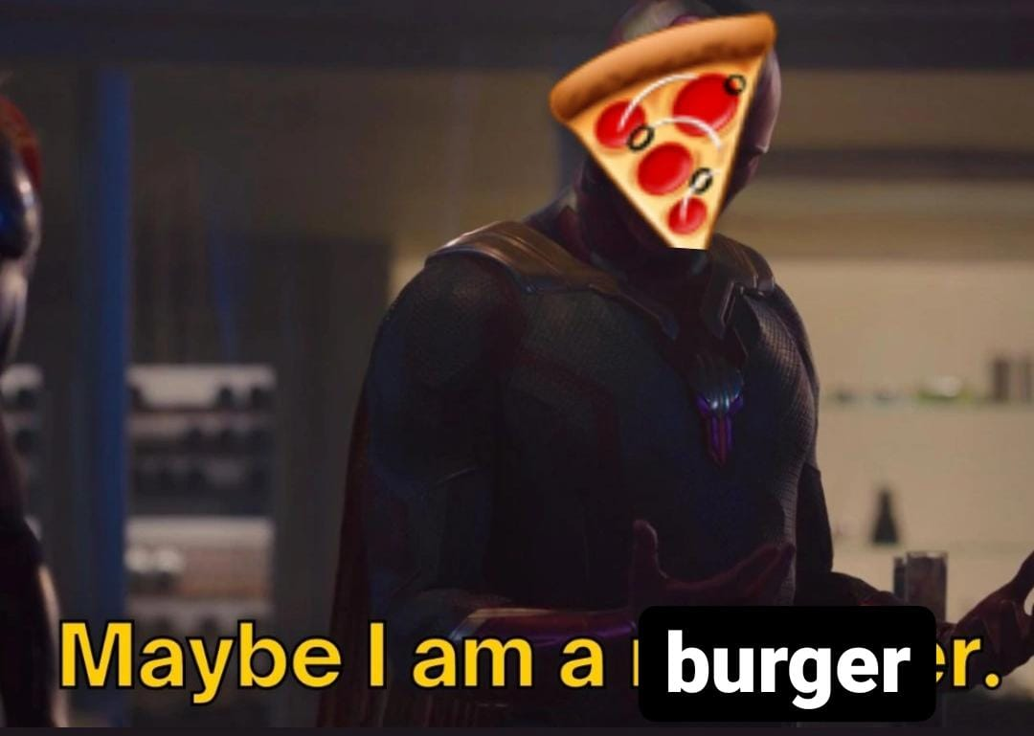
Introduction

Slide 3
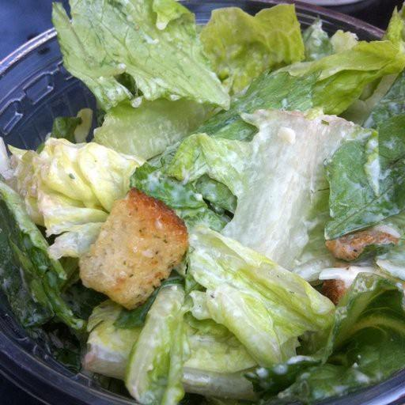
Data

Slide 4
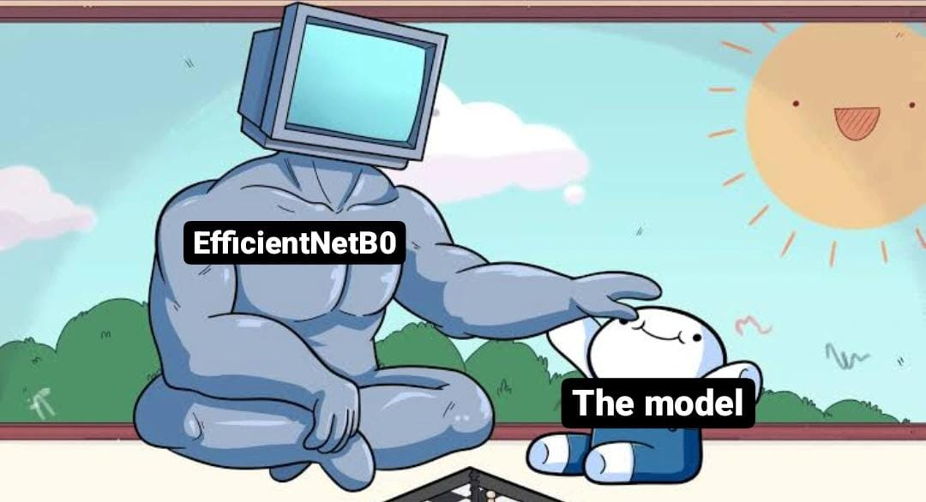
Model

Slide 5
Difficulties

Slide 6
Website Demo!

Slide 7
Future developments

Slide 8
Thank You!

